Slide 1
Dynamic Time Warping and the (Windowed) Dog-Keeper Distance
Jörg P. Bachmann and Johann-Christoph Freytag
International Conference on Similarity Search and Applications
4-6 October, 2017, Munich, Germany, Pages 127-140
Presenter: Shan-Ru Liu
Date: 2018/01/02

Slide 2
Abstract (1/2)
Finding similar time series is an important task in multimedia retrieval, including motion gesture recognition, speech recognition, or classification of hand-written letters. These applications typically require the similarity (or distance) measure to be robust against outliers and time warps. Time warps occur if two time series follow the same path in space, but need specific time adjustments. A common distance measure respecting time warps is the dynamic time warping (DTW) function. The edit distance with real penalties (ERP) and the dog-keeper distance (DK) are variations of DTW satisfying the triangle inequality.

Slide 3
Abstract (2/2)
In this paper we propose a novel extension of the DK distance called windowed dog-keeper distance (WDK). It operates on sliding windows, which makes it robust against outliers. It also satisfies the triangle inequality from the DK distance. We experimentally compare our measure to the existing ones and discuss the conditions under which it shows an optimal classification accuracy. Our evaluation also contributes a comparison of DK and DTW. For our experiments, we use well-known data sets such as the cylinder-bell-funnel data set and data sets from the UCI Machine Learning Repository.

Slide 4
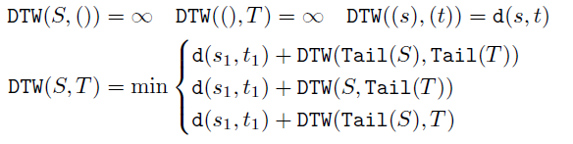
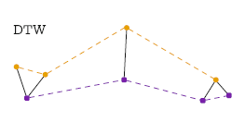
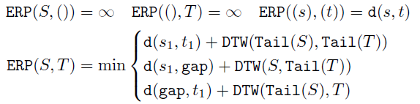
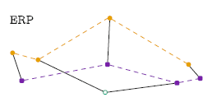
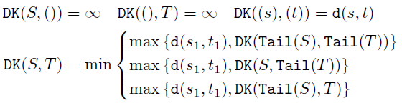
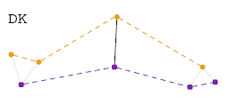
DTW, ERP, DK

Slide 5
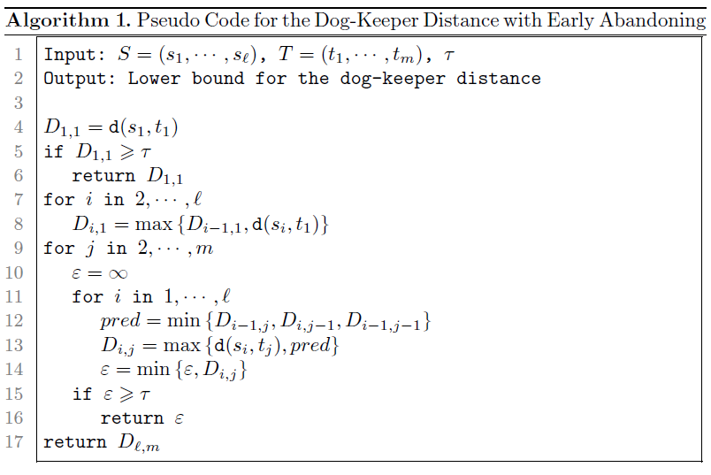
Dog-Keeper

Slide 6
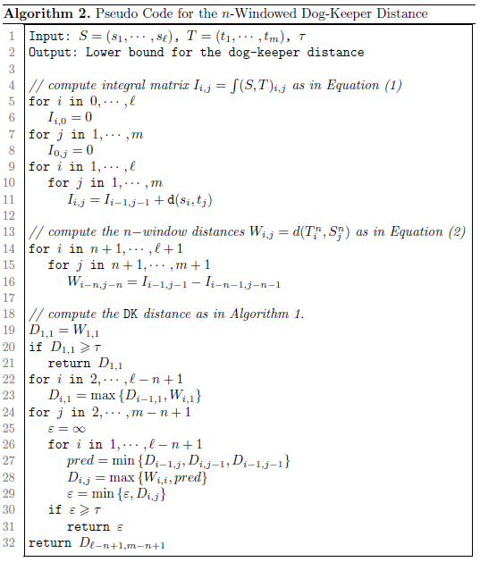
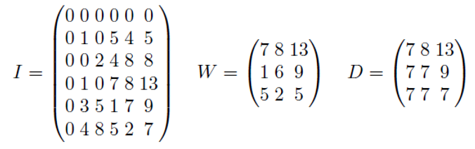
Windowed Dog-Keeper

Slide 7
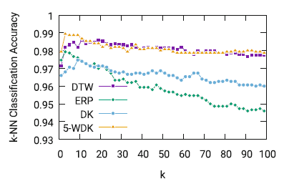
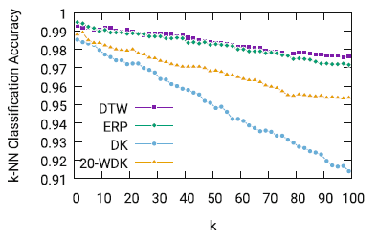
Experimental Result (1/4)
Cylinder-bell-funnel (CBF)
Character Trajectories (CT)

Slide 8
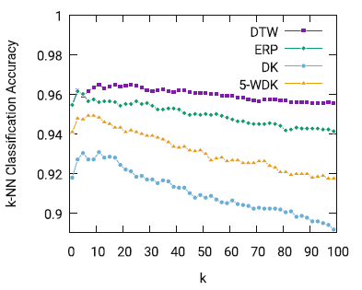
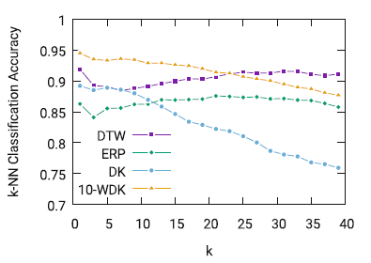
Experimental Result (2/4)
Spoken Arabic Digit (SAD)
Australian Sign Language (ASL)

Slide 9
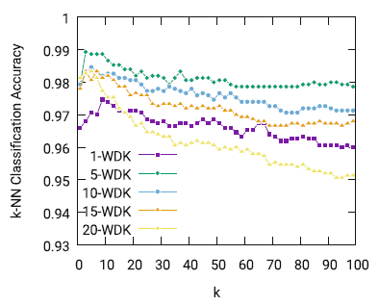
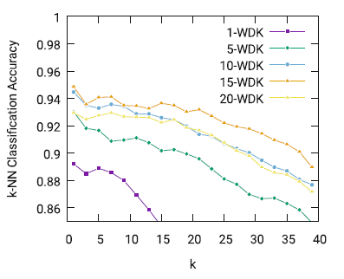
Experimental Result (3/4)
Cylinder-bell-funnel (CBF)
Australian Sign Language (ASL)

Slide 10
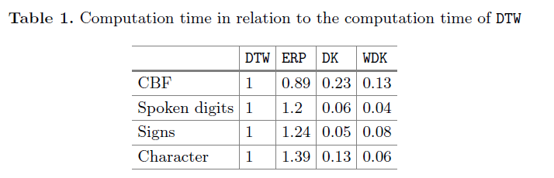
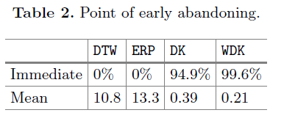
Experimental Result (4/4)

