Slide 1
Efficient construction of an assembly string graph using the FM-index
Jared T. Simpson and Richard Durbin
Bioinformatics, 2010 ,pp 367–373.
Presenter: Kuo-Feng Huang
Date: 2018/01/23

Slide 2
Abstract
Motivation: Sequence assembly is a difficult problem whose importance has grown again recently as the cost of sequencing has dramatically dropped. Most new sequence assembly software has started by building a de Bruijn graph, avoiding the overlap-based methods used previously because of the computational cost and complexity of these with very large numbers of short reads. Here, we show how to use suffix array-based methods that have formed the basis of recent very fast sequence mapping algorithms to find overlaps and generate assembly string graphs asymptotically faster than previously described algorithms.

Slide 3
Abstract
Results: Standard overlap assembly methods have time complexity O(N2), where N is the sum of the lengths of the reads. We use the Ferragina–Manzini index (FM-index) derived from the Burrows– Wheeler transform to find overlaps of length at least τ among a set of reads. As well as an approach that finds all overlaps then implements transitive reduction to produce a string graph, we show how to output directly only the irreducible overlaps, significantly shrinking memory requirements and reducing compute time to O(N), independent of depth. Overlap-based assembly methods naturally handle mixed length read sets, including capillary reads or long reads promised by the third generation sequencing technologies. The algorithms we present here pave the way for overlap-based assembly approaches to be developed that scale to whole vertebrate genome de novo assembly.

Slide 4
Suffix array
X =AAGTA$
SA_{X} = [6,5,1,2,3,4]
AAGTA$
AGTA$
GTA$ =
TA$
A$
$
$
A$
AAGTA$ =
AGTA$
GTA$
TA$
X[6,6]
X[5,6]
X[1,6]
X[2,6]
X[3,6]
X[4,6]

Slide 5
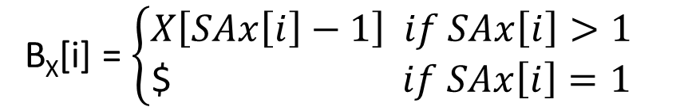
BTW
B_{X}[i] = $\left\{\begin{aligned}X\left[SAx\left[i\right]−1\right] if SAx\left[i\right]>1 \\ \text{\$} if SAx\left[i\right]=1\end{aligned}\right.$
X =AAGTA$
SA_{X} = [6,5,1,2,3,4]
AAGTA$
AGTA$A
GTA$AA =
TA$AAG
A$AAGT
$AAGTA
B_{X}=[A,T,$,A,A,G]
SA_{X}
X[6,6]
X[5,6]
X[1,6]
X[2,6]
X[3,6]
X[4,6]
$
A$
AAGTA$ =
AGTA$
GTA$
TA$
$
A
A
A
G
T
A
T
$
A
A
G

Slide 6
FM-index
Read Z的suffix= AG 求在read X=AAGTA$ , Y=AGAGT$中的prefix
AAGTA$
AGTA$A
GTA$AA
TA$AAG
A$AAGT
$AAGTA
AGAGT$
GAGT$A
AGT$AG
GT$AGA
T$AGAG
$AGAGT
$AAGTA
A$AAGT
AAGTA$
AGTA$A
GTA$AA
TA$AAG
$AGAGT
AGAGT$
AGT$AG
GAGT$A
GT$AGA
T$AGAG
SA_{T}
$AAGTA (1,6)
$AGAGT (2,6)
A$AAGT (1,5)
AAGTA$ (1,1)
AGAGT$ (2,1)
AGT$AG (2,3)
AGTA$A (1,2)
GAGT$A (2,2)
GT$AGA (2,4)
GTA$AA (1,3)
T$AGAG (2,5)
TA$AAG (1,4)
B_{T}
A
T
T
$
$
G
A
A
A
A
G
G

Slide 7
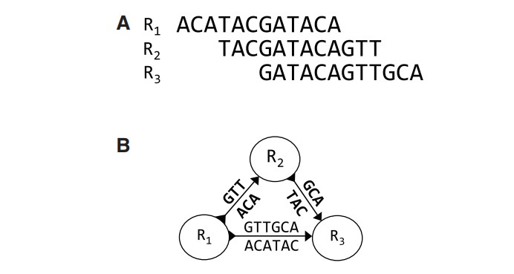
Irreducible edge

Slide 8
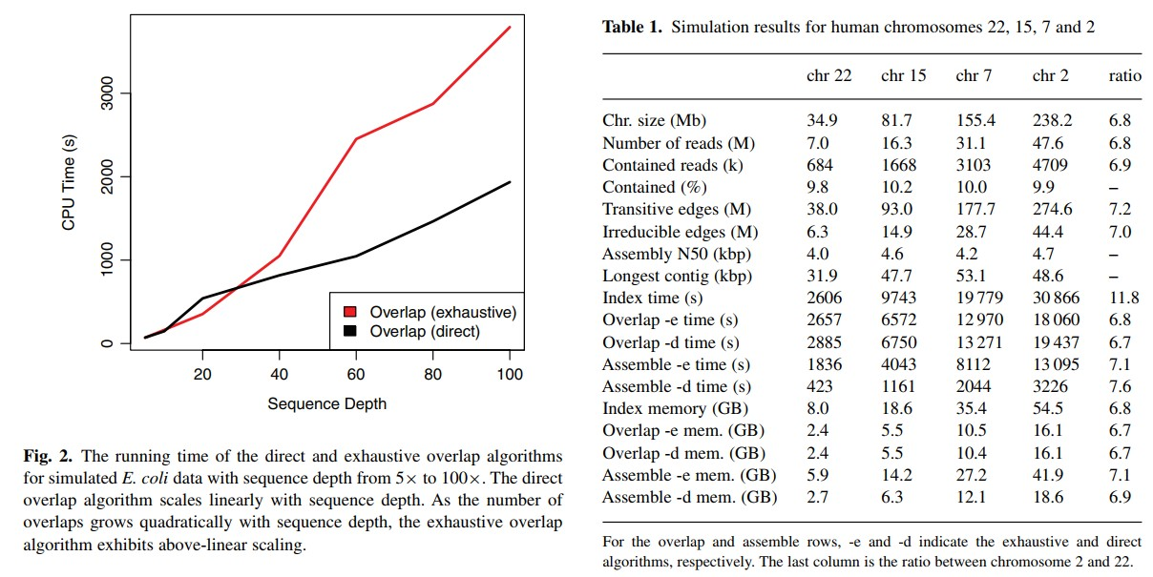
Result

