Slide 1
A Deep Reinforcement Learning Framework for the Financial Portfolio Management Problem
Zhengyao Jiang, Dixing Xu, Jinjun Liang
Xi’an Jiaotong-Liverpool University(西交利物浦大學)
arxiv.org, 2017
Presenter: Jia-Hong Liu
Date: 2017/1/23

Slide 2
Abstract
Financial portfolio management is the process of constant redistribution of a fund into different financial products. This paper presents a financial-model-free Reinforcement Learning framework to provide a deep machine learning solution to the portfolio management problem. The framework consists of the Ensemble of Identical Independent Evaluators(EIIE) topology, a Portfolio-Vector Memory (PVM), an Online Stochastic Batch Learning(OSBL) scheme, and a fully exploiting and explicit reward function. This framework is realized in three instants in this work with a Convolutional Neural Network (CNN), a basic Recurrent Neural Network (RNN), and a Long Short-Term Memory (LSTM). They are, along with a number of recently reviewed or published portfolio-selection strategies, examined in three back-test experiments with a trading period of 30 minutes in a cryptocurrency market. Cryptocurrencies are electronic and decentralized alternatives to government-issued money, with Bitcoin as the best-known example of a cryptocurrency. All three instances of the framework monopolize the top three positions in all experiments, outdistancing other compared trading algorithms. Although with a high commission rate of 0.25% in the backtests, the framework is able to achieve at least 4-fold returns in 50 days.

Slide 3
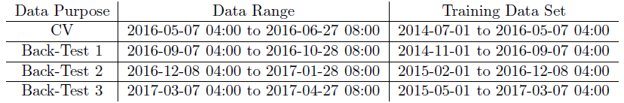
Data Set
2 year 2 month
1 month
30 min
Trainng Data Set
Data Range
CV(cross-validation)
2014-07
2016-05
2016-06
2017-03
4 month
Trainng Data Set
Data Range
Back-Test 1
2014-07
2014-11
2016-09
2016-10
2017-03
…
…

Slide 4

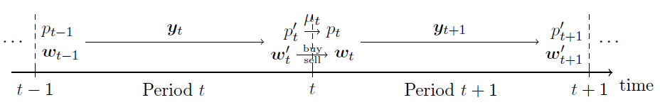




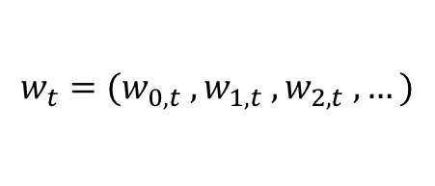

Reward Function
Maximizing the average logarithmic cumulated return R
$$=$$
$$πθ\left(st\right)=w_{t}$$
$$w_{t}=({w_{0,t} ,w}_{1,t} ,w_{2,t} , …)$$

Slide 5

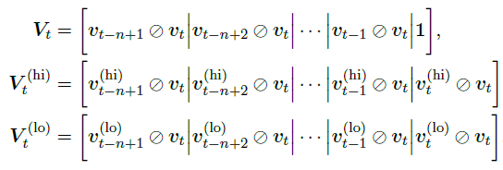
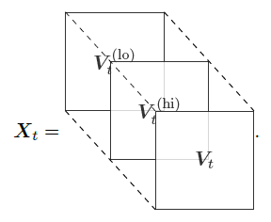
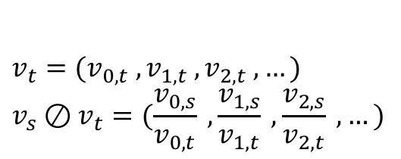

Reward Function
Maximizing the average logarithmic cumulated return R
$$=$$
$$v_{t}=({v_{0,t} ,v}_{1,t} ,v_{2,t} , …)$$
$$v_{s}⊘v_{t}=(\frac{v_{0,s}}{v_{0,t}} ,\frac{v_{1,s}}{v_{1,t}} , \frac{v_{2,s}}{v_{2,t}} ,…)$$

Slide 6


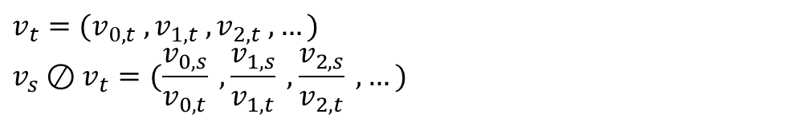
Reward Function
Maximizing the average logarithmic cumulated return R
$$=$$
$$w_{t}=({w_{0,t} ,w}_{1,t} ,w_{2,t} , …)$$
$$v_{t}=({v_{0,t} ,v}_{1,t} ,v_{2,t} , …)$$
$$v_{s}⊘v_{t}=(\frac{v_{0,s}}{v_{0,t}} ,\frac{v_{1,s}}{v_{1,t}} , \frac{v_{2,s}}{v_{2,t}} ,…)$$

Slide 7
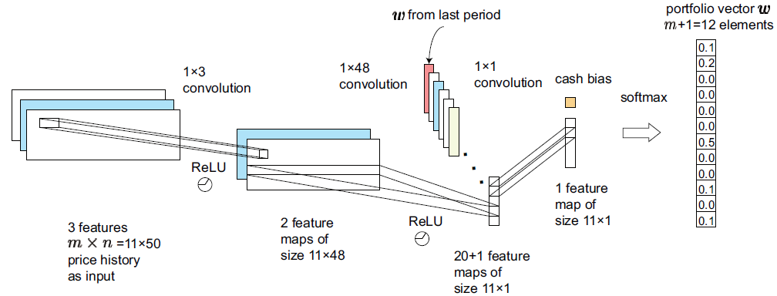
Convolutional Neural Network(CNN)

Slide 8
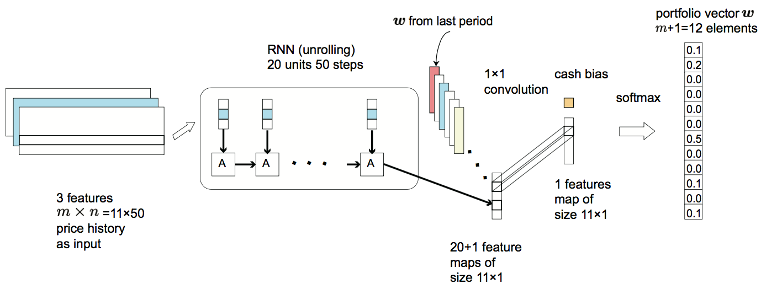
Recurrent Neural Network(RNN)

Slide 9
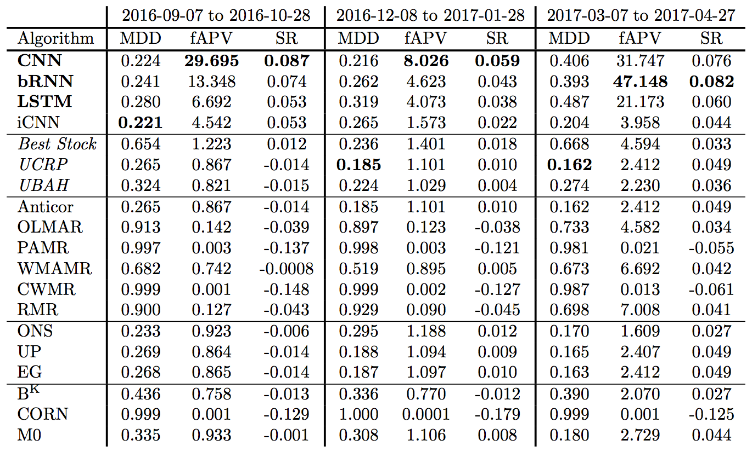
Results

Slide 10
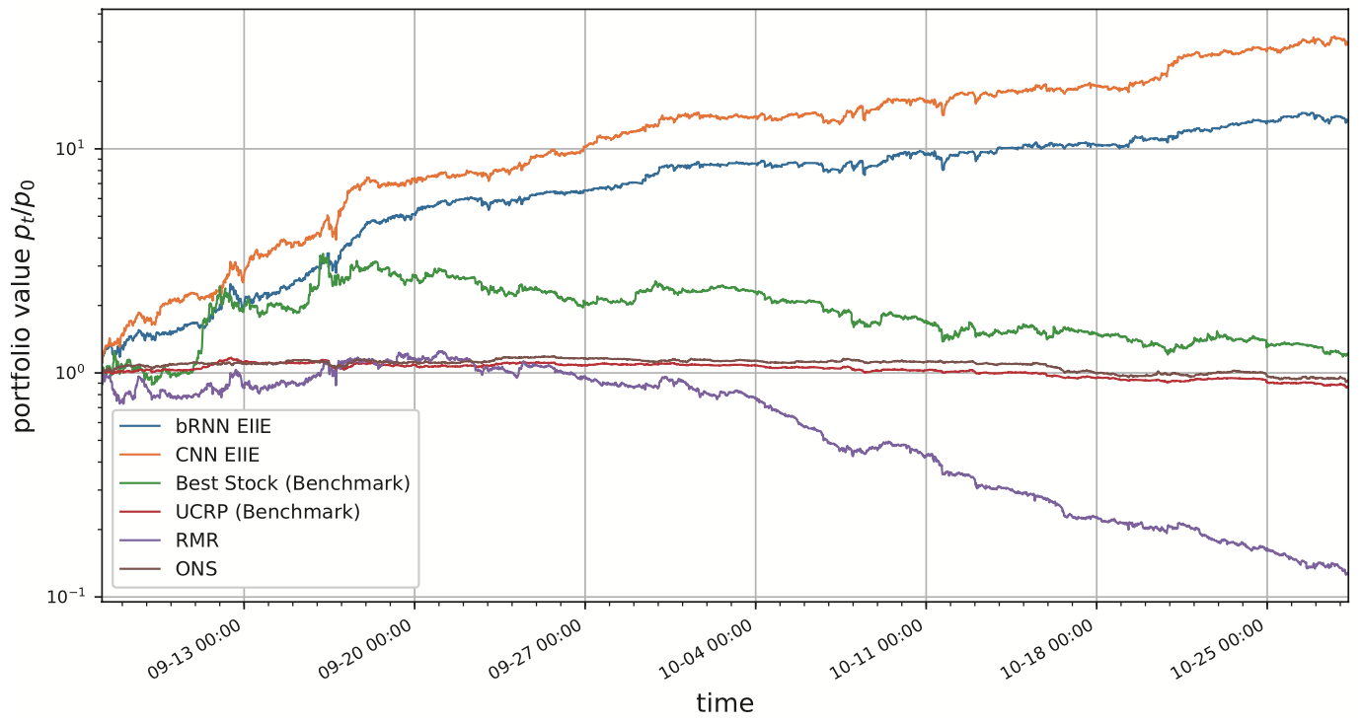
2016-09-07-4:00 to 2016-10-28-8:00

Slide 11
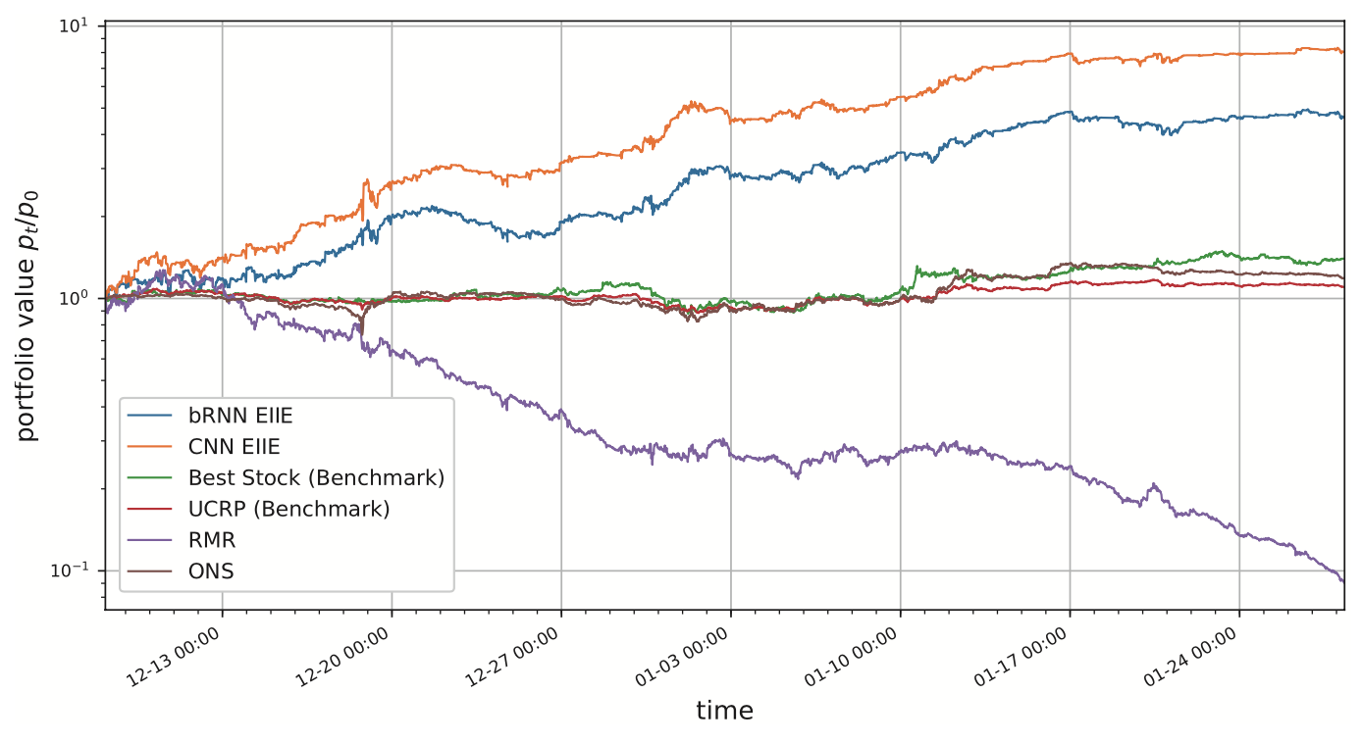
2016-12-08-4:00 to 2017-01-28-8:00

Slide 12

$$0$$
t-1
t
t+1
t_{f+1}

