Slide 1
Velvet: Algorithms for de novo short read assembly using de Bruijn graphs
Daniel R. Zerbino and Ewan Birney
Cold Spring Harbor Laboratory Press on March 18, 2008,
Volume 18,pp 821-829
Presenter: Cheng-Han Wu
Date:2017/1/23

Slide 2
Abstract
We have developed a new set of algorithms, collectively called “Velvet,” to manipulate de Bruijn graphs for genomic sequence assembly. A de Bruijn graph is a compact representation based on short words (k-mers) that is ideal for high coverage, very short read (25–50 bp) data sets. Applying Velvet to very short reads and paired-ends information only, one can produce contigs of significant length, up to 50-kb N50 length in simulations of prokaryotic data and 3-kb N50 on simulated mammalian BACs. When applied to real Solexa data sets without read pairs, Velvet generated contigs of ∼8 kb in a prokaryote and 2 kb in a mammalian BAC, in close agreement with our simulated results without read-pair information. Velvet represents a new approach to assembly that can leverage very short reads in combination with read pairs to produce useful assemblies.

Slide 3
Contig
A critical stage in genome sequencing is the assembly of shotgun reads, or piecing together fragments randomly extracted from the sample, to form a set of contiguous sequences (contigs) representing the DNA in the sample.

Slide 4
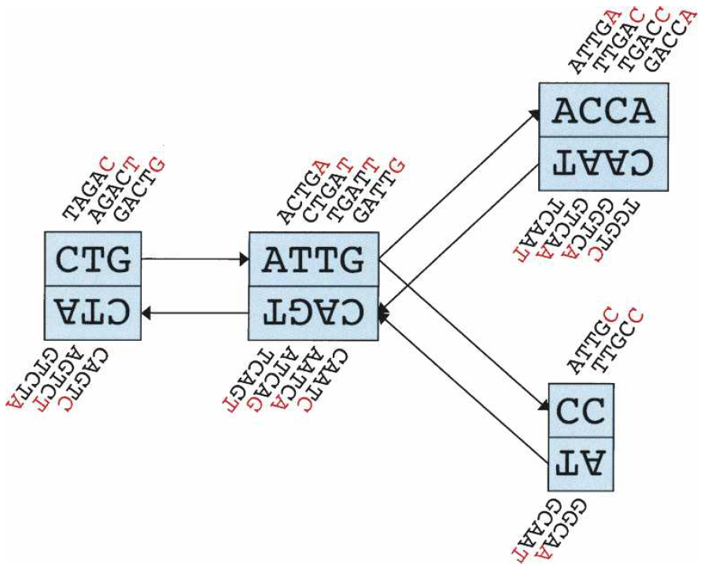
de Bruijn graphs
TAGAC
ATCTG
Notes:
DBG原不適合reads較長的測序數，k值越小重複越多分支越多

Slide 5
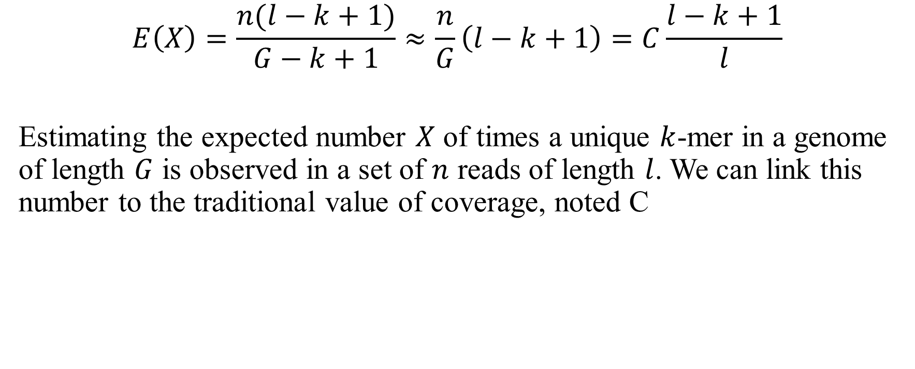
Velvet parameters
$$E\left(X\right)=\frac{n(l−k+1)}{G−k+1}≈\frac{n}{G}\left(l−k+1\right)=C\frac{l−k+1}{l}$$
Estimating the expected number $X$ of times a unique $k$-mer in a genome of length $G$ is observed in a set of $n$ reads of length $l$. We can link this number to the traditional value of coverage, noted C

Slide 6
Construction
hash table records the ID of the first read encountered containing that k-mer and the position of its occurrence within that read
Another records, for each read, which of its original k-mers are overlapped
Notes:
k-mer determine balance between sensitivity and specificity
k must be odd to ensure that each k-mer cannot be its own reverse complement

Slide 7
Simplification
GGACT
GACTA
ACTAG
CTAGA
TAGAC
AGACT
GACTG
GACTC
ACTCC
GGACT
GACTAGA
TAGACT
GACTA
GACTCC
Notes:
errors can be due to both the sequencing process or to the biological
sample, for example, polymorphisms

Slide 8
Removing bubbles tips
tip
GGACT
GACTAGA
TAGACT
GACTA
GACTCC

Slide 9
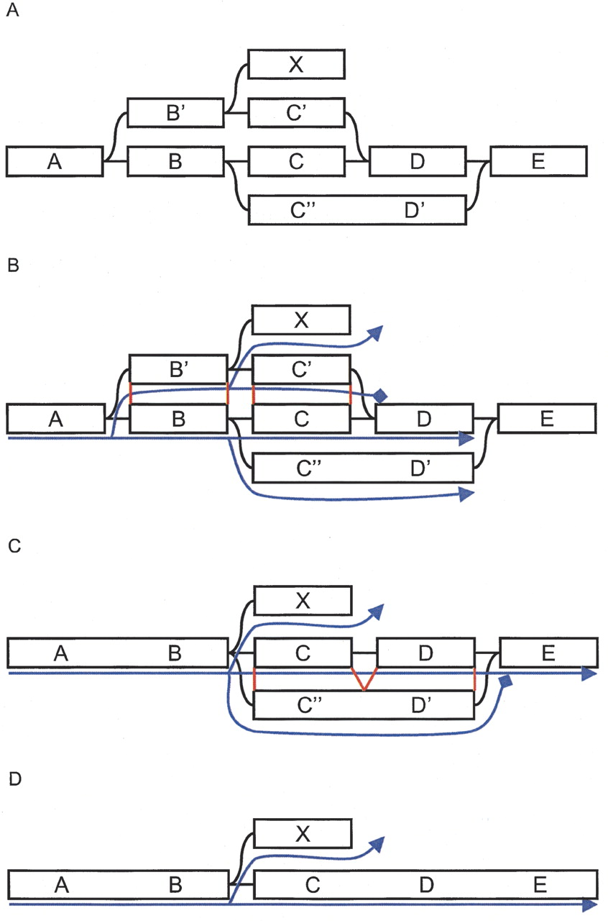
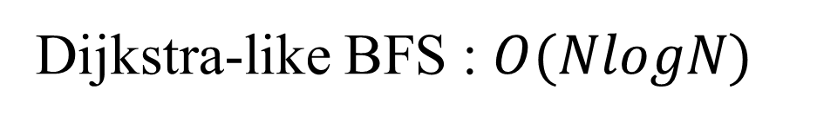
Removing bubbles with the Tour Bus algorithm
Dijkstra-like BFS : $O(NlogN)$

Slide 10
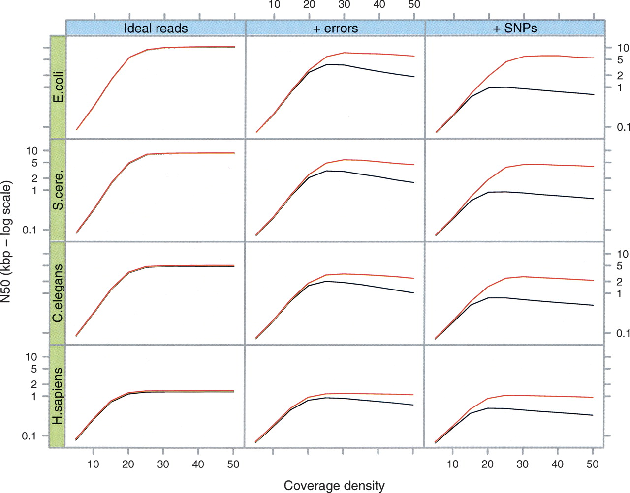
Testing error removal on simulated data

Slide 11
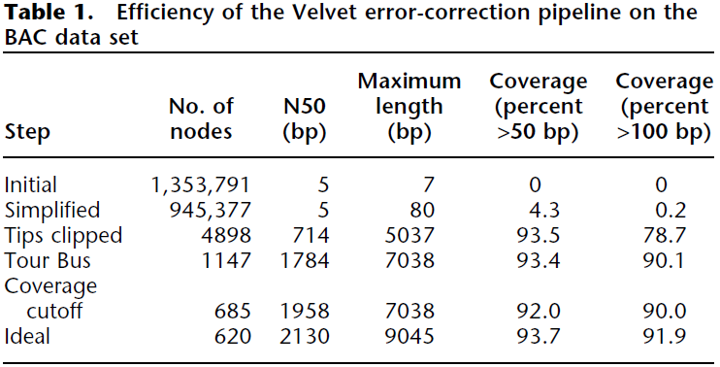
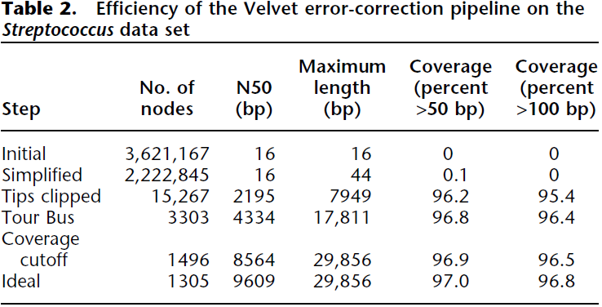
Testing error removal on experimental data

Slide 12
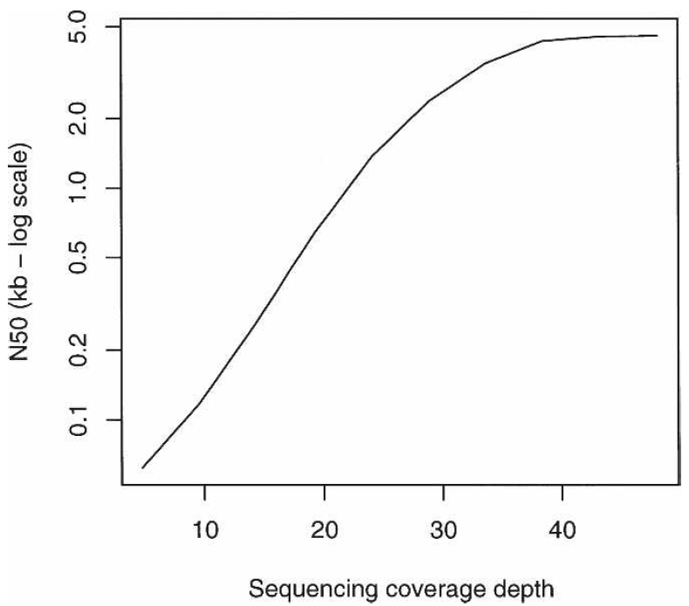
Effect of coverage on contig length with experimental Streptococcus data.

Slide 13
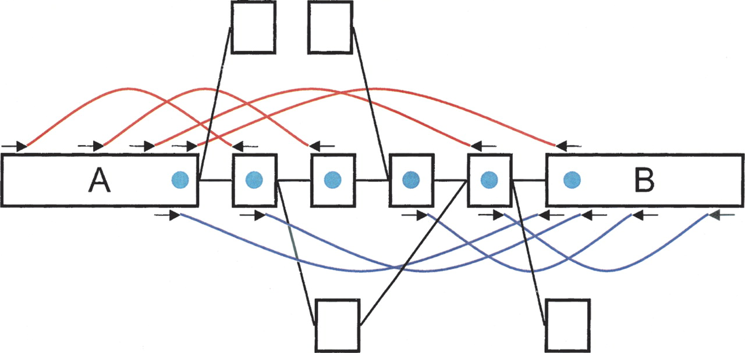
Breadcrumb algorithm

Slide 14
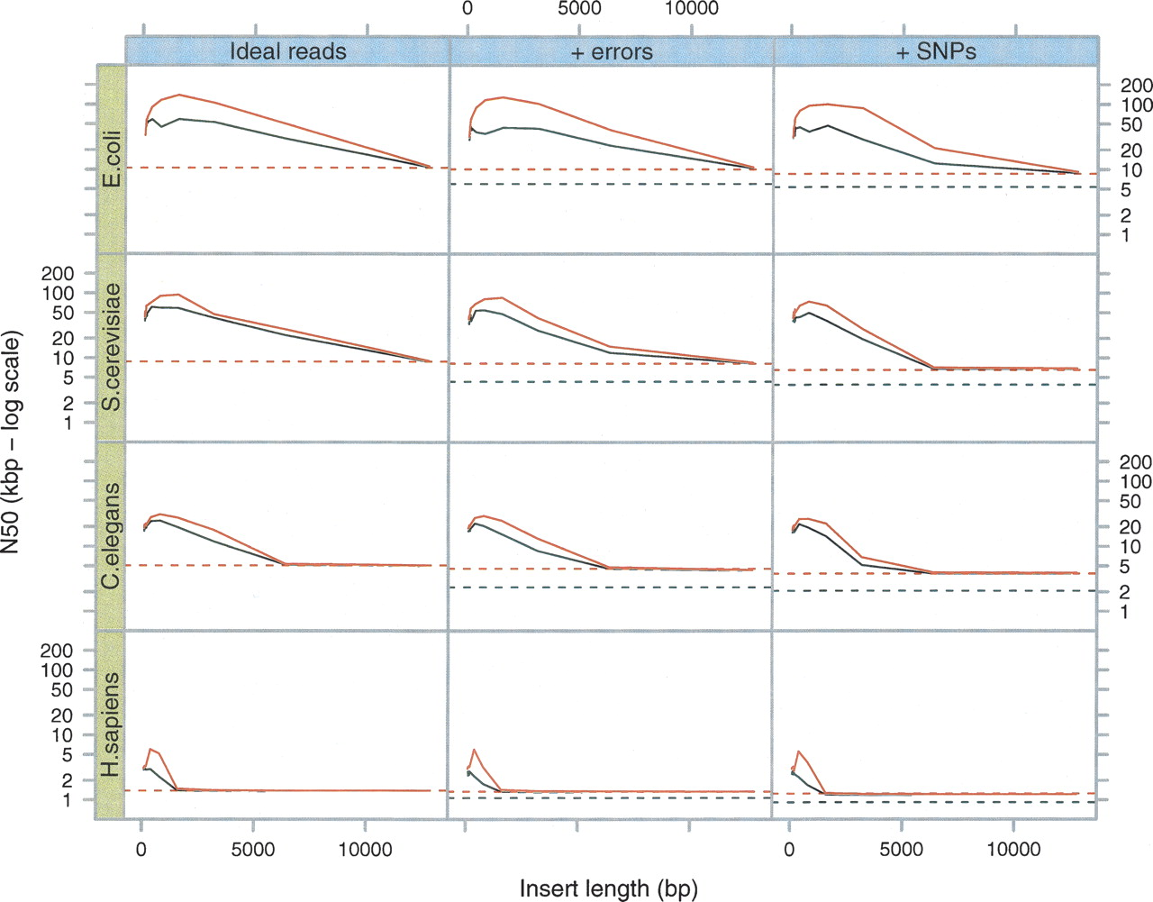
Breadcrumb performance on simulated data sets

Slide 15
Complexity
Hashing the reads into k-mers
Constructing the graph
Correcting errors
Resolving repeats

Slide 16
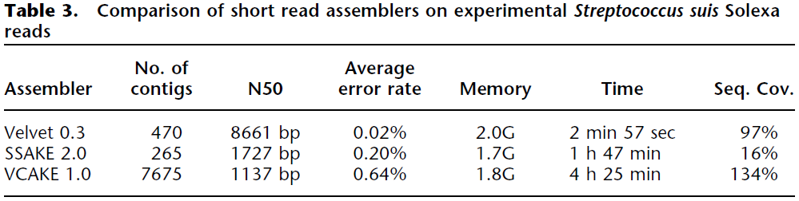
Comparison to other very short read assemblers

