Slide 1
An improved algorithm for the all-pairs suffix–prefix problem
William H.A. Tustumi, Simon Gog, Guilherme P. Telles, and Felipe A. Louza
Journal of Discrete Algorithms 37 (2016) 34–43
Presenter: Kuo-Feng Huang
Date: 2018/12/10

Slide 2
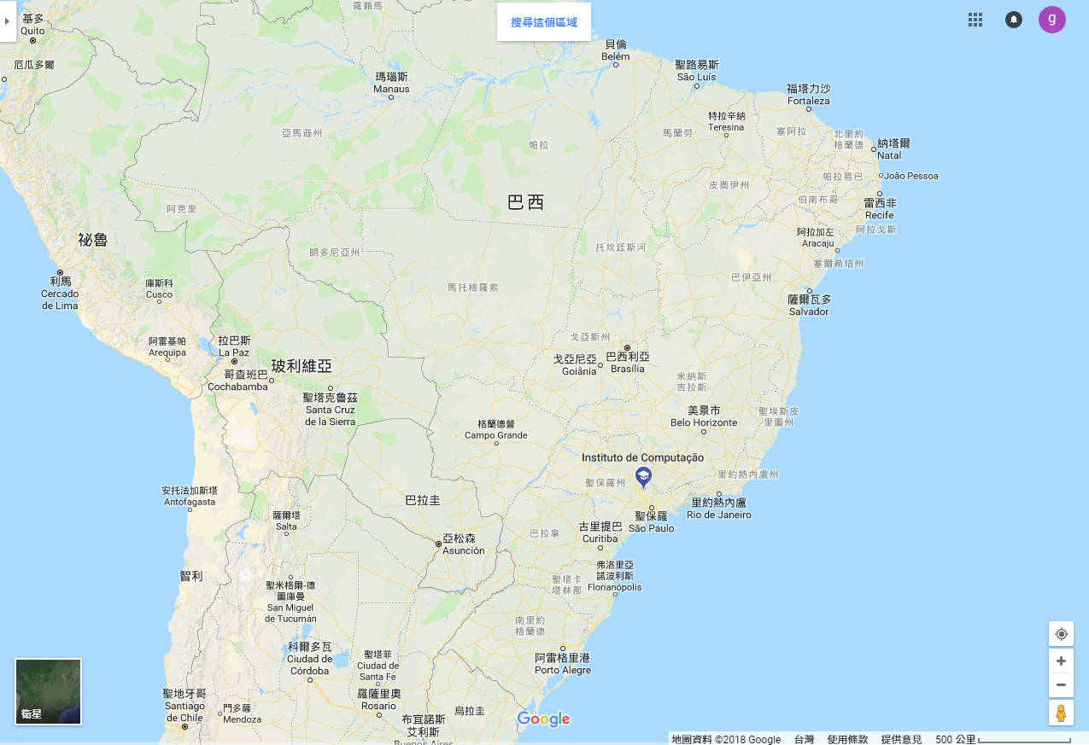
Institute of Computing, University of Campinas, Campinas, SP, Brazil

Slide 3
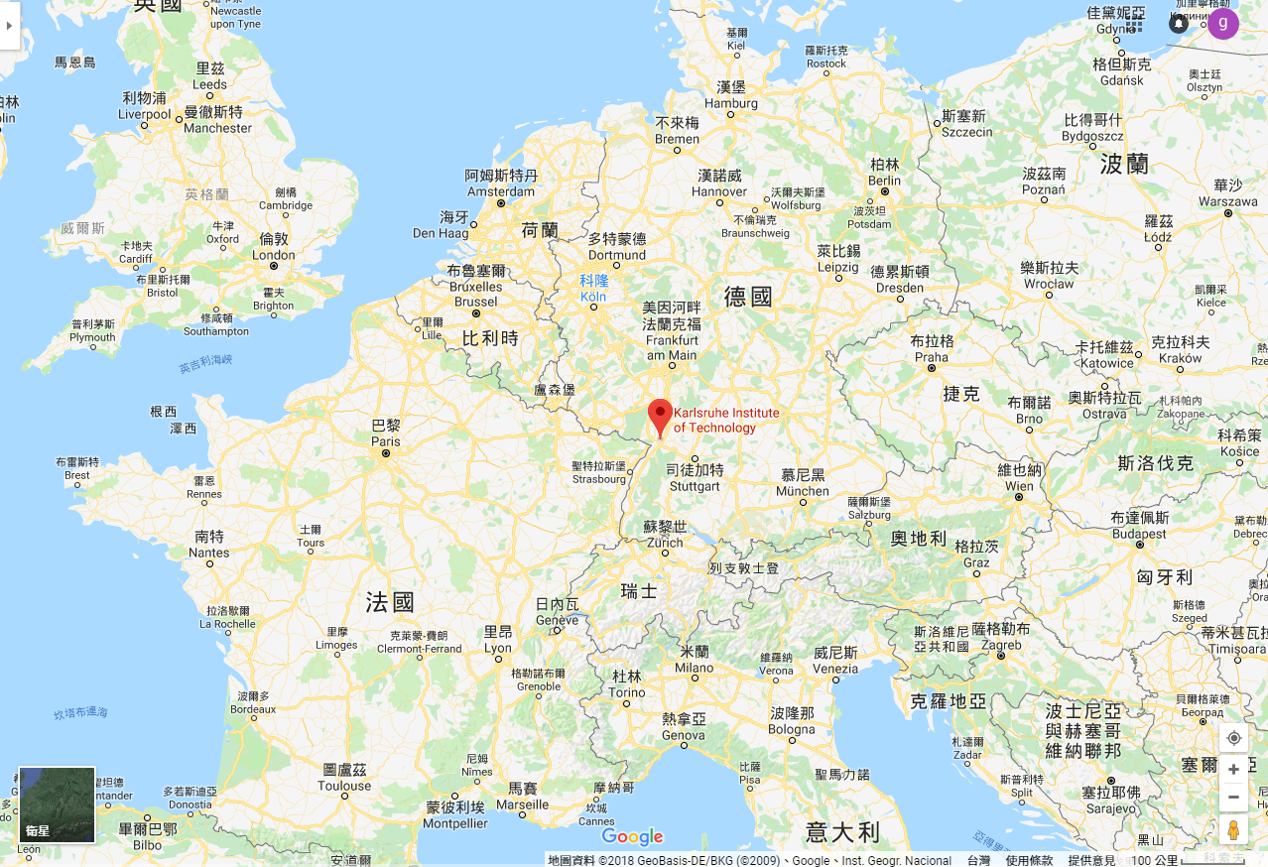
Institute of Theoretical Informatics, Karlsruhe Institute of Technology, Germany

Slide 4
Abstract (1/2)
Finding all longest suffix–prefix matches for a collection of strings is known as the all pairs suffix–prefix match problem and its main application is de novo genome assembly. This problem is well studied in stringology and has been solved optimally in 1992 by Gusfield et al. using suffix trees. In 2010, Ohlebusch and Gog proposed an alternative solution based on enhanced suffix arrays which has also optimal time complexity but is faster in practice. In this article, we present another optimal algorithm based on enhanced suffix arrays which further improves the practical running time.

Slide 5
Abstract (2/2)
Our new solution solves the problem locally for each string, scanning the enhanced suffix array backwards to avoid the processing of suffixes that are no suffix–prefix matching candidates. In an empirical evaluation we observed that the new algorithm is over two times faster and more space-efficient than the method proposed by Ohlebusch and Gog. When compared to Readjoiner, a good practical solution, our algorithm is faster for small overlap lengths, in pace with theoretical optimality.

Slide 6
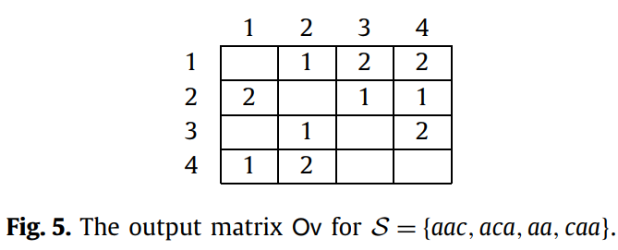
All longest suffix–prefix matches

Slide 7
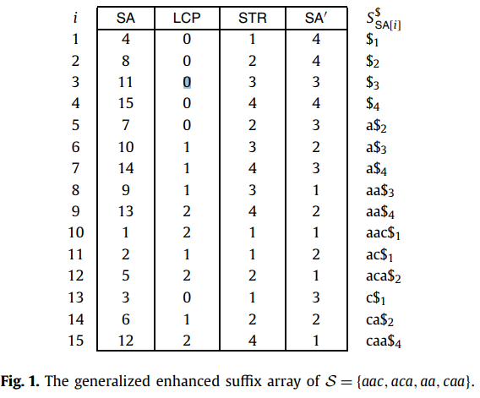
The generalized enhanced suffix array (GESA)
S= aac$₁aca$₂aa$₃caa$₄
P={8,10,12,15}

Slide 8
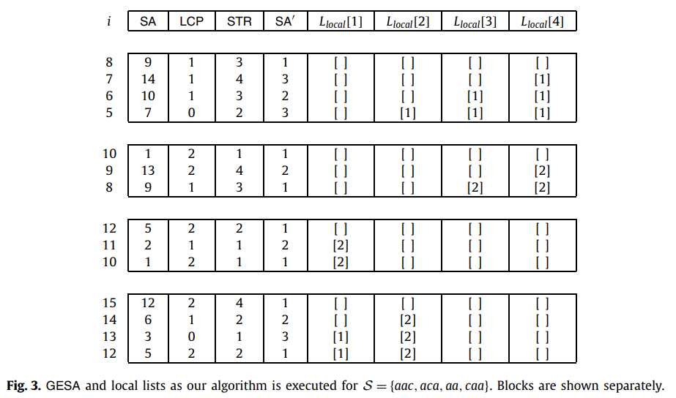
GESA and local lists
L= ∞ aa
L=1 |a|=1
L=1 |a|=1
L=1 |a|=1
L= ∞ aac
L=2 |aa|=2
L=2 |aa|=2
L= ∞ aca
L=2 |ac|=2
L=1 |aac|=3
L= ∞ caa
L=2 |ca|=2
L=1 |c|=1
L=0 |aca|=3

Slide 9
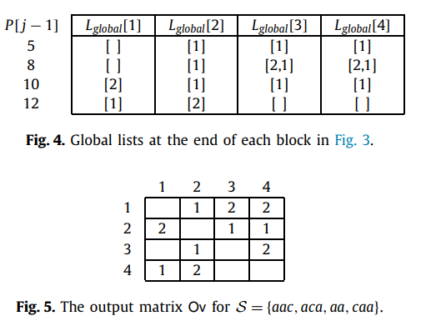
Output
3
1
2
4

Slide 10
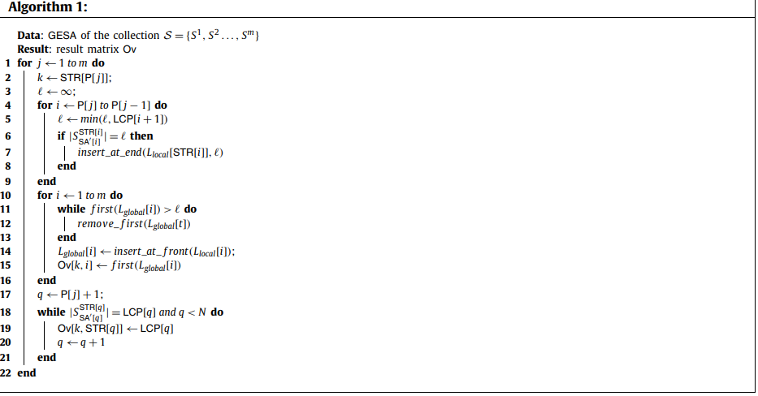
Algorithm
Time: O(N+m²)

Slide 11
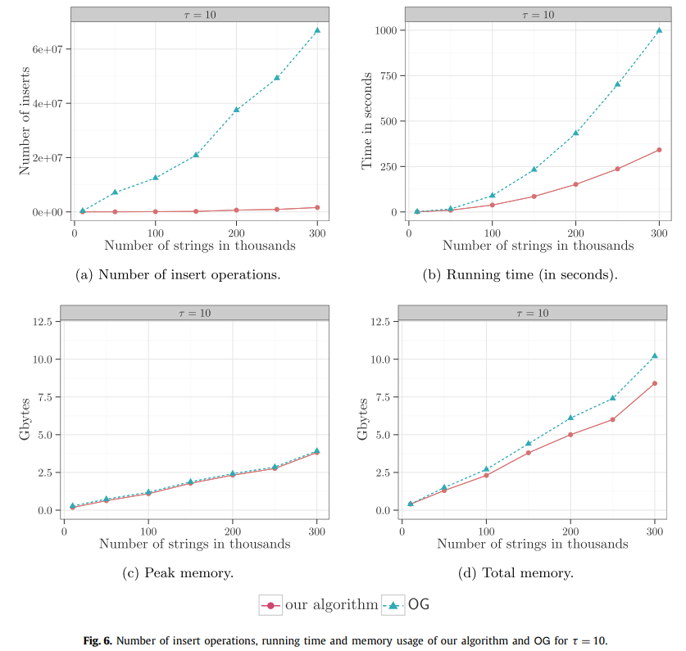
Experimental results

Slide 12
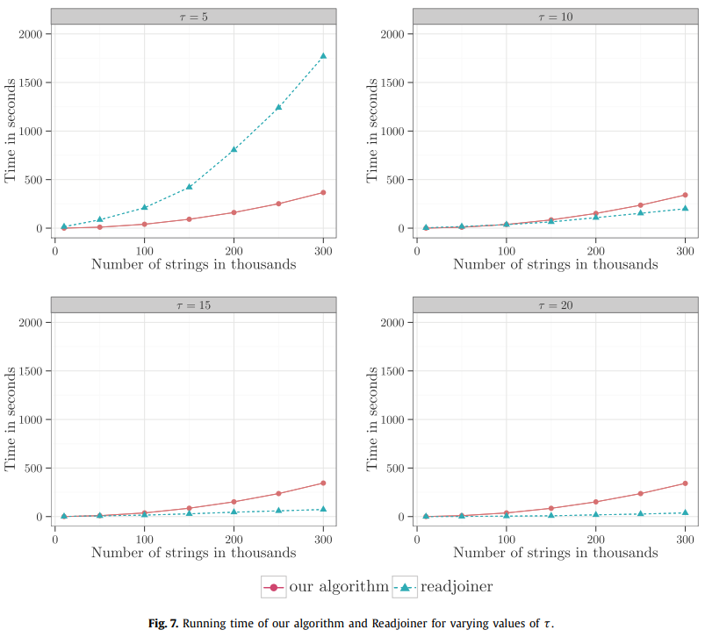
Experimental results

Slide 13
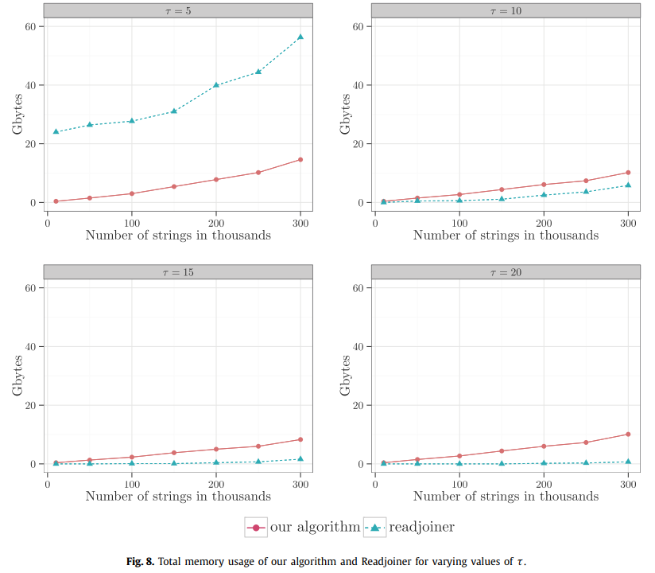
Experimental results

Slide 14
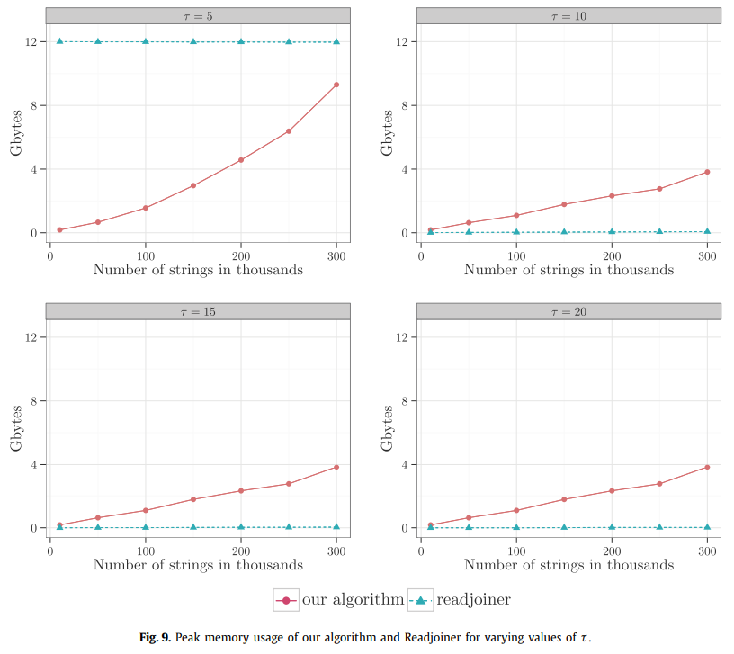
Experimental results

