Slide 1
Practical Deep Reinforcement Learning Approach for Stock Trading
Zhuoran Xiong, Xiao-Yang Liu, Shan Zhong, Hongyang (Bruce) Yang, and Anwar Walid
arXiv:1811.07522v2 [cs.LG] 2 Dec 2018
Presenter: Cheng-Han Wu
Date:2018/12/10

Slide 2
Abstract
Stock trading strategy plays a crucial role in investment companies. However, it is challenging to obtain optimal strategy in the complex and dynamic stock market. We explore the potential of deep reinforcement learning to optimize stock trading strategy and thus maximize investment return. 30 stocks are selected as our trading stocks and their daily prices are used as the training and trading market environment. We train a deep reinforcement learning agent and obtain an adaptive trading strategy. The agent’s performance is evaluated and compared with Dow Jones Industrial Average and the traditional min-variance portfolio allocation strategy. The proposed deep reinforcement learning approach is shown to outperform the two baselines in terms of both the Sharpe ratio and cumulative returns

Slide 3



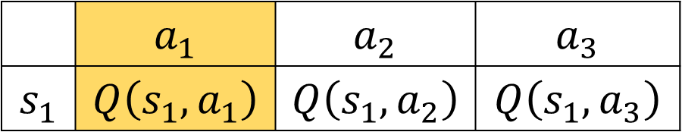






Q-learning
$Q_{π}\left(s_{t},a_{t}\right)=𝔼_{s_{t+1}}[r\left(s_{t},a_{t},s_{t+1}\right)+γ\max_{a_{t+1}}{Q(s_{t+1},a_{t+1})}$]
$$a_{3}$$
$$a_{3}$$
$$s_{1}$$
$$a_{2}$$
$$s_{2}$$
$$a_{2}$$
$$a_{1}$$
$$a_{1}$$
 | $$a_{1}$$ | $$a_{2}$$ | $$a_{3}$$
$$s_{1}$$ | $$Q\left(s_{1},a_{1}\right)$$ | $$Q\left(s_{1},a_{2}\right)$$ | $$Q\left(s_{1},a_{3}\right)$$
Notes:
ith-producer

Slide 4
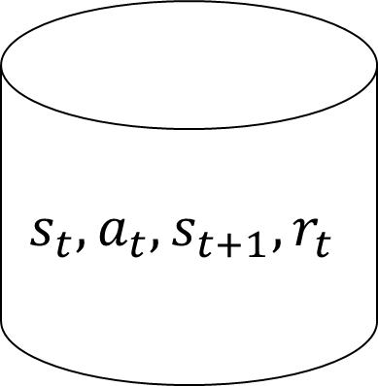



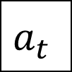
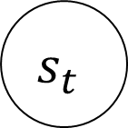
Deep Deterministic Policy Gradient (DDPG)
Actor
Network
$$μ(s)$$
$$s_{t}$$
$$a_{t}$$
$$s_{t},a_{t},s_{t+1},r_{t}$$
R
Critic
Network
$$Q(s,a)$$
$$Q(s,a)$$
Notes:
ith-producer

Slide 5
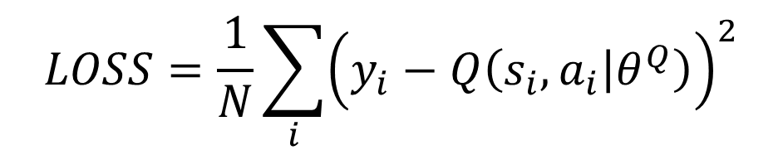
Update critic network
R
$$y_{i}=r_{i}+γQ^{′}\left(s_{i+1},μ^{′}\left(s_{i+1} | Q^{u^{′}},θ^{Q^{′}}\right)\right), i=1,…,N$$
$$LOSS=\frac{1}{N}\sum_{i}{{\left(y_{i}−Q\left(s_{i},a_{i} | θ^{Q}\right)\right)}^{2}}$$
$$L(θ^{Q})=𝔼_{s_{t},a_{t},r_{t},s_{t+1}\sim buffer}[{\left(r_{t}+γQ^{′}\left(s_{i+1},μ^{′}\left(s_{i+1} | θ^{μ} \right)|θ^{Q^{′}}\right)−Q\left(s_{t},a_{t} | θ^{Q}\right)\right)}^{2}]$$
Critic
Network
update
Notes:
ith-producer

Slide 6
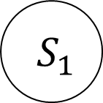
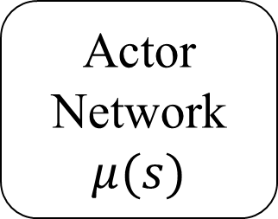
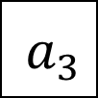
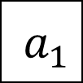
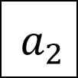
Policy gradient
$$a_{3}$$
Actor
Network
$$μ(s)$$
$$S_{1}$$
$$a_{2}$$
$$a_{1}$$
$$∇_{θ^{μ}}J=𝔼_{s_{t},a_{t},r_{t},s_{t+1}\sim buffer}[∇_{a}Q\left(s_{t},μ\left(s_{t}\right) | θ^{Q}\right)∇_{θ^{μ}}μ(s_{t}|θ^{μ})]$$
Notes:
ith-producer

Slide 7
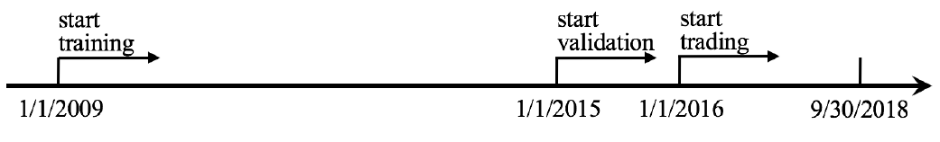
Data
Stocks : Dow Jones 30 stocks
Notes:
ith-producer

Slide 8
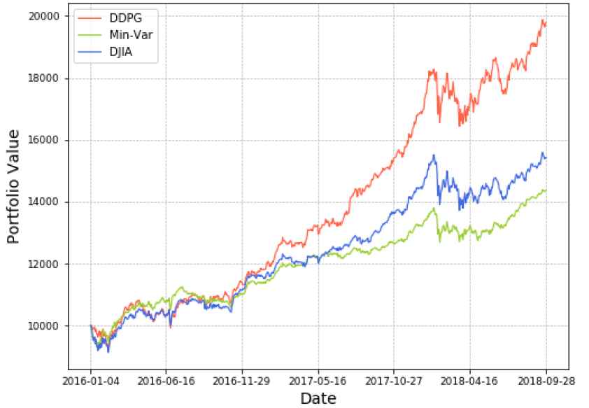
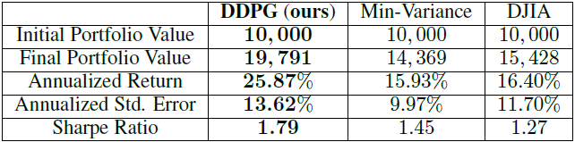
Result
Notes:
ith-producer

