Slide 1
Effective training of convolutional neural networks for face-based gender and age prediction
Grigory Antipov, Moez Baccouche, Sid-Ahmed Berrani, Jean-Luc Dugelay
Pattern Recognition 72 (2017) 15-26
Speaker: Du-Cheng Wu
Date: 2018.12.10
Notes:
Orange labs: https://goo.gl/nknG8Q

Slide 2
Abstract(1/2)
Convolutional Neural Networks (CNNs) have been proven very effective for human demographics estimation by a number of recent studies. However, the proposed solutions significantly vary in different aspects leaving many open questions on how to choose an optimal CNN architecture and which training strategy to use. In this work, we shed light on some of these questions improving the existing CNN-based approaches for gender and age prediction and providing practical hints for future studies. In particular, we analyse four important factors of the CNN training for gender recognition and age estimation: (1) the target age encoding and loss function, (2) the CNN depth, (3) the need for pretraining, and (4) the training strategy: mono-task or multi-task.

Slide 3
Abstract(2/2)
As a result, we design the state-of-the-art gender recognition and age estimation models according to three popular benchmarks: LFW, MORPH-II and FG-NET. Moreover, our best model won the ChaLearn Apparent Age Estimation Challenge 2016 significantly outperforming the solutions of other participants.

Slide 4
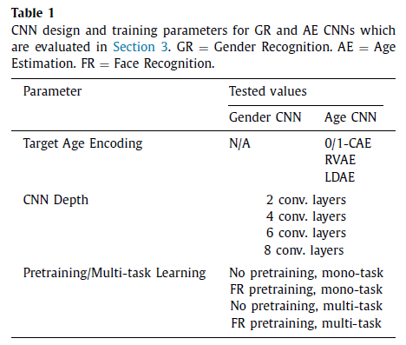
Four important factors of CNN training for gender recognition and age estimation
1.The target age encoding and loss function
2.The CNN depth
3.The need for pretraining
4.The training strategy: mono-task or multi-task

Slide 5
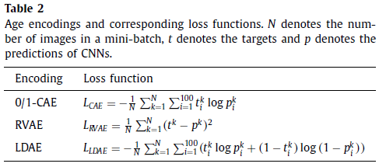
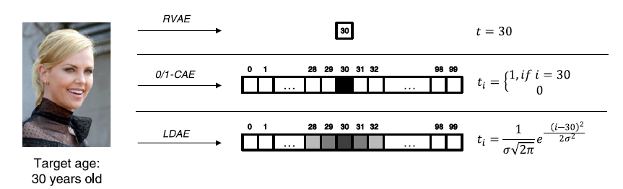
The target age encoding and loss function

Slide 6
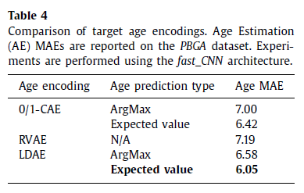
The target age encoding and loss function
ArgMax: Corresponds to the neuron with the highest activation
Expected value: The age be estimated of all output activations

Slide 7
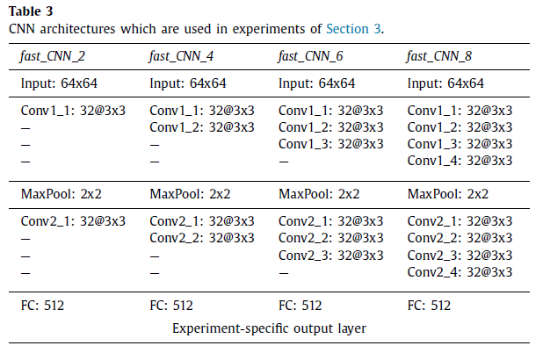
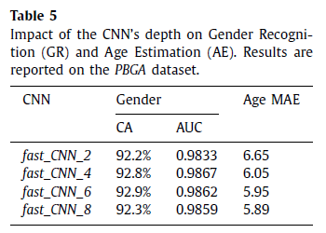
The CNN depth

Slide 8
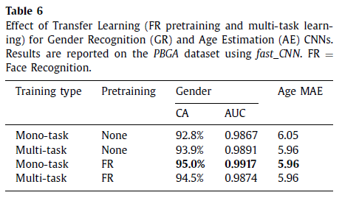
The need for pretraining and the training strategy: mono-task or multi-task

Slide 9
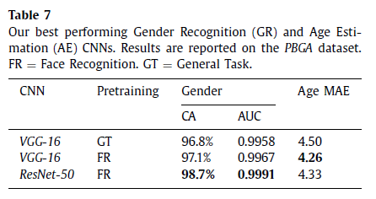
State-of-the-art CNNs for gender and age prediction
1. Gender Recognition and Age Estimation CNNs are firstly pretrained for Face Recognition
2. CNNs for Gender Recognition and Age Estimation are trained separaly
3. LDAE is used to encode ages for Age Estimation CNNs

Slide 10
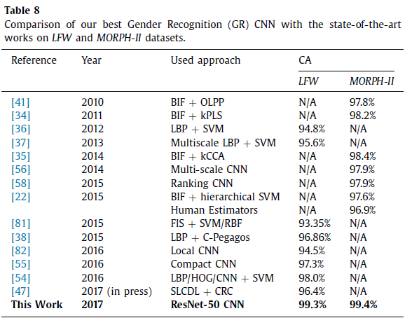
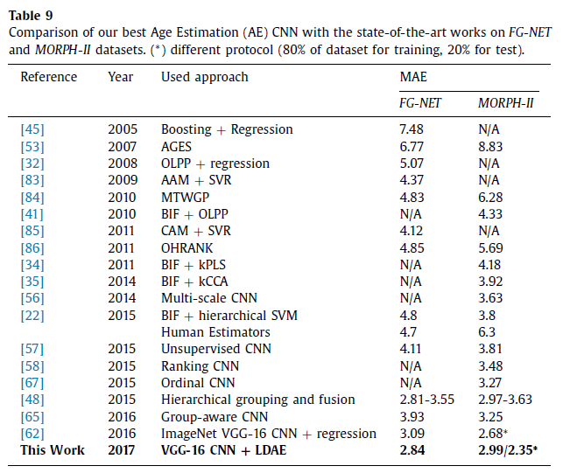
State-of-the-art CNNs for gender and age prediction

Slide 11
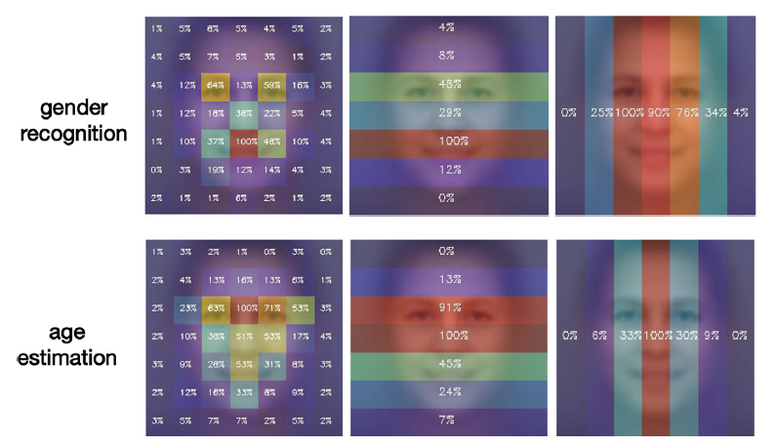
State-of-the-art CNNs for gender and age prediction

Slide 12
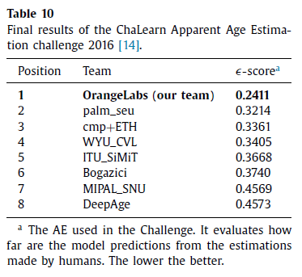
ChaLearn competition on apparent age estimation

Slide 13
Conclusion
Label Distribution Age Encoding (LDAE) is more effective for AE CNN
training
2. AE is a more complex problem than GR, Therefore, when no pretaining is used, AE requires deeper CNN architectures than GR
3. Face Recognition pretraining is essential for training deep gender and age CNNs
4. Multi-task training for GR and AE helps only when a CNN is trained from scratch

