Slide 1
Speeding Up String Matching by Weak Factor Recognition
Domenico Cantone , Simone Faro , and Arianna Pavone Proceedings of the Prague Stringology Conference 42-50
August 28–30, 2017, Czech Technical University, Prague Presenter：Kuan-Lin Lai
Date: 2018/12/17

Slide 2
Abstract(1/2)
String matching is the problem of finding all the substrings of a text which match a given pattern. It is one of the most investigated problems in computer science, mainly due to its very diverse applications in several fields. Recently, much research in the string matching field has focused on the efficiency and flexibility of the searching procedure and quite effective techniques have been proposed for speeding up the existing solutions. In this context, algorithms based on factors recognition are among the best solutions.

Slide 3
Abstract(2/2)
In this paper, we present a simple and very efficient algorithm for string matching based on a weak factor recognition and hashing. Our algorithm has a quadratic worst-case running time. However, despite its quadratic complexity, experimental results show that our algorithm obtains in most cases the best running times when compared, under various conditions, against the most effective algorithms present in literature. In the case of small alphabets and long patterns, the gain in running times reaches 28%. This makes our proposed algorithm one of the most flexible solutions in practical cases.

Slide 4

Weak Factor Recognition: Hash
Hash all substring of pattern
Time: O(m²)
Space: O(2^{α})
x = ATATCCG => ( A, AT, ATA, …, ATATCCG ), (T, TA, TAT, …, TATCCG), … , (G)

Slide 5
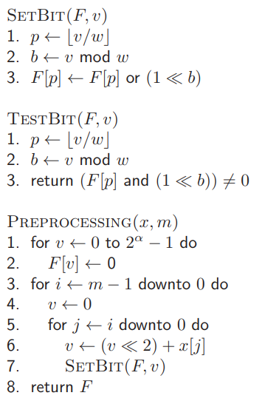

Preprocessing Phase

Slide 6
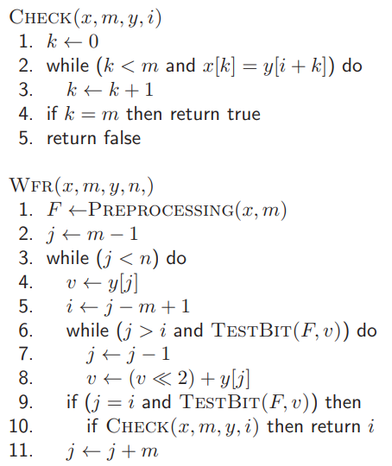
Searching Phase
search
？

Slide 7
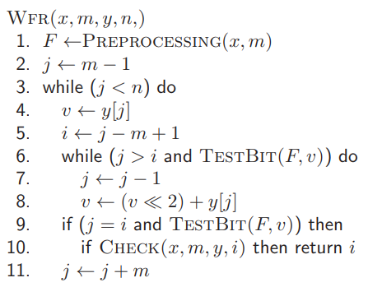
Variant

Slide 8
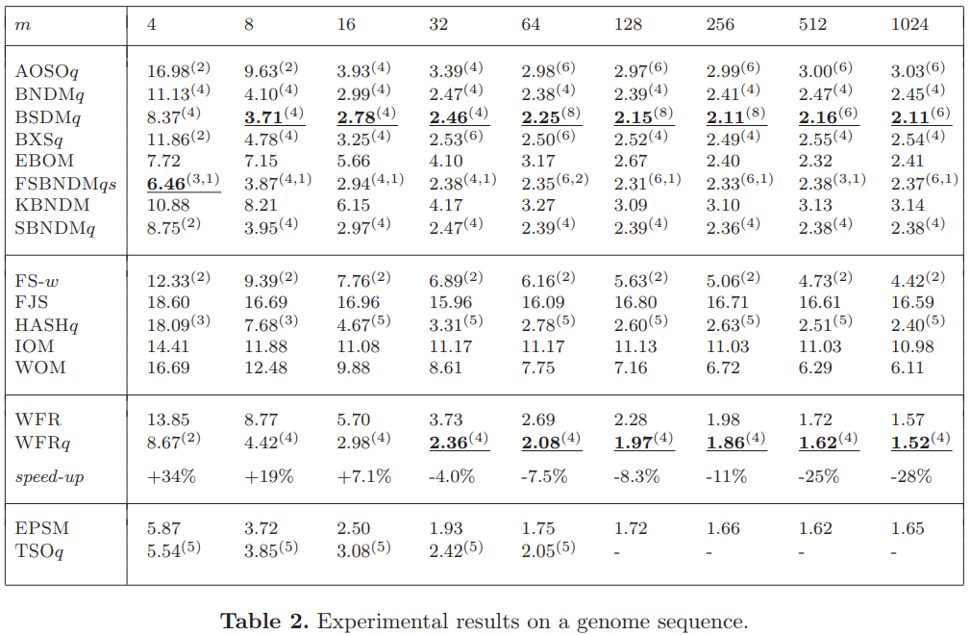
Experiment

Slide 9
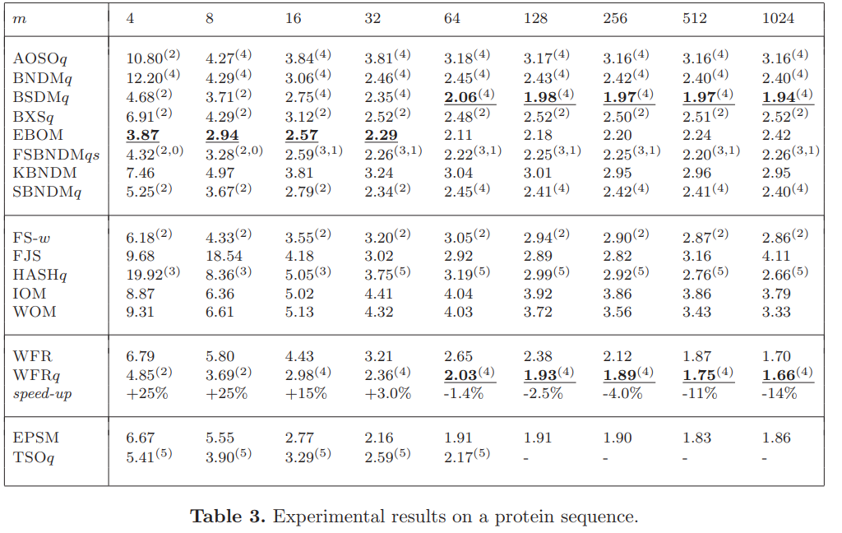
Experiment

Slide 10
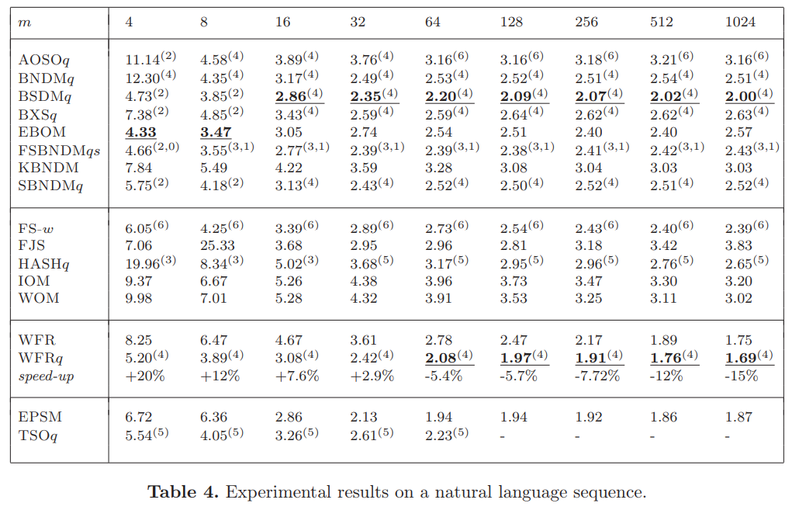
Experiment

