Slide 1
A filtration method for order-preserving matching
TamannaChhabra, JormaTarhio
Department of Computer Science, Aalto University, Aalto, Finland
Information Processing Letters 116 (2016) 71–74
Speaker: Guan-Zhi Chen
Date: 2018.12.25

Slide 2
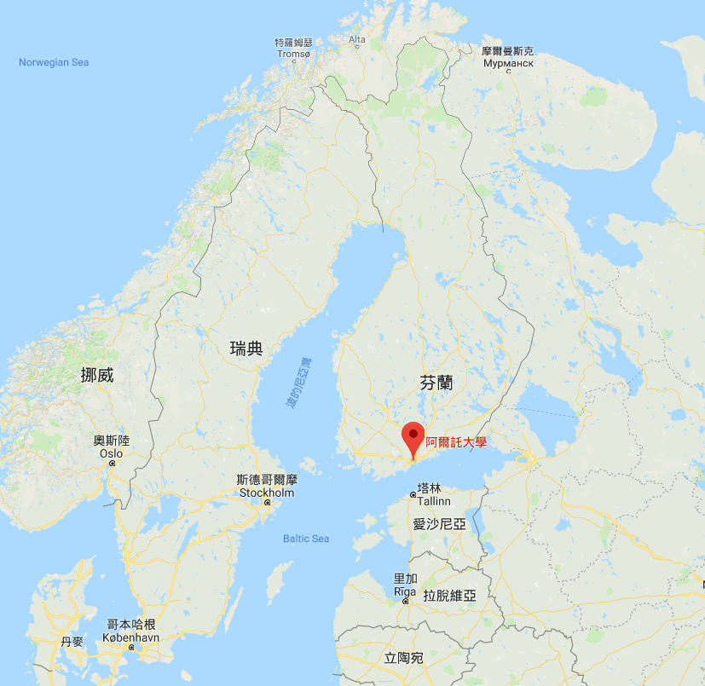

赫爾辛基
Helsinki
Notes:
阿爾托大學(2010): 赫爾辛基理工大學（1849）、赫爾辛基經濟學院（1904）和赫爾辛基藝術設計大學（1871）

Slide 3
Abstract
The problem of order-preserving matching has gained attention lately. The text and the pattern consist of numbers. The task is to find all the substrings in the text which have the same length and relative order as the pattern. The problem has applications in analysis of time series. We present a new sublinear solution based on filtration. Any algorithm for exact string matching can be used as a filtering method. If the filtration algorithm is sublinear, the total method is sublinear on average. We show by practical experiments that the new solution is more efficient than earlier algorithms.

Slide 4




Definition (1/2)
Pattern (String) matching problem:
Given text $T$ and pattern $P,$ find all occurrences of $P$ in $T.$
$T$: | A | A | C | T | G | A | C | G
$P$: | C | T | G
$$T[3:5]=P$$
Notes:
delta

Slide 5
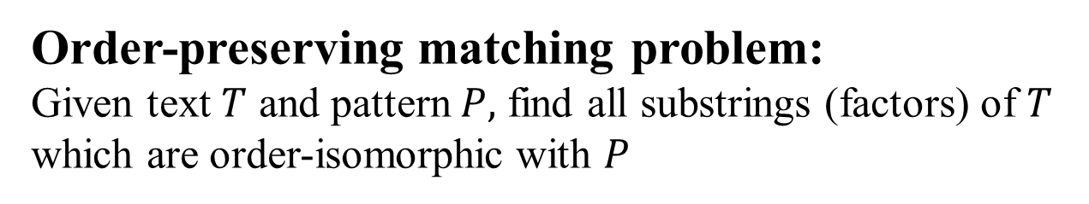
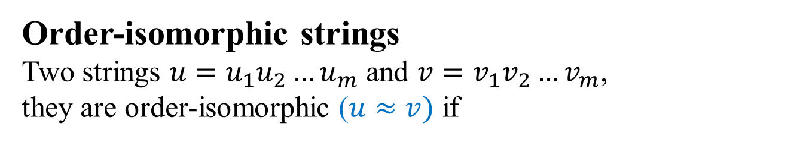
Definition (2/2)
Order-preserving matching problem:
Given text $T$ and pattern $P,$ find all substrings (factors) of $T$ which are order-isomorphic with $P$
Order-isomorphic strings
Two strings $u=u_{1}u_{2}…u_{m}$ and $v=v_{1}v_{2}…v_{m}$,
they are order-isomorphic ($u≈v)$ if
$u_{i}≤u_{j} ⟺v_{i}≤v_{j},$for $1≤i,j≤m$

Slide 6


Example
$$T\left[4:10\right]≈P$$
$T$: | 22 | 85 | 79 | 24 | 42 | 27 | 62 | 40 | 32 | 47 | 69 | 55 | 25
$P$: |  |  |  | 10 | 22 | 15 | 30 | 20 | 18 | 27
$$order$$
1 | 5 | 2 | 7 | 4 | 3 | 6

Slide 7
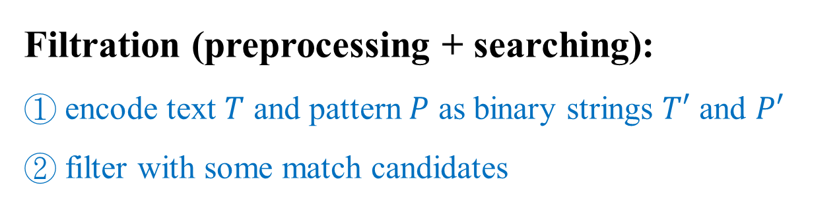
Their method
Filtration (preprocessing + searching):
① encode text $T$ and pattern $P$ as binary strings $T′$ and $P′$
② filter with some match candidates
Verification
use a checking routine to get the answer within match candidates

Slide 8
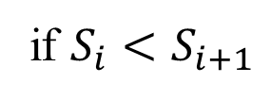
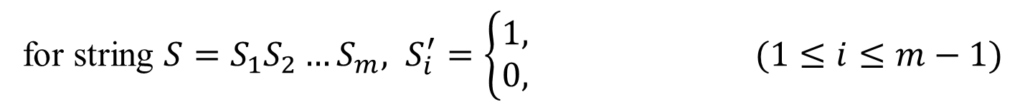

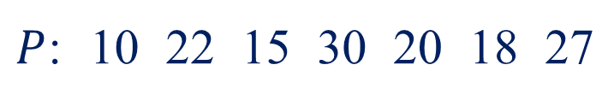
Preprocessing: binary number strings
for string $S=S_{1}S_{2}…S_{m}, S_{i}^{′}=\left\{\begin{aligned}1, \\ 0,\end{aligned}\right. (1≤i≤m−1)$
if $S_{i}<S_{i+1}$
otherwise
$T$: | 22 | 85 | 79 | 24 | 42 | 27 | 62 | 40 | 32 | 47 | 69 | 55 | 25
$T′$: | 1 | 0 | 0 | 1 | 0 | 1 | 0 | 0 | 1 | 1 | 0 | 0
$P$: | 10 | 22 | 15 | 30 | 20 | 18 | 27
$P′$: | 1 | 0 | 1 | 0 | 0 | 1

Slide 9

Searching: get candidate matches
use any algorithm for exact string matching problem
=> given text $T′$ and pattern $P′$, find candidate matches
$T′$: | 1 | 0 | 0 | 1 | 0 | 1 | 0 | 0 | 1 | 1 | 0 | 0
$P′$: | 1 | 0 | 1 | 0 | 0 | 1

Slide 10
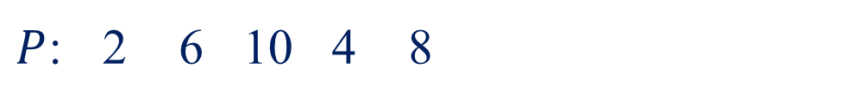
Another Example
$T$: | 5 | 10 | 20 | 15 | 25 | 35 | 20 | 30 | 15 | 30 | 25 | 20 | 15
$P$: | 2 | 6 | 10 | 4 | 8

Slide 11







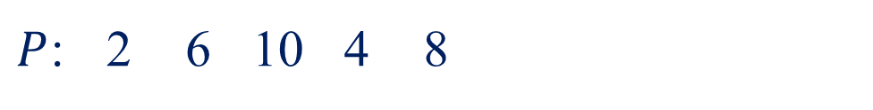

$T$: | 5 | 10 | 20 | 15 | 25 | 35 | 20 | 30 | 15 | 30 | 25 | 20 | 15
$T′$: | 1 | 1 | 0 | 1 | 1 | 0 | 1 | 0 | 1 | 0 | 0 | 0
$P$: | 2 | 6 | 10 | 4 | 8
$$order$$
1 | 3 | 5 | 2 | 4
$P′$: | 1 | 1 | 0 | 1
candidate:
$$T\left[1:5\right]$$
5 | 10 | 20 | 15 | 25
$$×$$
$$order$$
1 | 2 | 4 | 3 | 5
$$T\left[4:8\right]$$
15 | 25 | 35 | 20 | 30
$$◯$$
$$order$$
1 | 3 | 5 | 2 | 4

Slide 12
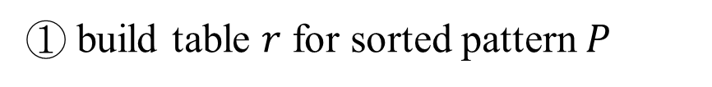

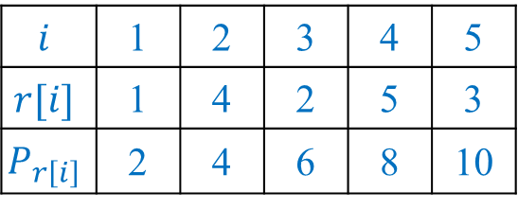
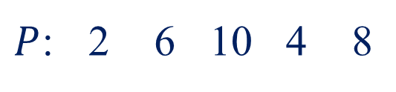
Verification
$P$: | 2 | 6 | 10 | 4 | 8
① build table $r$ for sorted pattern $P$
$$i$$ | 1 | 2 | 3 | 4 | 5
$$r[i]$$ | 1 | 4 | 2 | 5 | 3
$$P_{r\left[i\right]}$$ | 2 | 4 | 6 | 8 | 10
$P_{r\left[i\right]}≤$ $P_{r\left[j\right]}$, for each pair $i<j$

Slide 13



Verification
$P$: | 2 | 6 | 10 | 4 | 8
($1≤i≤m−1)$
② for each candidate, compare $T_{j−1+r[i]} \& T_{j−1+r[i+1]}$
if $T_{j−1+r[i]}> T_{j−1+r[i+1]}$
$$i$$ | 1 | 2 | 3 | 4 | 5
$$r[i]$$ | 1 | 4 | 2 | 5 | 3
$$P_{r\left[i\right]}$$ | 2 | 4 | 6 | 8 | 10
means mismatch, then discard it
5 < 15
candidate:
$$T\left[1:5\right]$$
5 | 10 | 20 | 15 | 25

Slide 14

Verification
$P$: | 2 | 6 | 10 | 4 | 8
($1≤i≤m−1)$
② for each candidate, compare $T_{j−1+r[i]} \& T_{j−1+r[i+1]}$
if $T_{j−1+r[i]}> T_{j−1+r[i+1]}$
$$i$$ | 1 | 2 | 3 | 4 | 5
$$r[i]$$ | 1 | 4 | 2 | 5 | 3
$$P_{r\left[i\right]}$$ | 2 | 4 | 6 | 8 | 10
means mismatch, then discard it
15 < 20 < $\text{2}\text{5 < }\text{30}\text{ < }\text{35}$
15 > 10
candidate:
$$T\left[1:5\right]$$
5 | 10 | 20 | 15 | 25
$$×$$
$$T\left[4:8\right]$$
15 | 25 | 35 | 20 | 30
$$◯$$

Slide 15
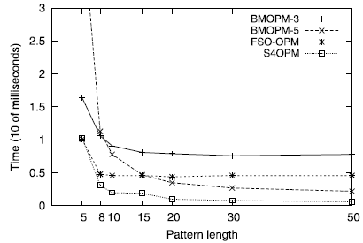
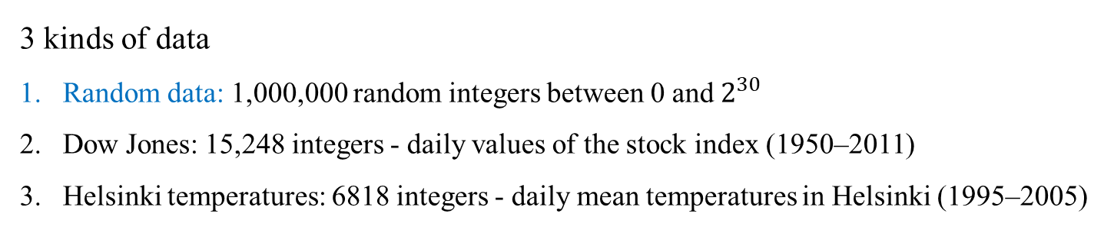
Experiments (1/2)
Execution times of algorithms (Dow Jones)
3 kinds of data
Random data: 1,000,000 random integers between 0 and $2^{30}$
Dow Jones: 15,248 integers - daily values of the stock index (1950–2011)
Helsinki temperatures: 6818 integers - daily mean temperatures in Helsinki (1995–2005)
Notes:
他們的演算法配合不同的filter(exact pattern matching algorithm)

Slide 16
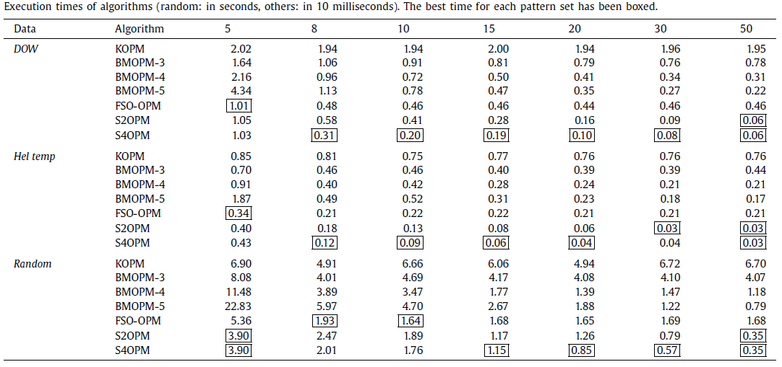
Experiments (2/2)

Slide 17
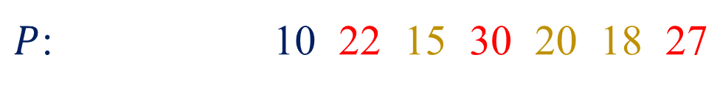
$T$: | 22 | 85 | 79 | 24 | 42 | 27 | 62 | 40 | 32 | 47 | 69 | 55 | 25
$T′$: | 1 | 0 | 0 | 1 | 0 | 1 | 0 | 0 | 1 | 1 | 0 | 0
$P$: |  |  |  | 10 | 22 | 15 | 30 | 20 | 18 | 27
$P′$: |  |  |  | 1 | 0 | 1 | 0 | 0 | 1

