Slide 1
DTW-based Authentication for Wireless Medical Device Security
Heena Rathore, Abdulla Al-Ali, Amr Mohamed, Xiaojiang Du, Mohsen Guizani
14th International Wireless Communications & Mobile Computing Conference (IWCMC),2018, Pages 476 – 481, Limassol, Cyprus
Speaker: Jheng-Yan Lyu
Date: 2018.12.25

Slide 2
Abstract (1/2)
Wireless medical devices play an important role in providing safety and privacy to patients suffering from major health issues. These light-weight devices can be worn inside or outside the patient’s body and provide more convenience and reliable doctor-patient communication. However, the design, development, and usage of these devices play a critical role in present network paradigm. They are vulnerable to network threats and attacks which break the confidentiality, integrity and availability protocols in networking scenarios. Thus, it is important to have identification and authentication of only the authorized people who can operate the device.

Slide 3
Abstract (2/2)
This paper proposes Dynamic Time Warping (DTW) algorithm for providing trusted authentication and identification of only authorized people using ECG signal. Here, DTW algorithm is used to measure the correlation between different ECG signal records. Experiments were carried out to evaluate the proposed algorithm with a large database consisting of users of all ages, including abnormal ECG data and long span of time intervals between ECG recordings for evaluating the reliability of the proposed algorithm. Comparative evaluation of the proposed system showed that, it is not only efficient, but also light weight in comparison to the existing systems.

Slide 4
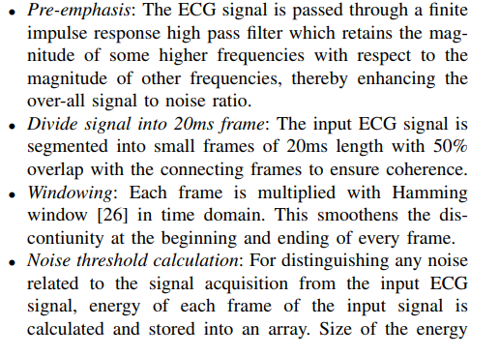
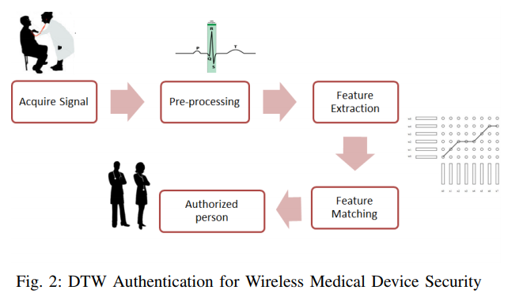
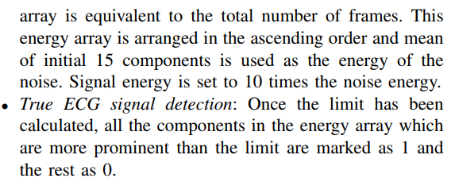
Pre-processing
T

Slide 5
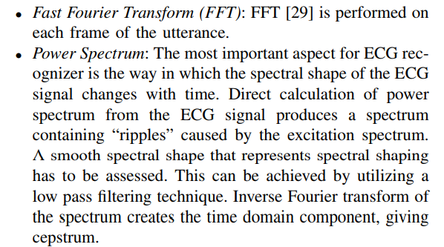
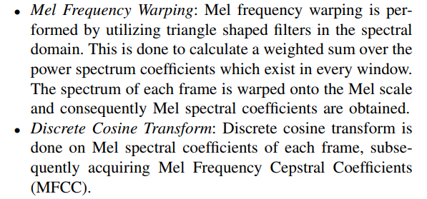
Feature Extraction
d

Slide 6
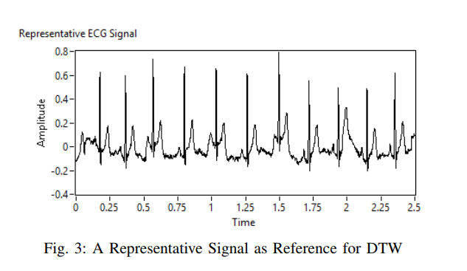
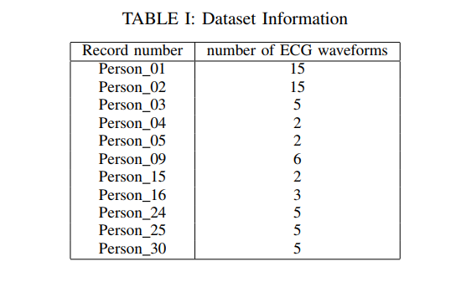
Experiment
Figure 3 shows the ECG signal for Person 1 which is used as the reference biometric signal. Using the database, a dataset containing 65 ECG waveforms was created. This dataset contains the waveforms as shown in Table I. As the test was executed, one waveform was randomly selected from the dataset.

Slide 7
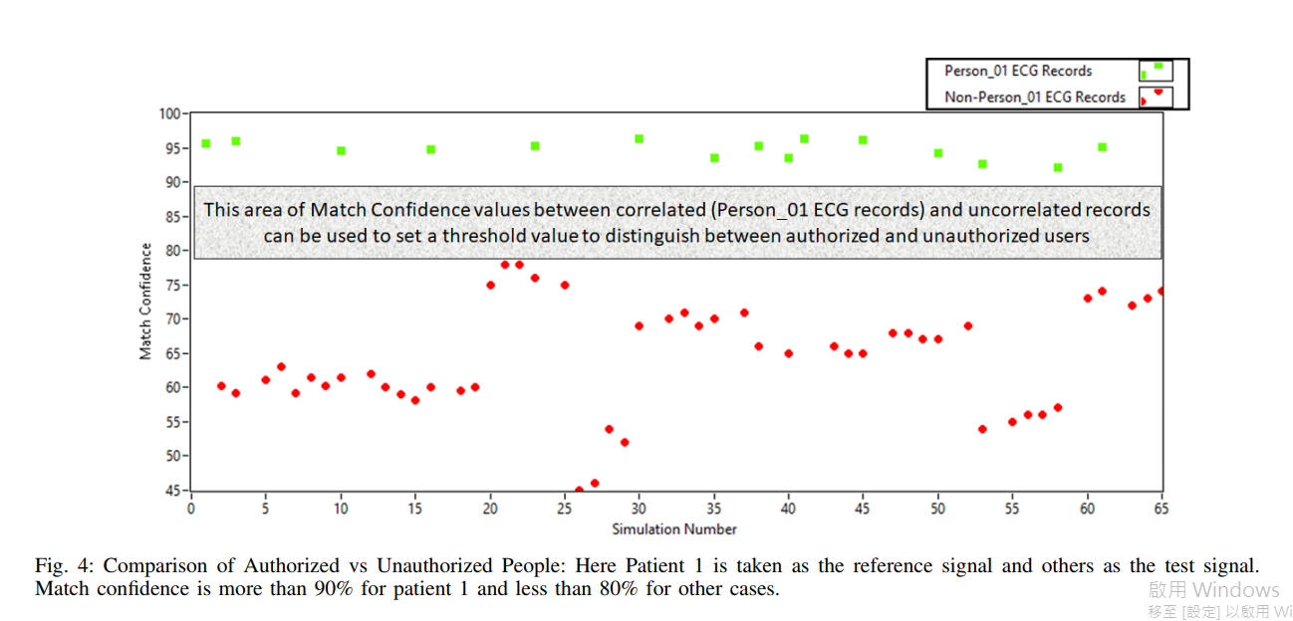
Results
w

Slide 8
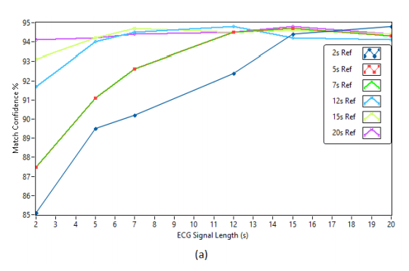
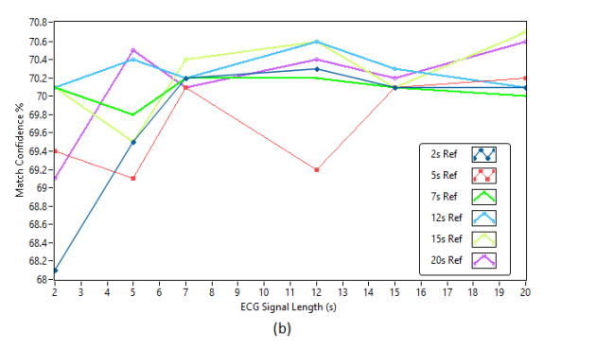
Experiment and Results
The effect of the length of the reference and ECG signals on the correlation parameter is studied next. To do so, we took three data sets. Similar to previous study, Record 0 of Person 0 was considered as the reference signal. Record 1 of Person 0 is considered for the correlated signal and Record 0 of Person 1 is considered for the uncorrelated signal. We got subsets of the 20s signals to create 6 different datasets of lengths 2s, 5s, 7s, 12s, 15s and finally 20s.

Slide 9
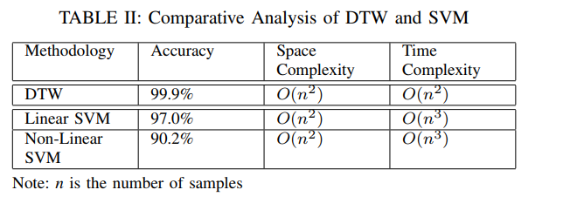
Comparative Analysis of DTW and SVM

Slide 10
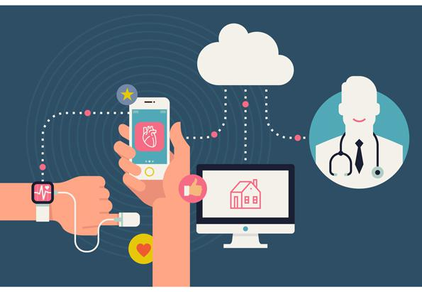
Wearable Medical Device(WMD)
d

