Slide 1
Camera Calibration Using Symmetric Objects
Xiaochun Cao and Hassan Foroosh
IEEE TRANSACTIONS ON IMAGE PROCESSING,
VOL. 15, NO. 11, MAY 2006
Reporter: Chiou-Yi Hor
Date: July 27, 2007

Slide 2
Introduction
This paper proposes a novel method for camera calibration using images of a mirror symmetric object.
Assuming unit aspect ratio (成像後像素長寬比) and zero skew (影像坐標彼此正交), the inter-image homography (為由世界座標轉到影像座標之矩陣) can be expressed as a function of only the principal point (鏡心之影像座標). By minimizing symmetric transfer errors, an accurate solution for the camera parameters (鏡心座標與焦距) can be estimated.
The effectiveness of this calibration method is that it utilizes inter-image constraints and does not require knowledge of the 3-D coordinates of feature points.

Slide 3
Review
Camera calibration
  It is a necessary step in 3D computer vision in order to extract metric information from 2D images and is roughly classified into two categories: photogrammetric (攝影測量的) calibration and self-calibration.
  Photogrammetric calibration
    Calibration is performed by observing a calibration object whose geometry in 3-D space is known with very good precision.
    Calibration can be done very efficiently but requires an expensive calibration apparatus, and an elaborate setup.
  Self-calibration
    It do not use any calibration object. Just by utilizing the rigidity of the scene to provide constraints for calibration.
    While this approach is very flexible, reliable results are not always obtained as too many parameters to estimate simultaneously.

Slide 4
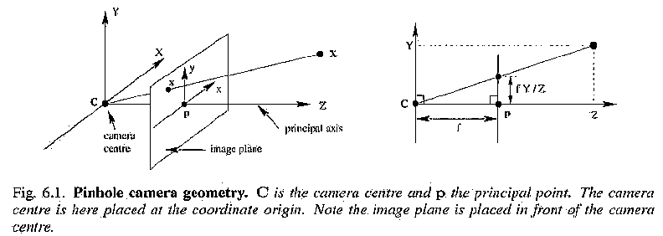

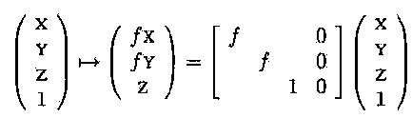
Review
The camera model
  Central projection using homogeneous coordinates

Slide 5
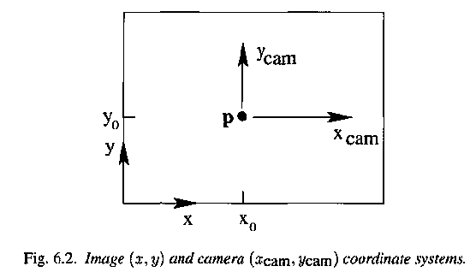

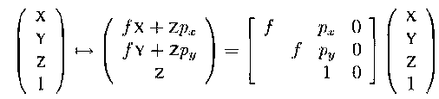
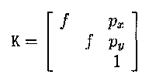
Review
The camera model with principal point offset
The camera calibration matrix and intrinsic (internal，內部的) parameters

Slide 6
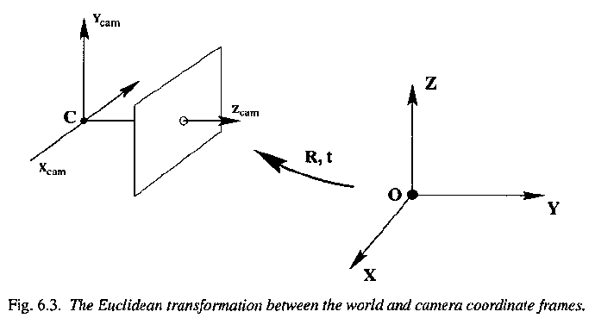
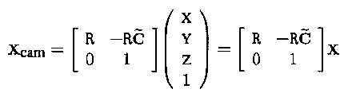

Review
The camera model with rotation & translation
The parameters of R and C which relate the camera orientation and position to a world coordinate system are called the external (extrinsic) parameters (外部參數) or the exterior orientation.

Slide 7

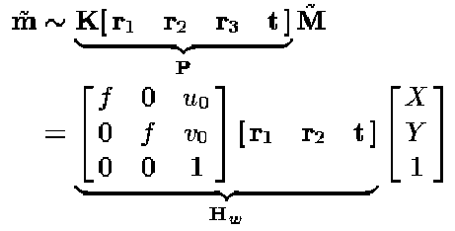
Review
Homography
  The homography matrix obtained by putting internal and external parameters together and depicts the relationship between points in camera and world coordinate system. The x and X are based on the camera and world coordinate system respectively.
  Usually, the Z coordinates of the model (or calibration) plane are assumed to be 0. Hence, the relationship between camera and world coordinates becomes

Slide 8


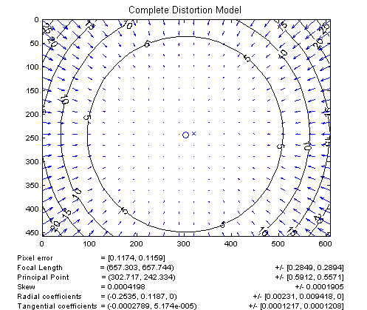
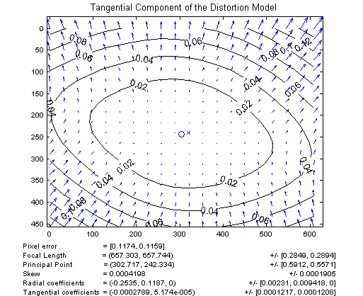
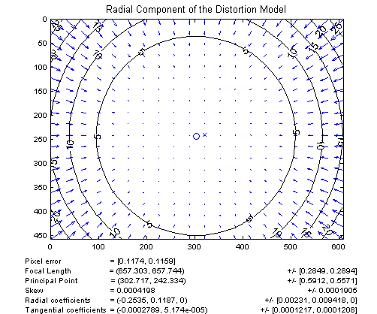
Review
Other intrinsic parameters: lens distortions
  Radial(徑向) & tangential(切線方向) distortions
v & v are image coordinates (corresponding to previous x & y) and r is sqrt(u^2+v^2)
=
+

Slide 9
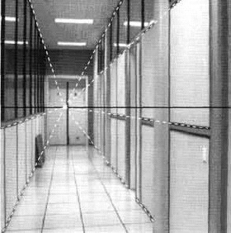
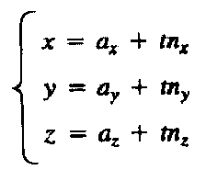
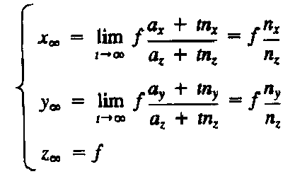
Review
Vanishing points
  Let us consider a straight line S in R³ through (a_{x},a_{y},a_{z}), parameterized as follows. The (n_{x},n_{y},n_{z}) represents S’s direction.
  The vanishing point of the straight line S is the point vs = (x∞,y∞,z∞) on the image plane (表示這條線沿伸至無窮遠時所成像位置) and does NOT depend on (a_{x},a_{y},a_{z}).

Slide 10
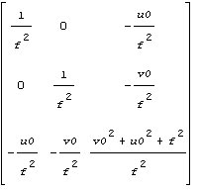


Review
Absolute conic
  The absolute conic is defined as ω=K^{-T}K⁻¹ where K and ω are
  The angle between two scene lines
    Let v1 and v2 be the vanishing points of two lines in an image, and let ω be the image of the absolute conic in the image. If θ is the angle between the two line directions, then

Slide 11
Review
Some notations
  The point x lies on the line l if and only x^{T}l = 0.
    A point x = (x, y)^{T} lies on the line 1 = (a, b, c)^{T} if and only if ax + by + c = 0. This may be written in terms of an inner product of vectors representing the point as (x, y, l)(a, b, c)^{T} = (x, y, 1)^{T}1 = 0.
  The intersection of two lines 1 and 1' is the point x = 1 x 1'.
    Given two lines 1 = (a, b, c)^{T} and 1' = (a', b ', c')^{T}, we wish to find their intersection. Define the vector x = 1 x 1', where x represents the vector or cross product. From the triple scalar product identity 1.(1 x 1') = l'.(l x 1') = 0, we see that l^{T}x = 1 ' ^{T}x = 0. Thus, if x is thought of as representing a point, then x lies on both lines 1 and 1', and hence is the intersection of the two lines.
  The cross product of two points represents a line.
    Given two points a = (xx, xy, 1)^{T} and a' = (xx', xy', 1)^{T}, then a x a' is a line passing through a and a' because a^{T}.(a x a')=0 and a'^{T}.(a x a')=0.
  For homogenous point ã = (x, y, w)^{T}, w=0 means ã is an infinity point.

Slide 12
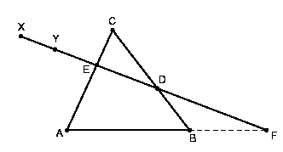

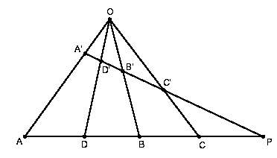

Review
Menelaus’s theorem
  Let ABC be a triangle and D, E, F be points on the lines BC, CA, AB respectively. If D, E, F are collinear, then
Invariant under perspectivity
  Let L1, L2 be two distinct lines on the plane. If A, B, C, D are distinct points on L and A', B', C', D' are distinct points on L2 , and if the lines AA', BB', CC', DD' are concurrent. According to Menelaus’s theorem, then

Slide 13
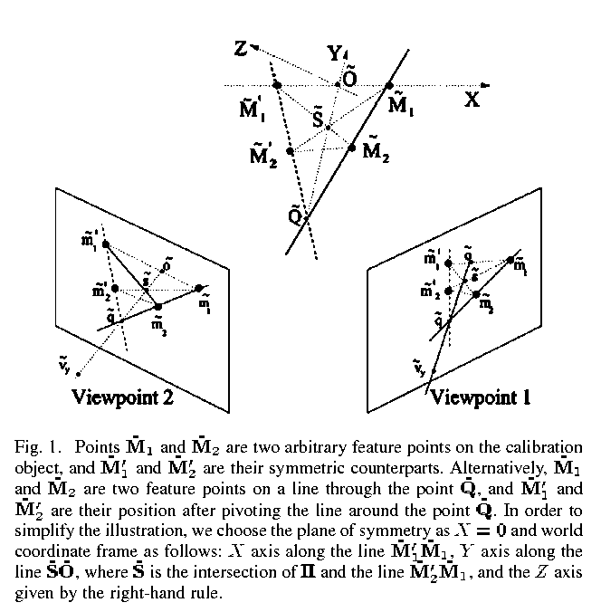
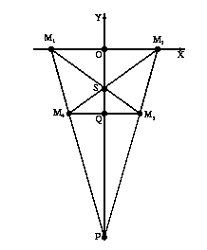
Methodology
The symmetric calibration object

Slide 14

Methodology
Simplification of Homography
  In this paper, the Z coordinates of the model (or calibration) plane are assumed to be 0. Hence, the relationship between camera and world coordinates becomes

Slide 15

Methodology
The reduced homography
  By applying [X,Y,1]^{T} with [1,0,0]^{T}, [0,1,0]^{T}, and [0,0,1]^{T} into the projective equation, we obtain
  Where v_{x}~[ v_{xx} v_{xy} 1 ]^{T} and v_{y}~[ v_{yx} v_{yy} 1 ]^{T} are the homogeneous x and y vanishing points in the image coordinate system, and õ~[ o_{x} o_{y} 1 ]^{T} is the homogeneous image point corresponding to the projection of the world origin O.

Slide 16
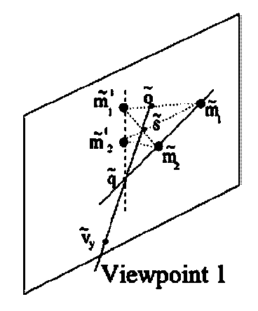
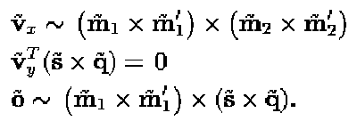



Methodology
Formulate v_{y} in terms of f, u₀, v₀
  By observing the geometry, we obtain
  By utilizing the relationship between vanishing points and absolute conic, v_{y} is expressed in terms of f, u₀ & v₀
90º

Slide 17
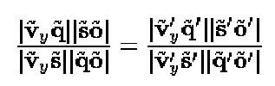
Methodology
Formulate f in terms of u₀, v₀
  By using the property of invariant under perspectivity, we obtain
  Because v_{y} depends on f, u₀ and v₀, by using the above constraint, f can be formulated in terms of u₀ and v₀

Slide 18



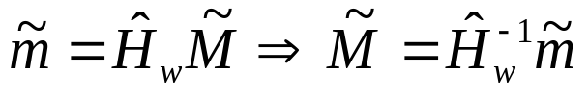
Methodology
Formulate H_{w} in terms of u₀, v₀
  v_{x}~K[ r1 r2 r3 t][1 0 0 0]^{T}=Kr₁ (similarly v_{y}~Kr₂), hence
  The r₁ = [r₁₁,r₂₁,r₃₁]^{T} and r₂ = [r₂₁,r₂₂,r₃₂]^{T}. The only unknow in Hw is tz.
  Assume tz=1 in one (reference) viewpoint. This causes
  Using the above homography to calculate estimated world points

Slide 19
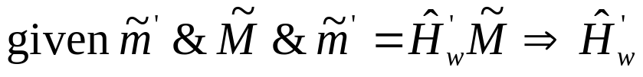
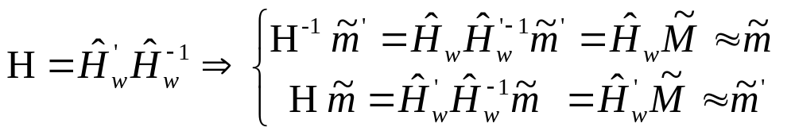

Methodology
Formulate H_{w} in terms of u₀, v₀
  Using estimated world points to calculate the homography in other viewpoints
  Transfer image points in other viewpoints to the reference viewpoint using inter-image homography H
  Minimizing the symmetric transfer error function by Levenberg-Marquardt algorithm to obtain c=(u₀,v₀)

Slide 20
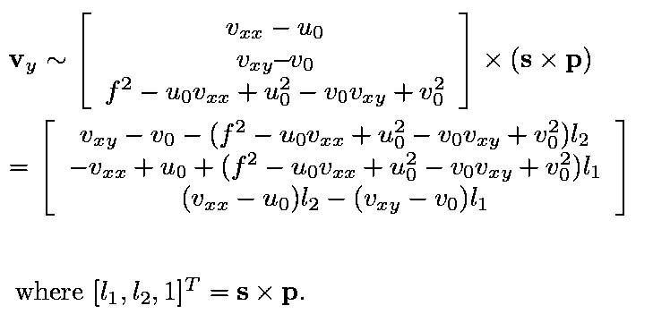
Methodology
Calculate other parameter by u₀ & v₀
  Calculate f.
  Calculate v_{y}

Slide 21
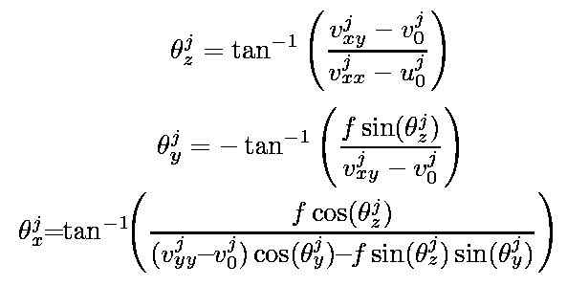
Methodology
Calculate other parameter by u₀ & v₀
  Calculate rotation angle and rotation matrix R
  Calculate t_{x}’/t_{z} & t_{y}’/t_{z} from the homographies in other viewpoints

Slide 22
Results
Experiment 1
  Input: synthetic data, several viewpoints.
    f = 1020, image resolution is 640x480, principal point at ( 316 243).
    The 3-D world points are M₁=[-75,0,0]^{T}, M₂=[-45,-150,0]^{T}
    M₁’=[75,0,0]^{T}, M₂’=[45,-150,0]^{T}
    Zero-mean Gaussian noise with σ=0.1~1.5pixel.
  Result:
    For noise level of 1.5 pixels, the relative error of f is 1.97%.
    The maximum relative error of principal points is around 0.9%.
    Relative errors less than 0.22% for t_{x} and 0.31% for t_{y}.
    Absolute errors less than 0.82 for θ_{x}, less than 0.33 for θ_{y}, and less than 0.09 for θ_{z}.

Slide 23
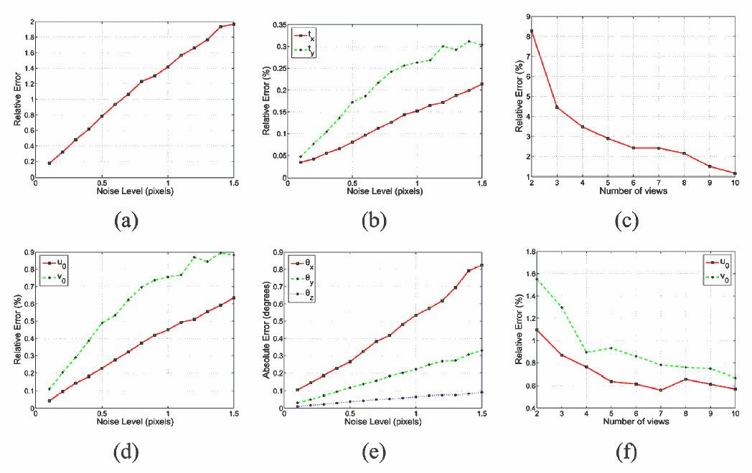
Results
Experiment 1

Slide 24
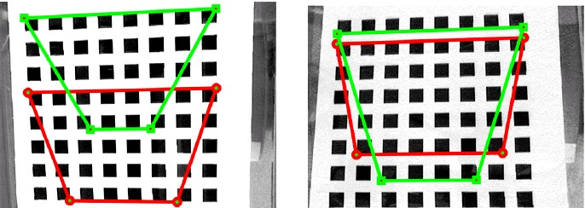
Results
Experiment 2-1
  Input: 2D real data from 5 viewpoints.

Slide 25
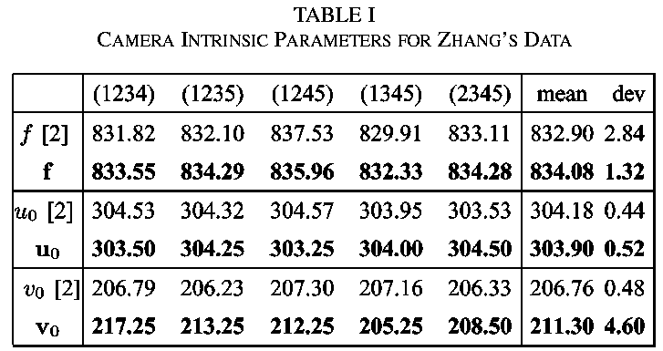
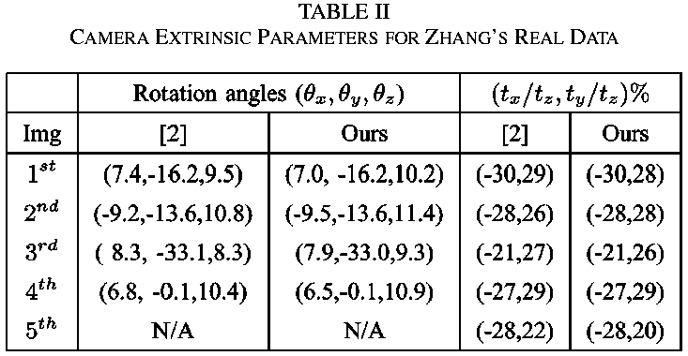
Results
Experiment 2-1
  Input: 2D real data from 5 viewpoints.
  Result: Compared with Zhang’s method.

Slide 26
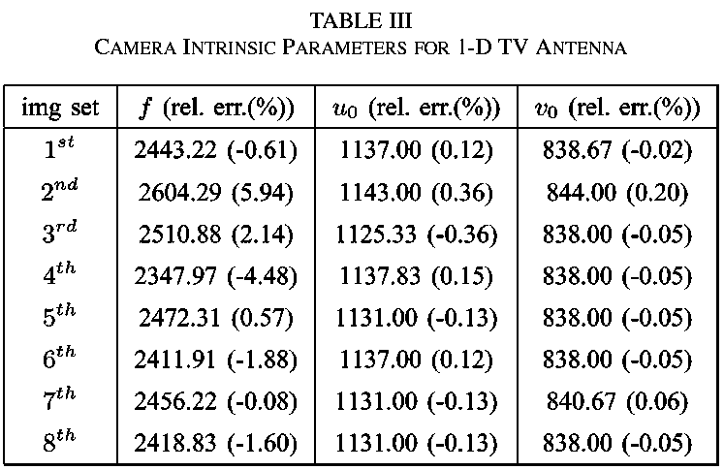
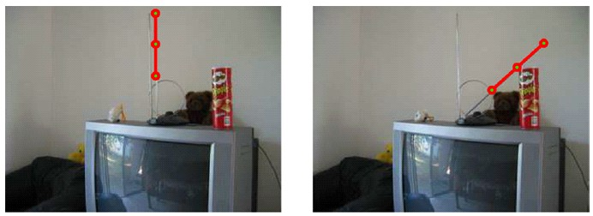
Results
Experiment 2-2
  Input: 1D real data from 8 viewpoints.
  Results:

Slide 27
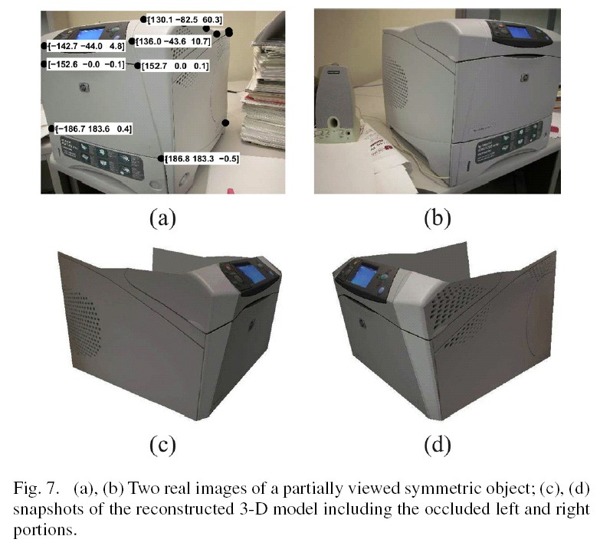
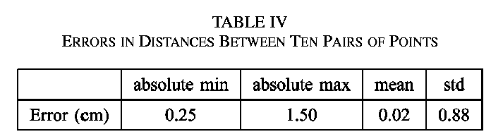
Results
Experiment 3
  Input: A printer from 2 viewpoints.
  Results: Recovered by the optimal triangulation method.

