Slide 1
Simple and Efficient Pattern Matching Algorithms for Biological Sequences
Peyman Neamatollahi, Montassir Hadi, and Mahmoud Naghibzadeh
IEEE Access ( Volume: 8 ) 23 January 2020. P. 938-947
Presenter：Yu-Cheng Chang
Date：April 14, 2020

Slide 2
Abstract
The remarkable growth of biological data is a motivation to accelerate the discovery of solutions in many domains of computational bioinformatics. In different phases of the computational pipelines, pattern matching is a very practical operation. For example, pattern matching enables users to find the locations of particular DNA subsequences in a database or DNA sequence. Furthermore, in these expanding biological databases, some patterns are updated over time. To perform faster searches, high-speed pattern matching algorithms are needed. The present paper introduces three pattern matching algorithms that are specially formulated to speed up searches on large DNA sequences. The proposed algorithms raise performance by utilizing word processing (in place of the character processing presented in previous works) and also by searching the least frequent word of the pattern in the sequence. In terms of time cost, the experimental results demonstrate the superiority of the presented algorithms over the other simulated algorithms.

Slide 3
3 Different Algorithm
FLPM：First-Last Pattern Matching Algorithm
PAPM：Processor-Aware Pattern Matching Algorithm
LFPM：Least-Frequency Pattern Matching Algorithm

Slide 4
FLPM：First-Last Pattern Matching Algorithm
Text
0 | 1 | 2 | 3 | 4 | 5 | 6 | 7 | 8 | 9 | 10 | 11 | 12 | 13 | 14 | 15 | 16 | 17 | 18 | 19 | 20 | 21 | 22 | 23 | 24 | 25
A | G | C | C | C | A | A | C | A | T | T | T | A | A | G | T | T | T | A | A | A | A | A | T | C | A
A | G | C | G | T | A | A | A | A | T | A | C | A | G | A | A | G | C | T | G | G | A | A | G | C | A
26 | 27 | 28 | 29 | 30 | 31 | 32 | 33 | 34 | 35 | 36 | 37 | 38 | 39 | 40 | 41 | 42 | 43 | 44 | 45 | 46 | 47 | 48 | 49 | 50 | 51
Pattern
A | A | G | C | G | T | A
0 | 1 | 2 | 3 | 4 | 5 | 6
Window_Index
0 | 6 | 12 | 13 | 19 | 20 | 25 | 26 | 32 | 34 | 41
Only record the start index
Match_Index
 |  | 25

Slide 5
FLPM：First-Last Pattern Matching Algorithm
Text
0 | 1 | 2 | 3 | 4 | 5 | 6 | 7 | 8 | 9 | 10 | 11 | 12 | 13 | 14 | 15 | 16 | 17 | 18 | 19 | 20 | 21 | 22 | 23 | 24 | 25
A | G | C | C | C | A | A | C | A | T | T | T | A | A | G | T | T | T | A | A | A | A | A | T | C | A
A | G | C | G | T | A | A | A | A | T | A | C | A | G | A | A | G | C | T | G | G | A | A | G | C | A
26 | 27 | 28 | 29 | 30 | 31 | 32 | 33 | 34 | 35 | 36 | 37 | 38 | 39 | 40 | 41 | 42 | 43 | 44 | 45 | 46 | 47 | 48 | 49 | 50 | 51
Pattern
A | A | G | C | G | T | A
0 | 1 | 2 | 3 | 4 | 5 | 6
Window
0 | A | G | C | C | C | A | A
6 | A | C | A | T | T | T | A
12 | A | A | G | T | T | T | A
13 | A | G | T | T | T | A | A
19 | A | A | A | A | T | C | A
20 | A | A | A | T | C | A | A
Window
25 | A | A | G | C | G | T | A
26 | A | G | C | G | T | A | A
32 | A | A | A | T | A | C | A
34 | A | T | A | C | A | G | A
41 | A | G | C | T | G | G | A

Slide 6
PAPM：Processor-Aware Pattern Matching Algorithm
Text
0 | 1 | 2 | 3 | 4 | 5 | 6 | 7 | 8 | 9 | 10 | 11 | 12 | 13 | 14 | 15 | 16 | 17 | 18 | 19 | 20 | 21 | 22 | 23 | 24 | 25
A | G | C | C | C | A | A | C | A | T | T | T | A | A | G | T | T | T | A | A | A | A | A | T | C | A
A | G | C | G | T | A | A | A | A | T | A | C | A | G | A | A | G | C | T | G | G | A | A | G | C | A
26 | 27 | 28 | 29 | 30 | 31 | 32 | 33 | 34 | 35 | 36 | 37 | 38 | 39 | 40 | 41 | 42 | 43 | 44 | 45 | 46 | 47 | 48 | 49 | 50 | 51
Pattern
A | A | G | C | G | T | A
0 | 1 | 2 | 3 | 4 | 5 | 6
Window_Index
 |  | 25 | 40
Window
25 | A | A | G | C | G | T | A
40 | A | A | G | C | T | G | G

Slide 7
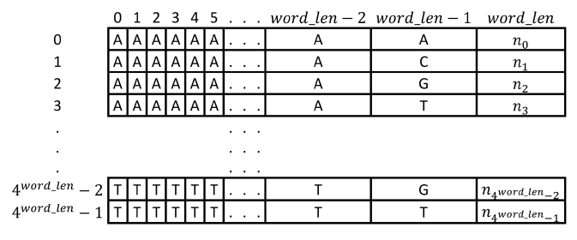
LFPM：Last-Frequency Pattern Matching Algorithm
Text
0 | 1 | 2 | 3 | 4 | 5 | 6 | 7 | 8 | 9 | 10 | 11 | 12 | 13 | 14 | 15 | 16 | 17 | 18 | 19 | 20 | 21 | 22 | 23 | 24 | 25
A | G | C | C | C | A | A | C | A | T | T | T | A | A | G | T | T | T | A | A | A | A | A | T | C | A
A | G | C | G | T | A | A | A | A | T | A | C | A | G | A | A | G | C | T | G | G | A | A | G | C | A
26 | 27 | 28 | 29 | 30 | 31 | 32 | 33 | 34 | 35 | 36 | 37 | 38 | 39 | 40 | 41 | 42 | 43 | 44 | 45 | 46 | 47 | 48 | 49 | 50 | 51
Pattern
A | A | G | C | G | T | A
0 | 1 | 2 | 3 | 4 | 5 | 6
HRG
785
144
146
67

Slide 8
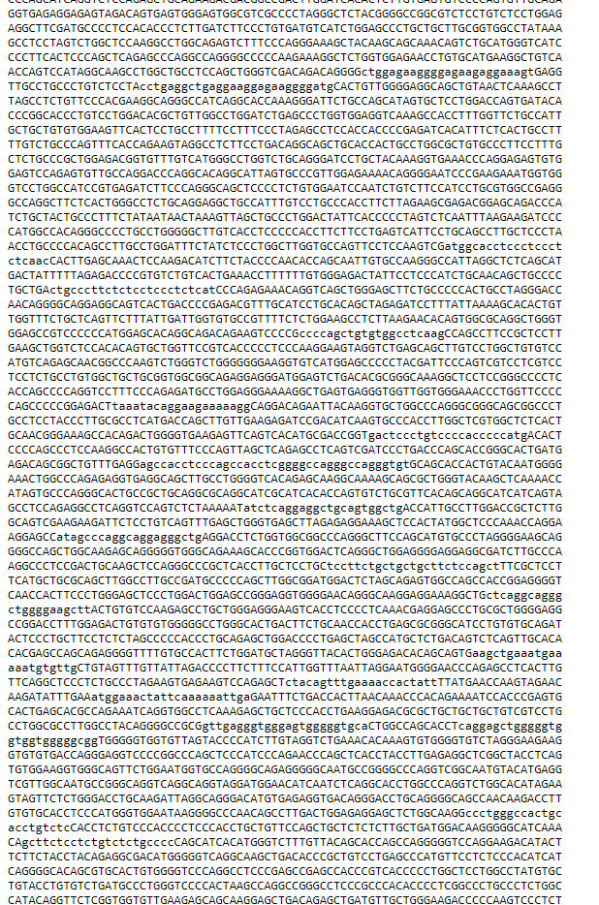
HRG：Human Reference Genome
Frequency Table
 | 0 | 1 | 2 | 3 | 4
0 | A | A | A | A | n₀
1 | A | A | A | C | n₁
2 | A | A | A | T | n₂
3 | A | A | A | G | n₃
. | . | . | . | . | .
. | . | . | . | . | .
. | . | . | . | . | .
4^{word_len}-2 | T | T | T | G | n₄^{word_len}₋₂
4^{word_len}-1 | T | T | T | T | n₄^{word_len}₋₁
(|Σ|^{word_len}) * (word_len + 1)
GAgcttct…
Notes:
https://www.ncbi.nlm.nih.gov/genome/guide/human/

Slide 9
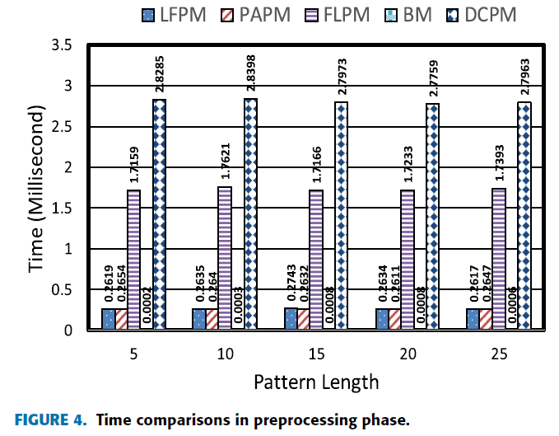
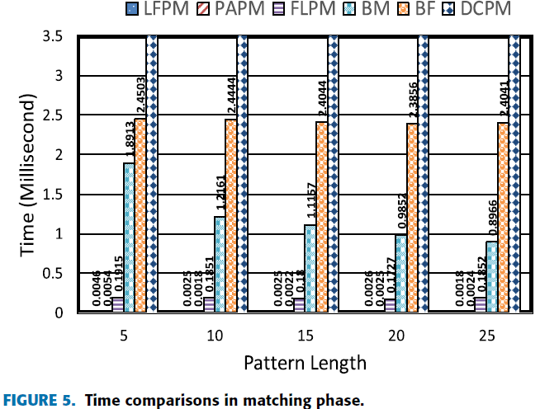
Comparison
FLPM：First-Last Pattern Matching Algorithm
PAPM：Processor-Aware Pattern Matching Algorithm
LFPM：Last-Frequency Pattern Matching Algorithm

Slide 10
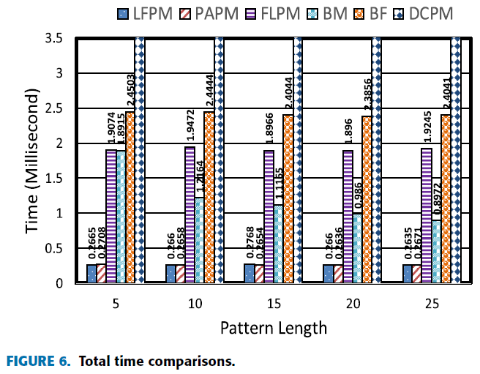
Comparison
FLPM：First-Last Pattern Matching Algorithm
PAPM：Processor-Aware Pattern Matching Algorithm
LFPM：Last-Frequency Pattern Matching Algorithm

Slide 11
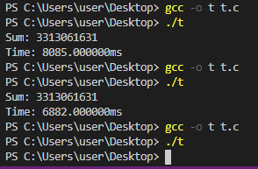
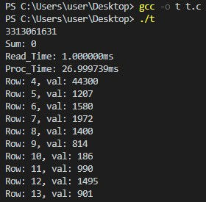

How?
純讀檔
處理100MB的資料
一次1KB
一次1MB
一次0.5GB

