Slide 1
Faster STR-EC-LCS Computation
Kohei Yamada, Yuto Nakashima, Shunsuke Inenaga, Hideo Bannai and Masayuki Takeda
46th International Conference on Current Trends in Theory and Practice of Informatics,
SOFSEM 2020, Limassol, Cyprus, January 20–24, 2020 pp. 125-135
Presenter: Du-Cheng Wu
Date: Apr. 14, 2020

Slide 2
Abstract(1/2)
The longest common subsequence (LCS) problem is a central problem in stringology that finds the longest common subsequence of given two strings A and B. More recently, a set of four constrained LCS problems (called generalized constrained LCS problem) were proposed by Chen and Chao [J. Comb. Optim, 2011]. In this paper, we consider the substring-excluding constrained LCS (STR-EC-LCS) problem. A string Z is said to be an STR-EC-LCS of two given strings A and B excluding P if, Z is one of the longest common subsequences of A and B that does not contain P as a substring. Wang et al. proposed a dynamic programming solution which computes an STR-EC-LCS in O(mnr) time and space where m = |A|, n = |B|, r = |P| [Inf. Process. Lett., 2013].

Slide 3
Abstract(2/2)
In this paper, we show a new solution for the STR-EC-LCS problem. Our algorithm computes an STR-EC-LCS in O(n|Σ|+(L+1)(m−L+1)r) time where |Σ| ≤ min{m,n} denotes the set of distinct characters occurring in both A and B, and L is the length of the STR-EC-LCS. This algorithm is faster than the O(mnr)-time algorithm for short/long STR-EC-LCS (namely, L∈O(1) or m−L∈O(1) ), and is at least as efficient as the O(mnr)-time algorithm for all cases.

Slide 4
LCS
X = aabacab
Y = baabbcaa
LCS = aabca, aabaa

Slide 5
STR-EC-LCS
X = aabacab
Y = baabbcaa
P = aab
LCS = aabca, aabaa
STR-EC-LCS = aaca, aaaa, baca

Slide 6
STR-EC-LCS
Length Round | 0 | 1 | 2 | 3
1 | D_{0,0} | D_{1,1} | D_{2,2} | D_{3,3}
 | (0,0,0) | (1,2,1) | (2,3,2) | (3,4,3)
X = aabacab
Y = baabbcaa
P = aab
 | b | a | a | b | b | c | a | a
a |  | 1
a |  |  | 2
b |  |  |  | 3
a
c
a
b
k = the length of the longest prefix of P

Slide 7
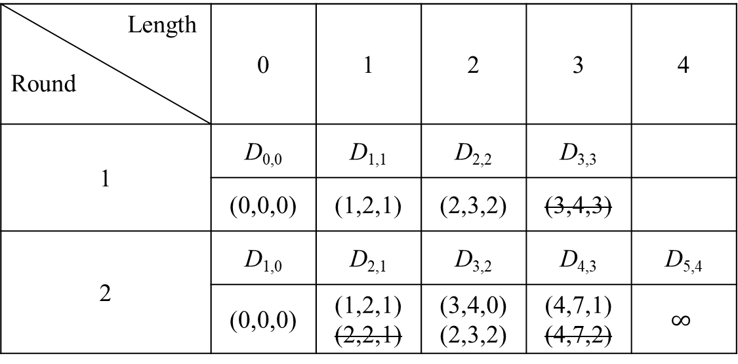
STR-EC-LCS
Length Round | 0 | 1 | 2 | 3 | 4
1 | D_{0,0} | D_{1,1} | D_{2,2} | D_{3,3}
 | (0,0,0) | (1,2,1) | (2,3,2) | (3,4,3)
2 | D_{1,0} | D_{2,1} | D_{3,2} | D_{4,3} | D_{5,4}
 | (0,0,0) | (1,2,1) (2,2,1) | (3,4,0) (2,3,2) | (4,7,1) (4,7,2) | $$∞$$
X = aabacab
Y = baabbcaa
P = aab
 | b | a | a | b | b | c | a | a
a |  | 1
a |  | 1 | 2
b |  |  |  | 2
a |  |  |  |  |  |  | 3
c
a
b

Slide 8
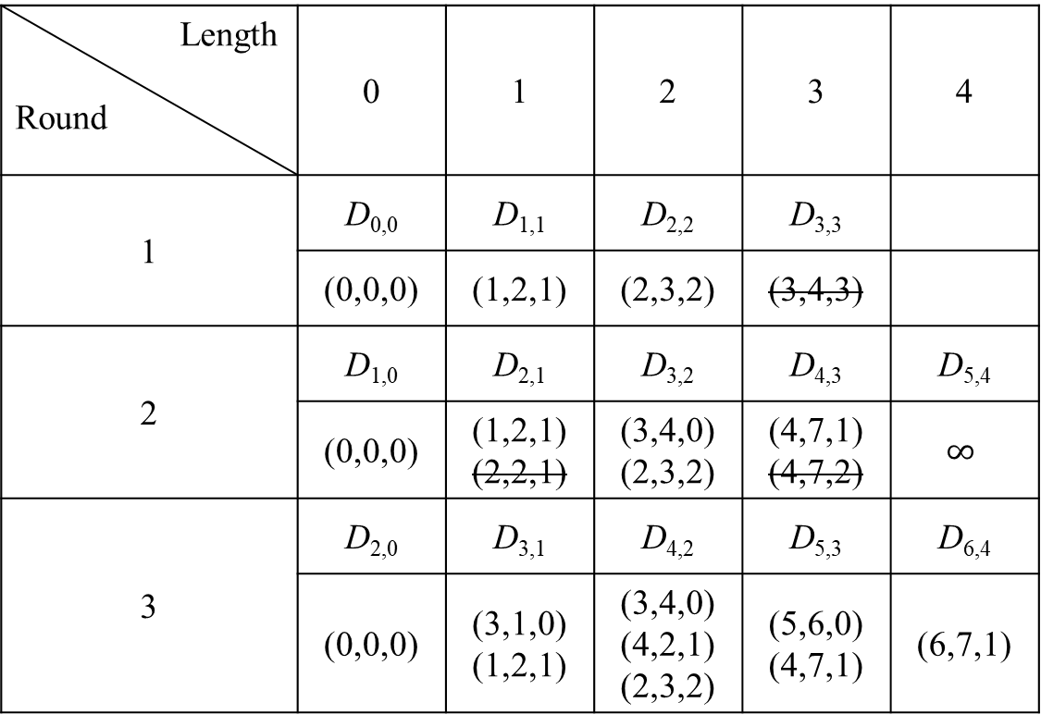
STR-EC-LCS
Length Round | 0 | 1 | 2 | 3 | 4
1 | D_{0,0} | D_{1,1} | D_{2,2} | D_{3,3}
 | (0,0,0) | (1,2,1) | (2,3,2) | (3,4,3)
2 | D_{1,0} | D_{2,1} | D_{3,2} | D_{4,3} | D_{5,4}
 | (0,0,0) | (1,2,1) (2,2,1) | (3,4,0) (2,3,2) | (4,7,1) (4,7,2) | $$∞$$
3 | D_{2,0} | D_{3,1} | D_{4,2} | D_{5,3} | D_{6,4}
 | (0,0,0) | (3,1,0) (1,2,1) | (3,4,0) (4,2,1) (2,3,2) | (5,6,0) (4,7,1) | (6,7,1)
X = aabacab
Y = baabbcaa
P = aab
 | b | a | a | b | b | c | a | a
a |  | 1
a |  | 1 | 2
b | 1 |  |  | 2
a |  | 2 |  |  |  |  | 3
c |  |  |  |  |  | 3
a |  |  |  |  |  |  | 4
b

Slide 9
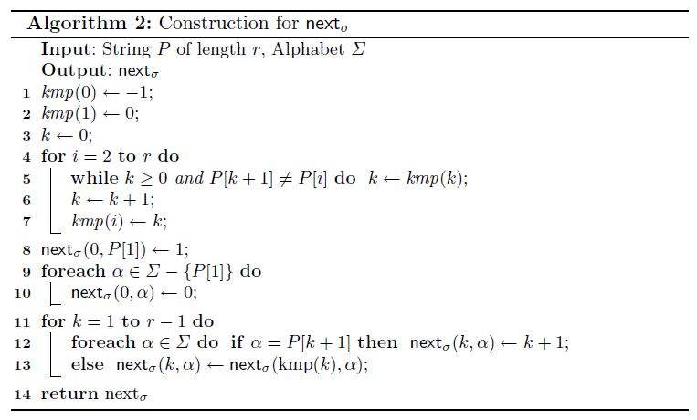
STR-EC-LCS time complexity
O(n|Σ| + (L+1)(m-L+1)r)

