Slide 1
On the Common Substring Alignment Problem
Gad M. Landau, Michal Ziv-Ukelson
Journal of Algorithms 41, 338–359 (2001)
Presenter: Shao-Xuan Lee
Date: Apr. 21, 2020

Slide 2
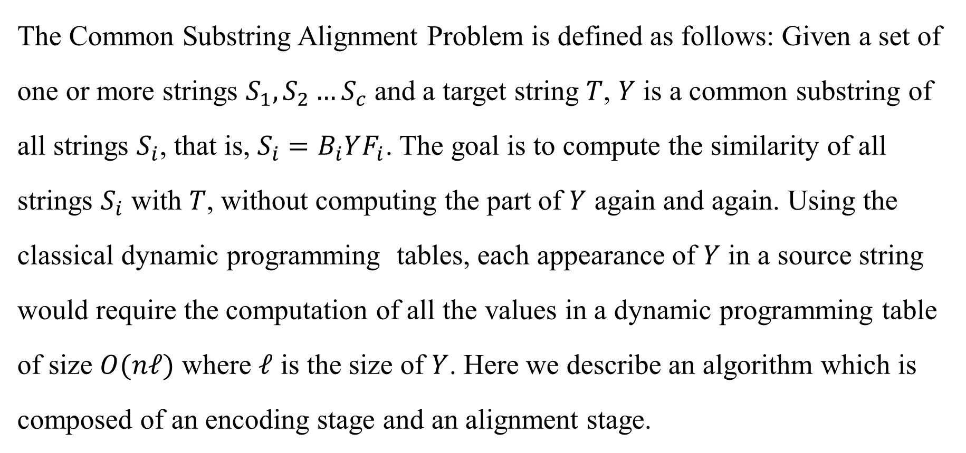
Abstract(1/2)
The Common Substring Alignment Problem is defined as follows: Given a set of one or more strings $S_{1},S_{2}…S_{c}$ and a target string $T$, $Y$ is a common substring of all strings $S_{i}$, that is, $S_{i}=B_{i}YF_{i}$. The goal is to compute the similarity of all strings $S_{i}$ with $T$, without computing the part of $Y$ again and again. Using the classical dynamic programming tables, each appearance of $Y$ in a source string would require the computation of all the values in a dynamic programming table of size $O(nℓ)$ where $ℓ$ is the size of $Y$. Here we describe an algorithm which is composed of an encoding stage and an alignment stage.

Slide 3
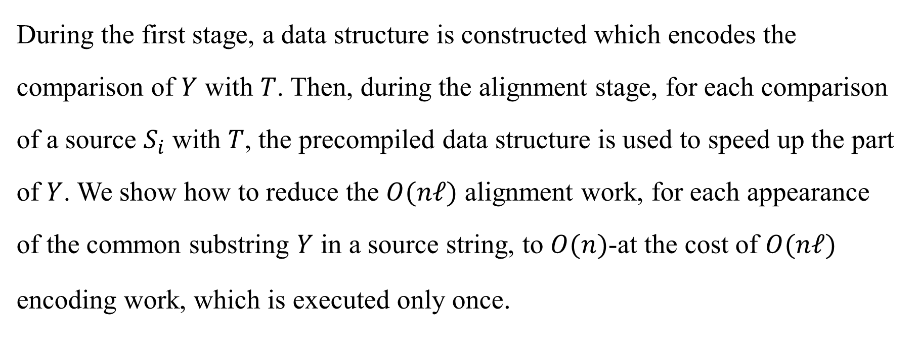
Abstract(2/2)
During the first stage, a data structure is constructed which encodes the comparison of $Y$ with $T$. Then, during the alignment stage, for each comparison of a source $S_{i}$ with $T$, the precompiled data structure is used to speed up the part of $Y$. We show how to reduce the $O(nℓ)$ alignment work, for each appearance of the common substring $Y$ in a source string, to $O(n)$-at the cost of $O(nℓ)$ encoding work, which is executed only once.

Slide 4
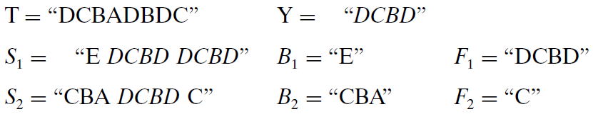
Common Substring Alignment Problem

Slide 5
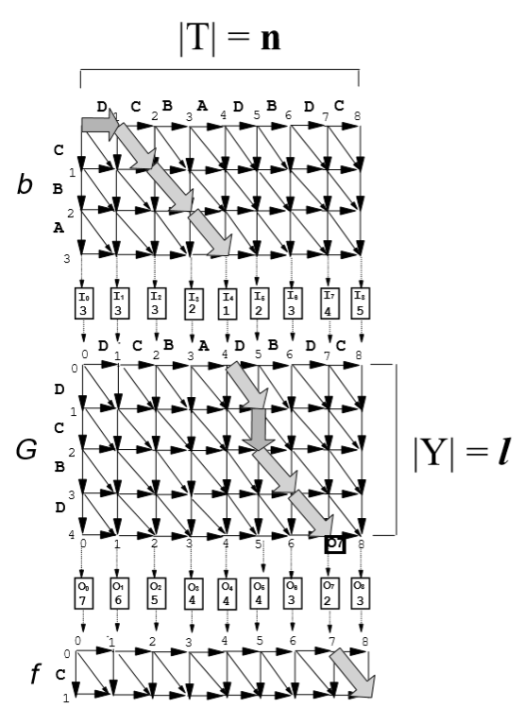

Slide 6
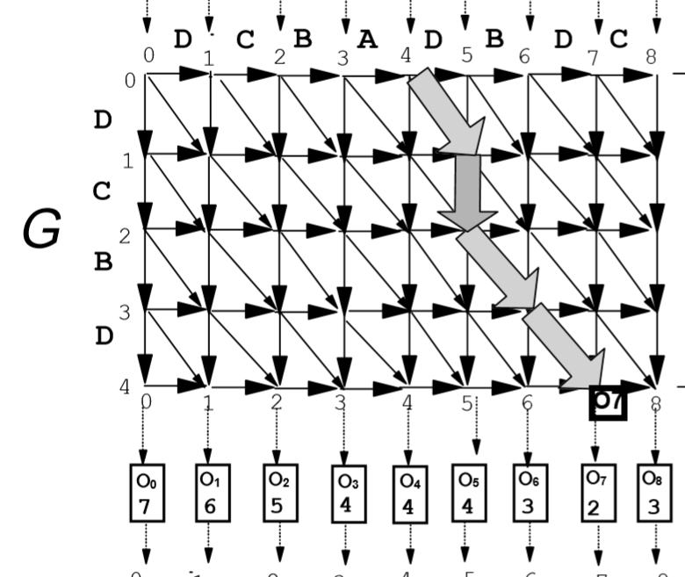
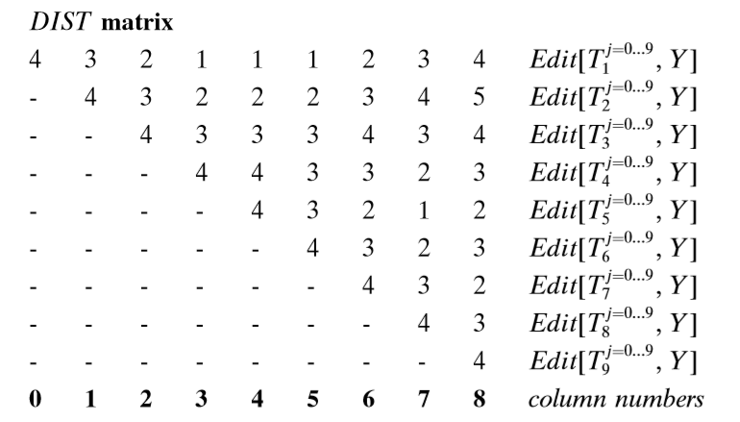

Slide 8
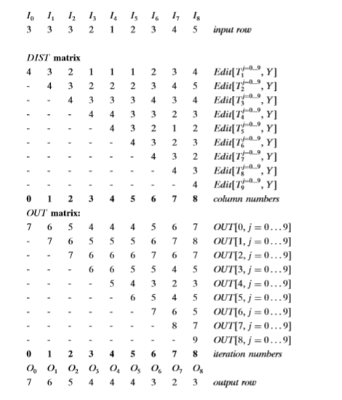

Slide 9
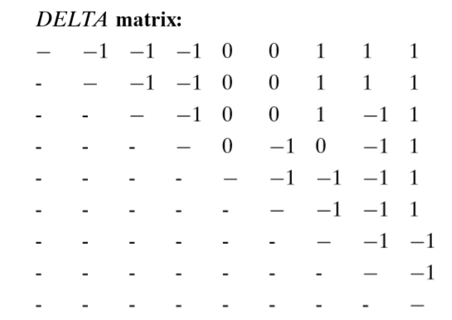
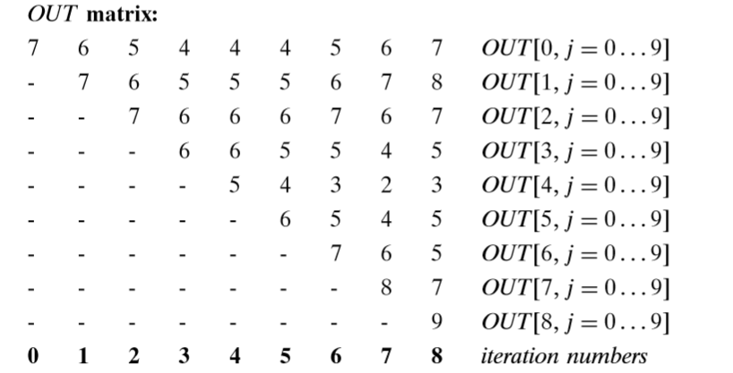

Slide 10
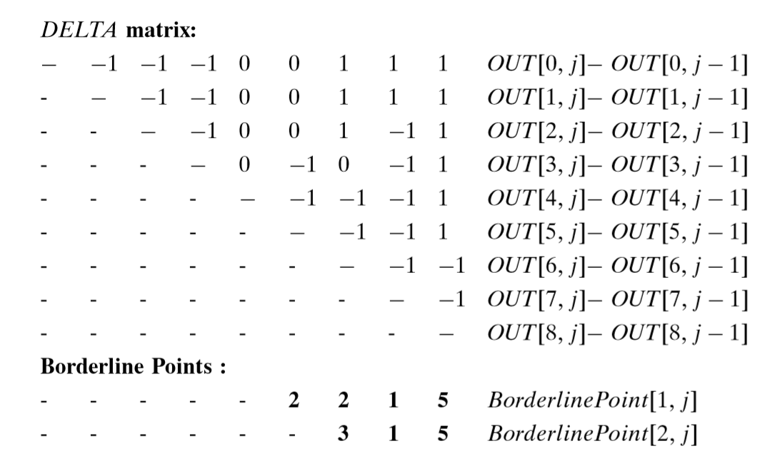

Slide 12
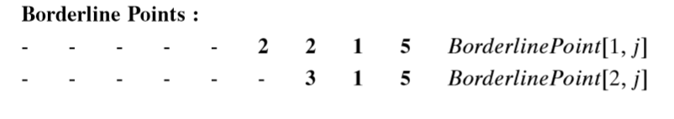
 | 0 | 1 | 2 | 3 | 4 | 5 | 6 | 7 | 8
0 | 7 | 6 | 5 | 4 | 4 | 4 | 5 | 6 | 7
1 |  | 7 | 6 | 5 | 5 | 5 | 6 | 7 | 8
2 |  |  | 7 | 6 | 6 | 6 | 7 | 6 | 7
3 |  |  |  | 6 | 6 | 5 | 5 | 4 | 5
4 |  |  |  |  | 5 | 4 | 3 | 2 | 3
5 |  |  |  |  |  | 6 | 5 | 4 | 5
6 |  |  |  |  |  |  | 7 | 6 | 5
7 |  |  |  |  |  |  |  | 8 | 7
8 |  |  |  |  |  |  |  |  | 9

Slide 13
 | 0 | 1 | 2 | 3 | 4 | 5 | 6 | 7 | 8
0 | 7/0 | 6 | 5 | 4 | 4 | 4 | 5 | 6 | 7
1 |  | 7 | 6 | 5 | 5 | 5 | 6 | 7 | 8
2 |  |  | 7 | 6 | 6 | 6 | 7 | 6 | 7
3 |  |  |  | 6 | 6 | 5 | 5 | 4 | 5
4 |  |  |  |  | 5 | 4 | 3 | 2 | 3
5 |  |  |  |  |  | 6 | 5 | 4 | 5
6 |  |  |  |  |  |  | 7 | 6 | 5
7 |  |  |  |  |  |  |  | 8 | 7
8 |  |  |  |  |  |  |  |  | 9

Slide 14
 | 0 | 1 | 2 | 3 | 4 | 5 | 6 | 7 | 8
0 | 7/0 | 6/1 | 5 | 4 | 4 | 4 | 5 | 6 | 7
1 |  | 7/0 | 6 | 5 | 5 | 5 | 6 | 7 | 8
2 |  |  | 7 | 6 | 6 | 6 | 7 | 6 | 7
3 |  |  |  | 6 | 6 | 5 | 5 | 4 | 5
4 |  |  |  |  | 5 | 4 | 3 | 2 | 3
5 |  |  |  |  |  | 6 | 5 | 4 | 5
6 |  |  |  |  |  |  | 7 | 6 | 5
7 |  |  |  |  |  |  |  | 8 | 7
8 |  |  |  |  |  |  |  |  | 9

Slide 15
 | 0 | 1 | 2 | 3 | 4 | 5 | 6 | 7 | 8
0 | 7 | 6/1 | 5/1 | 4 | 4 | 4 | 5 | 6 | 7
1 |  | 7/0 | 6/1 | 5 | 5 | 5 | 6 | 7 | 8
2 |  |  | 7/0 | 6 | 6 | 6 | 7 | 6 | 7
3 |  |  |  | 6 | 6 | 5 | 5 | 4 | 5
4 |  |  |  |  | 5 | 4 | 3 | 2 | 3
5 |  |  |  |  |  | 6 | 5 | 4 | 5
6 |  |  |  |  |  |  | 7 | 6 | 5
7 |  |  |  |  |  |  |  | 8 | 7
8 |  |  |  |  |  |  |  |  | 9

Slide 16
 | 0 | 1 | 2 | 3 | 4 | 5 | 6 | 7 | 8
0 | 7 | 6 | 5/1 | 4/1 | 4 | 4 | 5 | 6 | 7
1 |  | 7 | 6/1 | 5/1 | 5 | 5 | 6 | 7 | 8
2 |  |  | 7/0 | 6/0 | 6 | 6 | 7 | 6 | 7
3 |  |  |  | 6/0 | 6 | 5 | 5 | 4 | 5
4 |  |  |  |  | 5 | 4 | 3 | 2 | 3
5 |  |  |  |  |  | 6 | 5 | 4 | 5
6 |  |  |  |  |  |  | 7 | 6 | 5
7 |  |  |  |  |  |  |  | 8 | 7
8 |  |  |  |  |  |  |  |  | 9

Slide 17
 | 0 | 1 | 2 | 3 | 4 | 5 | 6 | 7 | 8
0 | 7 | 6 | 5/1 | 4/1 | 4 | 4 | 5 | 6 | 7
1 |  | 7 | 6/1 | 5/1 | 5 | 5 | 6 | 7 | 8
2 |  |  | 7/0 | 6/0 | 6 | 6 | 7 | 6 | 7
3 |  |  |  | 6/0 | 6 | 5 | 5 | 4 | 5
4 |  |  |  |  | 5 | 4 | 3 | 2 | 3
5 |  |  |  |  |  | 6 | 5 | 4 | 5
6 |  |  |  |  |  |  | 7 | 6 | 5
7 |  |  |  |  |  |  |  | 8 | 7
8 |  |  |  |  |  |  |  |  | 9

Slide 18
 | 0 | 1 | 2 | 3 | 4 | 5 | 6 | 7 | 8
0 | 7 | 6 | 5 | 4/1 | 4/1 | 4 | 5 | 6 | 7
1 |  | 7 | 6 | 5/1 | 5/1 | 5 | 6 | 7 | 8
2 |  |  | 7 | 6/0 | 6 | 6 | 7 | 6 | 7
3 |  |  |  | 6/0 | 6/-1 | 5 | 5 | 4 | 5
4 |  |  |  |  | 5/0 | 4 | 3 | 2 | 3
5 |  |  |  |  |  | 6 | 5 | 4 | 5
6 |  |  |  |  |  |  | 7 | 6 | 5
7 |  |  |  |  |  |  |  | 8 | 7
8 |  |  |  |  |  |  |  |  | 9

Slide 19
 | 0 | 1 | 2 | 3 | 4 | 5 | 6 | 7 | 8
0 | 7 | 6 | 5 | 4/1 | 4/1 | 4 | 5 | 6 | 7
1 |  | 7 | 6 | 5/1 | 5/1 | 5 | 6 | 7 | 8
2 |  |  | 7 | 6/0 | 6 | 6 | 7 | 6 | 7
3 |  |  |  | 6/0 | 6/-1 | 5 | 5 | 4 | 5
4 |  |  |  |  | 5/0 | 4 | 3 | 2 | 3
5 |  |  |  |  |  | 6 | 5 | 4 | 5
6 |  |  |  |  |  |  | 7 | 6 | 5
7 |  |  |  |  |  |  |  | 8 | 7
8 |  |  |  |  |  |  |  |  | 9

Slide 20
 | 0 | 1 | 2 | 3 | 4 | 5 | 6 | 7 | 8
0 | 7 | 6 | 5 | 4 | 4/1 | 4/1 | 5 | 6 | 7
1 |  | 7 | 6 | 5 | 5/1 | 5 | 6 | 7 | 8
2 |  |  | 7 | 6/0 | 6 | 6 | 7 | 6 | 7
3 |  |  |  | 6 | 6/-1 | 5 | 5 | 4 | 5
4 |  |  |  |  | 5/0 | 4/2 | 3 | 2 | 3
5 |  |  |  |  |  | 6/0 | 5 | 4 | 5
6 |  |  |  |  |  |  | 7 | 6 | 5
7 |  |  |  |  |  |  |  | 8 | 7
8 |  |  |  |  |  |  |  |  | 9

Slide 21
 | 0 | 1 | 2 | 3 | 4 | 5 | 6 | 7 | 8
0 | 7 | 6 | 5 | 4 | 4/1 | 4/0 | 5 | 6 | 7
1 |  | 7 | 6 | 5 | 5/1 | 5 | 6 | 7 | 8
2 |  |  | 7 | 6/0 | 6 | 6 | 7 | 6 | 7
3 |  |  |  | 6 | 6/-1 | 5 | 5 | 4 | 5
4 |  |  |  |  | 5/0 | 4/2 | 3 | 2 | 3
5 |  |  |  |  |  | 6/0 | 5 | 4 | 5
6 |  |  |  |  |  |  | 7 | 6 | 5
7 |  |  |  |  |  |  |  | 8 | 7
8 |  |  |  |  |  |  |  |  | 9

Slide 22
 | 0 | 1 | 2 | 3 | 4 | 5 | 6 | 7 | 8
0 | 7 | 6 | 5 | 4 | 4/1 | 4/0 | 5 | 6 | 7
1 |  | 7 | 6 | 5 | 5/1 | 5 | 6 | 7 | 8
2 |  |  | 7 | 6/0 | 6 | 6 | 7 | 6 | 7
3 |  |  |  | 6 | 6/-1 | 5 | 5 | 4 | 5
4 |  |  |  |  | 5/0 | 4/2 | 3 | 2 | 3
5 |  |  |  |  |  | 6/0 | 5 | 4 | 5
6 |  |  |  |  |  |  | 7 | 6 | 5
7 |  |  |  |  |  |  |  | 8 | 7
8 |  |  |  |  |  |  |  |  | 9

Slide 23
 | 0 | 1 | 2 | 3 | 4 | 5 | 6 | 7 | 8
0 | 7 | 6 | 5 | 4 | 4 | 4/0 | 5 | 6 | 7
1 |  | 7 | 6 | 5 | 5/1 | 5 | 6 | 7 | 8
2 |  |  | 7 | 6/0 | 6 | 6 | 7 | 6 | 7
3 |  |  |  | 6 | 6/-1 | 5 | 5 | 4 | 5
4 |  |  |  |  | 5 | 4/2 | 3/2 | 2 | 3
5 |  |  |  |  |  | 6/0 | 5/2 | 4 | 5
6 |  |  |  |  |  |  | 7/0 | 6 | 5
7 |  |  |  |  |  |  |  | 8 | 7
8 |  |  |  |  |  |  |  |  | 9

Slide 24
 | 0 | 1 | 2 | 3 | 4 | 5 | 6 | 7 | 8
0 | 7 | 6 | 5 | 4 | 4 | 4/0 | 5 | 6 | 7
1 |  | 7 | 6 | 5 | 5/1 | 5 | 6 | 7 | 8
2 |  |  | 7 | 6/0 | 6 | 6 | 7 | 6 | 7
3 |  |  |  | 6 | 6/-1 | 5 | 5 | 4 | 5
4 |  |  |  |  | 5 | 4 | 3/2 | 2/2 | 3
5 |  |  |  |  |  | 6 | 5/2 | 4/2 | 5
6 |  |  |  |  |  |  | 7/0 | 6/2 | 5
7 |  |  |  |  |  |  |  | 8/0 | 7
8 |  |  |  |  |  |  |  |  | 9

Slide 25
 | 0 | 1 | 2 | 3 | 4 | 5 | 6 | 7 | 8
0 | 7 | 6 | 5 | 4 | 4 | 4/0 | 5 | 6 | 7
1 |  | 7 | 6 | 5 | 5/1 | 5 | 6 | 7 | 8
2 |  |  | 7 | 6/0 | 6 | 6 | 7 | 6 | 7
3 |  |  |  | 6 | 6/-1 | 5 | 5 | 4 | 5
4 |  |  |  |  | 5 | 4 | 3 | 2/2 | 3/2
5 |  |  |  |  |  | 6 | 5 | 4/2 | 5/2
6 |  |  |  |  |  |  | 7 | 6/2 | 5/2
7 |  |  |  |  |  |  |  | 8/0 | 7/2
8 |  |  |  |  |  |  |  |  | 9/0

Slide 26
 | 0 | 1 | 2 | 3 | 4 | 5 | 6 | 7 | 8
0 | 7 | 6 | 5 | 4 | 4 | 4/0 | 5 | 6 | 7
1 |  | 7 | 6 | 5 | 5/1 | 5 | 6 | 7 | 8
2 |  |  | 7 | 6/0 | 6 | 6 | 7 | 6 | 7
3 |  |  |  | 6 | 6/-1 | 5 | 5 | 4 | 5
4 |  |  |  |  | 5 | 4 | 3 | 2/2 | 3/2
5 |  |  |  |  |  | 6 | 5 | 4/2 | 5/0
6 |  |  |  |  |  |  | 7 | 6/2 | 5/2
7 |  |  |  |  |  |  |  | 8/0 | 7/2
8 |  |  |  |  |  |  |  |  | 9/0

Slide 27
 | 0 | 1 | 2 | 3 | 4 | 5 | 6 | 7 | 8
0 | 7 | 6 | 5 | 4 | 4 | 4/0 | 5 | 6 | 7
1 |  | 7 | 6 | 5 | 5/1 | 5 | 6 | 7 | 8
2 |  |  | 7 | 6/0 | 6 | 6 | 7 | 6 | 7
3 |  |  |  | 6 | 6/-1 | 5 | 5 | 4 | 5
4 |  |  |  |  | 5 | 4 | 3 | 2/2 | 3/2
5 |  |  |  |  |  | 6 | 5 | 4/2 | 5/0
6 |  |  |  |  |  |  | 7 | 6/2 | 5/2
7 |  |  |  |  |  |  |  | 8/0 | 7/2
8 |  |  |  |  |  |  |  |  | 9/0

Slide 28
 | 0 | 1 | 2 | 3 | 4 | 5 | 6 | 7 | 8
0 | 7 | 6 | 5 | 4 | 4 | 4/0 | 5 | 6 | 7
1 |  | 7 | 6 | 5 | 5/1 | 5 | 6 | 7 | 8
2 |  |  | 7 | 6/0 | 6 | 6 | 7 | 6 | 7
3 |  |  |  | 6 | 6/-1 | 5 | 5 | 4 | 5
4 |  |  |  |  | 5 | 4 | 3 | 2 | 3
5 |  |  |  |  |  | 6 | 5 | 4 | 5/0
6 |  |  |  |  |  |  | 7 | 6 | 5
7 |  |  |  |  |  |  |  | 8 | 7
8 |  |  |  |  |  |  |  |  | 9

Slide 29
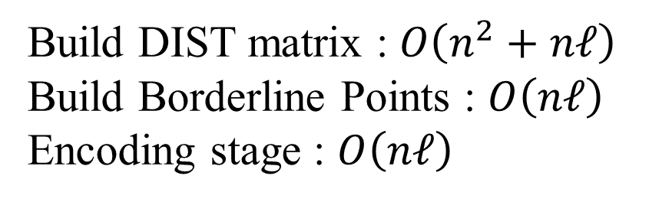
Build DIST matrix : $O\left(n^{2}+nℓ\right)$
Build Borderline Points : $O\left(nℓ\right)$
Encoding stage : $O\left(nℓ\right)$

