Slide 1
兼顧工作負載和資源規模之 工作流程排程方法研究 Workload- and Resource-Aware List-Based Workflow Scheduling
陳冠甫
指導教授：黃國展 博士
國立臺中教育大學資訊工程學系碩士班碩士論文 July, 2019
Presenter : Chih-Kai Wu
Date: APR.21, 2020.

Slide 2
Abstract (1/2)
Workflow scheduling is an NP-complete problem, and has always been an important research topic on parallel job scheduling. Different types of scheduling heuristics have been developed for tackling the challenging workflow scheduling problem. List-based scheduling is one of the most widely used categories for different workflow structures and optimization goals. Among various list-based workflow scheduling algorithms, HEFT and PEFT are two typical and well-known representatives with important innovations. However, none of them can consistently retain advantage over the other across various workflow properties and system scales.

Slide 3
Abstract(2/2)
That motivated our research work in this thesis, focusing on the problem of task-parallel workflow scheduling on homogeneous parallel systems which have become feasible and common on current cloud computing platforms with virtualization technology. Based on thorough experimental analysis of HEFT and PEFT, we found drawbacks of them, and then developed a new workload and resource-aware list-based workflow scheduling approach featuring three new mechanisms, including structural task ranking, task ranking based on allocated critical path, and adaptable task allocation. The proposed approach was evaluated with a series of simulation experiments based on both synthetic workflow structures and real-world workflow models, and compared to HEFT and PEFT. The experimental results demonstrate that our approach can achieve significantly superior performance in most circumstances in terms of both average makespan and best ratio.

Slide 4
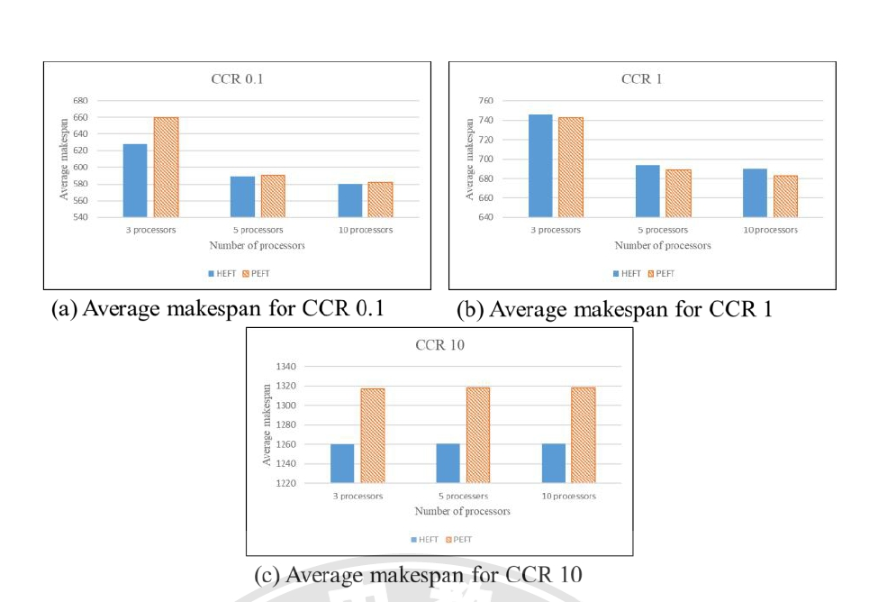
Comparative Analysis of HEFT and PEFT
CCR ( Communication to Computation Ratio )

Slide 5
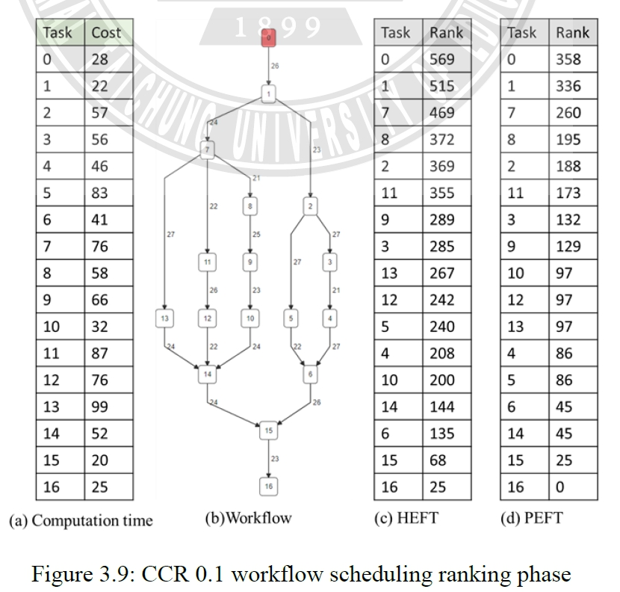
Comparative Analysis of HEFT and PEFT

Slide 6
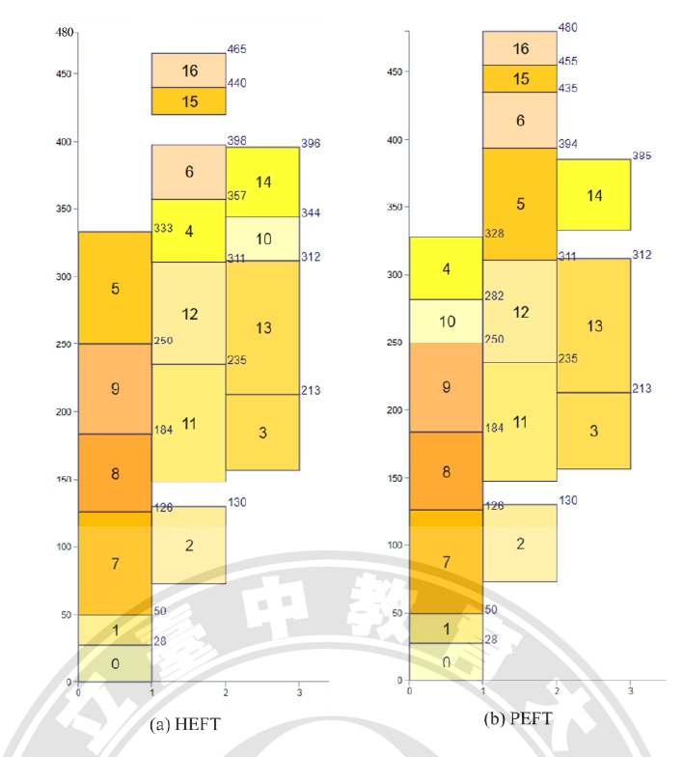

Slide 7
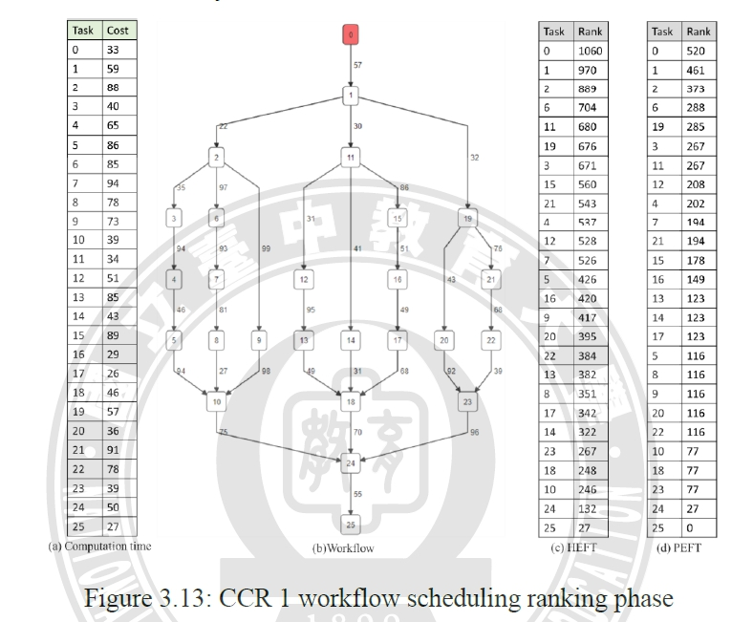

Slide 8
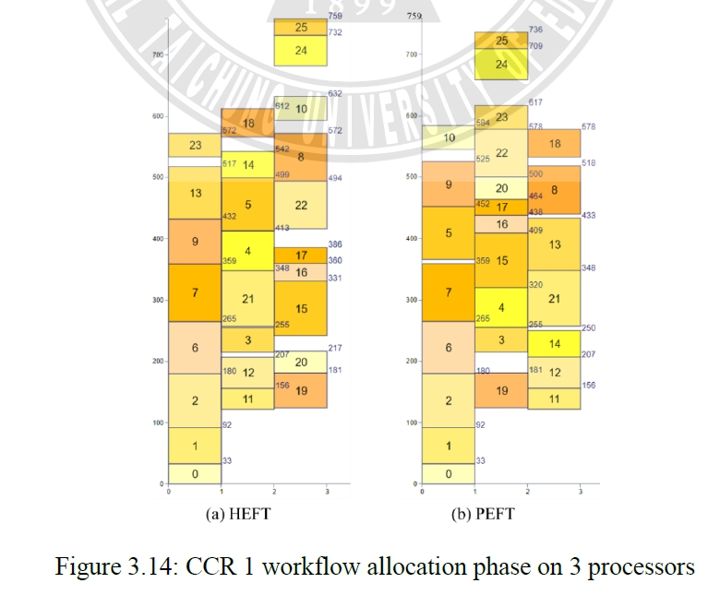

Slide 9
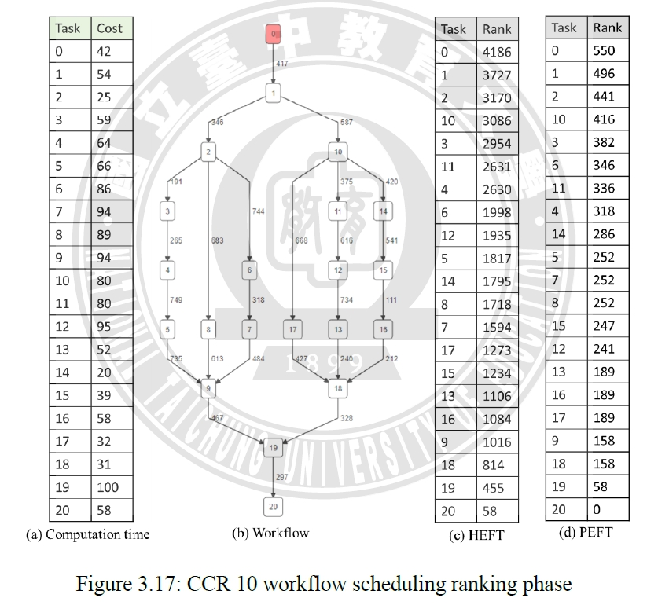

Slide 10
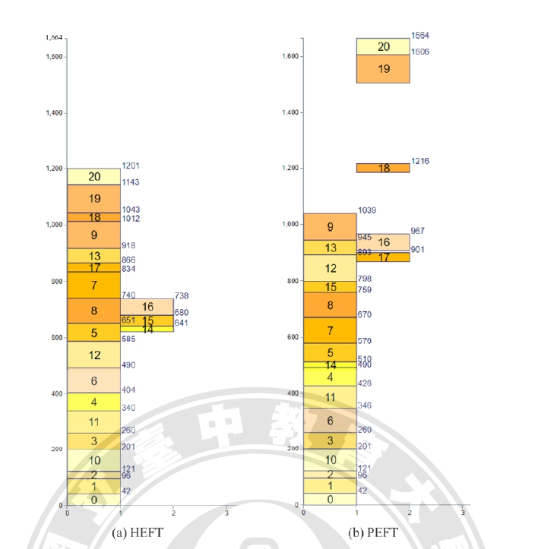

Slide 11
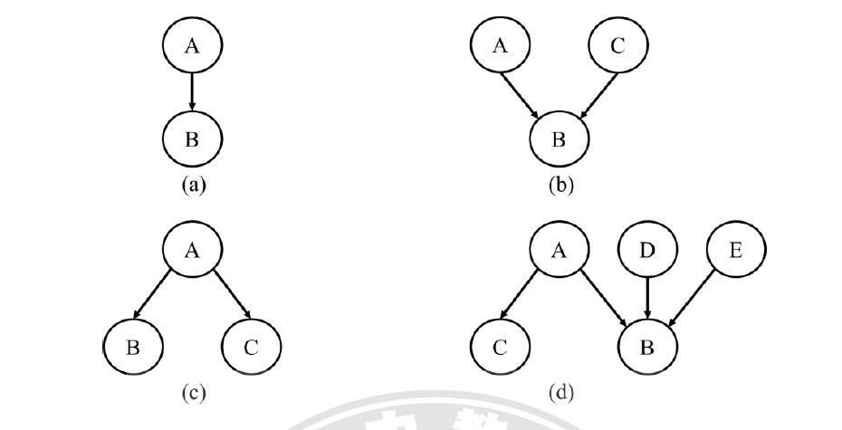

Structural Task Ranking

Slide 12
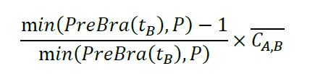


Structural Task Ranking

Slide 13
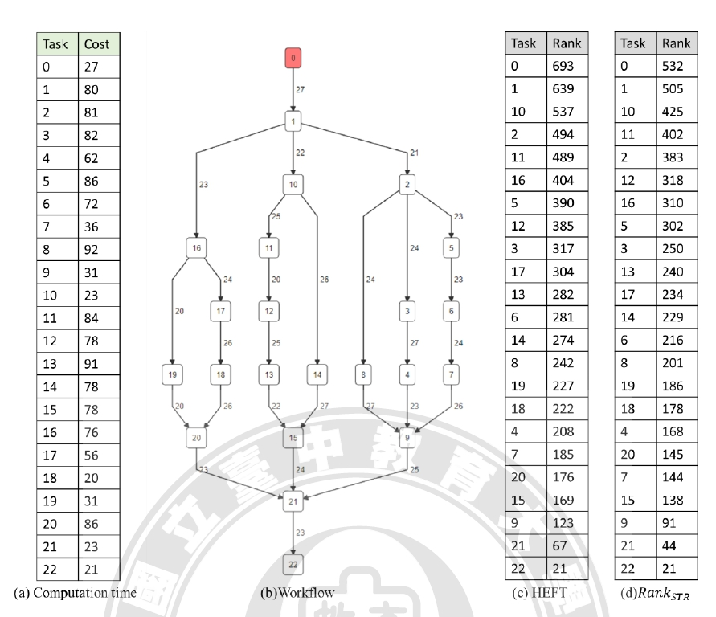

Slide 14
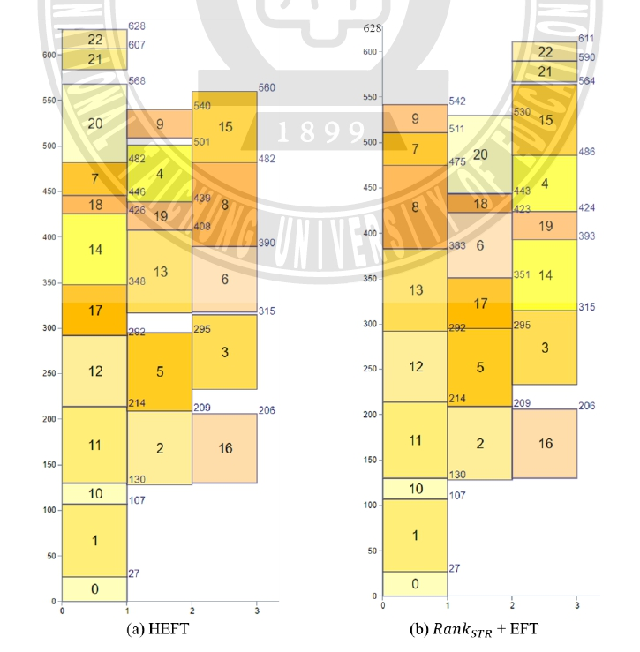

Slide 15
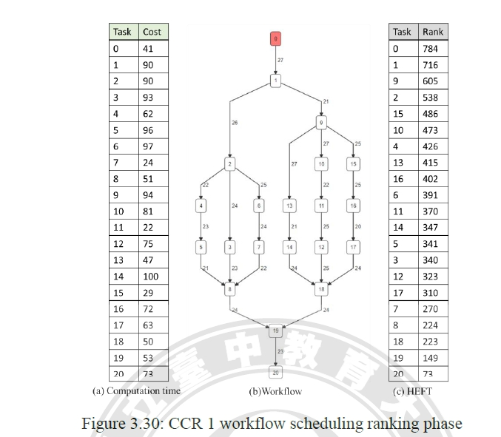

Slide 16
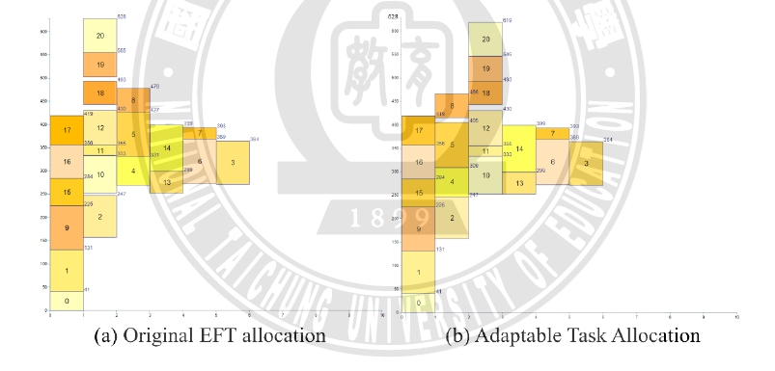

Slide 17
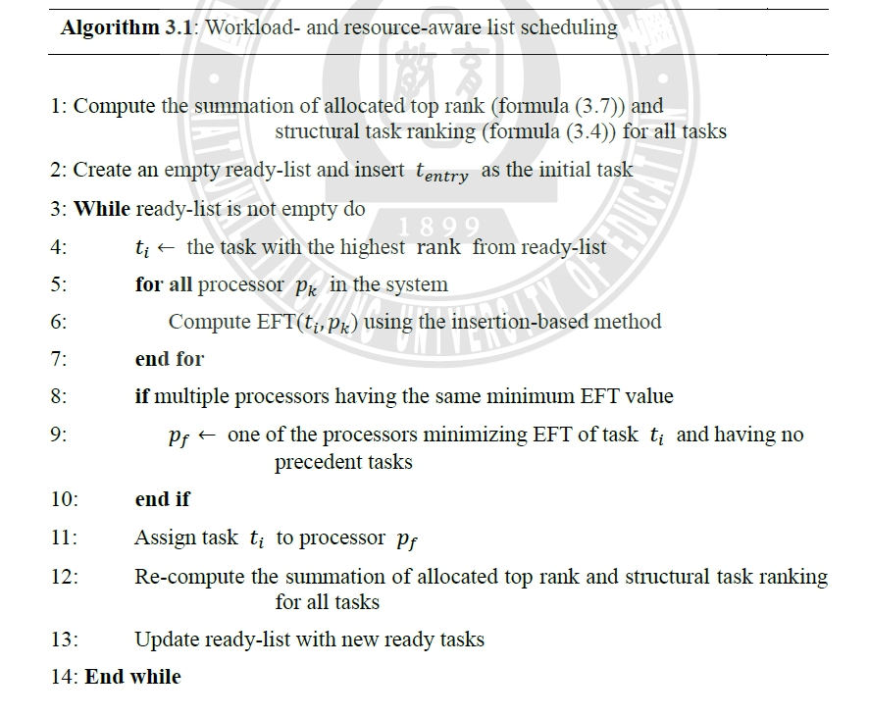

Slide 18
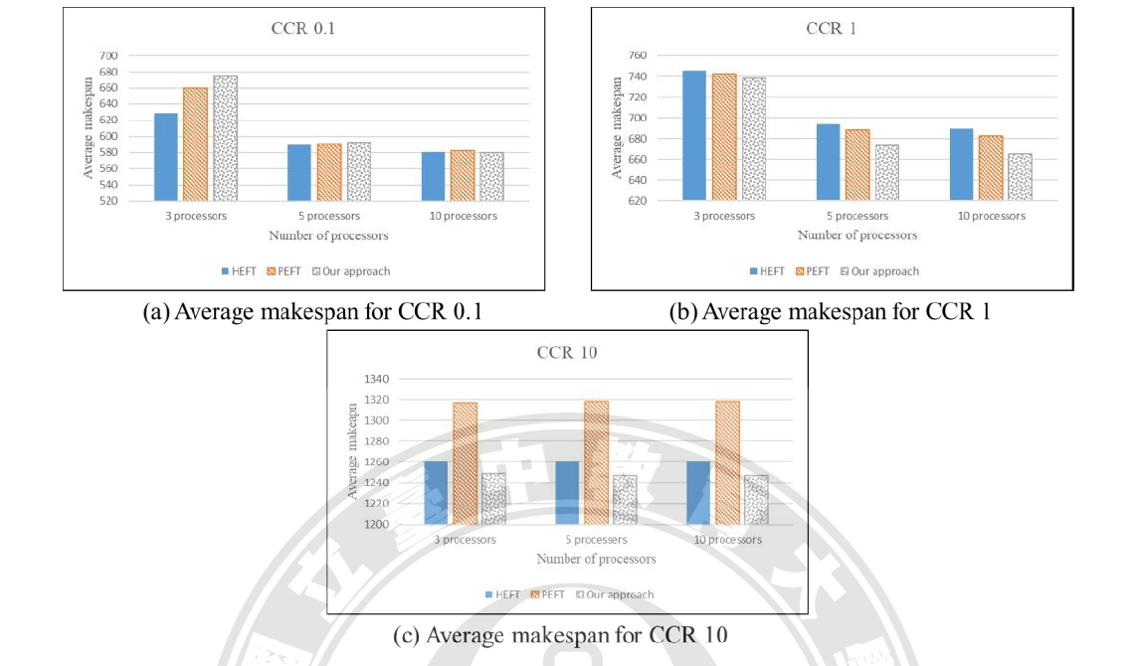

Slide 19
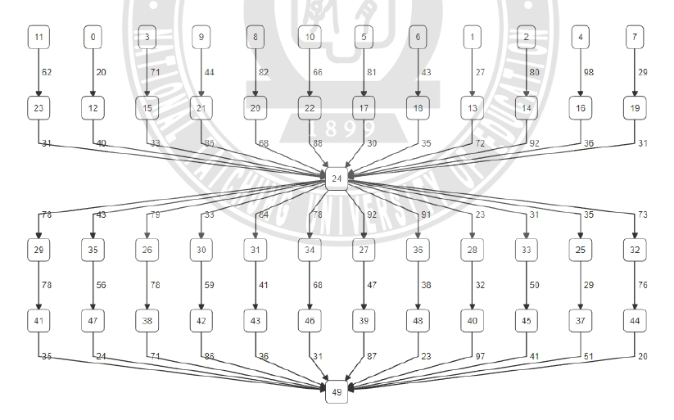

Slide 20
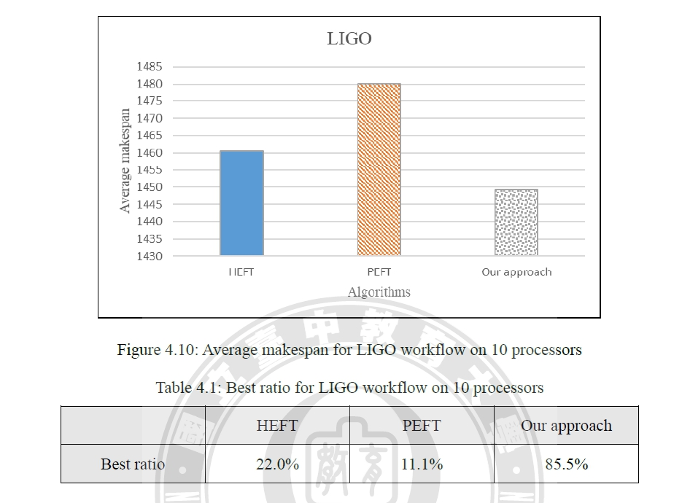

Slide 21
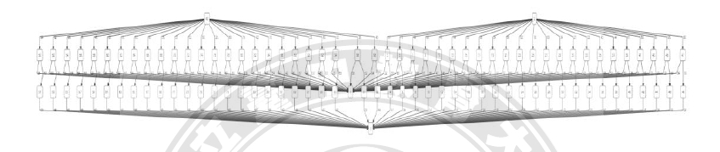

Slide 22
