Slide 1
Task Ranking and Allocation Heuristics for Efficient Workflow Schedules
Kuo-Chan Huang, Meng-Han Tsai
2016 International Computer Symposium (ICS), 15-17 Dec, Chiayi, Taiwan
Presenter : Chih-Kai Wu
Date: 6.15, 2020.
Notes:
聖胡安是美國自治領地波多黎各的首府和最大城市

Slide 2
Abstract
Task ranking and allocation are two major steps in list-based workflow scheduling. This paper explores various possibilities, evaluates recent approaches in the literature, and proposes several new task ranking and allocation heuristics. A series of simulation experiments have been conducted to evaluate the proposed heuristics. Experimental results indicate that effectiveness of task ranking and allocation heuristics largely depends on the characteristics of workflows to be scheduled, and our new scheduling heuristics can outperform previous methods when dealing with workflows of high CCR (Communication-to-Computation Ratio) values.

Slide 3
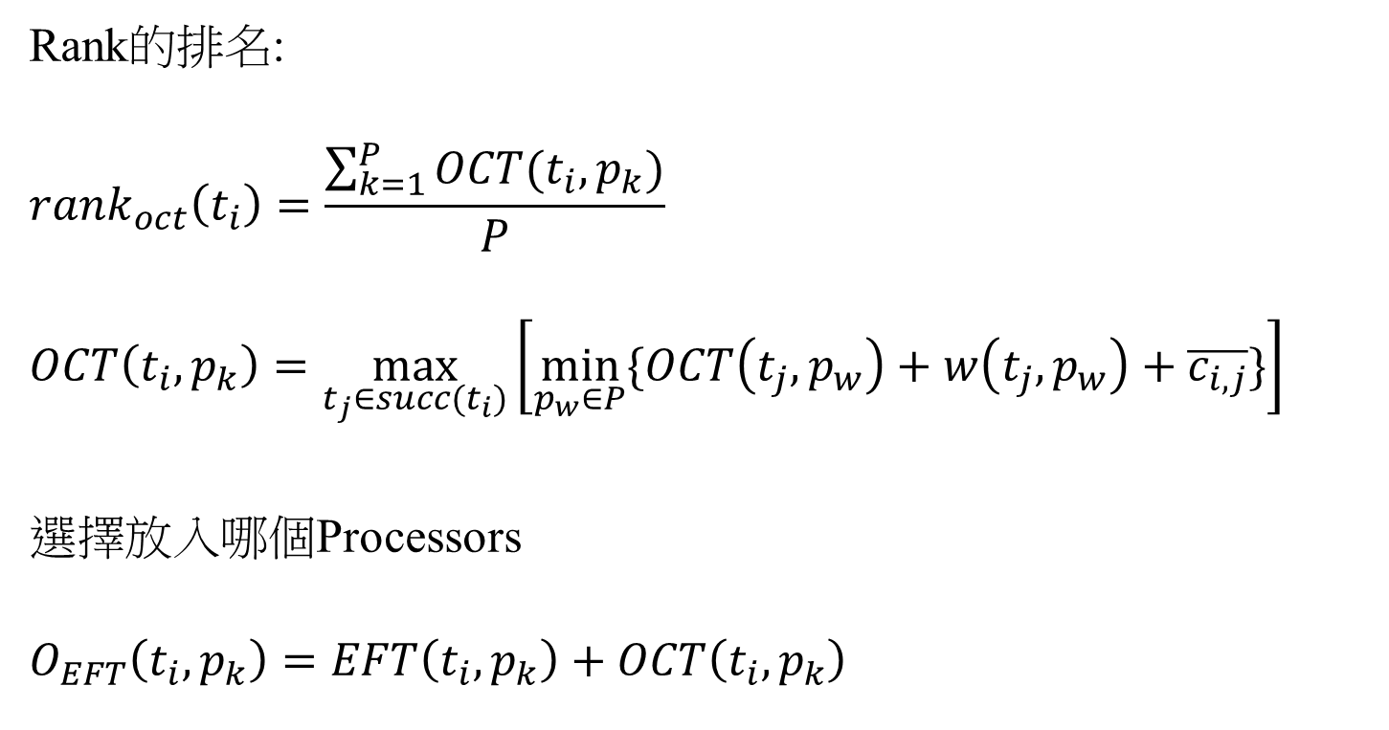
Predict Earliest Finish Time(PEFT)
Rank的排名:
$${rank}_{oct}\left(t_{i}\right)=\frac{\sum_{k=1}^{P}{OCT(t_{i},p_{k})}}{P}$$
$$OCT\left(t_{i},p_{k}\right)=\max_{t_{j}∈succ(t_{i})}\left[\min_{p_{w}∈P}{\{OCT\left(t_{j},p_{w}\right)+w\left(t_{j},p_{w}\right)+\overline{c_{i,j}}\}}\right]$$
選擇放入哪個Processors
$$O_{EFT}\left(t_{i},p_{k}\right)=EFT\left(t_{i},p_{k}\right)+OCT\left(t_{i},p_{k}\right)$$

Slide 4
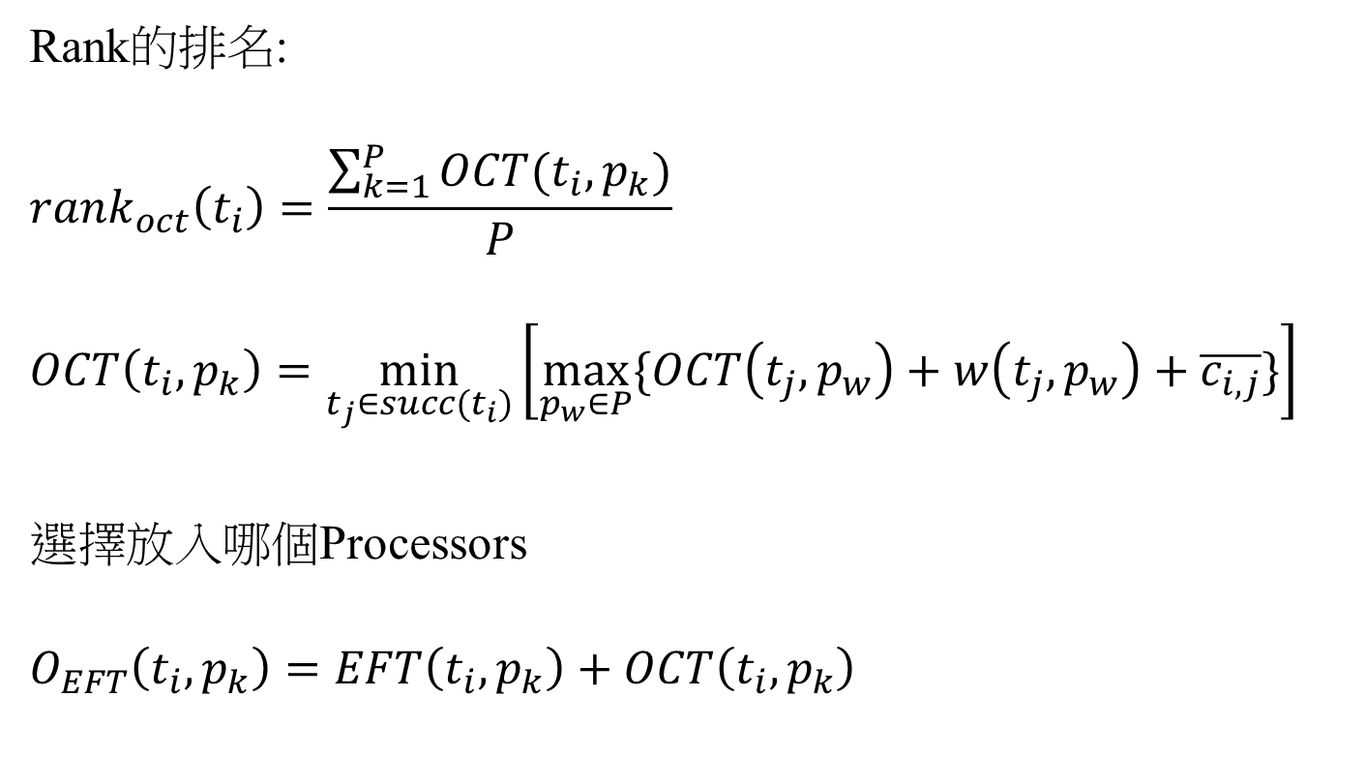
Min-Max OCT
Rank的排名:
$${rank}_{oct}\left(t_{i}\right)=\frac{\sum_{k=1}^{P}{OCT(t_{i},p_{k})}}{P}$$
$$OCT\left(t_{i},p_{k}\right)=\min_{t_{j}∈succ(t_{i})}\left[\max_{p_{w}∈P}{\{OCT\left(t_{j},p_{w}\right)+w\left(t_{j},p_{w}\right)+\overline{c_{i,j}}\}}\right]$$
選擇放入哪個Processors
$$O_{EFT}\left(t_{i},p_{k}\right)=EFT\left(t_{i},p_{k}\right)+OCT\left(t_{i},p_{k}\right)$$

Slide 5
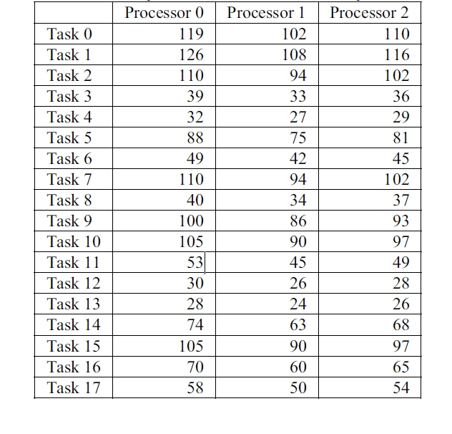
Evaluation

Slide 6
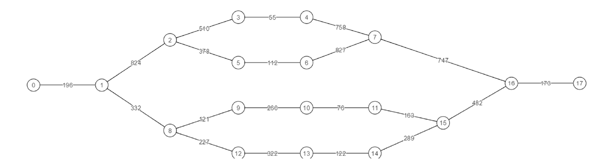
Evaluation

Slide 7
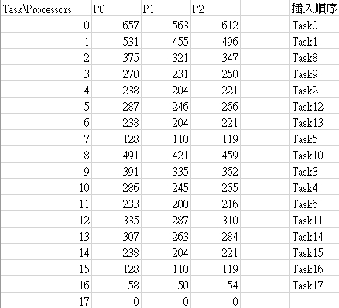
Evaluation (PEFT)

Slide 8
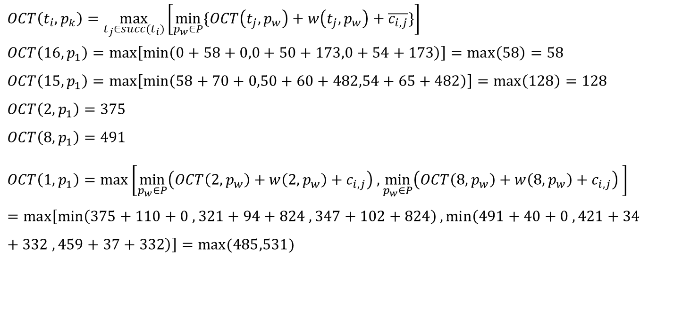
Evaluation (PEFT)
$$OCT\left(t_{i},p_{k}\right)=\max_{t_{j}∈succ(t_{i})}\left[\min_{p_{w}∈P}{\{OCT\left(t_{j},p_{w}\right)+w\left(t_{j},p_{w}\right)+\overline{c_{i,j}}\}}\right]$$
$$OCT\left(16,p_{1}\right)=\max\left[\min\left(0+58+0,0+50+173,0+54+173\right)\right]=\max\left(58\right)=58$$
$$OCT\left(15,p_{1}\right)=\max\left[\min\left(58+70+0,50+60+482,54+65+482\right)\right]=\max\left(128\right)=128$$
$$OCT\left(2,p_{1}\right)=375$$
$$OCT\left(8,p_{1}\right)=491$$
$$OCT\left(1,p_{1}\right)=\max\left[\min_{p_{w}∈P}\left(OCT\left(2,p_{w}\right)+w\left(2,p_{w}\right)+c_{i,j}\right) ,\min_{p_{w}∈P}\left(OCT\left(8,p_{w}\right)+w\left(8,p_{w}\right)+c_{i,j}\right) \right]=\max\left[\min\left(375+110+0 , 321+94+824 , 347+102+824\right),\min\left(491+40+0 , 421+34+332 , 459+37+332\right)\right]=\max{(485,531)}$$

Slide 9
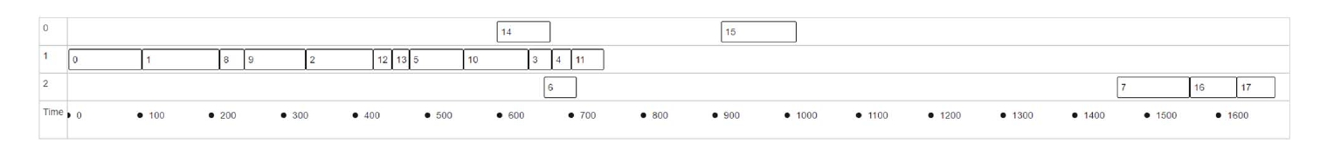
Evaluation (PEFT)

Slide 10
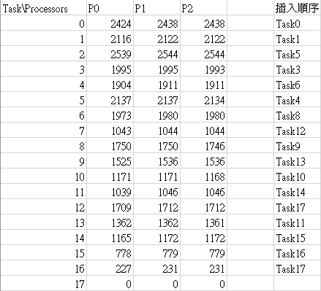
Evaluation (Min-Max OCT)

Slide 11
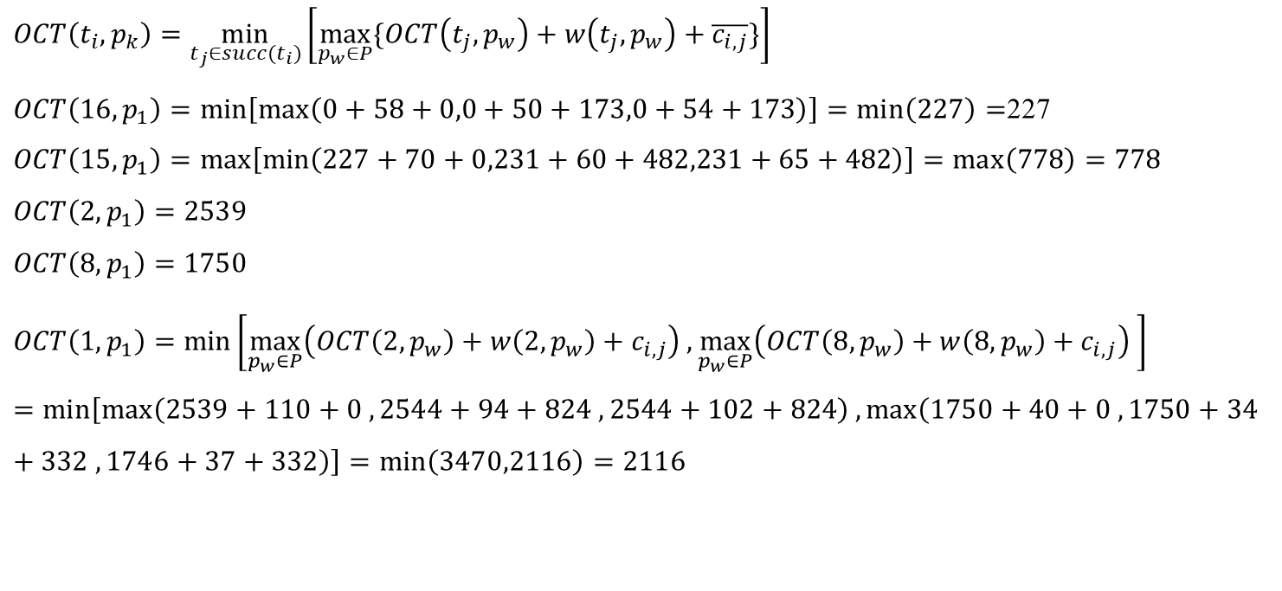
Evaluation (Min-Max OCT)
$$OCT\left(t_{i},p_{k}\right)=\min_{t_{j}∈succ(t_{i})}\left[\max_{p_{w}∈P}{\{OCT\left(t_{j},p_{w}\right)+w\left(t_{j},p_{w}\right)+\overline{c_{i,j}}\}}\right]$$
$OCT\left(16,p_{1}\right)=\min\left[\max\left(0+58+0,0+50+173,0+54+173\right)\right]=\min\left(227\right)=$227
$$OCT\left(15,p_{1}\right)=\max\left[\min\left(227+70+0,231+60+482,231+65+482\right)\right]=\max\left(778\right)=778$$
$$OCT\left(2,p_{1}\right)=2539$$
$$OCT\left(8,p_{1}\right)=1750$$
$$OCT\left(1,p_{1}\right)=\min\left[\max_{p_{w}∈P}\left(OCT\left(2,p_{w}\right)+w\left(2,p_{w}\right)+c_{i,j}\right) ,\max_{p_{w}∈P}\left(OCT\left(8,p_{w}\right)+w\left(8,p_{w}\right)+c_{i,j}\right) \right]=\min\left[\max\left(2539+110+0 , 2544+94+824 , 2544+102+824\right),\max\left(1750+40+0 , 1750+34+332 , 1746+37+332\right)\right]=\min\left(3470,2116\right)=2116$$

Slide 12
Evaluation (Min-Max OCT)

Slide 13
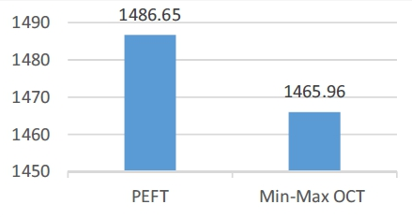
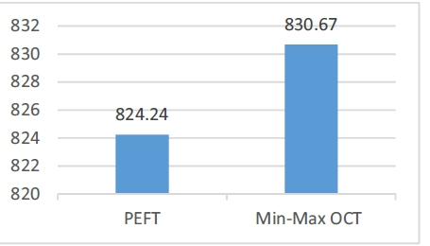
Evaluation
CCR=10
CCR=0.1

