Slide 1
Do you know that Florence is packed with visitors? Evaluating state-of-the-art models of speaker commitment
Proceedings of the 57th Annual Meeting of the Association for Computational Linguistics, pp.4208–4213
Nanjiang Jiang and Marie-Catherine de Marneffe
Present: Chia-Lin Chen
Date: June 30, 2020
Notes:
本文為2019年ACL最佳長短論文得主(只有ㄧ篇得主)。2019此期刊最佳長論文(只有一篇得主)長度共12頁，此篇最佳短論文共6頁。
第一作者為美國中部The Ohio State University的博士生，第二作者為其指導教授。
文中的Florence猜測是美國Ohio State的一個小鎮，此外美國東部南卡州也有個Florence City，義大利也有個Florence省。

Slide 2
Abstract
When a speaker, Mary, asks Do you know that Florence is packed with visitors?, we take her to believe that Florence is packed with visitors, but not if she asks Do you think that Florence is packed with visitors? Inferring speaker commitment (aka event factuality) is crucial for information extraction and question answering. Here we explore the hypothesis that linguistic deficits drive the error patterns of speaker commitment models by analyzing the linguistic correlates of model errors on a challenging naturalistic dataset. We evaluate two state-of-the-art speaker commitment models on the CommitmentBank, an English dataset of naturally occurring discourses.

Slide 3
Abstract
The CommitmentBank is annotated with speaker commitment towards the content of the complement (Florence is packed with visitors in our example) of clause-embedding verbs (know, think) under four entailment-canceling environments. We found that a linguistically- informed model outperforms a LSTM-based one, suggesting that linguistic knowledge is needed to capture such challenging naturalistic data. A breakdown of items by linguistic features reveals asymmetrical error patterns: while the models achieve good performance on some classes (e.g., negation), they fail to generalize to the diverse linguistic constructions (e.g., conditionals) in natural language, highlighting directions for improvement.

Slide 4
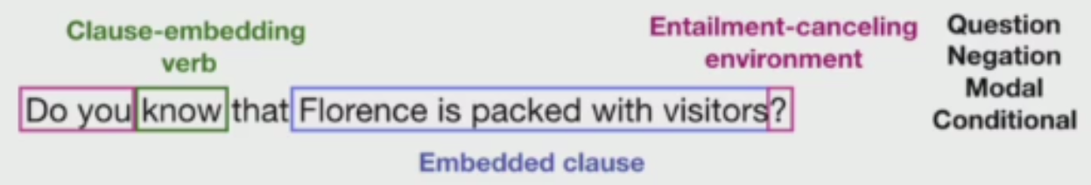
“know” being a Factive verb→embedding clause is true.
“think” being a Non-Factive verb→embedding clause is neither true or false.
“don’t know” being Neg-raisiog(Negation)→embedding clause is false.
Notes:
資料集來自2013/1/1到2017/1/1的推特文章

Slide 5
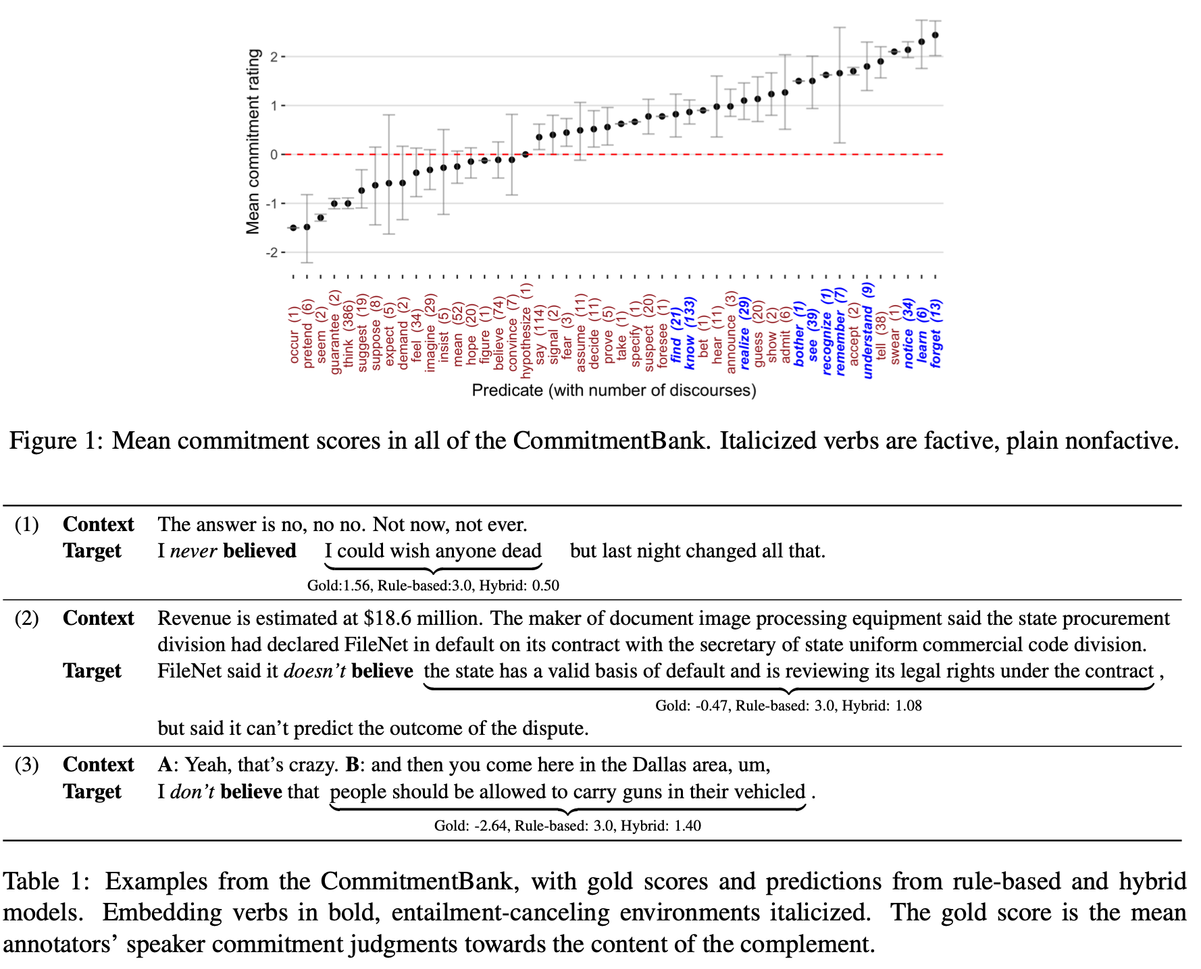
Notes:
這是來自Wall Street Journal(英國科幻、校園小說評論區)的context跟target。
每個item由至多二個Context跟一個Target組成，蒐集來自至少有八位naïve English speaker給的評論。
Gold score範圍[-3,3], -3表示肯定non factical, 0表不確定, +3表肯定factical。
table1中gold score值和Rule based跟Hybrid是兩種方法預測值，介於[-3,+3]。

Slide 6
Notes:
這是來自Wall Street Journal、英國科幻、校園小說評論區)的context跟target。
每個item由至多二個Context跟一個Target組成，蒐集來自至少有八位naïve English speaker給的評論。
Gold score範圍[-3,3], -3表示肯定non factical, 0表不確定, +3表肯定factical。
table1中gold score值和Rule based跟Hybrid是兩種方法預測值，介於[-3,+3]。

Slide 7
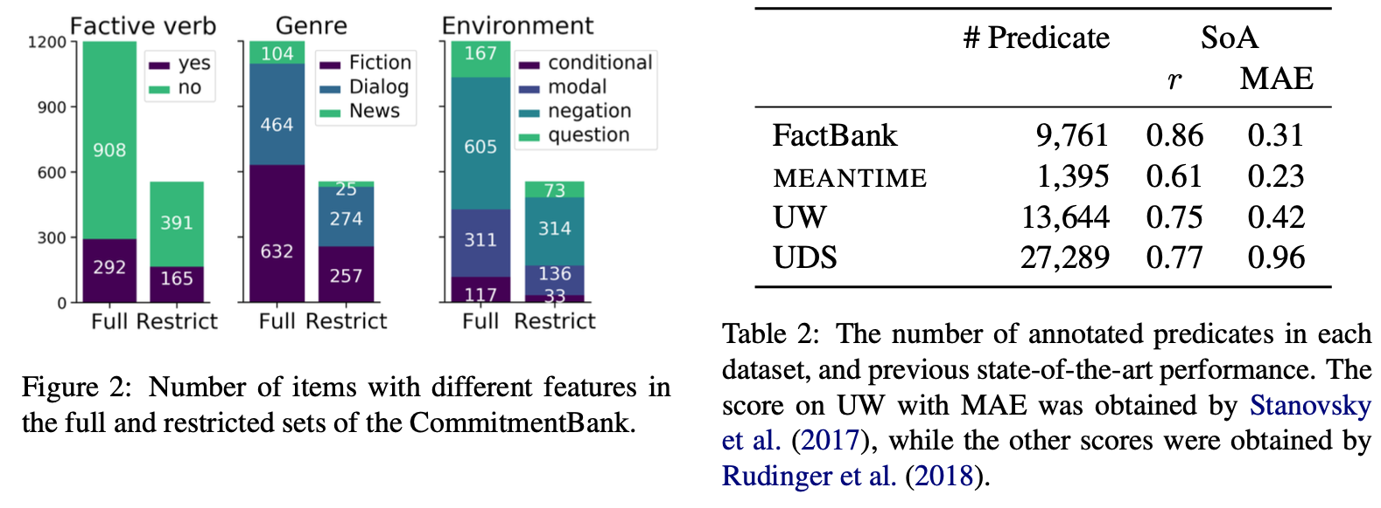

Slide 8
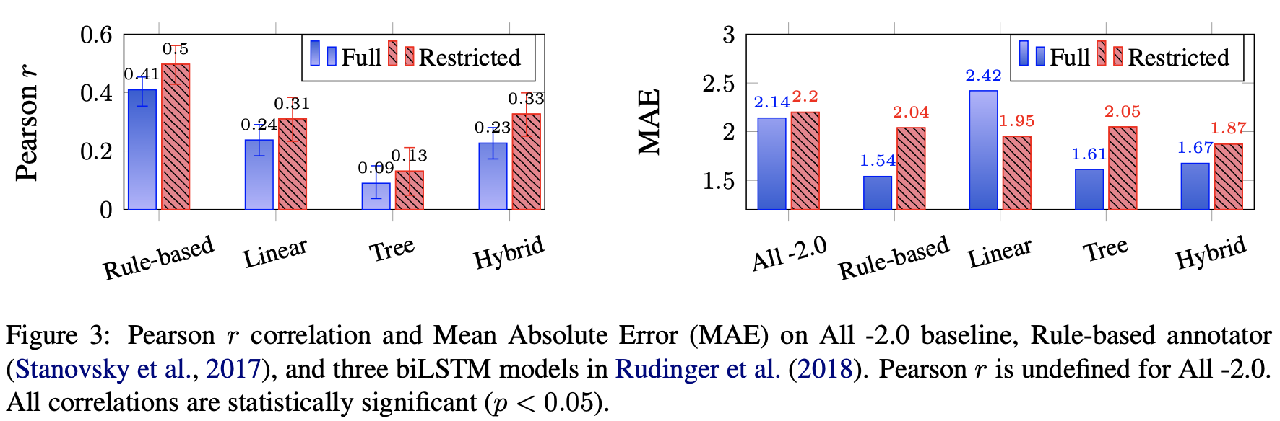
Rule-based(top-down approach on a dependency tree)
Notes:
右圖Retricted set的計算為原[-3,+3]變成[1,3]亦即-p變成p當-p為[-3,-1]，原則被放棄使用。
圖中Linear, Tree, Hybrid為Rudinger2018那篇三種BiLSTM model。
Rule-based則為2017的Stanovsky的模型。

Slide 9
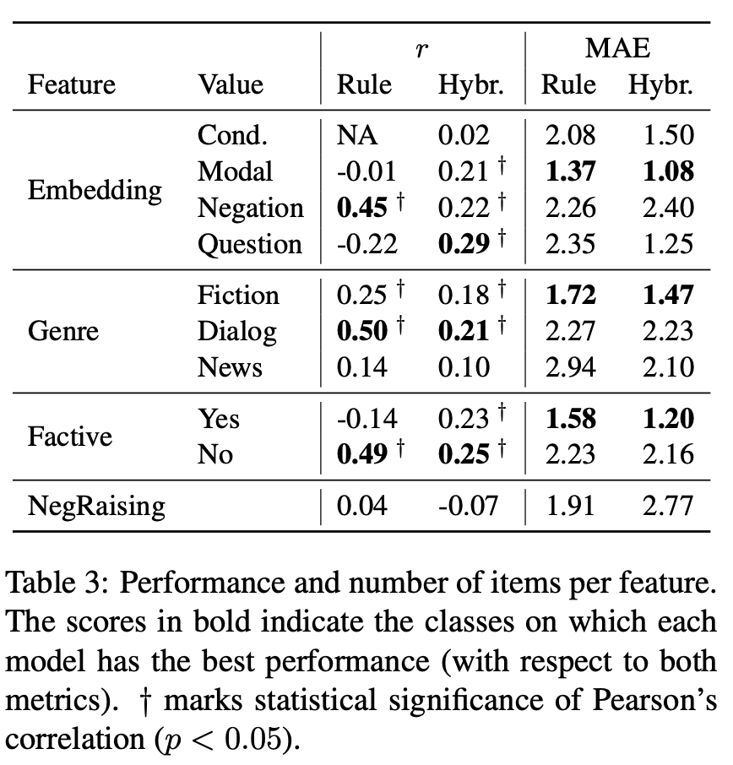
Notes:
Embedding部分在Modal情態動詞上表現不錯。
Genre部分在Dialog問答與Fiction小說上表現不錯。
Factive部分no在correlation表現較好，yes在MAE表現較好。
Pearson corelation相關係數介於[-1,+1]。
NegRasising的相關係數幾乎為0，表示rule-based跟Hybrid的BiLSTＭ幾乎抓不到neg-raising(negation)。

Slide 10
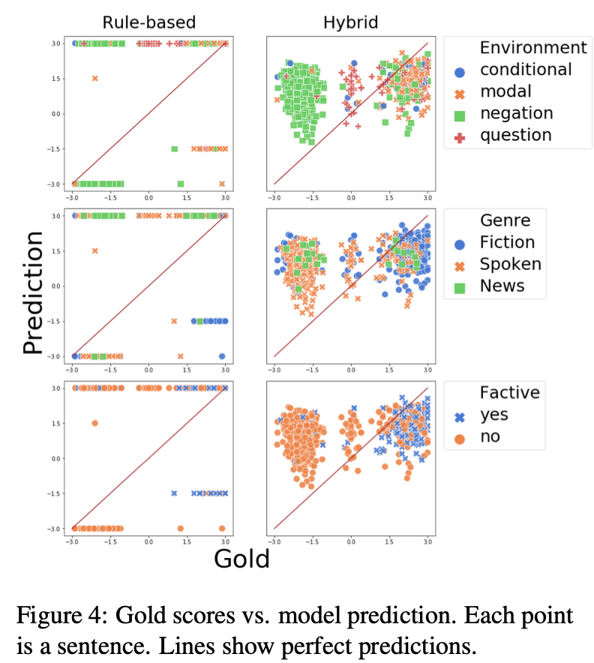
Notes:
Genre的Dialog(spoken):問答

Slide 11
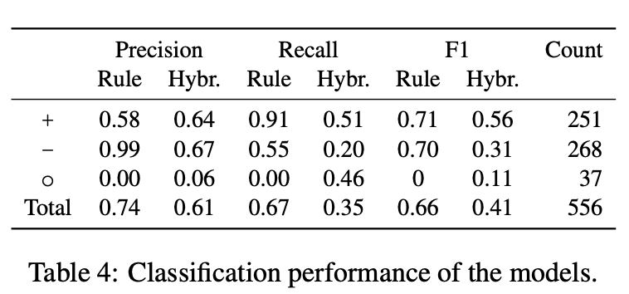

Slide 12
Conclusion
The rule- based model, outperforming the biLSTM models on the full CommitmentBank, shows that a linguistically-informed model scales more successfully to challenging naturalistic data.

Slide 13
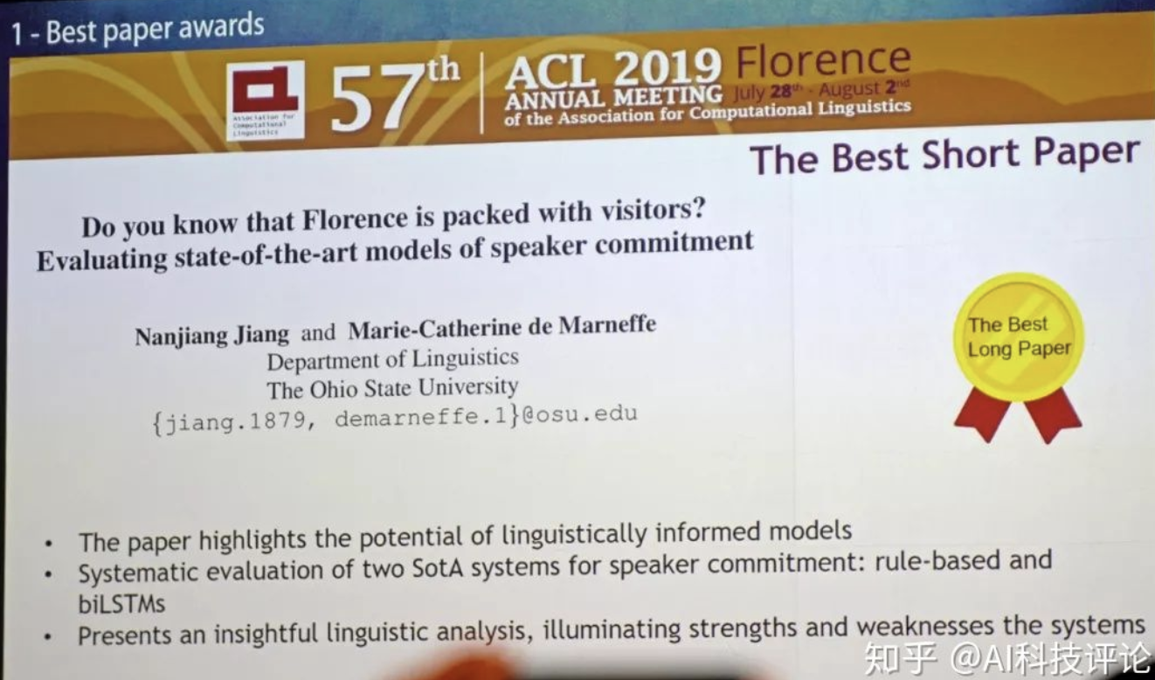

Slide 14
Thank you!

