Slide 1
GASSST: global alignment short sequence search tool
Guillaume Rizk, Dominique Lavenier
Bioinformatics, Volume 26, Issue 20, 15 October 2010, Pages 2534–2540
Presenter: Yuan-Hsiu Tsai
Date: June 30, 2020

Slide 2
Abstract(1/3)
Motivation:
The rapid development of next-generation sequencing technologies able to produce huge amounts of sequence data is leading to a wide range of new applications. This triggers the need for fast and accurate alignment software. Common techniques often restrict indels in the alignment to improve speed, whereas more flexible aligners are too slow for large-scale applications. Moreover, many current aligners are becoming inefficient as generated reads grow ever larger. Our goal with our new aligner GASSST (Global Alignment Short Sequence Search Tool) is thus 2-fold—achieving high performance with no restrictions on the number of indels with adesign that is still effective on long reads.

Slide 3
Abstract(2/3)
Results:
We propose a new efficient filtering step that discards most alignments coming from the seed phase before they are checked by the costly dynamic programming algorithm. We use a carefully designed series of filters of increasing complexity and efficiency to quickly eliminate most candidate alignments in a wide range of configurations. The main filter uses a precomputed table containing the alignment score of short four base words aligned against each other.

Slide 4
Abstract(3/3)
Results:
This table is reused several times by a new algorithm designed to approximate the score of the full dynamic programming algorithm.We compare the performance of GASSST against BWA, BFAST,SSAHA2 and PASS. We found that GASSST achieves high sensitivity in a wide range of configurations and faster overall execution time than other state-of-the-art aligners.

Slide 5
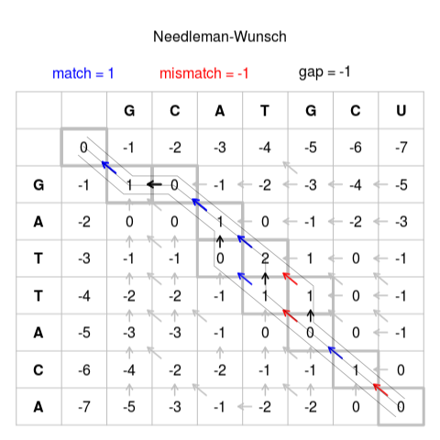
Introduction
Smith-Waterman

Slide 6
Introduction-Method
There are three strategy
Seed Searching for exact matching seeds between the reference genome and the query sequences.
Filter Quickly eliminating hits that have more than a user-specified number of errors.
Extend Computing the full gapped alignment with the NW algorithm.

Slide 7
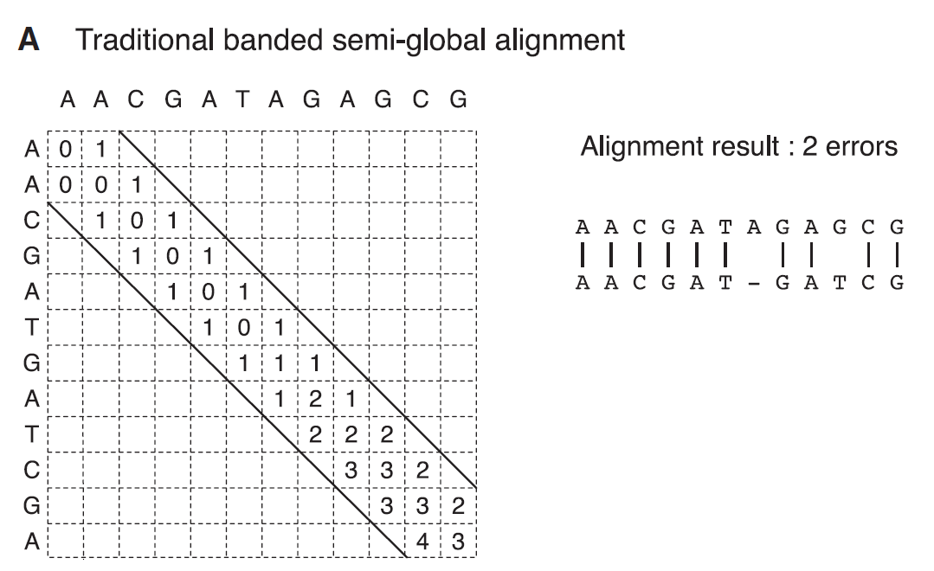

Slide 8
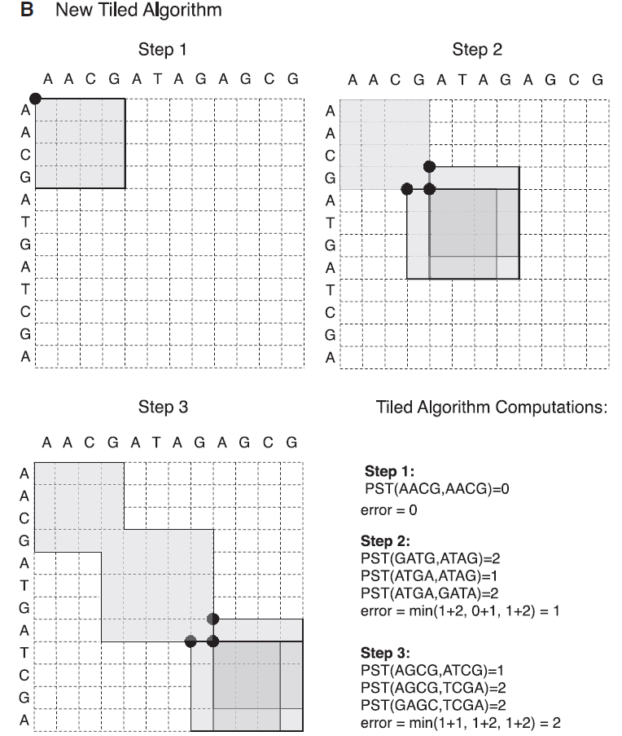

Slide 9
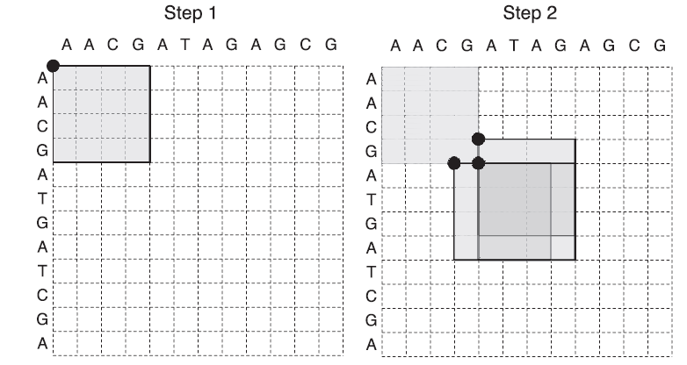

Slide 10
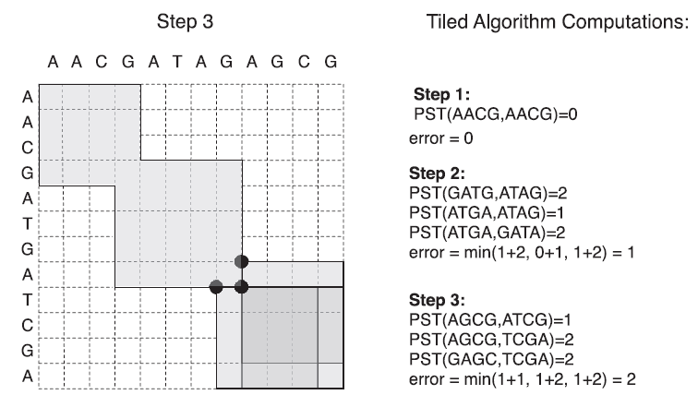

Slide 11
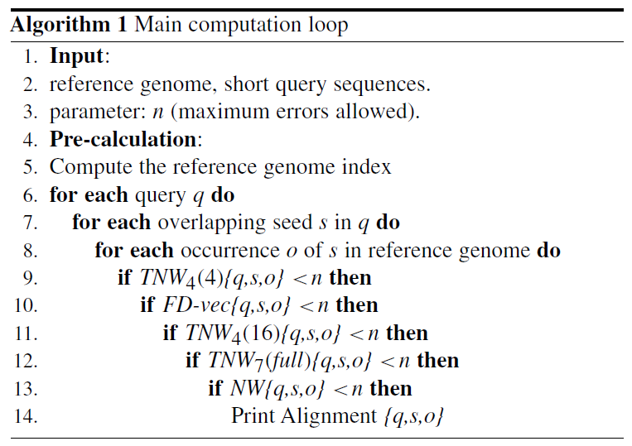

Slide 12
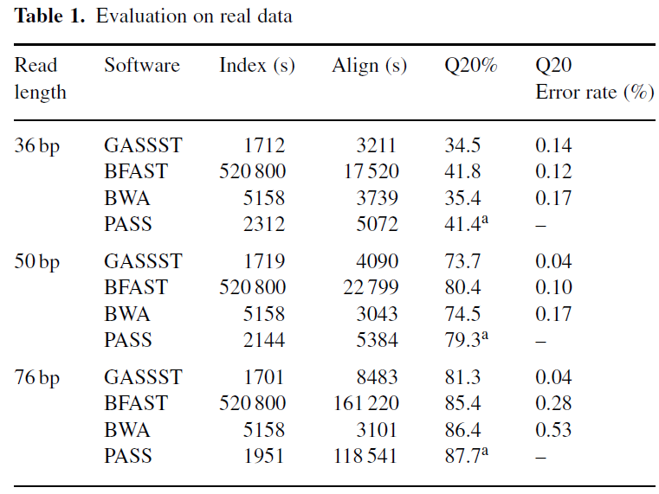

Slide 13
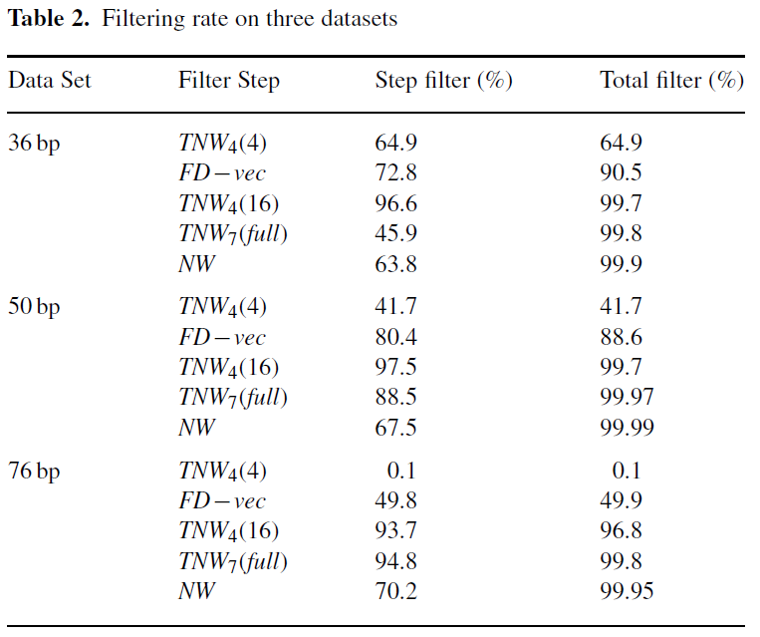

Slide 14
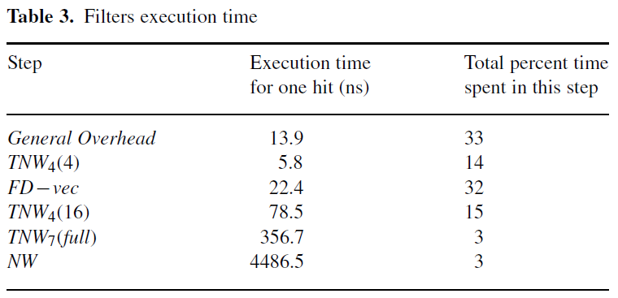

Slide 15
