Slide 1
Search Economics: A Solution Space and Computing Resource Aware Search Method
Chun-Wei Tsai
2015 IEEE International Conference on Systems, Man, and Cybernetics. IEEE, 2015. p. 2555-2560.
Presenter : Tz-Hsu Lee
Date : Jul 21, 2020.

Slide 2
Abstract(1/2)
Although most metaheuristic algorithms claimed that they have a chance to find the optimal solution if given sufficient computation time. In fact, a metaheuristic algorithm may search the same region or particular solutions for a long time when the search process is approaching the convergence state. The question that arises now is, how to invest the limited computing resource to search for the “solutions on the right region” instead of wasting time to search for the irrelevant solutions. This paper introduces a new metaheuristic algorithm, called search economics (SE), for solving optimization problems.

Slide 3
Abstract(2/2)
The basic idea of the SE is to depict the solution space based on the solutions that have been checked by the search algorithm and use the “information of solution space” to search for the solution on the convergence process. Based on these concepts, the investment of a search process will be more meaningful and thus not easy to fall into local optimum at the early iterations. The experimental results show that the proposed algorithm can provide a result that is significantly better than those provided by state-of-the-art metaheuristic algorithms in terms of the quality.

Slide 4
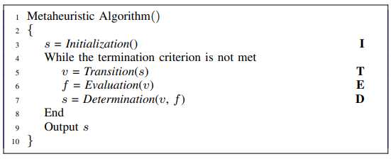

Metaheuristic Algorithm
Search the same region or particular solutions for a long time.
No way to exit the local optimum.

Slide 5
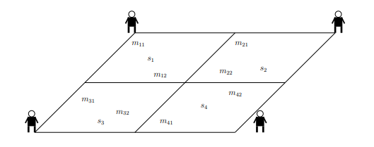
Search Economics(1/2)
The solution space is regarded as an investment.
Reduce the number of redundant searches in the search process.
The number of times a region is searched.
The region which has not been searched for a long time will have a higher chance to find better solutions than the other regions which have been searched frequently.
Notes:
if the objective values of solutions of two different regions are the same, their potentials may still be different because one region may have been searched for many more times than the other region.

Slide 6
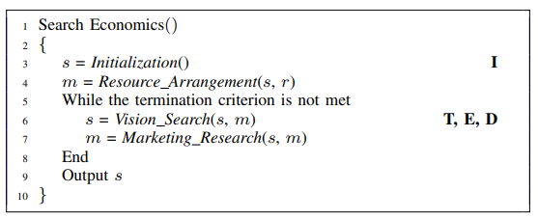
Search Economics(2/2)
The Resource Arrangement : assign the searchers to the regions of the market.
The Vision Search : the role of searching.
The Marketing Research : keep track of information of each region for the search operators.

Slide 7
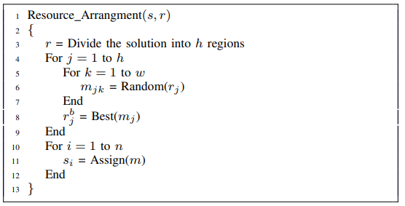
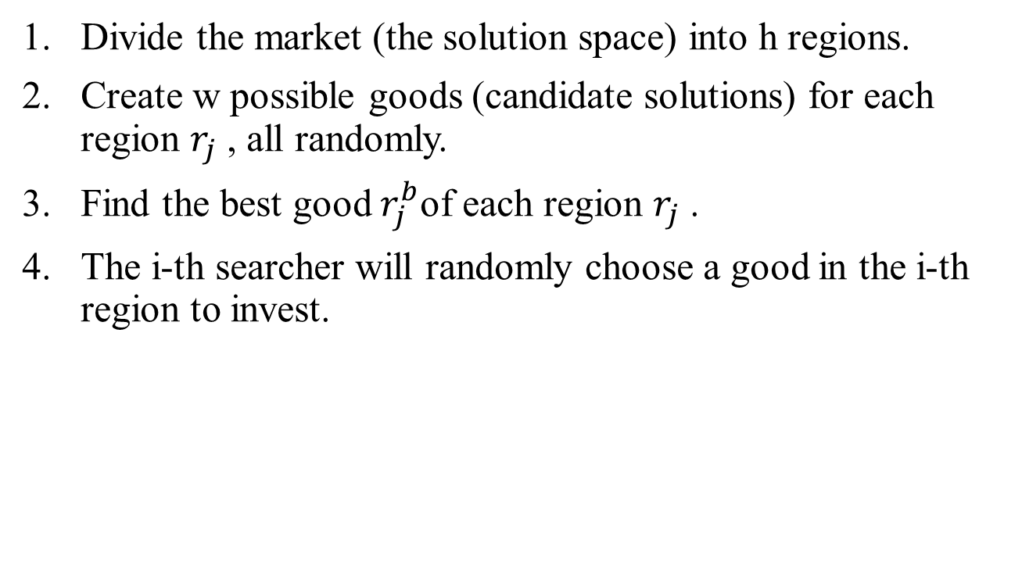
Resource Arrangement
Divide the market (the solution space) into h regions.
Create w possible goods (candidate solutions) for each region $r_{j}$ , all randomly.
Find the best good $r_{j}^{b}$of each region $r_{j}$ .
The i-th searcher will randomly choose a good in the i-th region to invest.

Slide 8
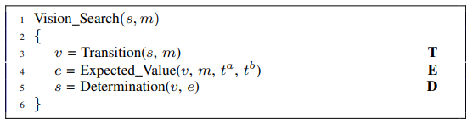




Vision Search
Transition : genetic algorithm(crossover and mutation).
Expected Value :
Determination : choose the better one to be the investment of the i-th searcher.

Slide 9
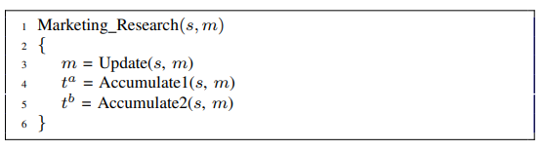

Marketing Research
Update : When finding a better good ($v_{jk}^{i}$ > $r_{j}^{b}$) in region $r_{j}$ , the update operator will use this good to replace one of the current goods in the same region.
Accumulate : if a searcher invests the j-th region, then $t_{j}^{b}$ will be set to 1 and $t_{j}^{a}$ = $t_{j}^{a}$ + 1.

Slide 10
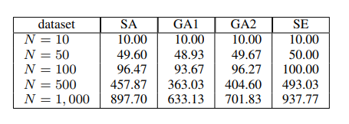
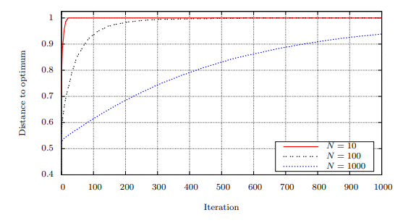
Experimental Results
Notes:
GA1 : the number of chromosomes is set equal to 8; the crossover rate to 0.8; and the mutation rate to 0.1.
GA2 : the number of chromosomes is set equal to 20; the crossover rate to 0.8; and the mutation rate to 0.2.
SE: The number of searchers n is set equal to 4; the population size h to 4; the number of possible goods (the number of samples of each region) w to 2; t a j = 1; and t b j = 1 initially

Slide 11
結合搜尋經濟切割解空間以及估算期望值的方法來使結果不限於區域最佳解。
Transition的部分可以不只使用GA，可改用其他演算法的移動方式或是結合其他演算法
Expected Value根據計算scoring matrix的方式可以更改計算方法

