Slide 1
Design-centric maze generation
P. H. Kim, J. Grove, S. Wurster & R. Crawfis
Proceedings of the 14th International Conference on the Foundations of Digital Games (pp. 1-9) (2019). San Luis Obispo California USA.
Presenter: Yen-Yu Chen
Date: May 29, 2024

Slide 2
Abstract
A maze is a common structure in a game level. When we design game levels having a different purpose of each level, we may desire mazes with different topological properties, such as lots of branches or long straight-ways. Thus, we need the ability to design mazes based on our game mechanics. In this paper, we introduce our design-centric maze generation in which designers can input their desired properties to create their own mazes. Our method also enables the designers to control the topology of the solution path of a maze. Additionally, this method can provide several mazes which satisfy the given desired properties allowing designers to choose the best maze and use it to build game content for a game level. To demonstrate how useful our design-centric method is, this paper provides several use-cases of building actual game levels and shows that we can design the levels effectively using our method.

Slide 3
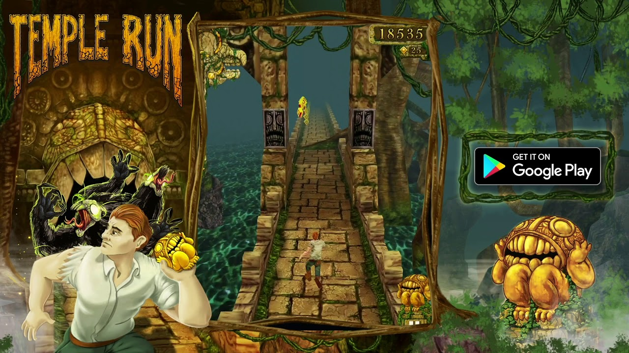
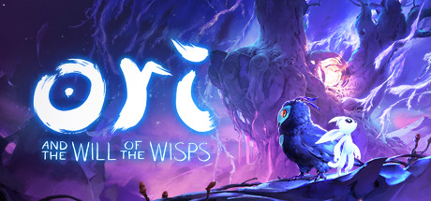
Maze in different game category
Ori and the Will of the Wisps
Temple Run

Slide 4
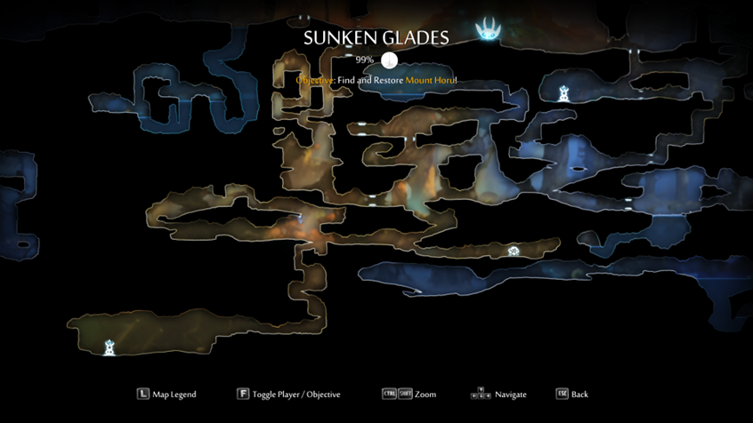
Ori and the Will of the Wisps

Slide 5
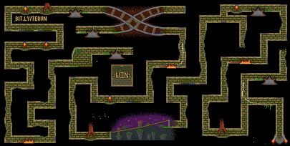
Temple Run

Slide 6
Perfect Maze
A maze is called perfect when you can pick two random points in it and still find a way between them.

Slide 7
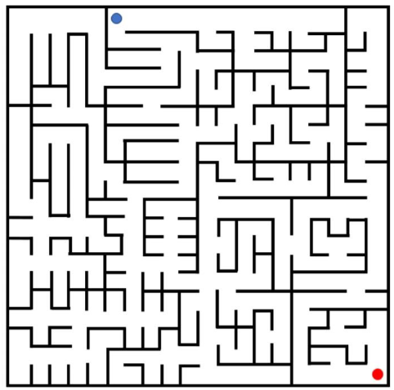
Output
Generate perfect maze with the starting point (blue) and the ending point (red).

Slide 8
Graph
We consider each cell center as a node and lines between cell centers as an edge. Each node has neighboring edges in either vertical or horizontal directions.
A MxN grid has M (N − 1) + (M − 1) N edges in total.

Slide 9
Cell’s Categories
turn cells
straight cells
T-junction cells
cross-junction cells
terminal cells

Slide 10
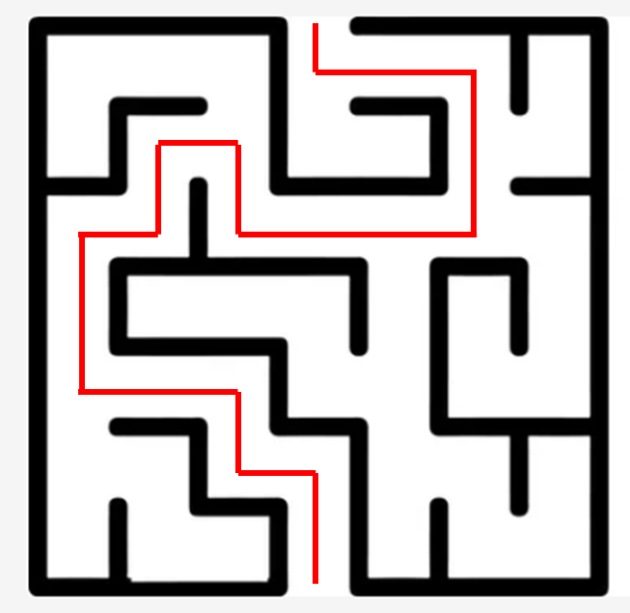
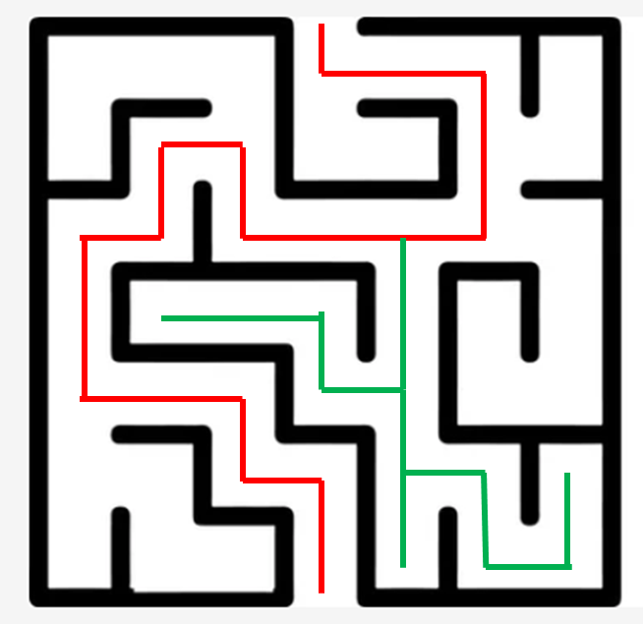
Solution Path and Dead-end Tree
Solution Path
Dead-End Tree

Slide 11
Basic Properties
Solution Path | Maze
Starting Point and Ending Point | Size
#Turns
#Straights
#Decisions | #T-Junctions
SolutionPathLength | #Cross-Junctions
 | #Terminals

Slide 12
Higher-Level Properties
Run | Indicates how long a maze path is straight before it meets a turn or junction.
River Factor | Relative density of dead-ends and junctions in the maze.
Bias | Tendency to have straight-ways in one direction more often than another direction.
Agility Versus Speed (AVS) | Indicates the twistiness of a path of a maze.
Homogeneity | Indicates the amount of homogeneity over a maze properties.
Hidden Factor | Indicates how hard it is to recognize the shape of paths from any place while playing a maze.

Slide 13
DESIGN-CENTRIC METHOD
Input Stage
Solution Path Generation Stage
Maze Generation Stage
Output Stage

Slide 14
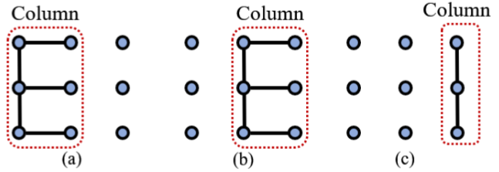
Generation Solution Path(2/2)
Column to column.

Slide 15
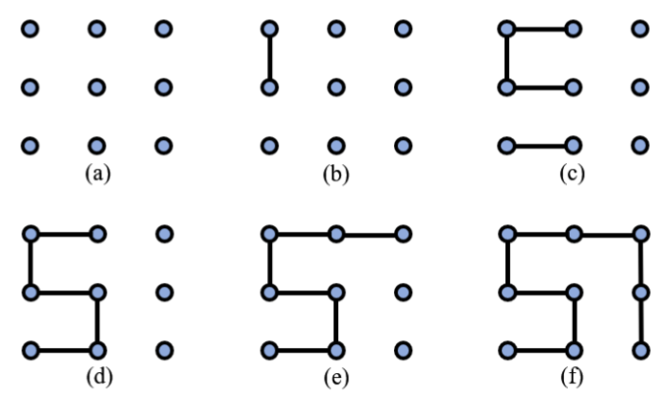
Generation Solution Path(1/2)
Generate edges that do not give us a loop or cause a disconnect with the previously generated edges so that a valid path is maintained.

Slide 16
SBPCG-Based Solution Path Generation
Search-Based Procedural Content Generation (SBPCG)
Generate a constant number result and choose the best one

Slide 17
SBPCG-Based Maze Generation
Pre-build a set of machine learning models that are trained to generate spanning trees.
To train the models effectively, this method uses the enumerated spanning tree data.
Based on the given desired properties, we select a proper model in the set of the trained models and use it to generate spanning trees for the SBPCG approach.

Slide 18
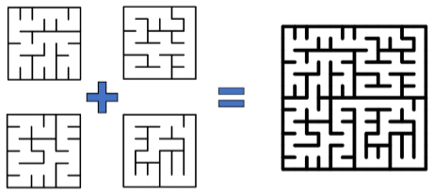
Generate Training Data
Enumerated spanning tree data to train the models.
We avoid enumerating other larger grid domains for training data, and instead implement a new technique for grids larger than 6x6.

Slide 19
Applying Hard Constraints
Specify some edges of the solution path directly over a grid.

Slide 20
Result
maze design tool
rolling ball game maze
rolling ball game actual gameplay view
plumbing game captured

