Slide 1
FCNN: Fourier Convolutional Neural Networks
Harry Pratt, Bryan Williams, Frans Coenen, and Yalin Zheng
Machine Learning and Knowledge Discovery in Databases: European Conference, Skopje, Macedonia, 2017.
Presenter: Yu-Yen Chu
Date: May 29, 2024

Slide 2
Abstract
The Fourier domain is used in computer vision and machine learning as image analysis tasks in the Fourier domain are analogous to spatial domain methods but are achieved using different operations. Convolutional Neural Networks (CNNs) use machine learning to achieve state-of-the-art results with respect to many computer vision tasks. One of the main limiting aspects of CNNs is the computational cost of updating a large number of convolution parameters. Further, in the spatial domain, larger images take exponentially longer than smaller image to train on CNNs due to the operations involved in convolution methods. Consequently, CNNs are often not a viable solution for large image computer vision tasks.

Slide 3
Abstract (Cont.)
In this paper a Fourier Convolution Neural Network (FCNN) is proposed whereby training is conducted entirely within the Fourier domain. The advantage offered is that there is a significant speed up in training time without loss of effectiveness. Using the proposed approach larger images can therefore be processed within viable computation time. The FCNN is fully described and evaluated. The evaluation was conducted using the benchmark Cifar10 and MNIST datasets, and a bespoke fundus retina image dataset. The results demonstrate that convolution in the Fourier domain gives a significant speed up without adversely affecting accuracy. For simplicity the proposed FCNN concept is presented in the context of a basic CNN architecture, however, the FCNN concept has the potential to improve the speed of any neural network system involving convolution.

Slide 4
Convolutional Neural Network
0 | 0 | 1 | 0
0 | 1 | 1 | 0
1 | 1 | 1 | 1
0 | 0 | 1 | 0
0 | 2 | 1
2 | 2 | 1
1 | 1 | 2
Convolution
Pooling
max pooling
average pooling
Flattening
0 | 1
1 | 0
*
2x2 kernel
result
4x4 image
0 | 2 | 1
2 | 2 | 1
1 | 1 | 2
2 | 2
2 | 2
2x2 max pooling
result
result of convolution
2
2
2
2
2 | 2
2 | 2
flattening
result of pooling
result (neural network’s input)

Slide 5
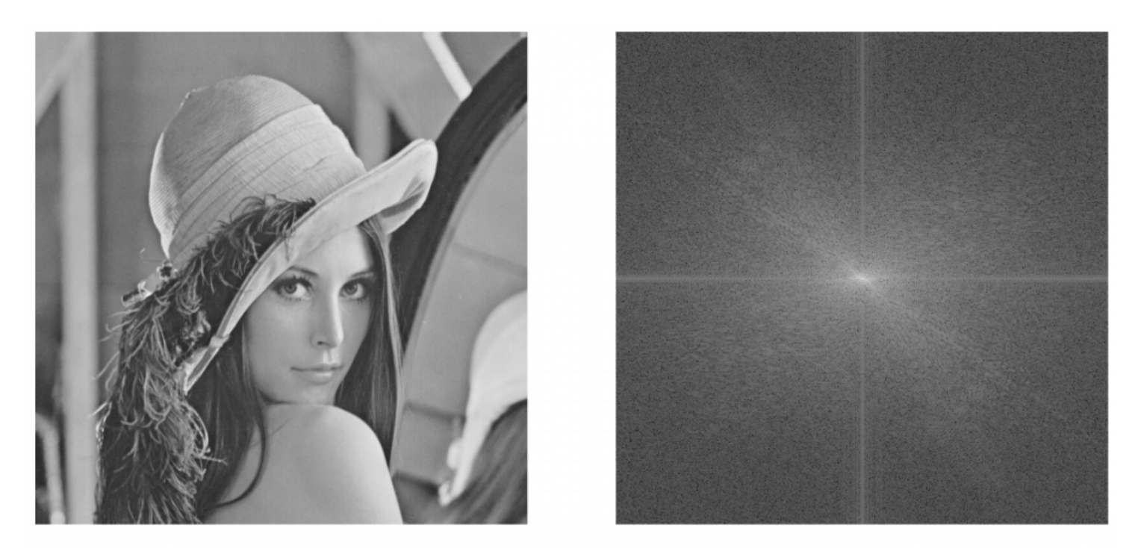
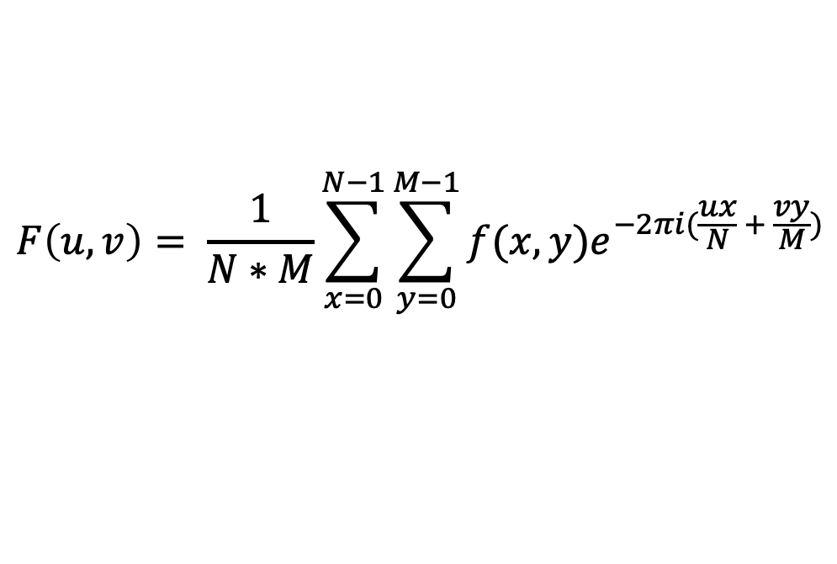
Fourier Transform
$$F\left(u, v\right)= \frac{1}{N∗M}\sum_{x=0}^{N−1}{\sum_{y=0}^{M−1}{f(x,y)e^{−2πi(\frac{ux}{N} + \frac{vy}{M})}}}$$
N: the height of image M: the width of image
f(x, y): the pixel at (x, y)
F(u, v): the frequency of (u, v)
y
v
x
u
image
frequency magnitude
(after log transformation)
photo credit: https://ithelp.ithome.com.tw/articles/10329091

Slide 6
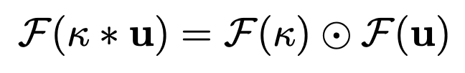
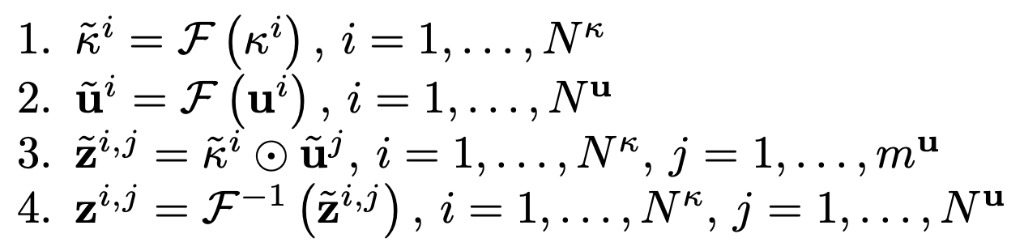
Fourier Convolution Neural Network
Two dimensional discrete Fourier transform
Algorithm
Kernels and images are converted to Fourier domain using FFT.
No inverse FFT is needed. Training processes are worked in Fourier domain.
Total multiplication and addition operations are reduced, and FCNN can train faster with large image.
k: kernel, u: image, *: convolution, ⊙: Hadamard Pointwise Product
~: the parameter in Fourier domain, N^{k}: # of kernel, N^{u}: # of image

Slide 7
Dataset
MNIST
hand written numbers
28x28 pixel, grayscale image
Cifar10
10 different categories: airplane, automobile, bird, cat, deer, dog, frog, horse, ship, truck
32x32 pixel, color image
Kaggle fundus images
eye fundus
large (about 3,000,000 pixels per image), color image

Slide 8
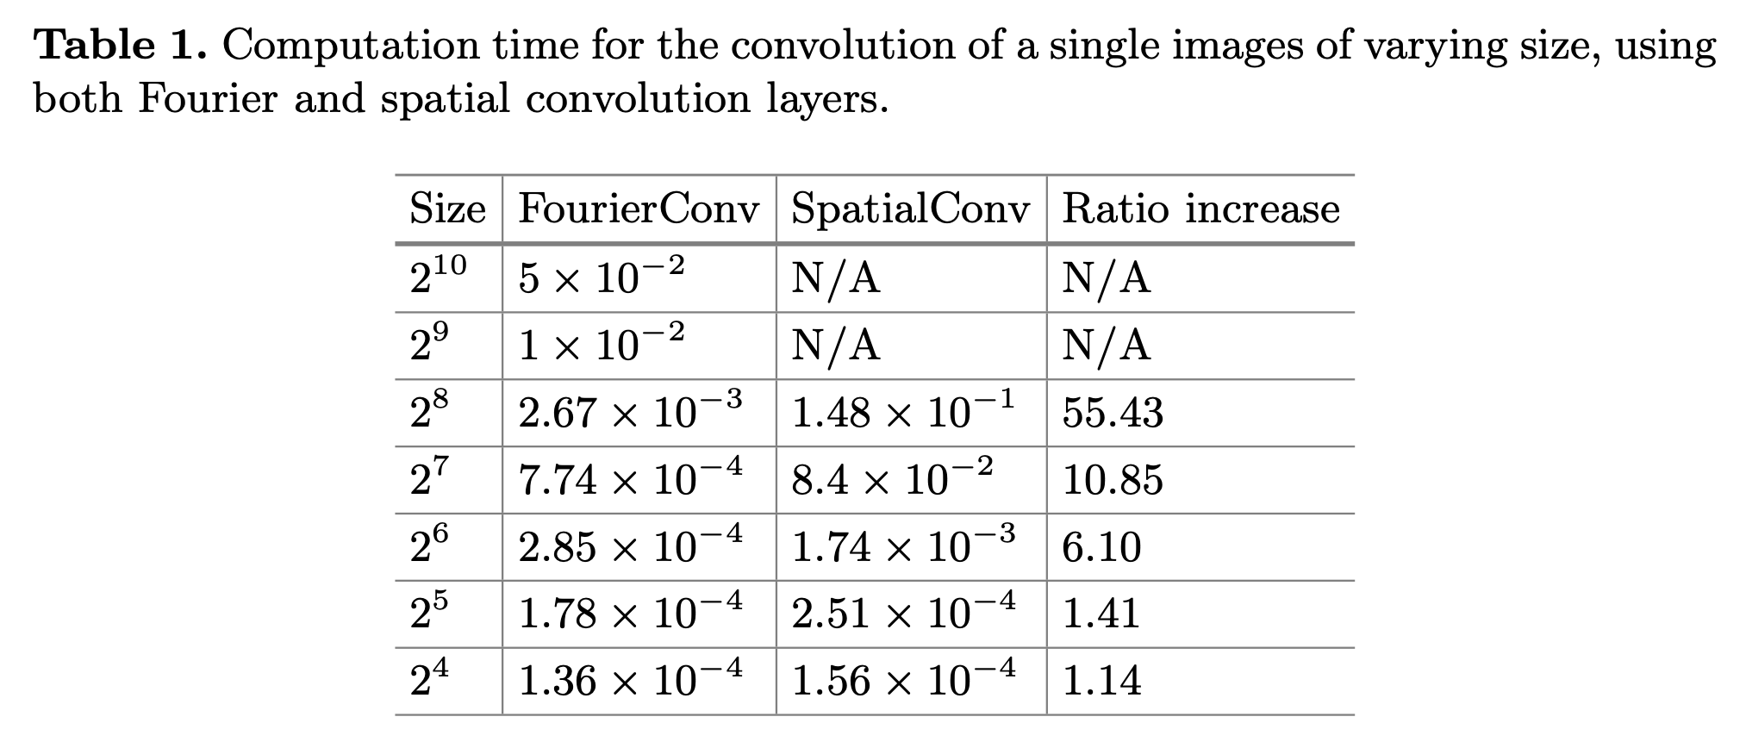

Slide 9
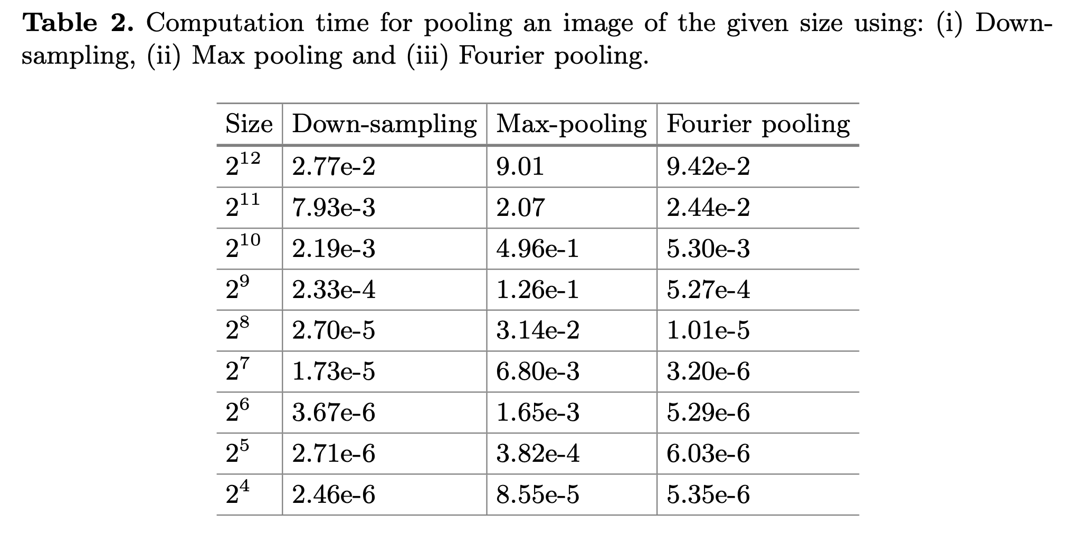

Slide 10
