Slide 1
Couple Sort
Indradeep Hayaran, Pritee Khanna
2016 Fourth International Conference on Parallel, Distributed and Grid Computing (PDGC), Waknaghat, India, 2016, pp. 390-393, doi: 10.1109/PDGC.2016.7913226.)
Presenter: Shih-Hong Lee
Date: May 29, 2024

Slide 2
Abstract
Computer systems and applications deal with numerous cases which require rearrangement of certain entities either in ascending or descending order. The operation required to perform this task is called Sorting. The sole purpose of designing new algorithms is to reduce the number of computations and time taken to perform a particular sort. Also there are cases where an algorithm is best suitable than the others and in some cases it is not. A sorting algorithm comprises of comparison, swapping, and assignment operations. Algorithms like bubble sort and insertion sort are easy to follow and understand but considered inferior to some other algorithms because of their worst case time complexity of O(n²) . This paper presents a new algorithm for sorting namely Couple Sort. It is a hybrid sorting algorithm which is influenced from quick sort and bubble sort techniques which results in a considerably lower time complexity by eliminating some useless comparisons.

Slide 3
Merge sort
12 | 8 | 9 | 3 | 11 | 5 | 4
12 | 8 | 9
3 | 11 | 5 | 4
12
8 | 9
3 | 11
5 | 4
12
8
9
3
11
5
4

Slide 4
Merge sort
12
8
9
3
11
5
4
8 | 12
3 | 9
5 | 11
4
3 | 8 | 9 | 12
4 | 5 | 11
3 | 4 | 5 | 8 | 9 | 11 | 12
Time complexity:
best/worst/average case : O(nlogn)

Slide 5
Couple sort
Buttom up merge sort + quick sort
Given an array below
Pivot = [n/2] = 11
After partition
20 | 19 | 18 | 17 | 16 | 15 | 14 | 13 | 12 | 11 | 10 | 9 | 8 | 7 | 6 | 5 | 4 | 3 | 2 | 1
10 | 9 | 8 | 7 | 6 | 5 | 4 | 3 | 2 | 1 | 11 | 19 | 18 | 17 | 16 | 15 | 14 | 13 | 12 | 20

Slide 6
Paring and swapping
10 | 9 | 8 | 7 | 6 | 5 | 4 | 3 | 2 | 1 | 11 | 19 | 18 | 17 | 16 | 15 | 14 | 13 | 12 | 20
Iteration 1:
Step1
Paring (兩兩一組):
(10,9) (8,7) (6,5) (4,3) (2,1) (11,19) (18,17) (16,15) (14,13) (12,20)
Swapping( 如果右邊比左邊大交換):
9 10 7 8 5 6 3 4 1 2 11 19 17 18 15 16 13 14 12 20
Swap = 8
Step2
Paring :
9 (10,7) (8,5) (6,3) (4,1) (2,11) (19,17) (18,15) (16,13) (14,12) (20)
Swapping : 9 7 10 5 8 3 6 1 4 2 11 17 19 15 18 13 16 12 14 20
Swap : 8

Slide 7
Paring and swapping
Iteration 1:
Iteration 2:
Iteration 3:
Iteration 4:
Iteration 5 (swap time :0 -> end):
9 | 7 | 10 | 5 | 8 | 3 | 6 | 1 | 4 | 2 | 11 | 17 | 19 | 15 | 18 | 13 | 16 | 12 | 14 | 20
7 | 5 | 9 | 3 | 10 | 1 | 8 | 2 | 6 | 4 | 11 | 15 | 17 | 13 | 19 | 12 | 18 | 14 | 16 | 20
5 | 3 | 7 | 1 | 9 | 2 | 10 | 4 | 8 | 6 | 11 | 13 | 15 | 12 | 17 | 14 | 19 | 16 | 18 | 20
3 | 1 | 5 | 2 | 7 | 4 | 9 | 6 | 10 | 8 | 11 | 12 | 13 | 14 | 15 | 16 | 17 | 18 | 19 | 20
1 | 2 | 3 | 4 | 5 | 6 | 7 | 8 | 9 | 10 | 11 | 12 | 13 | 14 | 15 | 16 | 17 | 18 | 19 | 20

Slide 8
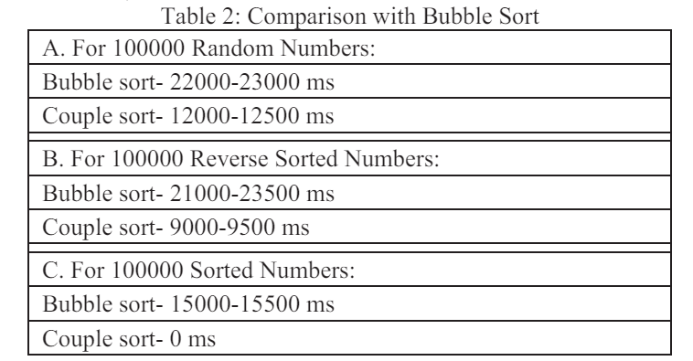
Result
Time complexity :
Best case : O(n)
Worst case : from O(nlogn) to O(n²)
Compare to quick sort
Best case
Quick sort : O(nlogn)
Couple sort: O(n)
Worst case
Quick sort : O(n²)
Couple sort: from O(nlogn) to O(n²)

Slide 9
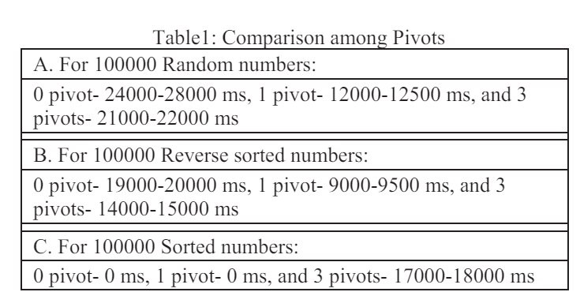
Result

Slide 10
CutShort: A Hybrid Sorting Technique
A. Garg, S. Goswami and V. Garg
2016 International Conference on Computing, Communication and Automation (ICCCA), Greater Noida, India, 2016, pp. 139-142, doi: 10.1109/CCAA.2016.7813705.
Presenter: Shih-Hong Lee
Date: May 29, 2024
Notes:
https://www.google.com/maps/place/Greater+Noida/data=!4m2!3m1!1s0x390cea64b8f89aef:0xec0ccabb5317962e?sa=X&ved=1t:155783&ictx=111

Slide 11
Abstract(1/2)
There are many sorting techniques which were developed over the hundreds of years and also optimized to reduce the complexity for worst and average cases. This paper presents a technique,that can be used to optimize the sorting algorithms, named CutShort. The name ‘CutShort’ signifies cutting of original array into shorter pieces. In this technique, the input array is divided into several subarray of shorter lengths based on bit-count, somewhat similar to the Bucket sort concept. Here each sub-arrays contains those elements which can be represented by same number of bits. We have tested this proposed technique on random samples of large input array and the results are very satisfactory.

Slide 12
Abstract(2/2)
This technique reduces the complexity of worst and average case by a significant factor depending on the number of sub-arrays formed. This method can be used as a preprocessing technique and can be more beneficial if implemented in the processor as a subroutine. It can be used to optimize the runtime of various sorting algorithms.

Slide 13
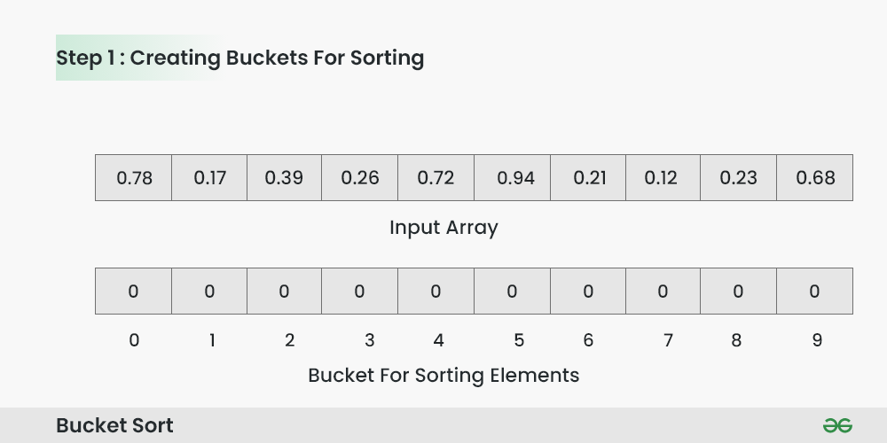
Bucket sort(1/5)

Slide 14
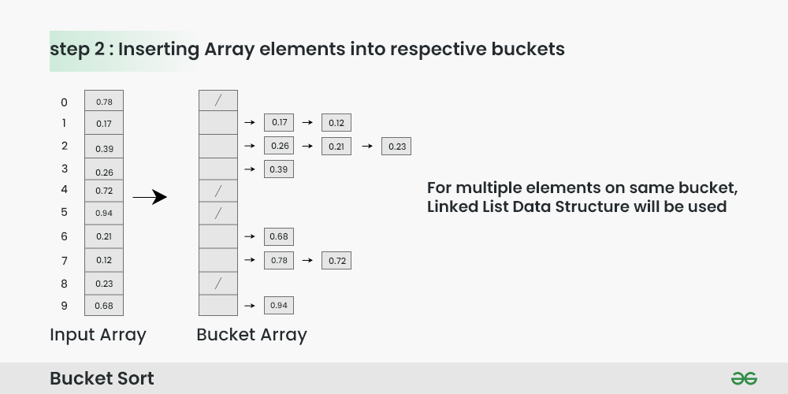
Bucket sort(2/5)

Slide 15
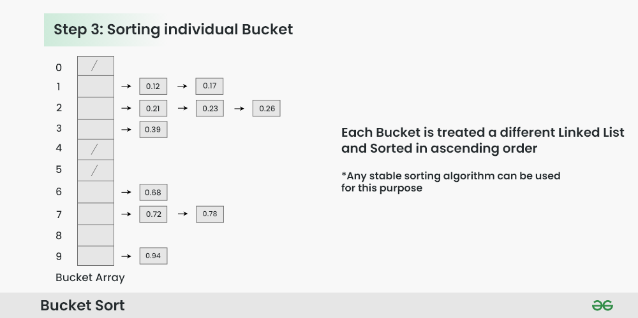
Bucket sort(3/5)

Slide 16
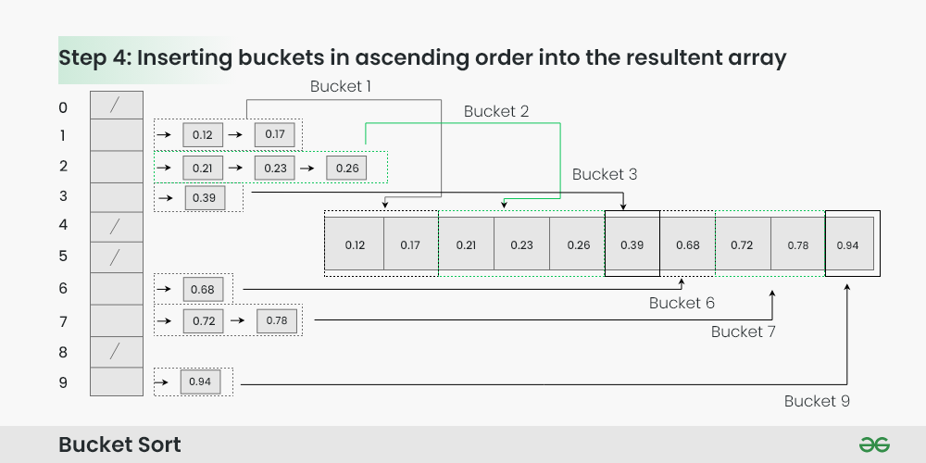
Bucket sort(4/5)

Slide 17
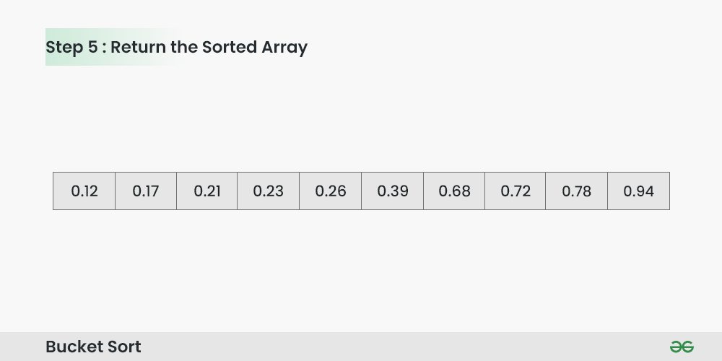
Bucket sort(5/5)

Slide 18
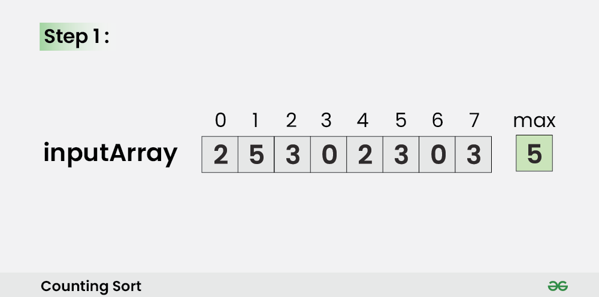
Counting sort

Slide 19
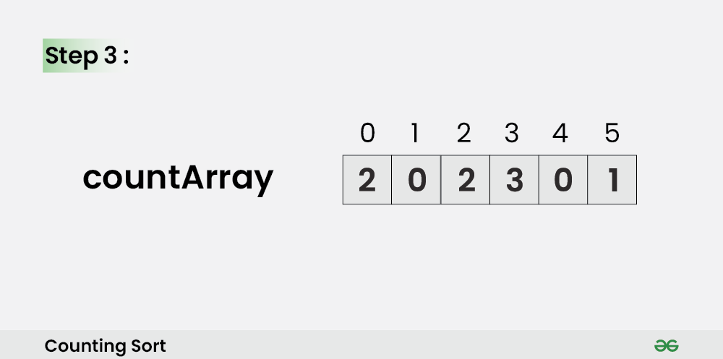
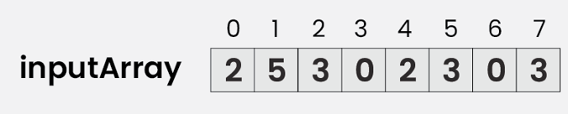
Counting sort

Slide 20
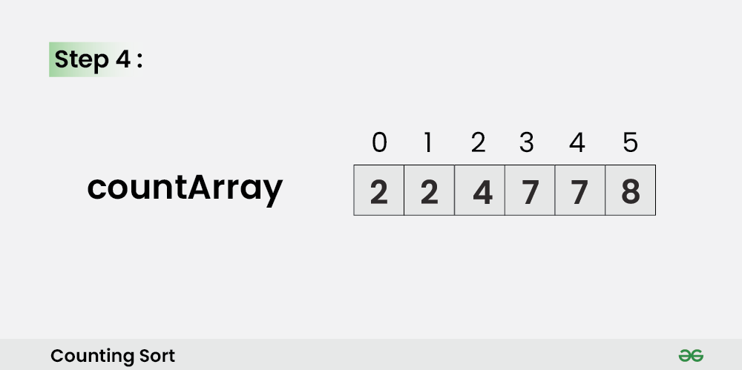
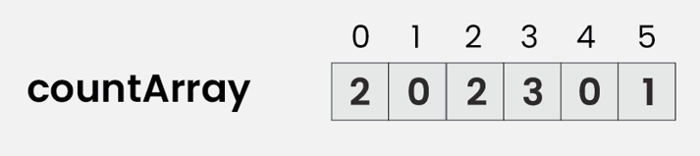
Counting sort

Slide 21
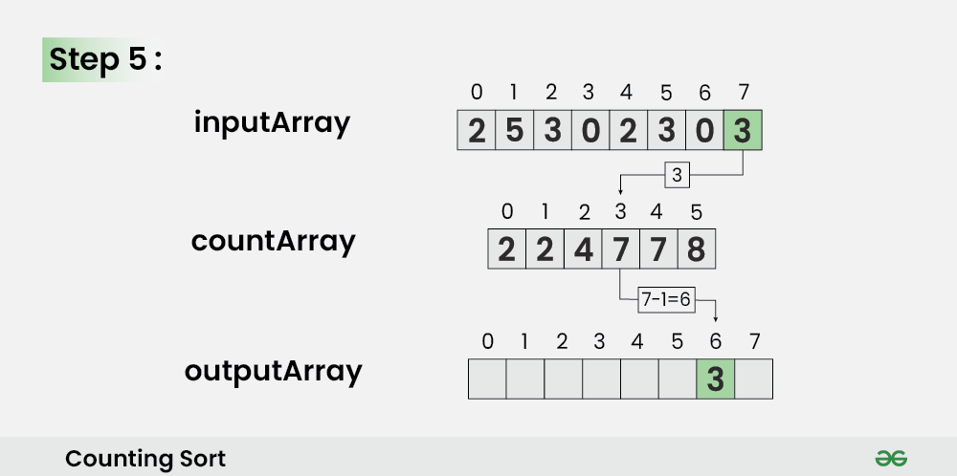
Counting sort

Slide 22
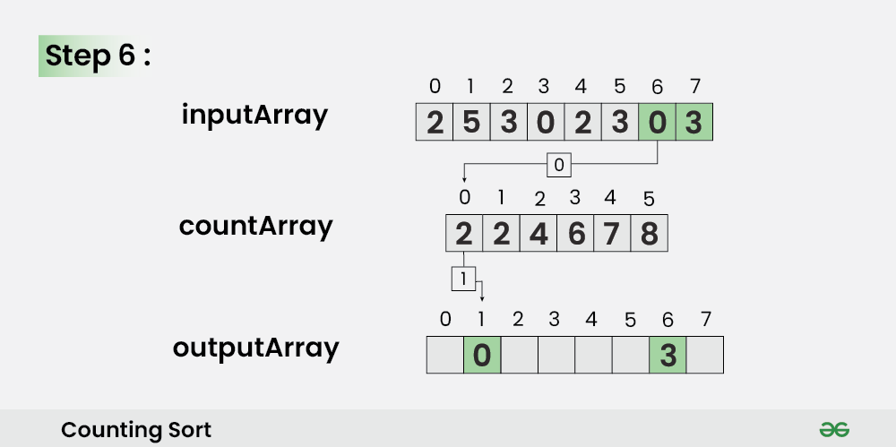
Counting sort

Slide 23
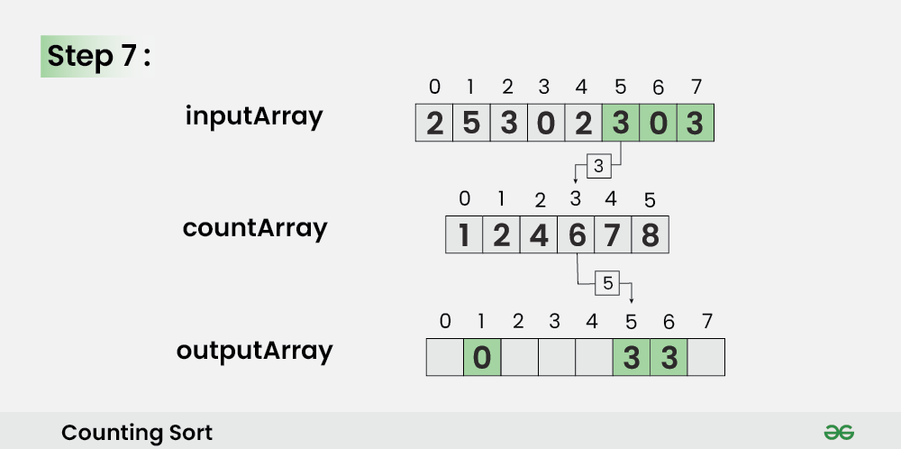
Counting sort

Slide 24
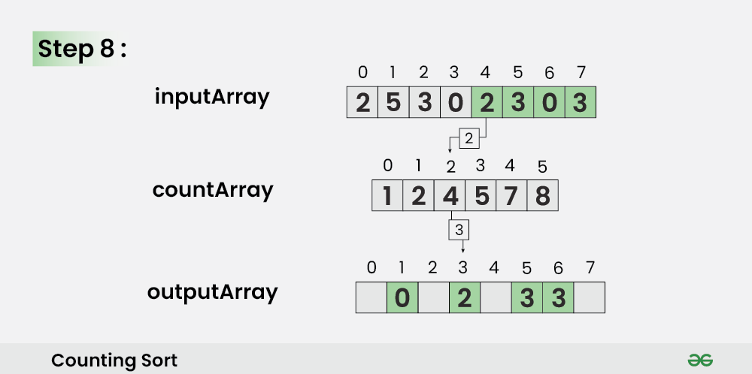
Counting sort

Slide 25
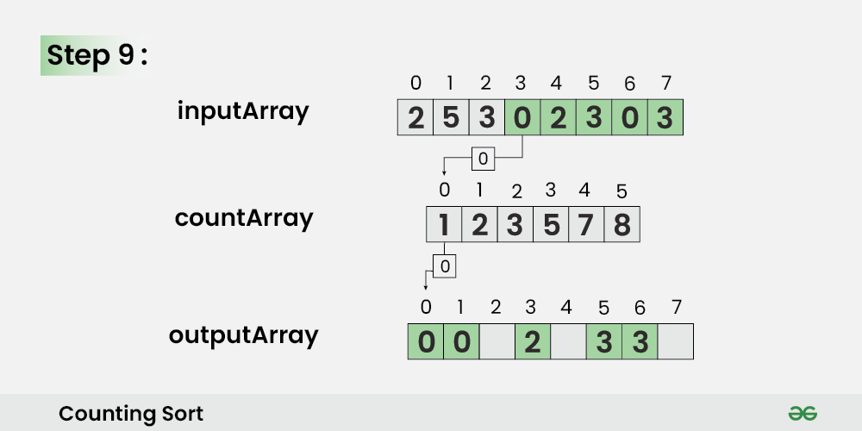
Counting sort

Slide 26
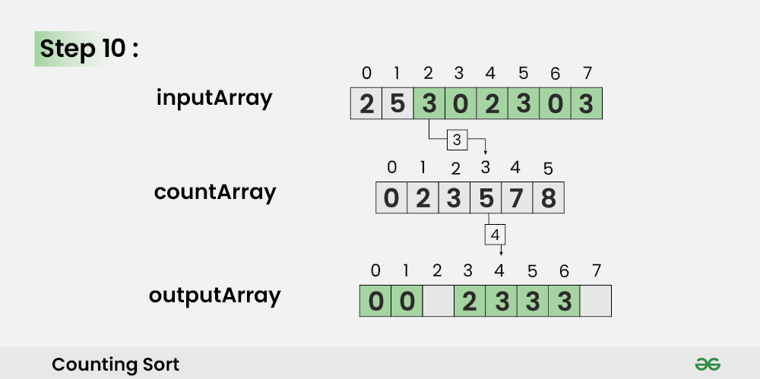
Counting sort

Slide 27
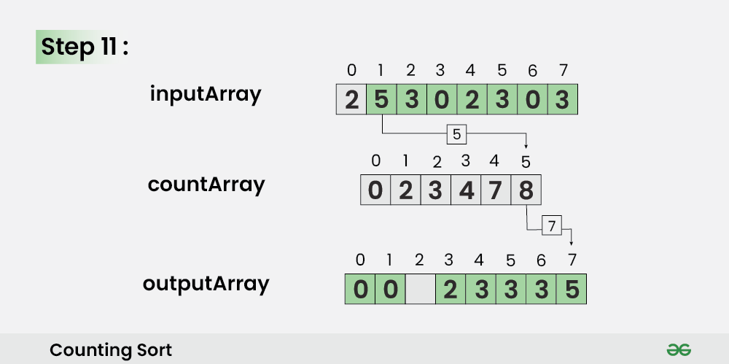
Counting sort

Slide 28
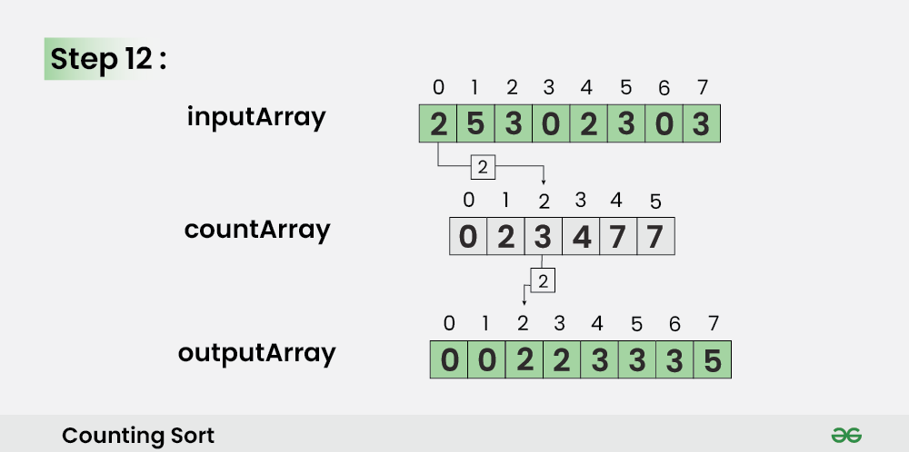
Counting sort

Slide 29
Cutshort algorithm
Basis step
Range definition step
Repositioning step
Sub-array sorting step

Slide 30
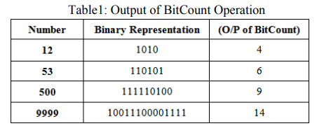
Bit count

Slide 31
Basis step
Bitband array size = 32/64
Input
Bitband array
1 bit = {1}, 2bit = {2,3}, 3bit = {4,5,7}, 4bit = {10,13,15,15}, 5bit = {16,17,19,20}, 6bits = {46,49,53}
0 | 1 | 2 | 3 | 4 | 5 | 6 | 7 | 8 | 9 | 10 | 11 | 12 | 13 | 14 | 15 | 16 | 17 | 18 | 19
15 | 10 | 19 | 49 | 13 | 2 | 7 | 4 | 1 | 3 | 10 | 20 | 17 | 15 | 46 | 16 | 53 | 0 | 5 | 9
0 | 1 | 2 | 3 | 4 | 5 | 6 | 7-31
1 | 1 | 2 | 3 | 6 | 4 | 3 | 0

Slide 32
Range definition step
Basis
0 | 1 | 2 | 3 | 4 | 5 | 6 | 7-31
1 | 1 | 2 | 3 | 6 | 4 | 3 | 0
K = 1
0 | 1 | 2 | 3 | 4 | 5 | 6 | 7-31
1 | 2 | 2 | 3 | 6 | 4 | 3 | 0
K = 2
0 | 1 | 2 | 3 | 4 | 5 | 6 | 7-31
1 | 2 | 4 | 3 | 6 | 4 | 3 | 0
K = 32
0 | 1 | 2 | 3 | 4 | 5 | 6 | 7-31
1 | 2 | 4 | 7 | 13 | 17 | 20 | 20

Slide 33
Repositioning step
Input
0 | 1 | 2 | 3 | 4 | 5 | 6 | 7 | 8 | 9 | 10 | 11 | 12 | 13 | 14 | 15 | 16 | 17 | 18 | 19
15 | 10 | 19 | 49 | 13 | 2 | 7 | 4 | 1 | 3 | 10 | 20 | 17 | 15 | 46 | 16 | 53 | 0 | 5 | 9
15₁₀ = 1111₂
Bitband
0 | 1 | 2 | 3 | 4 | 5 | 6 | 7-31
1 | 2 | 4 | 7 -> 8 | 13 | 17 | 20 | 20
Repositioning
0 | 1 | 2 | 3 | 4 | 5 | 6 | 7 | 8 | 9 | 10 | 11 | 12 | 13 | 14 | 15 | 16 | 17 | 18 | 19
 |  |  |  |  |  |  | 15

Slide 34
Repositioning step
Input
0 | 1 | 2 | 3 | 4 | 5 | 6 | 7 | 8 | 9 | 10 | 11 | 12 | 13 | 14 | 15 | 16 | 17 | 18 | 19
15 | 10 | 19 | 49 | 13 | 2 | 7 | 4 | 1 | 3 | 10 | 20 | 17 | 15 | 46 | 16 | 53 | 0 | 5 | 9
10₁₀ = 1010₂
Bitband
0 | 1 | 2 | 3 | 4 | 5 | 6 | 7-31
1 | 2 | 4 | 8 -> 9 | 13 | 17 | 20 | 20
Repositioning
0 | 1 | 2 | 3 | 4 | 5 | 6 | 7 | 8 | 9 | 10 | 11 | 12 | 13 | 14 | 15 | 16 | 17 | 18 | 19
 |  |  |  |  |  |  | 15 | 10

Slide 35
Repositioning step
Input
0 | 1 | 2 | 3 | 4 | 5 | 6 | 7 | 8 | 9 | 10 | 11 | 12 | 13 | 14 | 15 | 16 | 17 | 18 | 19
15 | 10 | 19 | 49 | 13 | 2 | 7 | 4 | 1 | 3 | 10 | 20 | 17 | 15 | 46 | 16 | 53 | 0 | 5 | 9
19₁₀ = 10001₂
Bitband
0 | 1 | 2 | 3 | 4 | 5 | 6 | 7-31
1 | 2 | 4 | 9 | 13 ->14 | 17 | 20 | 20
Repositioning
0 | 1 | 2 | 3 | 4 | 5 | 6 | 7 | 8 | 9 | 10 | 11 | 12 | 13 | 14 | 15 | 16 | 17 | 18 | 19
 |  |  |  |  |  |  | 15 | 10 |  |  |  |  | 19

Slide 36
Repositioning step
Input
0 | 1 | 2 | 3 | 4 | 5 | 6 | 7 | 8 | 9 | 10 | 11 | 12 | 13 | 14 | 15 | 16 | 17 | 18 | 19
15 | 10 | 19 | 49 | 13 | 2 | 7 | 4 | 1 | 3 | 10 | 20 | 17 | 15 | 46 | 16 | 53 | 0 | 5 | 9
49₁₀ = 110001₂
Bitband
0 | 1 | 2 | 3 | 4 | 5 | 6 | 7-31
1 | 2 | 4 | 9 | 14 | 17 ->18 | 20 | 20
Repositioning
0 | 1 | 2 | 3 | 4 | 5 | 6 | 7 | 8 | 9 | 10 | 11 | 12 | 13 | 14 | 15 | 16 | 17 | 18 | 19
 |  |  |  |  |  |  | 15 | 10 |  |  |  |  | 19 |  |  |  | 49

Slide 37
Repositioning step
Input
0 | 1 | 2 | 3 | 4 | 5 | 6 | 7 | 8 | 9 | 10 | 11 | 12 | 13 | 14 | 15 | 16 | 17 | 18 | 19
15 | 10 | 19 | 49 | 13 | 2 | 7 | 4 | 1 | 3 | 10 | 20 | 17 | 15 | 46 | 16 | 53 | 0 | 5 | 9
13₁₀ = 1011₂
Bitband
0 | 1 | 2 | 3 | 4 | 5 | 6 | 7-31
1 | 2 | 4 | 9 -> 10 | 14 | 18 | 20 | 20
Repositioning
0 | 1 | 2 | 3 | 4 | 5 | 6 | 7 | 8 | 9 | 10 | 11 | 12 | 13 | 14 | 15 | 16 | 17 | 18 | 19
 |  |  |  |  |  |  | 15 | 10 | 13 |  |  |  | 19 |  |  |  | 49

Slide 38
Repositioning step
Input
0 | 1 | 2 | 3 | 4 | 5 | 6 | 7 | 8 | 9 | 10 | 11 | 12 | 13 | 14 | 15 | 16 | 17 | 18 | 19
15 | 10 | 19 | 49 | 13 | 2 | 7 | 4 | 1 | 3 | 10 | 20 | 17 | 15 | 46 | 16 | 53 | 0 | 5 | 9
2₁₀ = 10₂
Bitband
0 | 1 | 2 | 3 | 4 | 5 | 6 | 7-31
1 | 2 -> 3 | 4 | 10 | 14 | 18 | 20 | 20
Repositioning
0 | 1 | 2 | 3 | 4 | 5 | 6 | 7 | 8 | 9 | 10 | 11 | 12 | 13 | 14 | 15 | 16 | 17 | 18 | 19
 |  | 2 |  |  |  |  | 15 | 10 | 13 |  |  |  | 19 |  |  |  | 49

Slide 39
Repositioning step
Input
0 | 1 | 2 | 3 | 4 | 5 | 6 | 7 | 8 | 9 | 10 | 11 | 12 | 13 | 14 | 15 | 16 | 17 | 18 | 19
15 | 10 | 19 | 49 | 13 | 2 | 7 | 4 | 1 | 3 | 10 | 20 | 17 | 15 | 46 | 16 | 53 | 0 | 5 | 9
7₁₀ = 111₂
Bitband
0 | 1 | 2 | 3 | 4 | 5 | 6 | 7-31
1 | 3 | 4 -> 5 | 10 | 14 | 18 | 20 | 20
Repositioning
0 | 1 | 2 | 3 | 4 | 5 | 6 | 7 | 8 | 9 | 10 | 11 | 12 | 13 | 14 | 15 | 16 | 17 | 18 | 19
 |  | 2 |  | 7 |  |  | 15 | 10 | 13 |  |  |  | 19 |  |  |  | 49

Slide 40
Repositioning step
Input
0 | 1 | 2 | 3 | 4 | 5 | 6 | 7 | 8 | 9 | 10 | 11 | 12 | 13 | 14 | 15 | 16 | 17 | 18 | 19
15 | 10 | 19 | 49 | 13 | 2 | 7 | 4 | 1 | 3 | 10 | 20 | 17 | 15 | 46 | 16 | 53 | 0 | 5 | 9
9₁₀ = 1001₂
Bitband
0 | 1 | 2 | 3 | 4 | 5 | 6 | 7-31
2 | 4 | 5 | 12 | 15 | 19 | 20 | 20
Repositioning
0 | 1 | 2 | 3 | 4 | 5 | 6 | 7 | 8 | 9 | 10 | 11 | 12 | 13 | 14 | 15 | 16 | 17 | 18 | 19
0 | 1 | 2 | 3 | 7 | 4 | 5 | 15 | 10 | 13 | 10 | 15 | 9 | 19 | 20 | 17 | 16 | 49 | 46 | 53

Slide 41
Sub-array sorting step
Use quick / merge / insertion sort to sort sub array
0 | 1 | 2 | 3 | 4 | 5 | 6 | 7-31
2 | 4 | 5 | 12 | 15 | 19 | 20 | 20
0 | 1 | 2 | 3 | 4 | 5 | 6 | 7 | 8 | 9 | 10 | 11 | 12 | 13 | 14 | 15 | 16 | 17 | 18 | 19
0 | 1 | 2 | 3 | 7 | 4 | 5 | 15 | 10 | 13 | 10 | 15 | 9 | 19 | 20 | 17 | 16 | 49 | 46 | 53

Slide 42
Sub-array sorting step
Use quick / merge / insertion sort to sort sub array
0 | 1 | 2 | 3 | 4 | 5 | 6 | 7-31
1 | 2 | 4 | 7 | 13 | 17 | 20 | 20
0 | 1 | 2 | 3 | 4 | 5 | 6 | 7 | 8 | 9 | 10 | 11 | 12 | 13 | 14 | 15 | 16 | 17 | 18 | 19
0 | 1 | 2 | 3 | 7 | 4 | 5 | 15 | 10 | 13 | 10 | 15 | 9 | 19 | 20 | 17 | 16 | 49 | 46 | 53

Slide 43
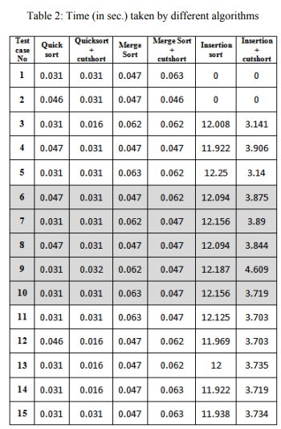
Result
Time complexity :
Best case : O(nlogn-nlog(dmax))
Worst case : O(nlogn)
Average case : O(nlogn-nlogd)
Random
Worst
Best
Notes:
dmax is the maximum number of subarrays obtained from original array

Slide 44
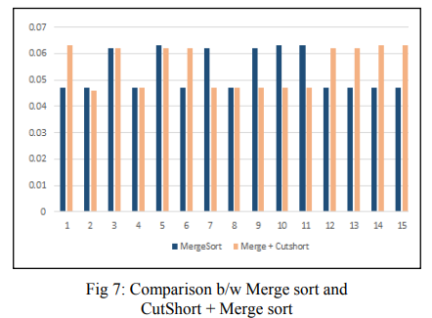
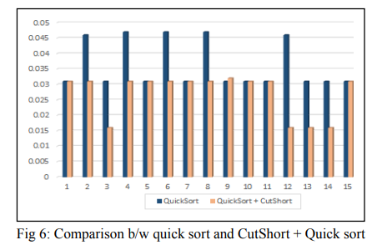
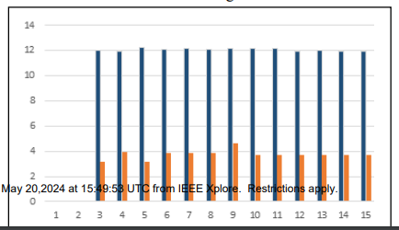
Result
Comparision Insertion sort and CutSort + Insertion sort

