Slide 1
Data Compression Using Adaptive Coding and Partial String Matching
John G. Cleary, Ian H. Witten
IEEE Transactions on Communications, vol. 32, no. 4, pp. 396-402, 1984
Presenter: Yen-Yu Chen
Date: Dec.17, 2024

Slide 2
Abstract
The recently developed technique of arithmetic coding, in conjunction with a Markov model of the source, is a powerful method of data compression in situations where a linear treatment is inappropriate. Adaptive coding allows the model to be constructed dynamically by both encoder and decoder during the course of the transmission, and has been shown to incur a smaller coding overhead than explicit transmission of the model's statistics. But there is a basic conflict between the desire to use high-order Markov models and the need to have them formed quickly as the initial part of the message is sent. This paper describes how the conflict can be resolved with partial string matching, and reports experimental results which show that mixed-case English text can be coded in as little as 2.2 bits/ character with no prior knowledge of the source.

Slide 3
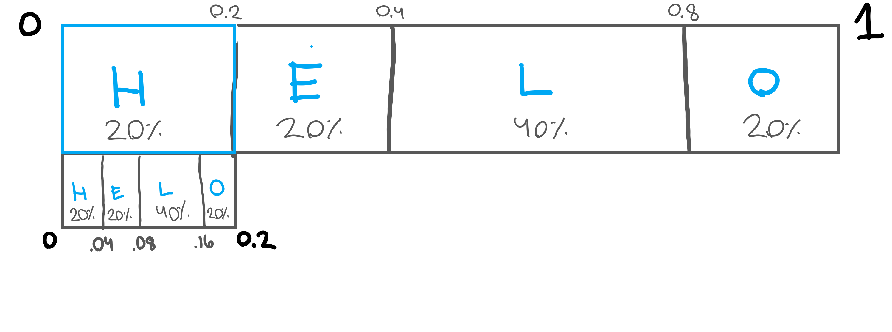
Arithmetic Coding
Arithmetic coding represents a sequence of symbols as a single number between 0 and 1. This is achieved by successively narrowing down the interval based on the probabilities of each symbol in the sequence.
HELLO
w | p(w)
H | 20%
E | 20%
L | 40%
O | 20%
Notes:
用一個浮點數表示一段序列

Slide 4
Arithmetic Coding
HELLO
w | p(w)
H | 20%
E | 20%
L | 40%
O | 20%
Notes:
用一個浮點數表示一段序列

Slide 5
Markov Model
bbb
bba
abb
bab
aba

Slide 6
Adaptive Transmission of the Model
bbbbbabaaa
bbb
bba

Slide 7
Markov Model in PPM
b
a
1
60%
20%
bbb
2
bba
1
3
2
1
2
abb
bab
aba
3
1

Slide 8
Escape Probabilities
b
?
…babacb…,c never occur
50%
50%
1
bbb
2
bba
?
1
1
3
2
1
abb
bab
aba
3
1

Slide 9
Escape Probabilities
1-order Markov Model
…babaab…
2-order Markov Model
a
1
bbb
2
bba
3-order Markov Model
ba
1
3
2
1
abb
bab
aba
3
1

