Slide 1
Research on Improving Genetic Algorithm in Mobile Robot Path Planning
Xiaoxiang Xia
2024 2nd International Conference on Algorithm, Image Processing and Machine Vision (AIPMV)
Presenter: Pei-Chian Lee
Date: Dec. 17, 2024

Slide 2
Abstract
Sound path planning is essential for mobile robots to carry out exploration tasks. To date, the use of various intelligent algorithms in robot path planning has yielded significant advancements, particularly in areas such as path planning, obstacle avoidance, and collaborative control. These advancements enhance the robots' capabilities, collaboration, and efficiency in complex environments. However, traditional algorithms like particle swarm optimization, ant colony algorithms, and dynamic window algorithms face challenges in robot path planning, including slow convergence and a tendency to get stuck in local optima. Addressing the complexities of mobile robot path planning, genetic algorithms have been integrated. Yet, standard genetic algorithms suffer from slow convergence and low efficiency. An enhanced mobile robot path planning scheme using an improved genetic algorithm has been proposed. Simulation tests in a grid environment demonstrate that this approach
narrows the local search range for paths, enhancing the algorithm's adaptability, convergence speed, and global search capabilities. Overall, it outperforms the standard genetic algorithm, offering valuable insights for researchers studying and applying algorithms in mobile robot path planning.
Notes:
聲音路徑規劃對於移動機器人執行探索任務至關重要。迄今為止，各種智能算法在機器人路徑規劃中的應用已經取得了顯著的進展，特別是在路徑規劃、避障和協同控制等領域。這些進展提升了機器人在複雜環境中的能力、協作性和效率。然而，傳統的算法，如粒子群優化、螞蟻算法和動態窗口算法，在機器人路徑規劃中面臨一些挑戰，包括收斂速度慢和容易陷入局部最優解。為了解決移動機器人路徑規劃的複雜性，遺傳算法已被集成進來。然而，標準的遺傳算法仍然存在收斂速度慢和效率低下的問題。因此，提出了一種基於改進遺傳算法的增強型移動機器人路徑規劃方案。在網格環境中的仿真測試表明，這種方法縮小了路徑的局部搜索範圍，提高了算法的適應性、收斂速度和全局搜索能力。總體而言，它優於標準遺傳算法，為研究和應用移動機器人路徑規劃算法的研究者提供了寶貴的見解。

Slide 3
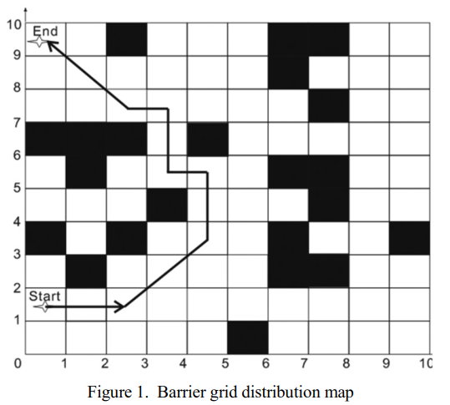
Mobile Robot Path Planing
Notes:
3b

Slide 4
Individual coding
Individual: {(0,1), (1,1), (2,1) ..., (0,9)}
Individual coding: {0000,0001,0001, 0001,..., 0000,1001}
Notes:
3b

Slide 5
population initialization
P ={ p1,p2,⋯,pn - 1,pn}
pi（i=1, 2,…,n）is the path individual.
Notes:
3b

Slide 6
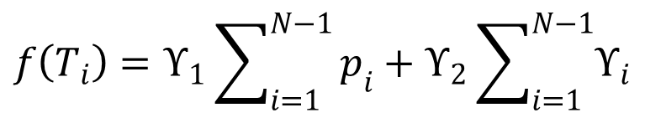
Fitness function
$$f\left(T_{i}\right)=ϒ_{1}\sum_{i=1}^{N−1}{p_{i}}+ϒ_{2}\sum_{i=1}^{N−1}{ϒ_{i}}$$
Notes:
3b

Slide 7
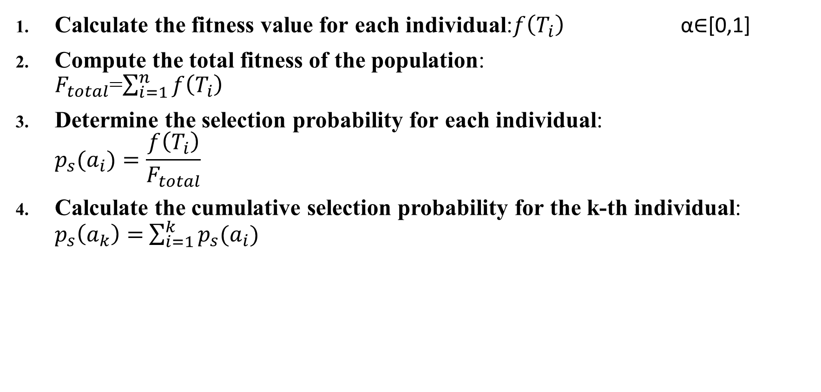
Selection Operator:roulette wheel method
Calculate the fitness value for each individual:$f\left(T_{i}\right)$ α∈[0,1]
Compute the total fitness of the population: $F_{total}$=$\sum_{i=1}^{n}{f\left(T_{i}\right)}$
Determine the selection probability for each individual: $p_{s}(a_{i})=\frac{f\left(T_{i}\right)}{F_{total}}$
Calculate the cumulative selection probability for the k-th individual: $p_{s}\left(a_{k}\right)=$ $\sum_{i=1}^{k}{p_{s}(a_{i})}$
Notes:
輪盤算法 舉例子

Slide 8
Crossover operator
Coincident-point crossover: Coincident-point crossover involves randomly selecting two individuals and choosing points with identical grid coordinates for the crossover operation. If there are multiple coincident points, one is randomly chosen for crossover.
A: [(0,0),(1, 2), (3, 4), (5, 6), (7, 8),(9,9)]
B: [(0,0),(1, 2), (4, 5), (5, 6), (9, 10),(9,9)]
A’: [(0,0),(1, 2), (3, 4), (5, 6), (9, 10),(9,9)]
B’:[(0,0),(1, 2), (4, 5), (5, 6), (7, 8),(9,9)]
Notes:
交叉涉及替換和重新組合兩個個體結構的部分，以創造下一代。在遺傳演化過程中，它在全局搜尋中起著至關重要的作用。每次迭代中選擇最佳基因進行交叉，可能會使算法陷入局部最優解，從而導致過早收斂。本文採用了單點交叉和重合點交叉的混合方法。重合點交叉是指隨機選擇兩個個體，並選擇具有相同網格座標的點進行交叉操作。如果有多個重合點，則隨機選擇一個進行交叉。如果找不到重合點，則隨機選擇交叉點進行單點交叉，在路徑上的重合點處進行部分染色體交換，並以交叉概率進行交換，從而防止形成不連續的路徑，並增強算法的搜尋能力，同時保證路徑個體的有效性

Slide 9
Crossover operator
2. single-point crossover: If no coincident points are found,
random crossover points are selected for single-point crossover,
exchanging partial chromosomes at the coincident points along
the path with a crossover probability.
A: [(0,0) ,(1, 2), (3, 4), (5, 6), (7, 8),(9,9)]
B: [(0,0) ,(2, 3), (4, 5), (6, 7), (8, 9),(9,9)]
A’: [(0,0) ,(1, 2), (3, 4), (6, 7), (8, 9),(9,9)]
B’: [(0,0) ,(2, 3), (4, 5), (5, 6), (7, 8),(9,9)]

Slide 10
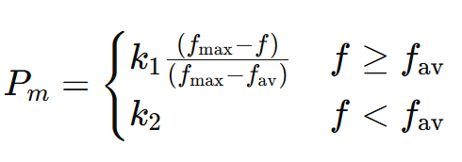
Mutation operator
Mutation can extend new search spaces, preserve population diversity, and prevent premature convergence during localized convergence of the population.

Slide 11
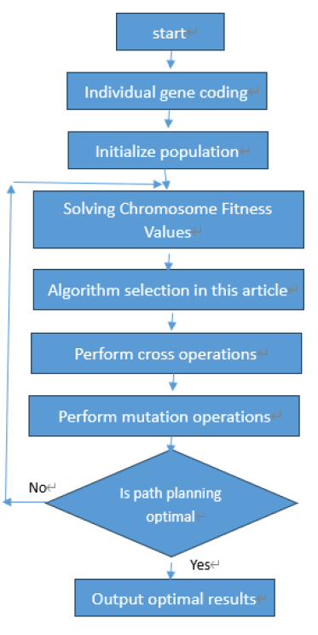
Improving the Genetic Algorithm Process
Notes:
The experimental results indicate that, within the
same environment, the improved genetic algorithm IGA
considers both path length and obstacle intersection degree as
weight factors in fitness calculations. It employs the roulette
wheel method for individual selection and a hybrid approach of
single and coincident points for crossover. By incorporating an
adaptive mutation probability function, the algorithm adjusts
mutation probability based on population fitness, thereby
preventing the algorithm from getting stuck in local optima.

Slide 12
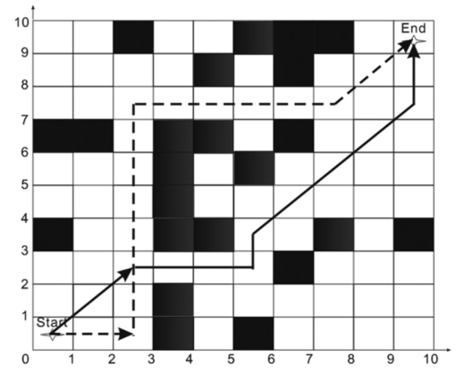
Result
Notes:
14+2根號 2​ ≈16.83
5+6根號2≈13.49

Slide 13
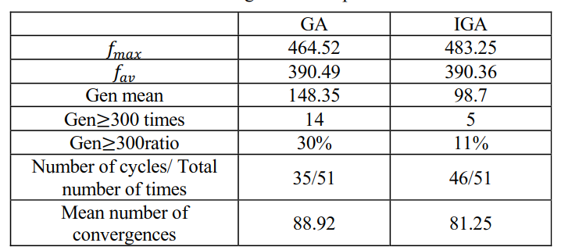
Result
Notes:
如表 2 所示，兩種算法的最大適應度和平均適應度水平相當。IGA 算法根據路徑長度和障礙物交叉程度來選擇下一代進行演化，顯著提高了識別最優解的效率。此外，增強的運算符選擇功能保證了具有較高適應度的個體有更大的機會被傳遞到下一代，從而使 IGA 算法中超過 300 次演化的比例比 GA 算法降低了約 70%。IGA 算法所使用的自適應突變概率函數能根據種群適應度調整突變概率，從而實現比 GA 算法更優的收斂性。因此，改進後的遺傳算法比標準遺傳算法具有顯著更高的效率【15】。
IGA未收斂次數較少，平均收斂次數比較少，所以IGA演算法效率比較高

Slide 14
Conclusions
Addressing the complexities of path planning for mobile robots, a path planning scheme is proposed using enhanced genetic algorithms. This approach mitigates the issues of slow convergence and premature convergence often associated with genetic algorithms.
Simulation tests demonstrate that this strategy narrows the search scope for the optimal path and cuts down on the number of evolutionary generations required.
It significantly reduces the time taken to locate the optimal path, enhancing the efficiency of the search process .
Notes:
避免過早收斂(避免局部最佳解情形)
1. 為了解決移動機器人路徑規劃的複雜性，提出了一種使用增強遺傳算法的路徑規劃方案。這種方法減少了遺傳算法中常見的收斂緩慢和過早收斂問題。
2. 模擬測試表明，這一策略縮小了尋找最優路徑的範圍，並減少了所需的進化代數。
3. 因此，顯著減少了尋找最優路徑所需的時間，提升了搜尋過程的效率【16】。

