Slide 1
Enumerating longest increasing subsequences and patience sorting
Sergei Bespamyatnikh, Michael Segal
Information Processing Letters 76, 2000, pp.7~11.
Presenter: Shih-Hong Lee
Date: Dec. 17, 2024

Slide 2
Abstract
In this paper we present three algorithms that solve three combinatorial optimization problems related to each other. One of them is the patience sorting game, invented as a practical method of sorting real decks of cards. The second problem is computing the longest monotone increasing subsequence of the given sequence of n positive integers in the range 1,..., n. The third problem is to enumerate all the longest monotone increasing subsequences of the given permutation.

Slide 3
Longest Increasing Subsequence
Given a sequence A = <1,5,3,7,6>
LIS of A = <1,3,6>, <1,5,7>, <1,5,6>

Slide 4
Van Emde Boas tree
Maintain the sorted list of integers in the range {1, 2, 3, …, n}
Each deletion and insertion cost O(loglogn)
Find predecessor and successor cost O(1)

Slide 5
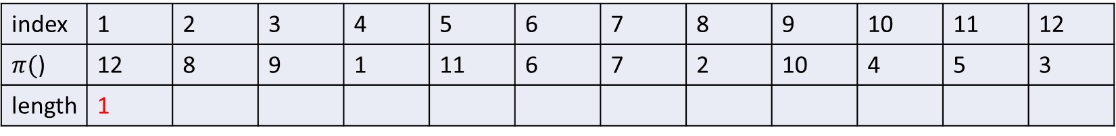
Algo 1. Longest Increasing Subsequence
Given a permutation sequence A = <12,8,9,1,11,6,7,2,10,4,5,3>
Van Emde Boas tree
12
L[]
index | 1 | 2 | 3 | 4 | 5 | 6 | 7 | 8 | 9 | 10 | 11 | 12
$π($) | 12 | 8 | 9 | 1 | 11 | 6 | 7 | 2 | 10 | 4 | 5 | 3
length | 1

Slide 6
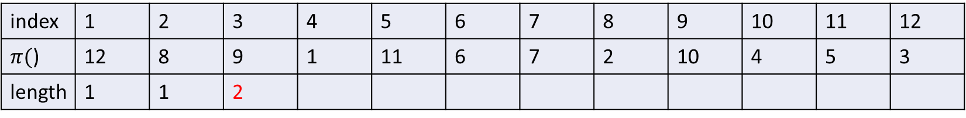
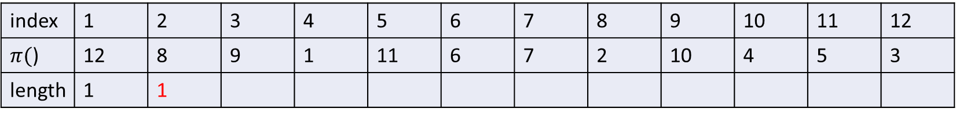
Given a permutation sequence A = <12,8,9,1,11,6,7,2,10,4,5,3>
Van Emde Boas tree
8 | 12
L[]
index | 1 | 2 | 3 | 4 | 5 | 6 | 7 | 8 | 9 | 10 | 11 | 12
$π($) | 12 | 8 | 9 | 1 | 11 | 6 | 7 | 2 | 10 | 4 | 5 | 3
length | 1 | 1
Van Emde Boas tree
8 | 9
L[]
index | 1 | 2 | 3 | 4 | 5 | 6 | 7 | 8 | 9 | 10 | 11 | 12
$π($) | 12 | 8 | 9 | 1 | 11 | 6 | 7 | 2 | 10 | 4 | 5 | 3
length | 1 | 1 | 2

Slide 7
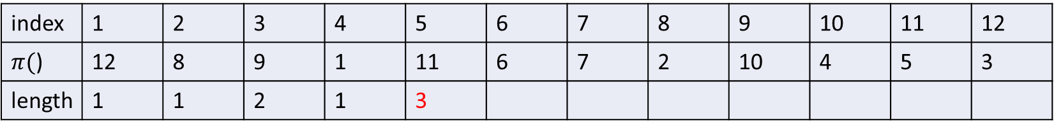
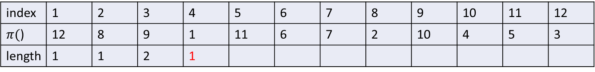
Given a permutation sequence A = <12,8,9,1,11,6,7,2,10,4,5,3>
Van Emde Boas tree
1 | 8 | 9
L[]
index | 1 | 2 | 3 | 4 | 5 | 6 | 7 | 8 | 9 | 10 | 11 | 12
$π($) | 12 | 8 | 9 | 1 | 11 | 6 | 7 | 2 | 10 | 4 | 5 | 3
length | 1 | 1 | 2 | 1
Van Emde Boas tree
1 | 9 | 11
L[]
index | 1 | 2 | 3 | 4 | 5 | 6 | 7 | 8 | 9 | 10 | 11 | 12
$π($) | 12 | 8 | 9 | 1 | 11 | 6 | 7 | 2 | 10 | 4 | 5 | 3
length | 1 | 1 | 2 | 1 | 3

Slide 8
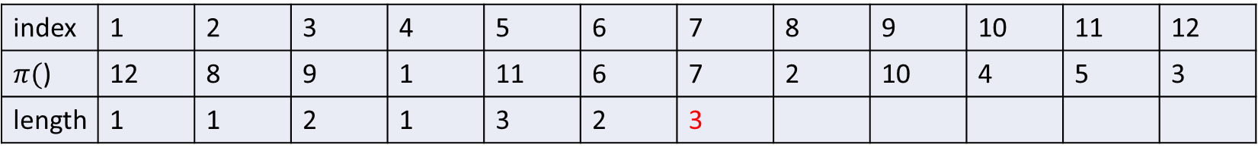
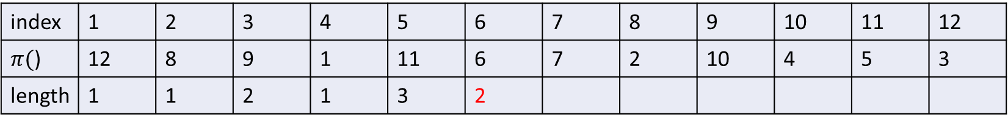
Given a permutation sequence A = <12,8,9,1,11,6,7,2,10,4,5,3>
Van Emde Boas tree
1 | 6 | 9 | 11
L[]
index | 1 | 2 | 3 | 4 | 5 | 6 | 7 | 8 | 9 | 10 | 11 | 12
$π($) | 12 | 8 | 9 | 1 | 11 | 6 | 7 | 2 | 10 | 4 | 5 | 3
length | 1 | 1 | 2 | 1 | 3 | 2
Van Emde Boas tree
1 | 6 | 7 | 11
L[]
index | 1 | 2 | 3 | 4 | 5 | 6 | 7 | 8 | 9 | 10 | 11 | 12
$π($) | 12 | 8 | 9 | 1 | 11 | 6 | 7 | 2 | 10 | 4 | 5 | 3
length | 1 | 1 | 2 | 1 | 3 | 2 | 3

Slide 9
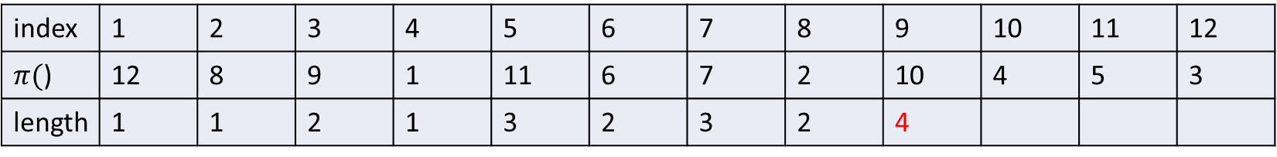
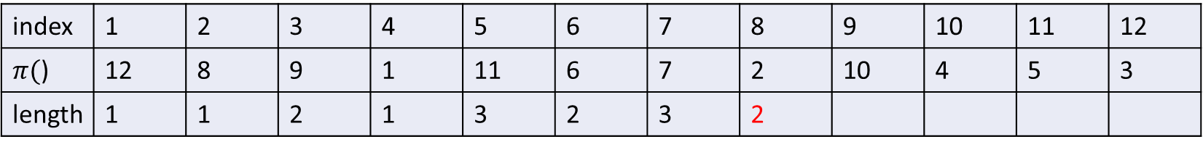
Given a permutation sequence A = <12,8,9,1,11,6,7,2,10,4,5,3>
Van Emde Boas tree
1 | 2 | 6 | 7
L[]
index | 1 | 2 | 3 | 4 | 5 | 6 | 7 | 8 | 9 | 10 | 11 | 12
$π($) | 12 | 8 | 9 | 1 | 11 | 6 | 7 | 2 | 10 | 4 | 5 | 3
length | 1 | 1 | 2 | 1 | 3 | 2 | 3 | 2
Van Emde Boas tree
1 | 2 | 7 | 10
L[]
index | 1 | 2 | 3 | 4 | 5 | 6 | 7 | 8 | 9 | 10 | 11 | 12
$π($) | 12 | 8 | 9 | 1 | 11 | 6 | 7 | 2 | 10 | 4 | 5 | 3
length | 1 | 1 | 2 | 1 | 3 | 2 | 3 | 2 | 4

Slide 10
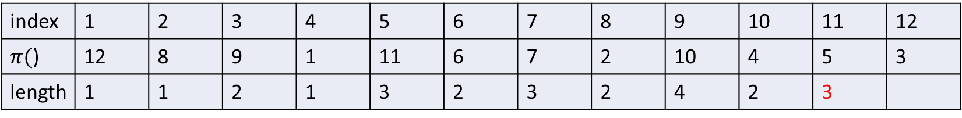
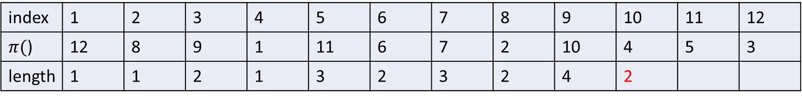
Given a permutation sequence A = <12,8,9,1,11,6,7,2,10,4,5,3>
Van Emde Boas tree
1 | 2 | 4 | 7 | 10
L[]
index | 1 | 2 | 3 | 4 | 5 | 6 | 7 | 8 | 9 | 10 | 11 | 12
$π($) | 12 | 8 | 9 | 1 | 11 | 6 | 7 | 2 | 10 | 4 | 5 | 3
length | 1 | 1 | 2 | 1 | 3 | 2 | 3 | 2 | 4 | 2
Van Emde Boas tree
1 | 2 | 4 | 5 | 7 | 10
L[]
index | 1 | 2 | 3 | 4 | 5 | 6 | 7 | 8 | 9 | 10 | 11 | 12
$π($) | 12 | 8 | 9 | 1 | 11 | 6 | 7 | 2 | 10 | 4 | 5 | 3
length | 1 | 1 | 2 | 1 | 3 | 2 | 3 | 2 | 4 | 2 | 3

Slide 11
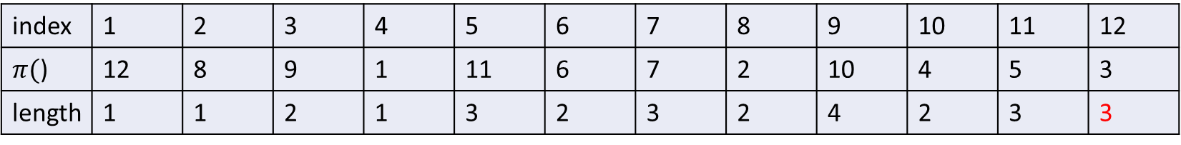
Given a permutation sequence A = <12,8,9,1,11,6,7,2,10,4,5,3>
Van Emde Boas tree
1 | 2 | 3 | 4 | 5 | 10
L[]
index | 1 | 2 | 3 | 4 | 5 | 6 | 7 | 8 | 9 | 10 | 11 | 12
$π($) | 12 | 8 | 9 | 1 | 11 | 6 | 7 | 2 | 10 | 4 | 5 | 3
length | 1 | 1 | 2 | 1 | 3 | 2 | 3 | 2 | 4 | 2 | 3 | 3

Slide 12
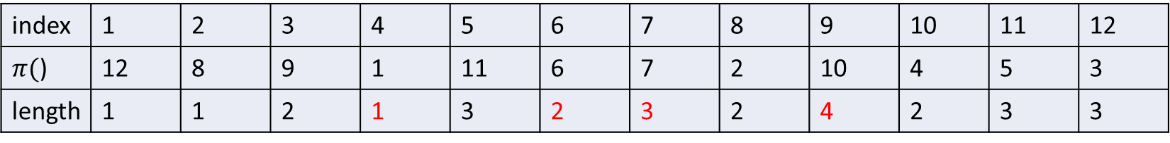
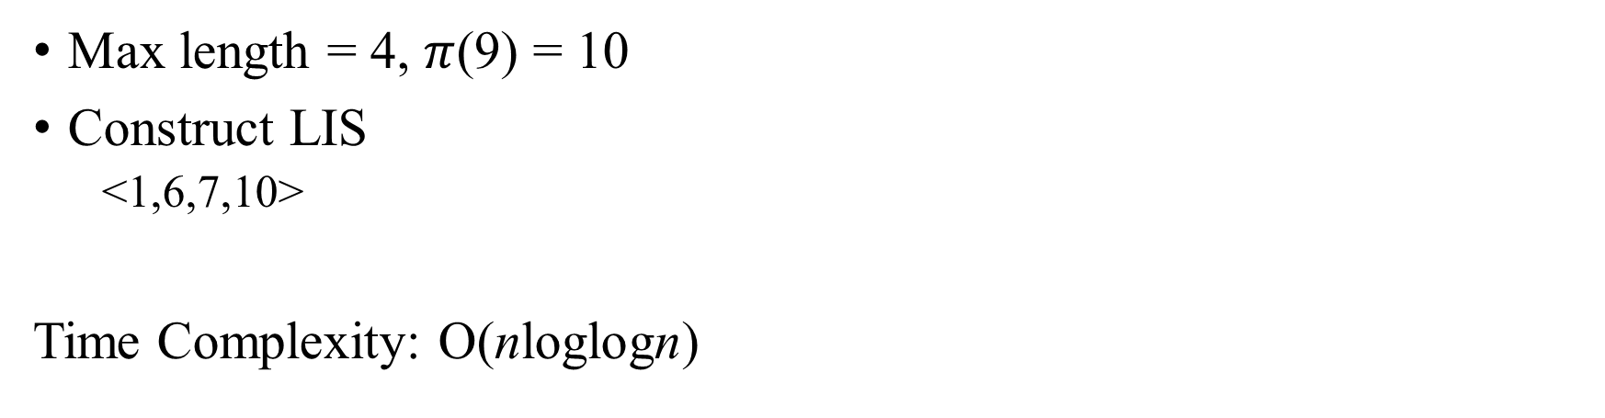
Construct LIS in O(n)
L[]
index | 1 | 2 | 3 | 4 | 5 | 6 | 7 | 8 | 9 | 10 | 11 | 12
$π($) | 12 | 8 | 9 | 1 | 11 | 6 | 7 | 2 | 10 | 4 | 5 | 3
length | 1 | 1 | 2 | 1 | 3 | 2 | 3 | 2 | 4 | 2 | 3 | 3
Max length = 4, $π$(9) = 10
Construct LIS
<1,6,7,10>
Time Complexity: O(nloglogn)

Slide 13
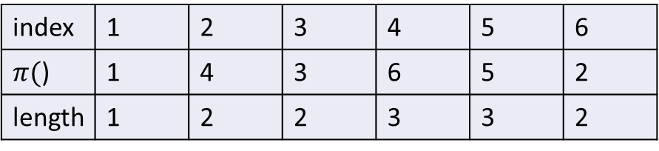
Algo 2. Reporting all subsequence
Given a permutation sequence A = <1,4,3,6,5,2>
Left1(5) = 4
Left2(5) = 3
L[]
index | 1 | 2 | 3 | 4 | 5 | 6
$π($) | 1 | 4 | 3 | 6 | 5 | 2
length | 1 | 2 | 2 | 3 | 3 | 2

Slide 14
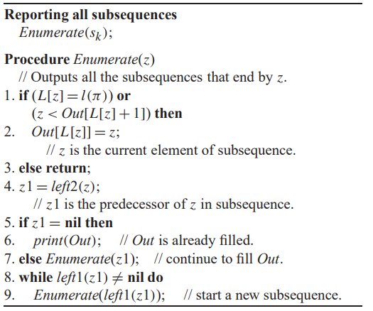

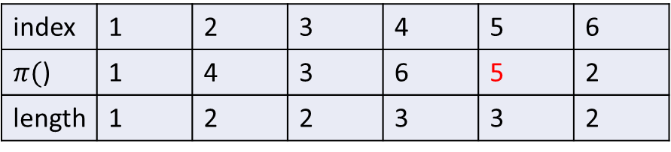
Algo 2. Reporting all subsequence
Main idea DFS
All subsequence of LIS end with 5
{1,3,5},{1,4,5},{1,3,6},{1,4,6}
Time complexity : O(n + Kl($π$))
n : maintain left1 and left2
K : numbers of LIS
l($π$)) : length of LIS
L[]
index | 1 | 2 | 3 | 4 | 5 | 6
$π($) | 1 | 4 | 3 | 6 | 5 | 2
length | 1 | 2 | 2 | 3 | 3 | 2

Slide 15
Algo 3. patience sorting
Take a deck of cards labeled 1, 2, 3,...,n. The deck is shuffled.
The rule: A card with a low index may be placed on a card with a higher index, or may be put into a new pile to the right of the existing piles
The target of the game is to finish with as few piles as possible.
Time complexity : O(nloglogn) with Van Emde Boas tree

Slide 16
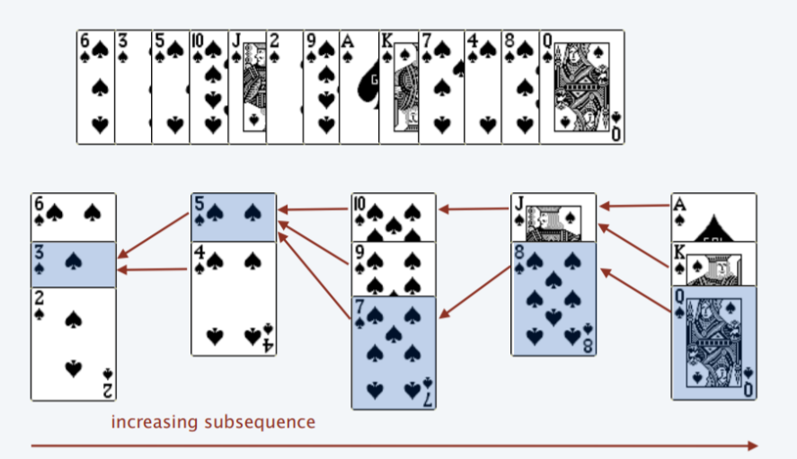
Algo 3. patience sorting

Slide 17
Thanks

