Slide 1
Risk factors affecting crash injury severity for different groups of e-bike riders: A classification tree-based logistic regression model
Zhengwu Wang,Shuai Huang,Jie Wang,Denisa Sulaj,Wei Hao, Aiwu Kuang
Journal of Safety Research 76(2021) 176~183
Presenter: Tse-Ying Huang
Date: Dec. 24, 2024
Notes:
2014 年第十屆數字技術國際會議
斯洛伐克 日利納
1

Slide 2
Abstract
This study investigates the risk factors for severe injuries among different groups of e-bike riders using a combined classification tree and logistic regression model. Data from three years of e-bike crashes in Hunan province were analyzed, considering factors such as rider attributes, vehicle characteristics, improper behaviors, and road conditions. The analysis segmented riders into five groups, revealing that non-occupational riders over 55 in urban areas have the highest likelihood of severe injury. Key risk factors, including high-speed roads, significantly affect injury severity across groups, while some factors are specific to certain groups. Policy recommendations include enhanced education on risky behaviors and traffic engineering measures to regulate e-bike use on high-speed roads.
2
Notes:
2

Slide 3

Motivation
1.Rapid growth of e-bike usage
In 1998, the number of e-bikes in China has surged from 58,000 to over 170 million by 2014
2.Safety statistics
In 2014 alone, e-bike-related crashes results in 7,201 fatalities, accounting for 11.4% of all road traffic deaths in China.
3.Risky Rider Behavior
They don't follow traffic rules and lack safety awareness.
4.Need for Comprehensive Research
Analyzing car accidents between people who work with e-bikes and ordinary people.
Notes:
電動自行車的普及：隨著電動自行車在中國的廣泛使用，從1998年立法以來，其數量從58,000輛增至2014年的超過1.7億輛，顯示出其作為方便且經濟的交通工具的重要性。
安全問題：電動自行車的流行伴隨著嚴重的安全問題。根據2014年的統計，與電動自行車相關的事故造成7,201人死亡，佔所有交通死亡的11.4%。這突顯了對電動自行車使用安全性的關注。
騎士行為：許多電動自行車騎士由於缺乏安全意識和交通法執行不嚴，經常違反交通規則，例如不遵守交通信號、在機動車道上行駛等，這增加了他們及其他道路使用者的事故風險。
較高的受傷風險：與傳統非機動交通工具相比，電動自行車在事故中造成嚴重傷害的風險更高。研究顯示，電動自行車事故中嚴重受傷的概率幾乎是傳統自行車事故的兩倍。
研究需求：儘管已有一些研究探討了影響電動自行車事故傷害嚴重性的因素，但針對不同騎士類別（尤其是職業騎士）的研究仍然相對較少。因此，有必要進一步探討影響不同類別騎士受傷風險的因素。
分析方法：本研究旨在填補這一空白，通過結合分類樹和邏輯回歸模型的方法，識別影響不同類別電動自行車騎士事故傷害嚴重性的潛在風險因素。

Slide 4
Data
From:Hunan Provincial Department of Traffic Police
Time:2014~2016
Attribute:
1.Injury severity
2.E-bike rider age
3.Rider gender
4.Rider occupation
5.Rider living region
11.Road type
12.Opponent vehicle type
13.Driver age of opponent vehicle
14.Driver gender of opponent vehicle
15.Pre-crash improper behavior of Riders
16. Pre-crash improper behavior of opponent
vehicle drivers
6. Time
7.Week
8.Season
9.Weather
10.Lighting

Slide 5
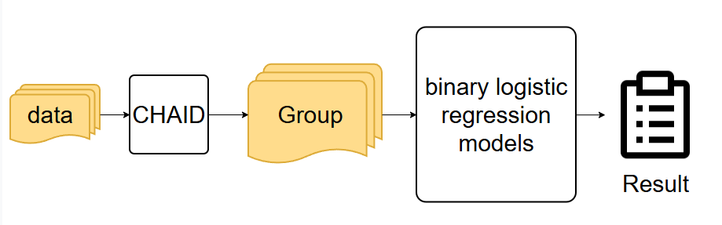
Method
Notes:
CHAID用於根據四個與騎士相關的屬性對涉及事故的電動自行車騎士進行分類：年齡、性別、職業（職業騎士與非職業騎士）和居住地區（城市與鄉村）。因變量是受傷嚴重性，分為嚴重受傷（致命和重傷）和非嚴重受傷（輕傷和僅有財產損失）
這些模型的反應變量是二元的，表示受傷嚴重性是嚴重還是非嚴重。指定了十個風險因素作為解釋變量，包括時間、星期幾、季節、天氣條件、光照條件、道路類型、對方車輛類型及其駕駛者年齡、不當駕駛行為和騎士的不當行為 前面說過就不在多贅述。

Slide 6
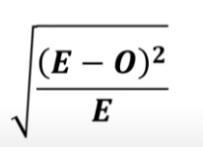



Method
CHAID:
Chi-Square=
Dependent valuable :
Injury severity
Independent valubable:
1.E-bike rider age
2.Rider gender
3.Rider occupation
4.Rider living region
 | Serious injury | Slightly injury | Expected value | Chi-square (serious) | Chi-square (slightly)
Above 55 | 452 | 150 | 301 | 8.7 | 8.7
Under 55 | 1012 | 146 | 579 | 17.9 | 17.9
Notes:
期望值減去我所想觀察的值

Slide 7
Method
Binary logestic regression model:
Response variable
Injury severity
Independent valubable:
(1) time
(2) week
(3) season
(4) weather
(5) lighting
(6) road type
(7) opponent vehicle type
(8) driver age of opponent vehicle
(9) pre-crash improper behavior of driver
(10) pre-crash improper behavior of the rider
delete p1>0.1
Notes:
刪除對這受傷嚴不嚴重這件事引響不大的

Slide 8
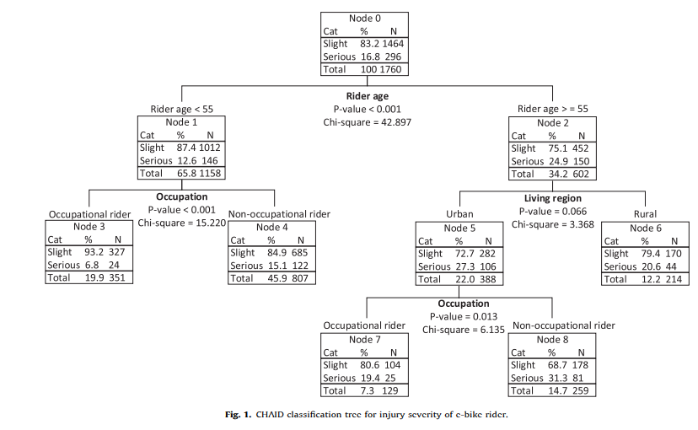








Result:Logistic regression analysis

Slide 9



Result:CHAID classification tree
1.under 55 + occupationl rider (lowest serious injury rate)
2.under 55 non-occupationl rider
3.above 55 + Rural rider
4.above 55 + urban occupationl rider
5.above 55 + urban non-occupationl rider (highest serious injury rate, 31.3%)
Notes:
1.55 歲以下 + 職業騎士（重傷率最低）
2.55 歲以下 + 非職業騎士
3.55 歲以上 + 農村騎士
4.55 歲以上 + 城區職業騎士
5.55 歲以上 + 城區非職業騎士（重傷率最高，31.3%）

Slide 10
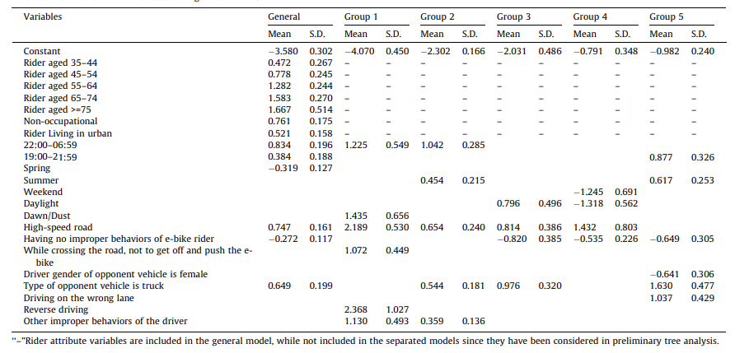
Result:Logistic regression analysis

Slide 11











Result:Logistic regression analysis
Time:
22:00–06:59(under 55 occupationl and non-occupationl rider) fatal
19:00–21:59(above 55 non-occupationl and urban rider ) fatal
Daylight(above 55 + urban occupationl rider)safety
50km/h road:
The average serve injury increase 10.9%,and different group from 9.2% to 24.1%.
Improper behavior:
If elder people have improper behavior it could increase 11~12% serve injury,and it could increase 3% in average.
Notes:
對於不同組別的騎乘者來說，此變數的邊 際效應從 0.092 到 0.241 不等。這表示
這表示在高速道路上發生的車禍，騎乘者嚴重受傷的機率比在低速道路上發生的車禍平均增加了 10.9%，而不同組別的騎乘者嚴重受傷的機率則增加了 9.2% 到 24.1%。
「無不當行為」與「有不當行為」相比，對整體樣本而言，前者可降低約 3.4% 的重傷機率；但在某些高齡騎士群中可降低高達 11–12% 不等。
亦即，高齡騎士若有不當騎乘行為（如該推車處未推行 e-bike、逆向行駛等），風險上升的幅度更大。

Slide 12





Result:Logistic regression analysis
Vehicle type:
When crush on truck the rsik will increase 9.5% in average.And above 55 urban non-occupational it will increase 35.7%.
Gender:
Rider(Above 55 , in urban areas, and non-professional riders) if the driver is a female driver, the risk will be decrease.
Notes:
對於不同組別的騎乘者來說，此變數的邊 際效應從 0.092 到 0.241 不等。這表示
這表示在高速道路上發生的車禍，騎乘者嚴重受傷的機率比在低速道路上發生的車禍平均增加了 10.9%，而不同組別的騎乘者嚴重受傷的機率則增加了 9.2% 到 24.1%。
「無不當行為」與「有不當行為」相比，對整體樣本而言，前者可降低約 3.4% 的重傷機率；但在某些高齡騎士群中可降低高達 11–12% 不等。
亦即，高齡騎士若有不當騎乘行為（如該推車處未推行 e-bike、逆向行駛等），風險上升的幅度更大。

Slide 13



Conclusion
Policy Implications:
Education and Norms:
1.Promote and train high-risk groups (above 55 urban non-occupational rider)
2.Establish a "formalized education and examination system" to increase ridrs' risk awareness of inappropriate behavior.
Notes:
針對高風險族群（特別是高齡騎士）進行宣導與訓練；
建議建立「正規化教育與考照制度」，提高騎士對不當行為的風險意識；

Slide 14
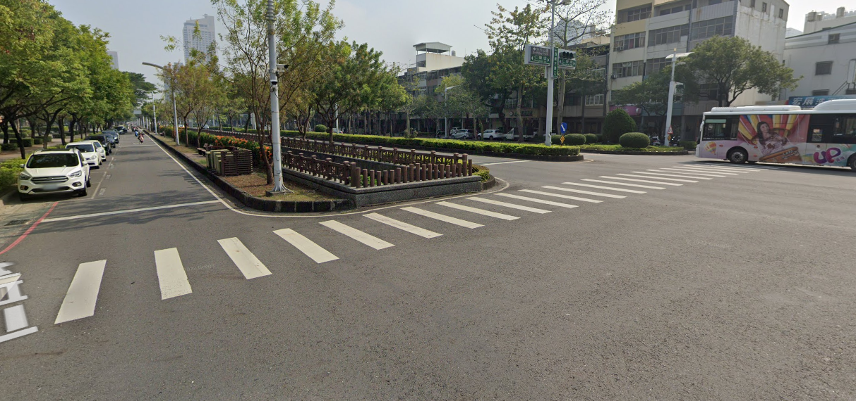




Conclusion
Policy Implications:
2.Road and Traffic Engineering
Create some physical partitions
3.Law Enforcement and Punishment
Notes:
針對高風險族群（特別是高齡騎士）進行宣導與訓練；
建議建立「正規化教育與考照制度」，提高騎士對不當行為的風險意識；

Slide 15



Conclusion
Study Limitation:
More detailed road characteristics (e.g. number of lanes, median width).
Vehicle characteristics (e-bike size, weight, power configuration).
The physical/mental state of the rider.
Traffic flow information at the time of the incident.
Notes:
針對高風險族群（特別是高齡騎士）進行宣導與訓練；
建議建立「正規化教育與考照制度」，提高騎士對不當行為的風險意識；
因此必須要規範 e-bike 在高速道路上的使用，或透過「物理隔離」與高車速車流分離。
執法與懲處
執法力度不夠

