Slide 1
Dispersed particle swarm optimization
Xingjuan Cai, Zhihua Cui, Jianchao Zeng, Ying Tan
Information Processing Letters
105 (2008) 231–235
Presenter: Wan-Ni Ou
Date: Dec. 24, 2024
Notes:
Division of System Simulation and Computer Application, Taiyuan University of Science and Technology, Taiyuan 030024, P.R. China b State Key Laboratory for Manufacturing Systems Engineering, Xi’an Jiaotong University, Xi’an 710049, P.R. China

Slide 2
Abstract
In particle swarm optimization (PSO) literatures, the published social coefficient settings are all centralized control manner aiming to increase the search density around the swarm memory. However, few concerns the useful information inside the particles’ memories.
Thus, to improve the convergence speed, we propose a new setting about social coefficient by introducing an explicit selection pressure, in which each particle decides its search direction toward the personal memory or swarm memory.
Due to different adaptation, this setting adopts a dispersed manner associated with its adaptive ability. Furthermore, a mutation strategy is designed to avoid premature convergence. Simulation results show the proposed strategy is effective and efficient.

Slide 3
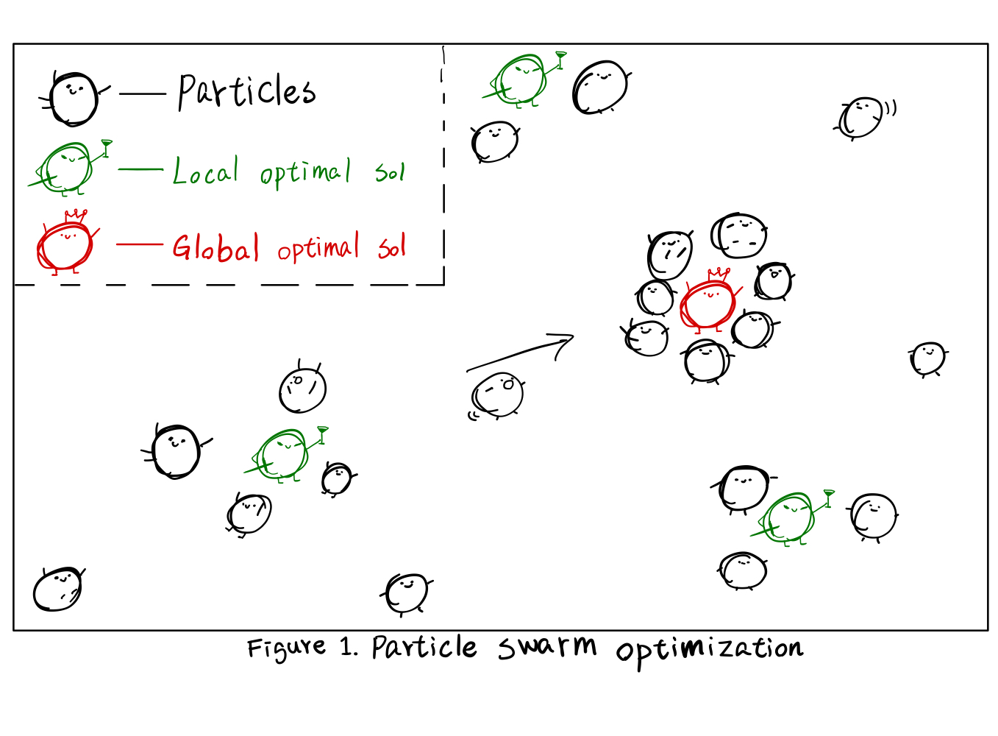
Particle swarm optimization (PSO) (1/3)

Slide 4
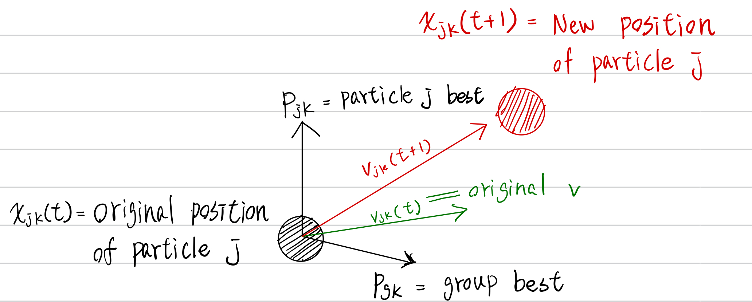




Particle swarm optimization (PSO) (2/3)
P_{jk}: particle j’s best
P_{gk}: group best
V_{jk}(t): original v

Slide 5
Particle swarm optimization (PSO) (3/3)

Slide 6



Dispersed PSO (1/2)

Slide 7
Dispersed PSO (2/2)
Step 1. Initial
Step 2. Calculate the dispersed social coefficient.
Step 3. Update particles’ position
Step 4. Update P_{g}、P_{j}
Step 5. Mutation
Step 6. If the stop criteria is satisfied, output P_{g}; otherwise, go to Step 2.

Slide 8
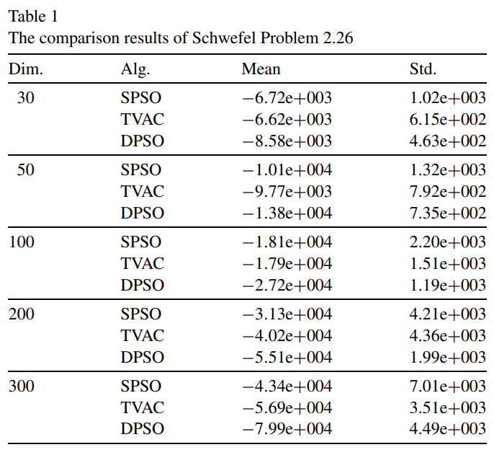
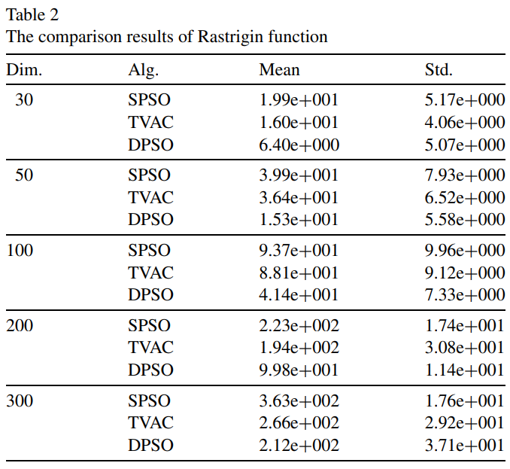
Results (1/2)

Slide 9
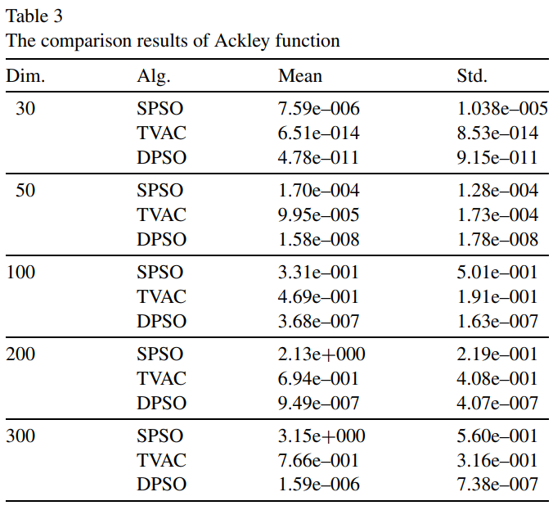
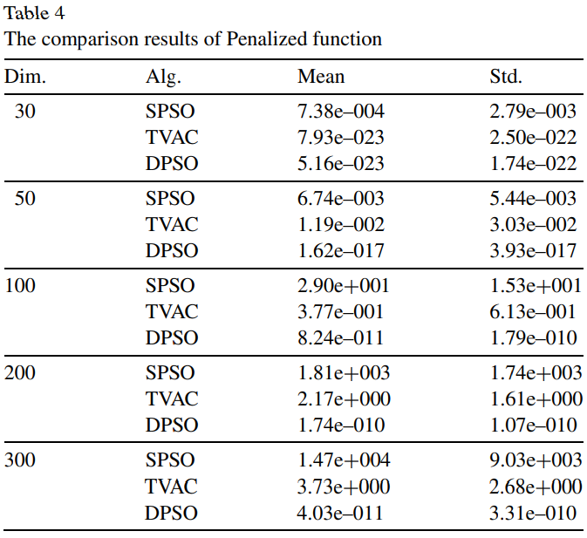
Results (2/2)

Slide 10
Conclusion
Using dispersed control mechanism, let each particle dynamically adjusts its social coefficient based on performance.

Slide 11
Thanks

