Slide 1
Exact and approximation algorithms for the inversion distance between two chromosomes
John Kececioglu and David Sankoff
93 Proceedings of the 4th Annual Symposium on Combinatorial Pattern Matching, pp.87-105(1993)
Presenter: Shian-Liang Lin
Notes:
http://www.combinatorialmath.ca/jcmcc/jcmcc71.html

Slide 2
Abstract
Motivated by the problem in computational biology of reconstructing the series of chromosome inversions by which one organism evolved from another, we consider the problem of computing the shortest series of reversals that transform one permutation to another, The permutations describe the order of genes on corresponding chromosomes, and a reversal takes an arbitrary substring of elements and reverses their order.

Slide 3
Abstract
For this problem we develop two algorithms: a greedy approximation algorithm that finds a solution provably close to optimal in O(n²) time and O(n) space for an n element permutation, and a branch and bound exact algorithm that finds an optimal solution in O(mL(n, n)) time and O(n²) space,
where m is the size of the branch and bound search tree and L(n, n) is the time to solve a linear program of n variables and n constraints. The greedy algorithm is the first to come within a constant factor of the optimum, and guarantees a solution that uses no more than twice the minimum number of reversals. The lower and upper bounds of the branch and bound algorithm
are a novel application of maximum weight matchings, shortest paths, and linear programming.

Slide 4
The reversal distance problem on permutations
Input: | 4 | 1 | 2 | 3
Reverse [1,n] | 3 | 2 | 1 | 4
Reverse [1,n-1] | 1 | 2 | 3 | 4
Reversal distance =2
Output: | 1 | 2 | 3 | 4

Slide 5
Natural algorithm
Input: | 4 | 1 | 2 | 3
Reverse [1,2] | 1 | 4 | 2 | 3
Reverse [2,3] | 1 | 2 | 4 | 3
Reverse [3,4] | 1 | 2 | 3 | 4
Reversal distance
=3=n-1
Output: | 1 | 2 | 3 | 4

Slide 6
Terminology
Input(π): | 0 | 4 | 1 | 2 | 3 | 5
breakpoints
A pair of adjacent positions (i, i+ 1) such that $|$π_{i+1}-π_{i}$|≠$1
A pair of adjacent positions (i, i+ 1) such that |π_{i+1}-π_{i} |≠1
adjacent
A pair of adjacent positions (i, i+ 1) such that $|$π_{i+1}-π_{i}$|=$1
A pair of adjacent positions (i, i+ 1) such that |π_{i+1}-π_{i} |=1
strip
an interval [i, j] such that (i - 1, i) and (j, j + 1) are breakpoints,and no breakpoint lies between them.

Slide 7
Terminology
Input(π): | 0 | 4 | 1 | 2 | 3 | 5
breakpoints
A pair of adjacent positions (i, i+ 1) such that $|$π_{i+1}-π_{i}$|≠$1
A pair of adjacent positions (i, i+ 1) such that |π_{i+1}-π_{i} |≠1
adjacent
A pair of adjacent positions (i, i+ 1) such that $|$π_{i+1}-π_{i}$|=$1
A pair of adjacent positions (i, i+ 1) such that |π_{i+1}-π_{i} |=1
strip
an interval [i, j] such that (i - 1, i) and (j, j + 1) are breakpoints,and no breakpoint lies between them.

Slide 8
decreasing strip
Input: | 0 | 4 | 1 | 2 | 3 | 5
Remove 1 breakpoint
Reverse [1,4] | 0 | 3 | 2 | 1 | 4 | 5
Remove 2 breakpoints
Reverse [1,3] | 0 | 1 | 2 | 3 | 4 | 5

Slide 9
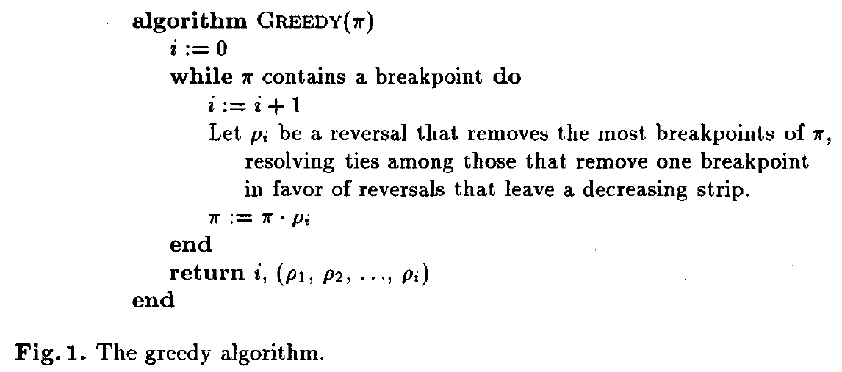
The greedy algorithm

Slide 10

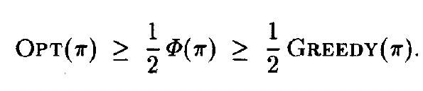
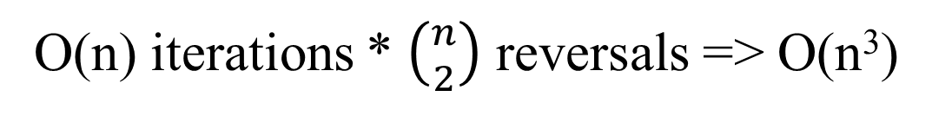
Time complexity
Number of breakpoint ==
O(n) iterations * $\left({n \atop 2}\right)$ reversals => O(n³)
By considering the form of reversals that remove one and two breakpoints.
O(n) iterations * O(n)=> O(n²)

Slide 11
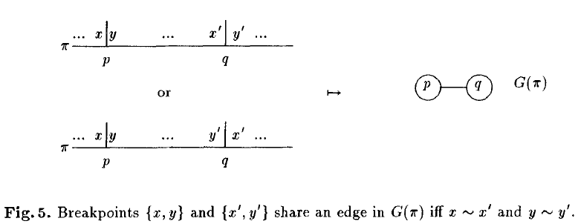
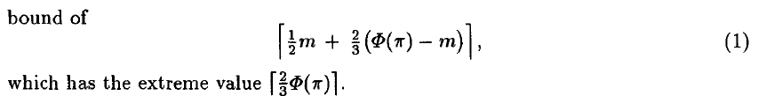
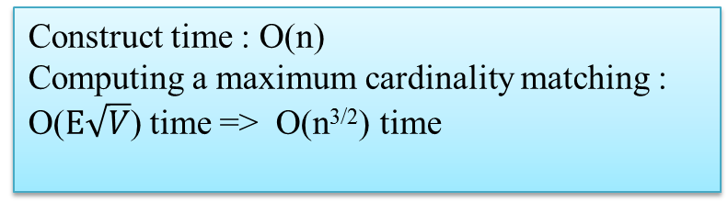
Lower bound
Reverse [1,4] | 0 x | 3 y | 2 | 1 x' | 4 y' | 5
Construct time : O(n)
Computing a maximum cardinality matching :
O($E\sqrt{V}$) time => O(n^{3/2}) time

Slide 12
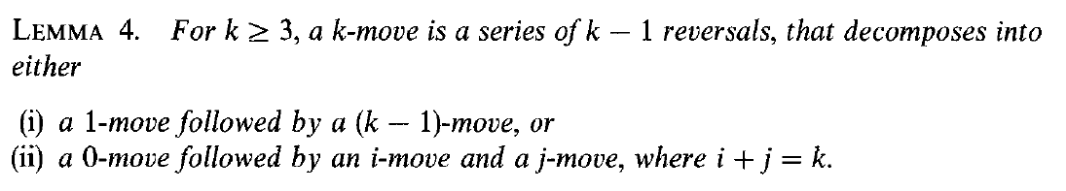
A Family of Lower Bounds
3-move
Input: | 0 | 4 | 1 | 2 | 3 | 5
Reverse [1,n] | 0 | 3 | 2 | 1 | 4 | 5
Reverse [1,n-1] | 0 | 1 | 2 | 3 | 4 | 5

Slide 13
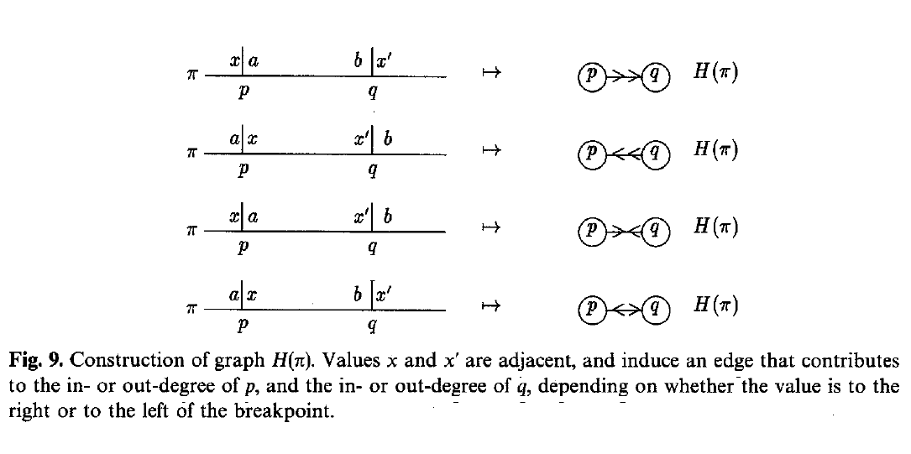
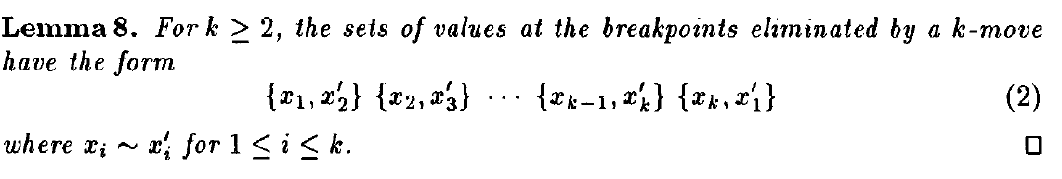
A Family of Lower Bounds

Slide 14
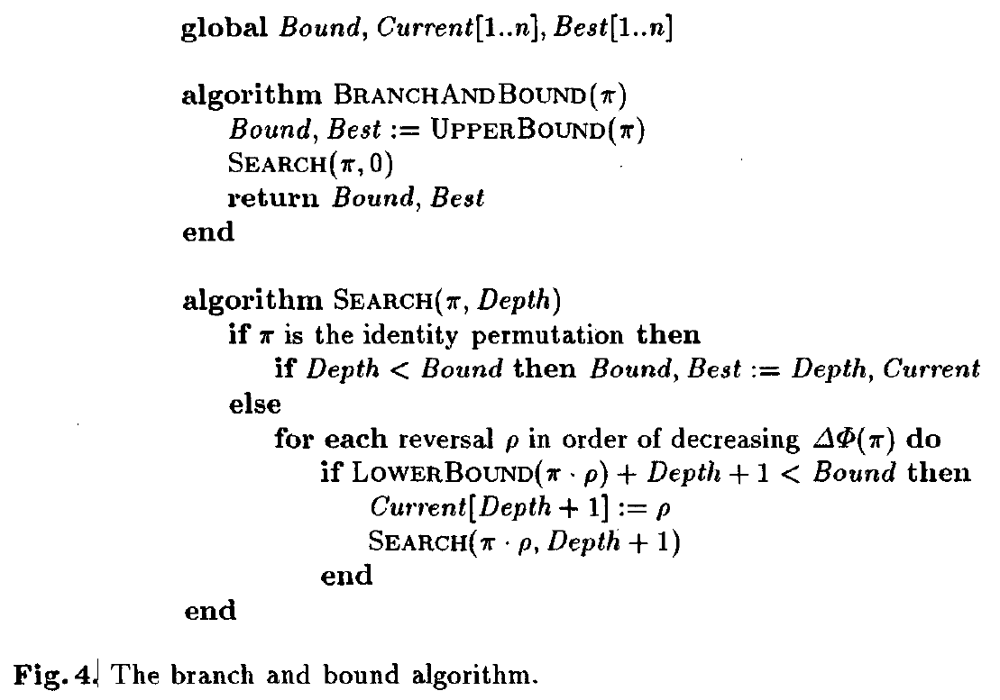
Exact algorithm (linear programing)

Slide 15
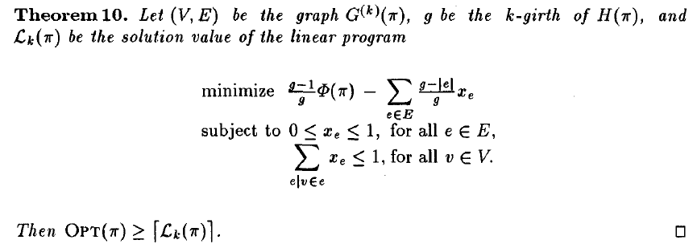
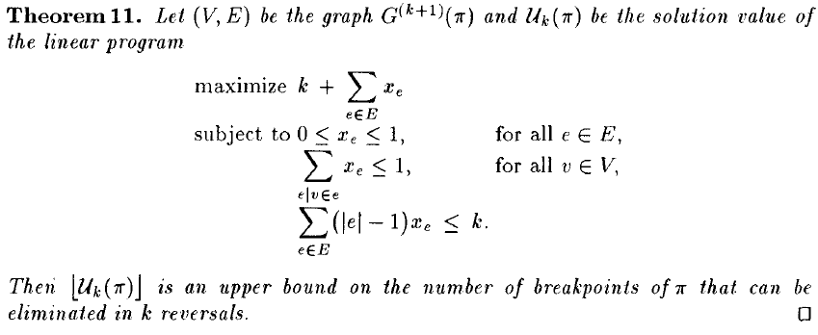
Lower bound
upper bound

Slide 16
Time complexity
O(mL(4^{k}n, n)) time
O(mL(n, n)) time
m : the size of the branch and bound search tree
L(n, n) : the time to solve a linear program of n variables and n constraints

Slide 17
