Slide 1
The ubiquitous Kronecker product
Charles F. Van Loan
Journal of Computational and Applied Mathematics 123 pp. 85-100 (2000)
Department of Computer Science, Cornell University, Ithaca, New York 14853, USA
Presenter: Syuan-Zong Ciou
Date:2015/10/20

Slide 2
Abstract
The Kronecker product has a rich and very pleasing algebra that supports a wide range of fast, elegant, and practical algorithms. Several trends in scientific computing suggest that this important matrix operation will have an increasingly greater role to play in the future. First, the application areas where Kronecker products abound are all thriving. These include signal processing, image processing, semidefinite programming, and quantum computing.

Slide 3
Abstract
Second, sparse factorizations and Kronecker products are proving to be a very effective way to look at fast linear transforms. Researchers have taken the Kronecker methodology as developed for the fast Fourier transform and used it to build exciting alternatives. Third, as computers get more powerful, researchers are more willing to entertain problems of high dimension and this leads to Kronecker products whenever low-dimension techniques are “tensored” together.

Slide 4
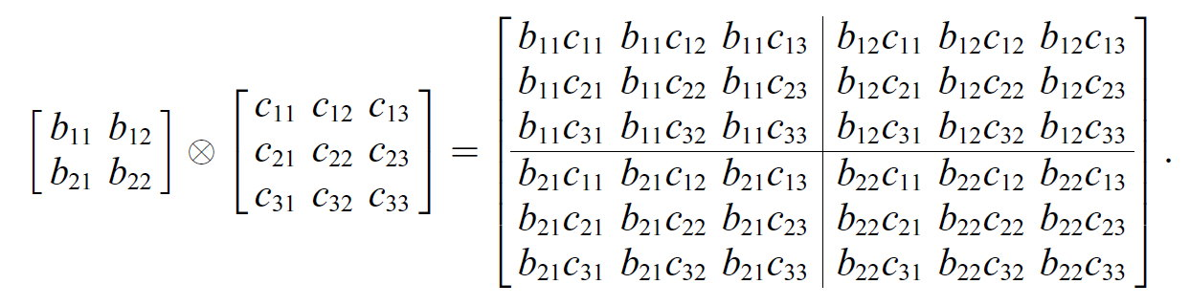
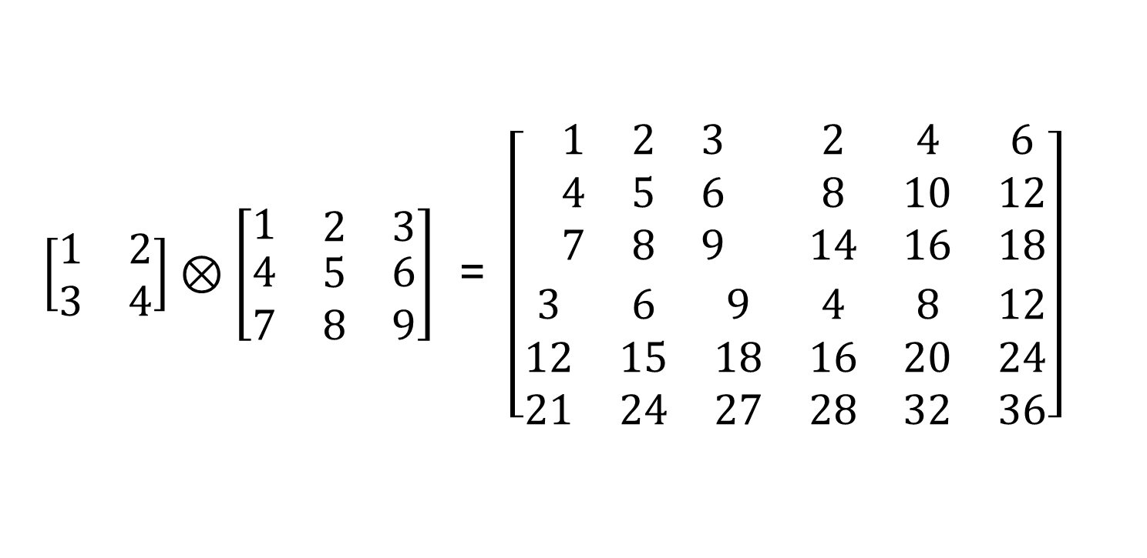
Basic properties
$\left[\begin{matrix}1 & 2 \\ 3 & 4\end{matrix}\right]⊗\left[\begin{matrix}1 & \begin{matrix}2 & 3\end{matrix} \\ \begin{matrix}4 \\ 7\end{matrix} & \begin{matrix}\begin{matrix}5 \\ 8\end{matrix} & \begin{matrix}6 \\ 9\end{matrix}\end{matrix}\end{matrix}\right]$ = $\left[\begin{matrix}\begin{aligned}\begin{matrix}1 & 2 & 3 \\ 4 & 5 & 6 \\ 7 & 8 & 9\end{matrix} \\ \end{aligned} & \begin{aligned}\begin{matrix}2 & 4 & 6 \\ 8 & 10 & 12 \\ 14 & 16 & 18\end{matrix} \\ \end{aligned} \\ \begin{matrix}3 & 6 & 9 \\ 12 & 15 & 18 \\ 21 & 24 & 27\end{matrix} & \begin{matrix}4 & 8 & 12 \\ 16 & 20 & 24 \\ 28 & 32 & 36\end{matrix}\end{matrix}\right]$

Slide 5
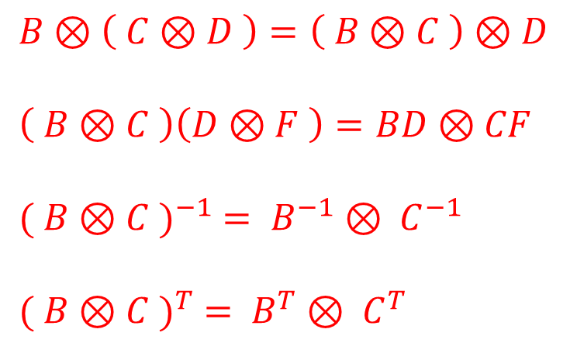
Basic properties
The basicproperties of the Kronecker product are quite predictable:
$$B⊗\left( C⊗D \right)=\left( B⊗C \right)⊗D$$
$$\left( B⊗C \right)\left(D⊗F \right)=BD⊗CF$$
$${( B⊗C )}^{−1} = B^{−1}⊗ C^{−1}$$
$${( B⊗C )}^{T} = B^{T}⊗ C^{T}$$
$\left( B⊗C \right)\left( B^{−1}⊗ C^{−1} \right)={BB}^{−1}⊗ {CC}^{−1}=I ⟺$ B.C are invertible

Slide 6

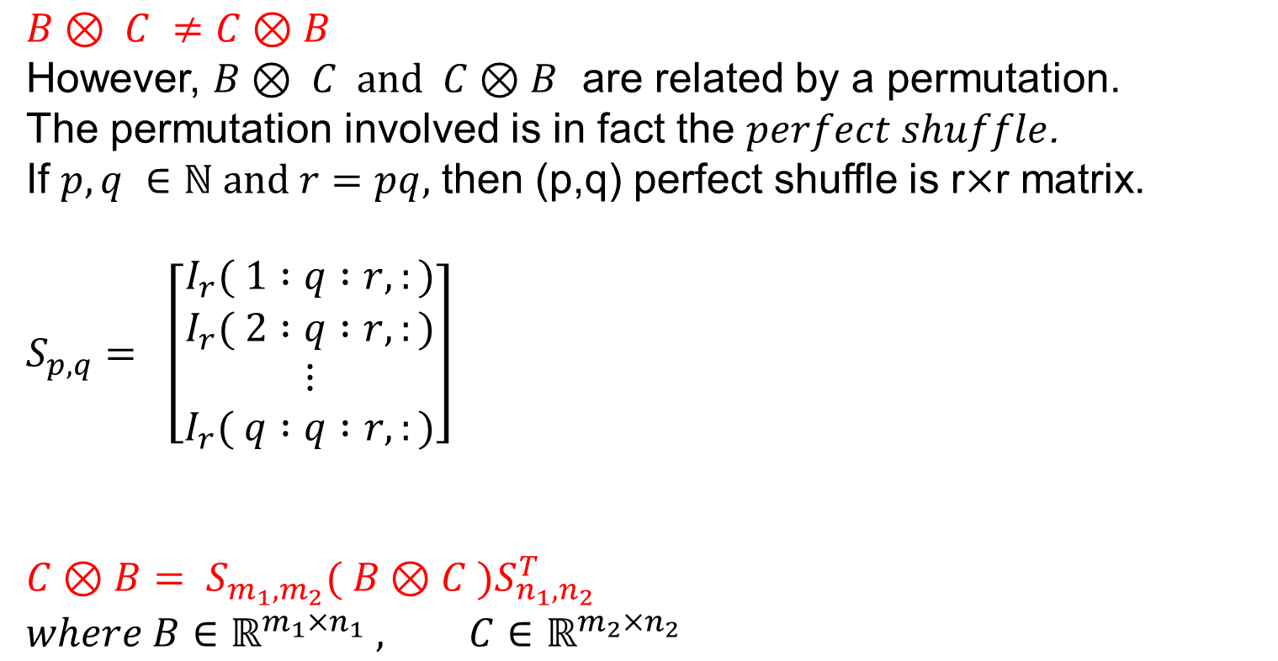
Basic properties
$$B⊗ C ≠C⊗B$$
However, $B⊗ C$ and$C⊗B$ are related by a permutation.
The permutation involved is in fact the $perfect shuffle$.
If $p,q ∈ℕ and r=pq,$ then (p,q) perfect shuffle is r$×$r matrix.
$$S_{p,q}= \left[\begin{matrix}I_{r}( 1 :q :r,:) \\ I_{r}( 2 :q :r,:) \\ \begin{aligned}⋮ \\ I_{r}( q :q :r,:)\end{aligned}\end{matrix}\right]$$
$$C⊗B= S_{m_{1},m_{2}}( B⊗C )S_{n_{1},n_{2}}^{T}$$
$$where B∈ℝ^{m_{1}×n_{1}} , C∈ℝ^{m_{2}×n_{2}}$$
$$S_{2,3}=\left[\begin{matrix}\begin{matrix}1 & 0 & 0 \\ 0 & 0 & 0 \\ 0 & 1 & 0\end{matrix} & \begin{matrix}0 & 0 & 0 \\ 1 & 0 & 0 \\ 0 & 0 & 0\end{matrix} \\ \begin{matrix}0 & 0 & 0 \\ 0 & 0 & 1 \\ 0 & 0 & 0\end{matrix} & \begin{matrix}0 & 1 & 0 \\ 0 & 0 & 0 \\ 0 & 0 & 1\end{matrix}\end{matrix}\right]$$

Slide 7
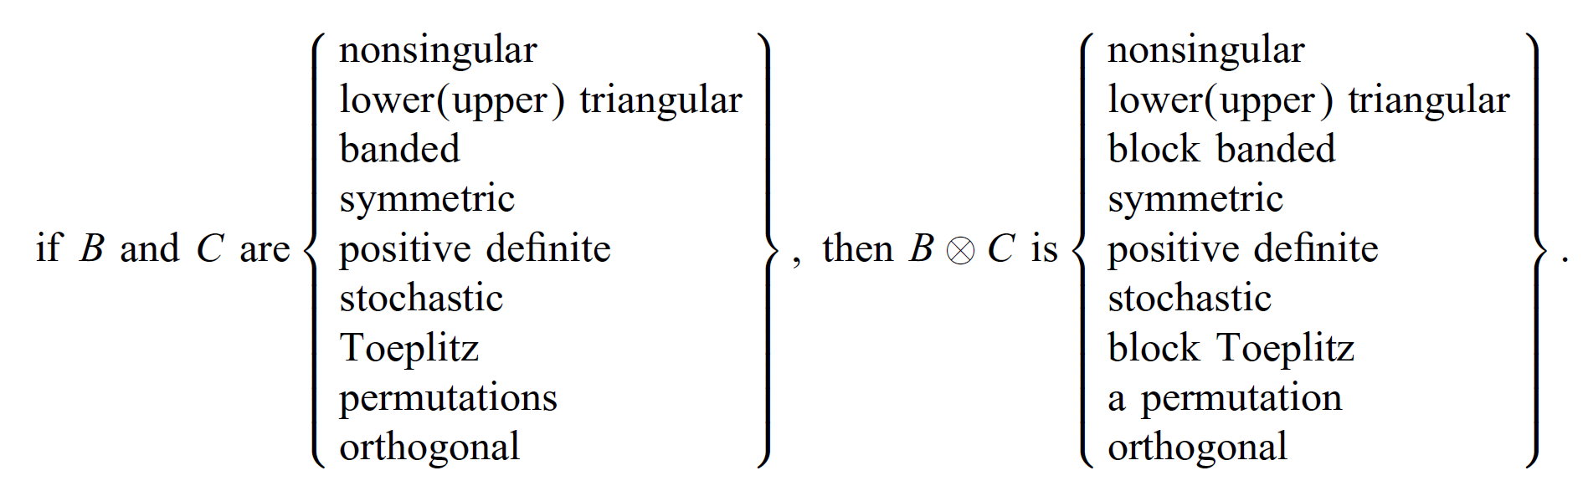
Basic properties
Particularly important in computational work are the issues theat surround the exploitation pf structure and the application of matrix factorizations. By and large, Kronecker product inherits structure from its factors.

Slide 8
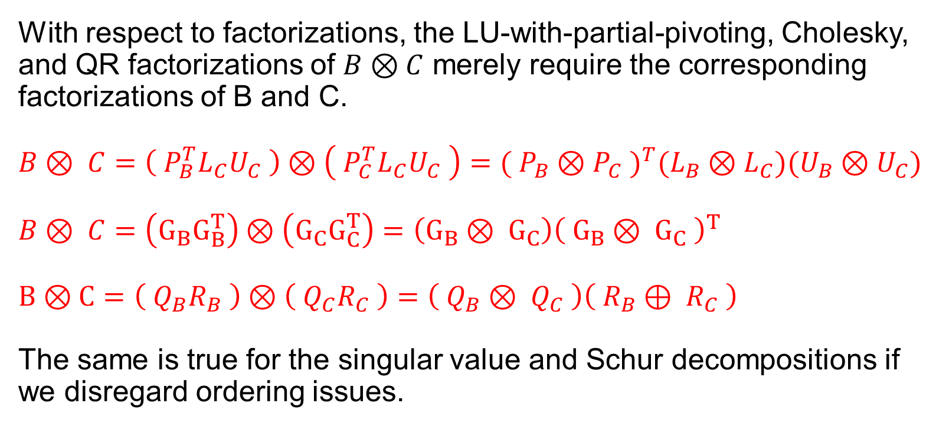
Basic properties
With respect to factorizations, the LU-with-partial-pivoting, Cholesky, and QR factorizations of $B⊗C$ merely require the corresponding factorizations of B and C.
$$B⊗ C=\left( P_{B}^{T}L_{C}U_{C} \right)⊗\left( P_{C}^{T}L_{C}U_{C} \right)={( P_{B}⊗P_{C} )}^{T}(L_{B}⊗L_{C})(U_{B}⊗U_{C})$$
$$B⊗ C=\left(G_{B}G_{B}^{T}\right)⊗\left(G_{C}G_{C}^{T}\right)=\left(G_{B}⊗ G_{C}\right){\left( G_{B}⊗ G_{C} \right)}^{T}$$
$$B⊗C=\left( Q_{B}R_{B} \right)⊗\left( Q_{C}R_{C} \right)=\left( Q_{B}⊗ Q_{C} \right)\left( R_{B}⊕ R_{C} \right)$$
The same is true for the singular value and Schur decompositions if we disregard ordering issues.

Slide 9

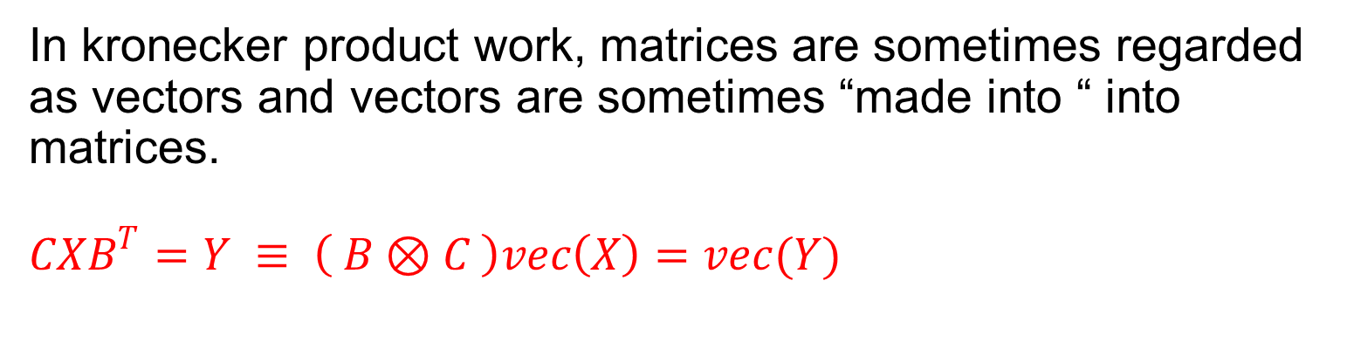
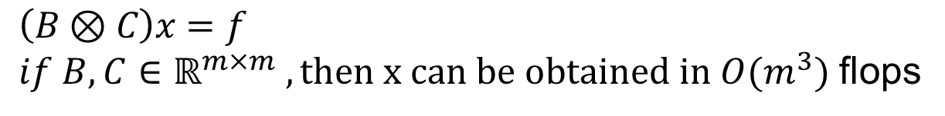
Basic properties
In kronecker product work, matrices are sometimes regarded as vectors and vectors are sometimes “made into “ into matrices.
$$CXB^{T}=Y ≡ \left( B⊗C \right)vec\left(X\right)=vec(Y)$$
$$X=\left[\begin{matrix}a & b \\ c & d\end{matrix}\right]$$
$$vec\left(x\right)= \left[\begin{matrix}\begin{matrix}a \\ c\end{matrix} \\ \begin{matrix}b \\ d\end{matrix}\end{matrix}\right]$$
$$\left(B⊗C\right)x=f$$
$if B,C∈ℝ^{m×m} , then x can be obtained in O(m^{3})$ flops

Slide 10
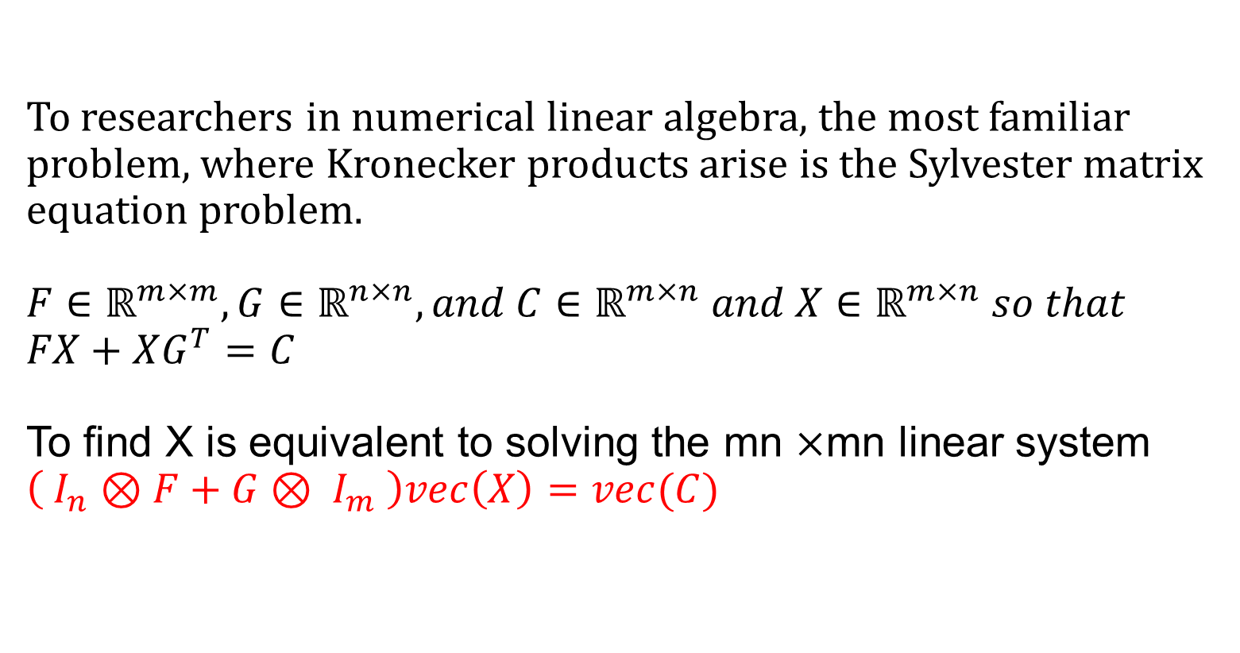
Matrix equations
To researchers in numerical linear algebra, the most familiar problem, where Kronecker products arise is the Sylvester matrix equation problem.
$$F∈ℝ^{m×m},G∈ℝ^{n×n},and C∈ℝ^{m×n} and X∈ℝ^{m×n} so that$$
$$FX+XG^{T}=C$$
To find X is equivalent to solving the mn $×$mn linear system
$$\left( I_{n}⊗F+G⊗ I_{m} \right)vec\left(X\right)=vec(C)$$

Slide 11
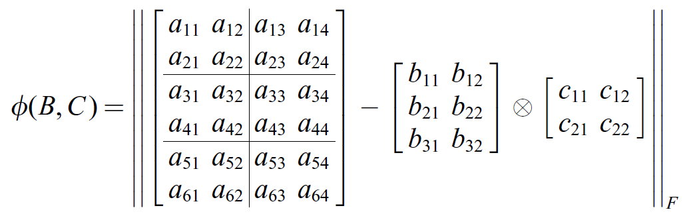
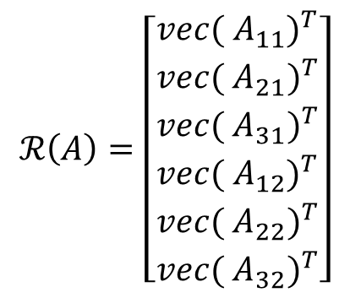
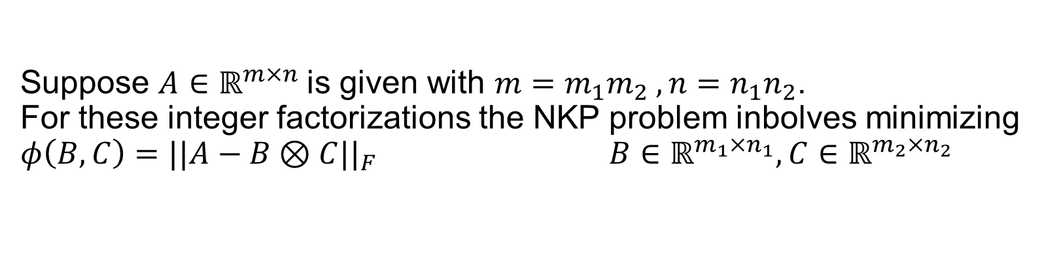
The nearest Kronecker product problem
Suppose $A∈ℝ^{m×n}$is given with $m=m_{1}m_{2} , n=n_{1}n_{2}$.
For these integer factorizations the NKP problem inbolves minimizing
$φ\left(B,C\right)=||A−B⊗C{||}_{F}$ $B∈ℝ^{m_{1}×n_{1}}, C∈ℝ^{m_{2}×n_{2}}$
$$ℛ\left(A\right)=\left[\begin{matrix}\begin{matrix}{vec( A_{11})}^{T} \\ {vec( A_{21})}^{T} \\ {vec( A_{31})}^{T}\end{matrix} \\ \begin{matrix}{vec( A_{12})}^{T} \\ {vec( A_{22})}^{T} \\ {vec( A_{32})}^{T}\end{matrix}\end{matrix}\right]$$
$$φ\left(B,C\right)={\left\|{ℛ\left(A\right)−vec\left(B\right)vec(C)}^{T}\right\|}_{F}$$

Slide 12
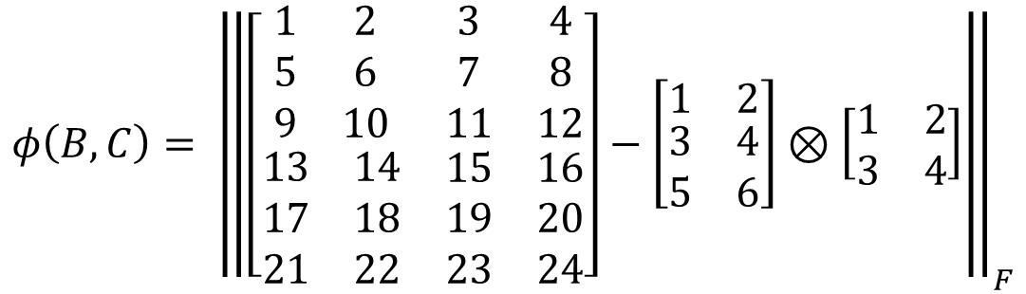
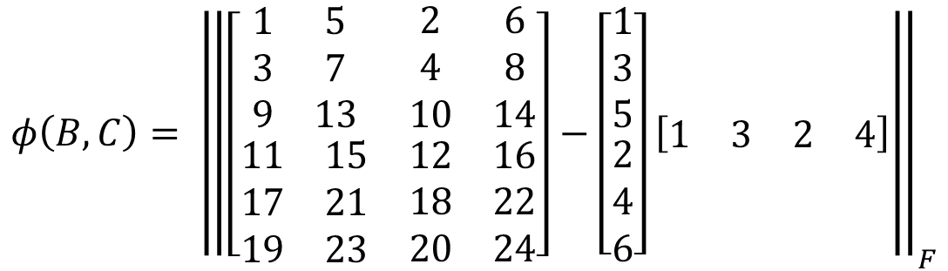
$$φ\left(B,C\right)= {\left\|\left[\begin{matrix}\begin{matrix}1 & 2 \\ 5 & 6 \\ 9 & 10\end{matrix} & \begin{matrix}3 & 4 \\ 7 & 8 \\ 11 & 12\end{matrix} \\ \begin{matrix}13 & 14 \\ 17 & 18 \\ 21 & 22\end{matrix} & \begin{matrix}15 & 16 \\ 19 & 20 \\ 23 & 24\end{matrix}\end{matrix}\right]−\left[\begin{matrix}1 & 2 \\ \begin{matrix}3 \\ 5\end{matrix} & \begin{matrix}4 \\ 6\end{matrix}\end{matrix}\right]⊗\left[\begin{matrix}1 & 2 \\ 3 & 4\end{matrix}\right]\right\|}_{F}$$
$$φ\left(B,C\right)= {\left\|\left[\begin{matrix}\begin{matrix}1 & 5 \\ 3 & 7 \\ 9 & 13\end{matrix} & \begin{matrix}2 & 6 \\ 4 & 8 \\ 10 & 14\end{matrix} \\ \begin{matrix}11 & 15 \\ 17 & 21 \\ 19 & 23\end{matrix} & \begin{matrix}12 & 16 \\ 18 & 22 \\ 20 & 24\end{matrix}\end{matrix}\right]−\left[\begin{matrix}\begin{matrix}1 \\ 3 \\ 5\end{matrix} \\ \begin{matrix}2 \\ 4 \\ 6\end{matrix}\end{matrix}\right]\left[\begin{matrix}\begin{matrix}1 & 3\end{matrix} & \begin{matrix}2 & 4\end{matrix}\end{matrix}\right]\right\|}_{F}$$

Slide 13
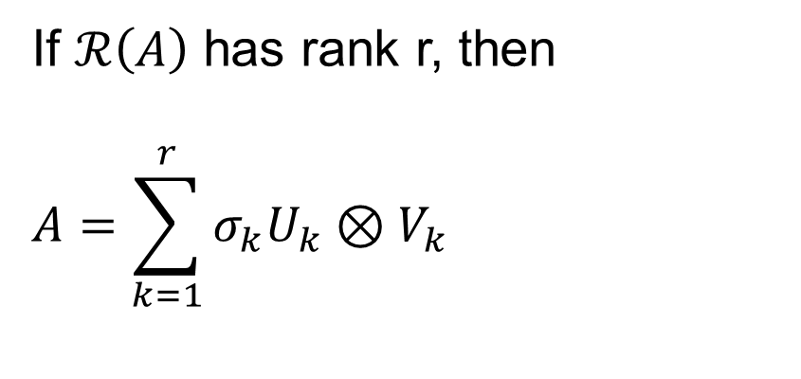
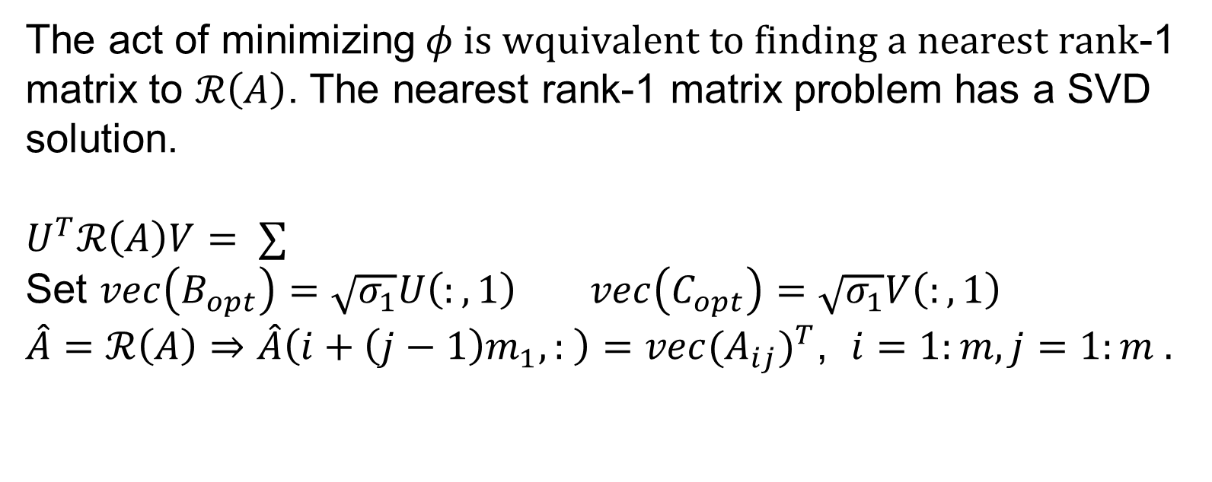
The nearest Kronecker product problem
The act of minimizing$φ is wquivalent to finding a nearest rank$-1 matrix to $ℛ\left(A\right)$. The nearest rank-1 matrix problem has a SVD solution.
$U^{T}ℛ\left(A\right)V= ∑$
Set $vec\left(B_{opt}\right)=\sqrt{σ_{1}}U\left(:,1\right) vec\left(C_{opt}\right)=\sqrt{σ_{1}}V\left(:,1\right)$
$\hat{A}=ℛ\left(A\right)⇒\hat{A}\left(i+\left(j−1\right)m_{1},: \right)={vec(A_{ij})}^{T}$, $i=1:m,j=1:m .$
If $ℛ\left(A\right)$ has rank r, then
$$A=\sum_{k=1}^{r}{σ_{k}U_{k}{⊗V}_{k}}$$

