Slide 1
Two-Dimensional Pattern Matching
R.S. BIRD
Information Processing Letters
Volume 6, Issues 5, October 1977, Pages 168-170
Presenter: Shu-Kai hung
Date:2015/10/20

Slide 2
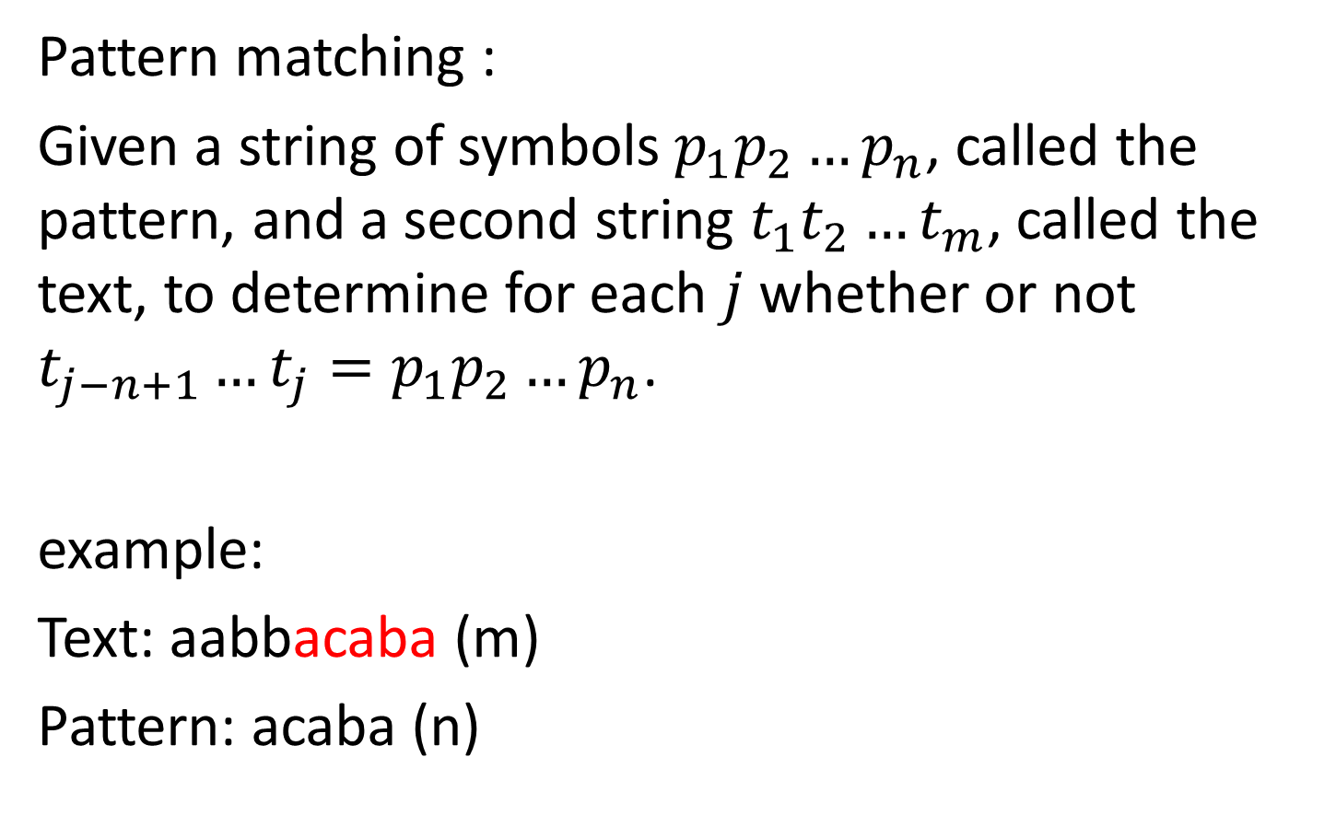
The Problem
Pattern matching :
Given a string of symbols $p_{1}p_{2}…p_{n}$, called the pattern, and a second string $t_{1}t_{2}…t_{m}$, called the text, to determine for each $j$ whether or not $t_{j−n+1}…t_{j}=p_{1}p_{2}…p_{n}$.
example:
Text: aabbacaba (m)
Pattern: acaba (n)

Slide 3
Pattern Matching with brute
Text : abacaabaccbba
Pattern: abacc
One by one , if it does not match , move one position.

Slide 4
Pattern Matching with brute
Text : abacaabaccbba
Pattern: abacc
One by one , if it does not match , move one position.

Slide 5
Pattern Matching with brute
Text : abacaabaccbba
Pattern: abacc
One by one , if it does not match , move one position.

Slide 6
Pattern Matching with brute
Text : abacaabaccbba
Pattern: abacc
One by one , if it does not match , move one position.

Slide 7
Pattern Matching with brute
Text : abacaabaccbba
Pattern: abacc
One by one , if it does not match , move one position.

Slide 8
Pattern Matching with brute
Text : abacaabaccbba
Pattern: abacc
One by one , if it does not match , move one position.

Slide 9
Pattern Matching with brute
Text : abacaabaccbba
Pattern: abacc
One by one , if it does not match , move one position.

Slide 10
Pattern Matching with brute
Text : abacaabaccbba
Pattern: abacc
One by one , if it does not match , move one position.

Slide 11
Pattern Matching with brute
Text : abacaabaccbba
Pattern: abacc
One by one , if it does not match , move one position.

Slide 12
Pattern Matching with brute
Text : abacaabaccbba
Pattern: abacc
One by one , if it does not match , move one position.

Slide 13
Pattern Matching with brute
Text : abacaabaccbba
Pattern: abacc
One by one , if it does not match , move one position.

Slide 14
Pattern Matching with brute
Text : abacaabaccbba
Pattern: abacc
match pattern=>output
Time complexity : O(mn)

Slide 15
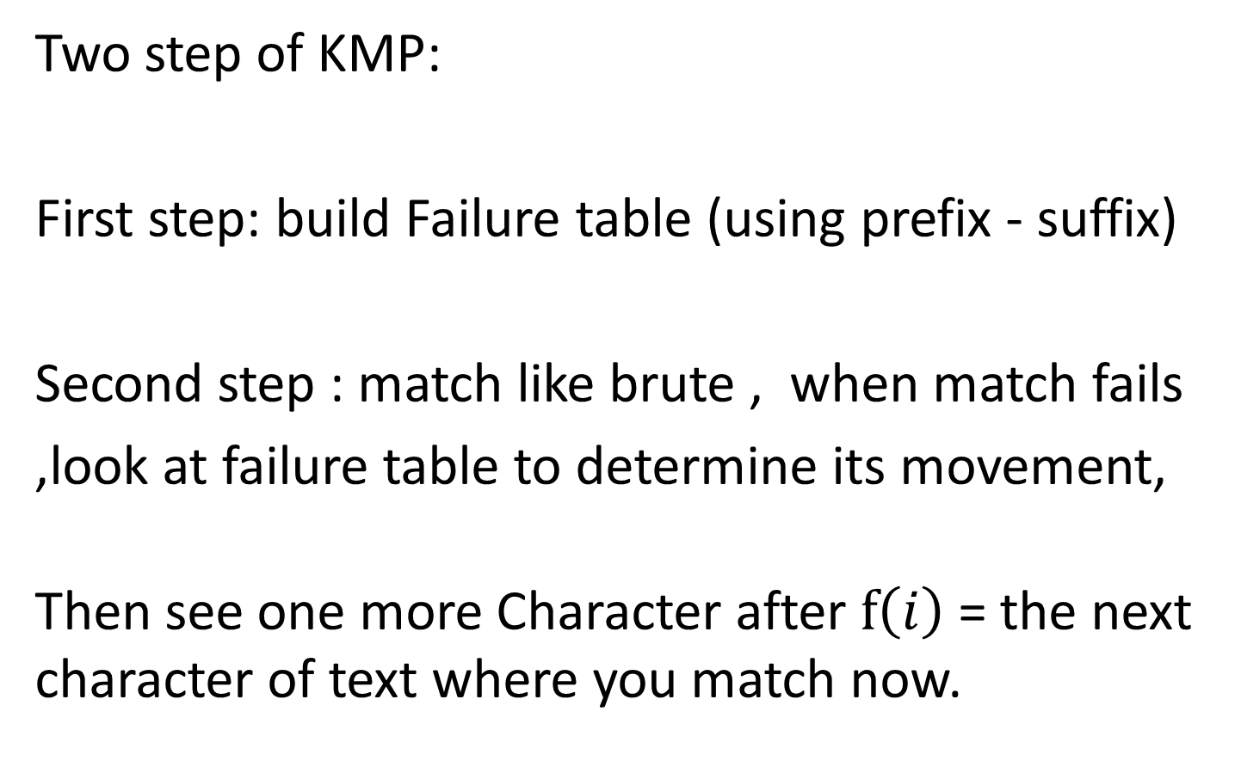
KMP algorithm
Two step of KMP:
First step: build Failure table (using prefix - suffix)
Second step : match like brute , when match fails
,look at failure table to determine its movement,
Then see one more Character after $f\left(i\right)$ = the next character of text where you match now.
MP
KMP

Slide 16
Prefix-suffix
Means「Minister same prefixes and suffixes」
Longest : string itself .
Shortest : Empty string.
Example:
Pattern : aacbazaacb
Prefix – suffix : aacb

Slide 17
Build failure
Space complexity : O(n)
Time complexity : O(n)
j
i
 | 0 | 1 | 2 | 3 | 4 | 5 | 6 | 7 | 8
string | A | B | B | A | C | A | B | B | A
F[i] | 0 | 0 | 0 | 1 | 0 | 1 | 2 | 3 | 4

Slide 18
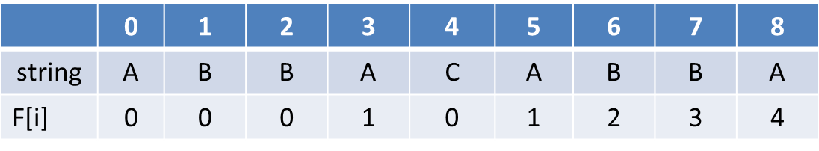
Build failure
Space complexity : O(n)
Time complexity : O(n)
j
i

Slide 19
Build failure
Space complexity : O(n)
Time complexity : O(n)
j
i

Slide 20
Build failure
Space complexity : O(n)
Time complexity : O(n)
j
i

Slide 21
Build failure
Space complexity : O(n)
Time complexity : O(n)
j
i

Slide 22
Build failure
Space complexity : O(n)
Time complexity : O(n)
j
i

Slide 23
Build failure
Space complexity : O(n)
Time complexity : O(n)
j
i

Slide 24
Build failure
Space complexity : O(n)
Time complexity : O(n)
j
i

Slide 25
Build failure
Space complexity : O(n)
Time complexity : O(n)
j
i

Slide 26
KMP
Text : CABABBAKABBACABBA
Pattern :

Slide 27
KMP
Text : CABABBAKABBACABBA
Pattern :

Slide 28
KMP
Text : CABABBAKABBACABBA
Pattern :

Slide 29
KMP
Text : CABABBAKABBACABBA
Pattern :

Slide 30
KMP
Text : CABABBAKABBACABBA
Pattern :

Slide 31
KMP
Text : CABABBAKABBACABBA
Pattern :

Slide 32
KMP
Text : CABABBAKABBACABBA
Pattern :

Slide 33

KMP
Text : CABABBAKABBACABBA
Pattern :
Time complexity : $O(n+m)$

Slide 34
KMP
Text : ABXABCABCABY
Pattern:
 | 0 | 1 | 2 | 3 | 4 | 5
String | A | B | C | A | B | Y
F[i] | 0 | 0 | 0 | 1 | 2 | 0

Slide 35
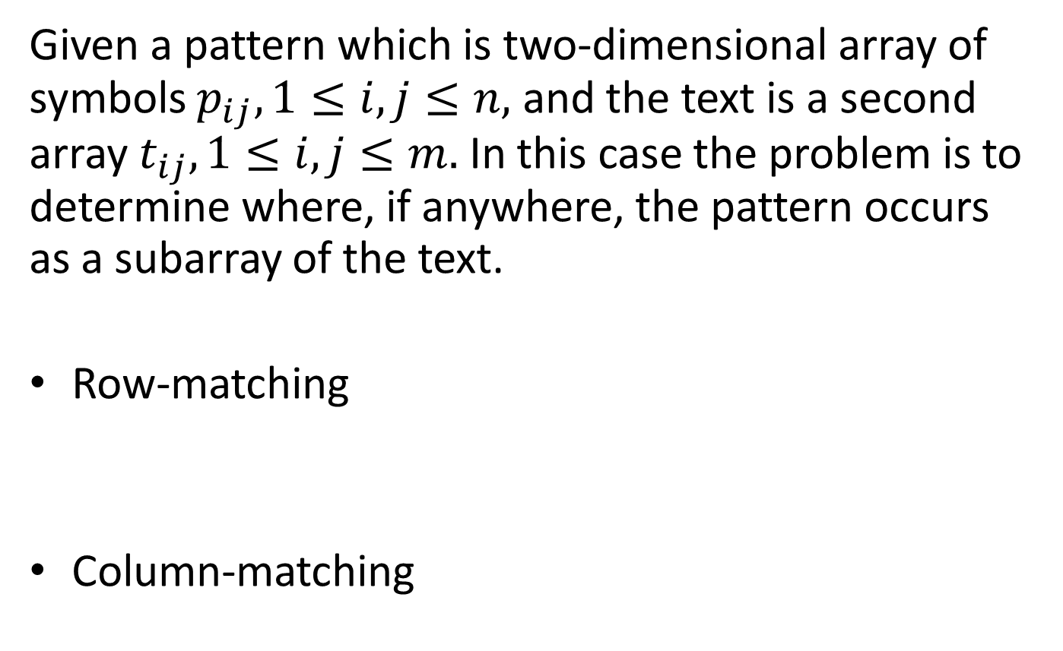
Two-Dimensional Pattern Matching
Given a pattern which is two-dimensional array of symbols $p_{ij},1≤i,j≤n,$ and the text is a second array $t_{ij}, 1≤i,j≤m.$ In this case the problem is to determine where, if anywhere, the pattern occurs as a subarray of the text.
Row-matching
Column-matching

Slide 36
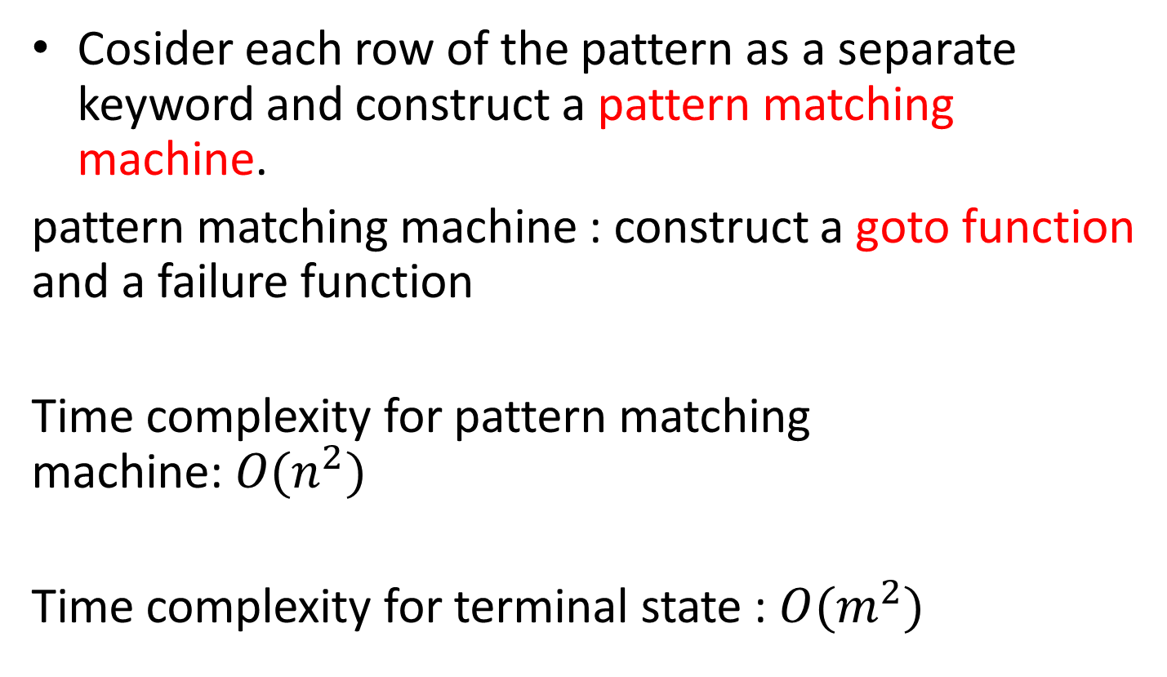
Row-matching
Cosider each row of the pattern as a separate keyword and construct a pattern matching machine.
pattern matching machine : construct a goto function and a failure function
Time complexity for pattern matching machine:$O(n^{2})$
Time complexity for terminal state : $O(m^{2})$

Slide 37
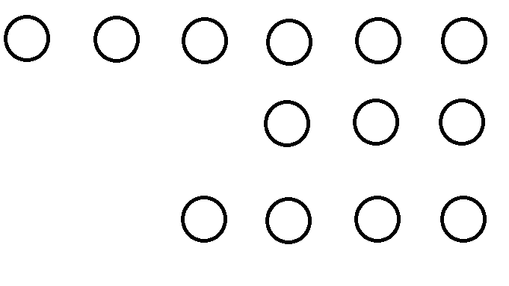
a
a
b
b
a
b
0
1
2
3
4
5
b
b
a
6
7
8
b
a
b
a
9
10
11
12
p1 =aabba p2 =aaabb p3 =ababa p4=aabba
p5= aaabb
 | 1 | 2 | 3 | 4 | 5 | 6 | 7 | 8 | 9 | 10 | 11 | 12
F[i] | 0 | 1 | 0 | 0 | 1 | 2 | 0 | 0 | 0 | 1 | 0 | 1

Slide 38
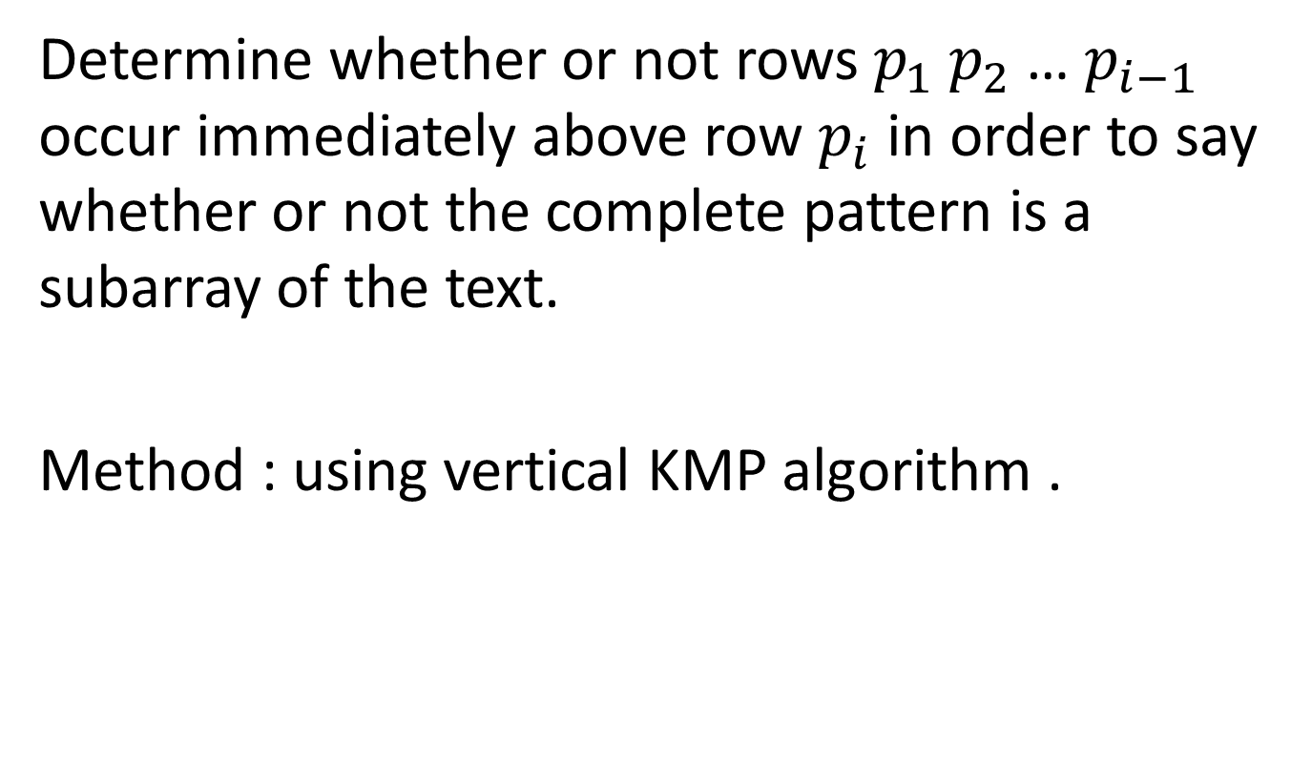
Column-matching
Determine whether or not rows $p_{1}$ $p_{2}$… $p_{i−1}$ occur immediately above row $p_{i}$ in order to say whether or not the complete pattern is a subarray of the text.
Method : using vertical KMP algorithm .

Slide 39
p1 =aabba p2 =aaabb p3 =ababa p4=aabba
p5 = aaabb
Give number to each row , and p1=p4 , p5=p2
So we give p1=1 p2=2 p3=3 p4=1 p5=2
And give the failure function t with example.
Index | 0 | 1 | 2 | 3 | 4
p | 1 | 2 | 3 | 1 | 2
t | 0 | 0 | 0 | 1 | 2

Slide 40

row $p_{i}$
(j,k)

Slide 41
A | B | A | B | A
A | A | A | B | B
A | A | A | A | C
B | A | A | C | C
A | C | A | C | B
A | A
A | C

Slide 42
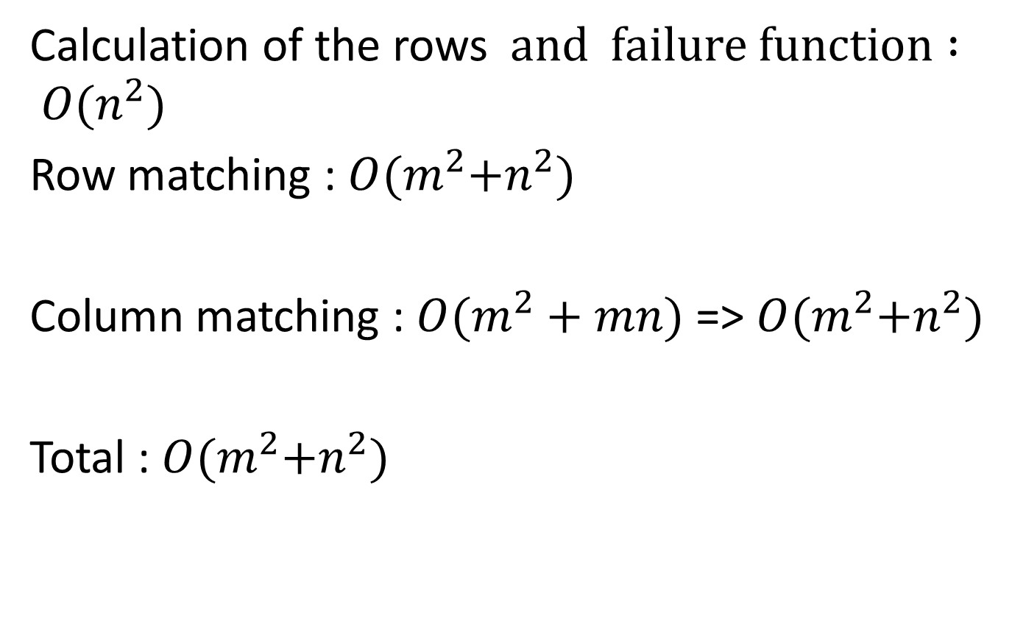
Time complexity
Calculation of the rows $and failure function : O(n^{2})$
Row matching : $O(m^{2}{+n}^{2})$
Column matching : $O(m^{2}+mn)$ => $O(m^{2}{+n}^{2})$
Total : $O(m^{2}{+n}^{2})$

Slide 43
謝謝聆聽!!

Slide 44
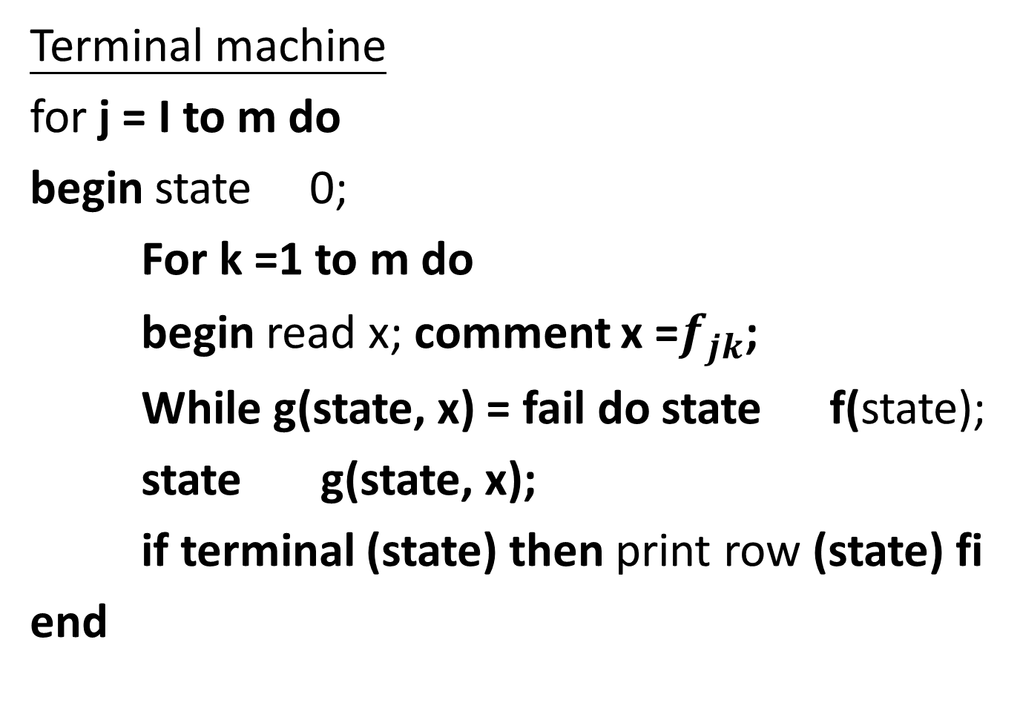
Terminal machine
for j = I to m do
begin state 0;
For k =1 to m do
begin read x; comment x =$f_{jk}$;
While g(state, x) = fail do state f(state);
state g(state, x);
if terminal (state) then print row (state) fi
end

Slide 45
Column-matching terminal
if terminal (state)
then i : =a[k];
while i > 0 and p(i) != row (state) do i : = t(i)
a[k] : =i+ 1;
if i = n then print pattern found at (j, k)
else a[k] : = 1
fi

