Slide 1
Approximate String Matching Allowing for Inversions and Translocations
Domenico Cantone, Simone Faro, Emanuele Giaquinta
Proceedings of Prague Stringology Conference 2010, pp. 37-51
Presenter: Tzu-Chiang Hsu (徐子強)
2015/11/03

Slide 2
Abstract (1/3)
The approximate string matching problem consists in finding all locations at which a pattern P of length m matches a substring of a text T of length n, after a given finite number of edit operations. In this paper we investigate such problem when the string distance involves translocations of equal length adjacent factors and inversions of factors.

Slide 3
Abstract (2/3)
In particular, we devise a O(nm max(α,β))-time and O(m²)-space algorithm, where α and β are respectively the maximum length of the factors involved in any translocation and inversion. Our algorithm is based on the dynamic-programming approach and makes use of the Directed Acyclic Word Graph of the pattern.

Slide 4
Abstract (3/3)
Moreover we show that under the assumptions of equiprobability and independence of characters our algorithm has a O(n log_{σ}m) average time complexity. Finally, we briefly sketch in an appendix an efficient implementation, based on bit-parallelism.

Slide 5
reversal
=
inversion
attagcct
atcgatct

Slide 6
translocation
acatgcct
agcccatt

Slide 7
Approximate string matching
allowing for inversions and translocations
text:
pattern:
cabccbabcc
cbaabcbc

Slide 8
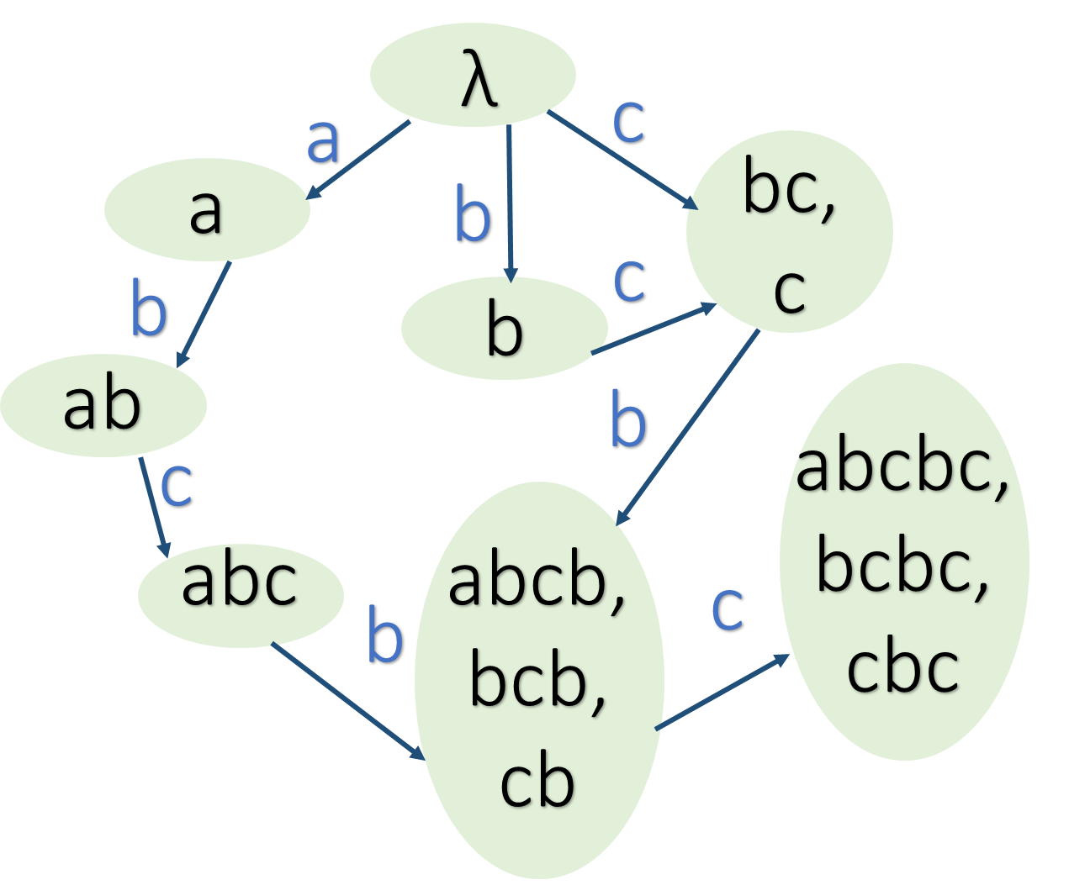
abcbc
Directed Acyclic Word Graph

Slide 9
abcbc
{0}
{2,4}
{1,3}
{1}
{2}
{4}
{3}

Slide 10
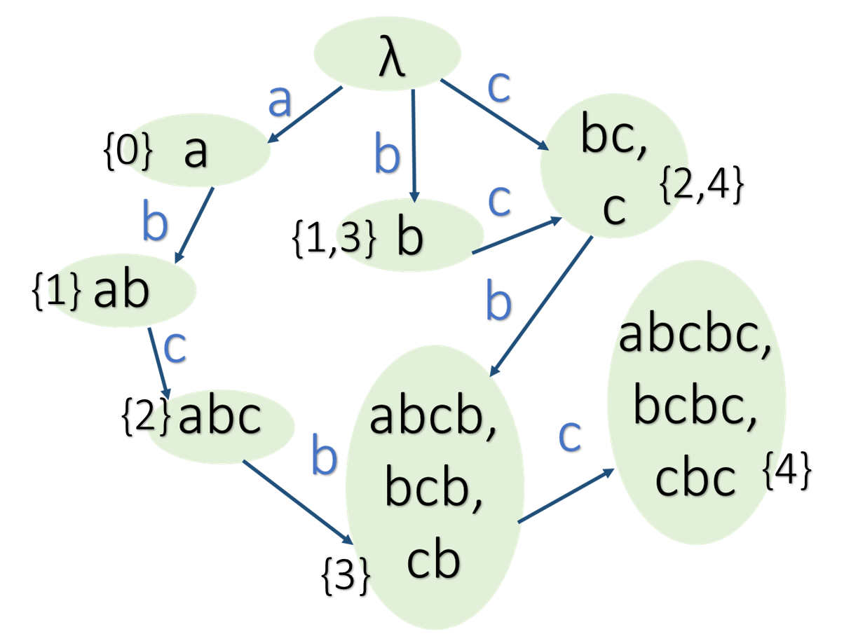
abcbc
abacbabcc
121121221
{0}{1}{0}
{0}{1}{2}
{2,4}
{2,4}
{1,3}

Slide 11
acbabcc
0
abcbc

Slide 12
acbabcc
0
x
abcbc

Slide 13
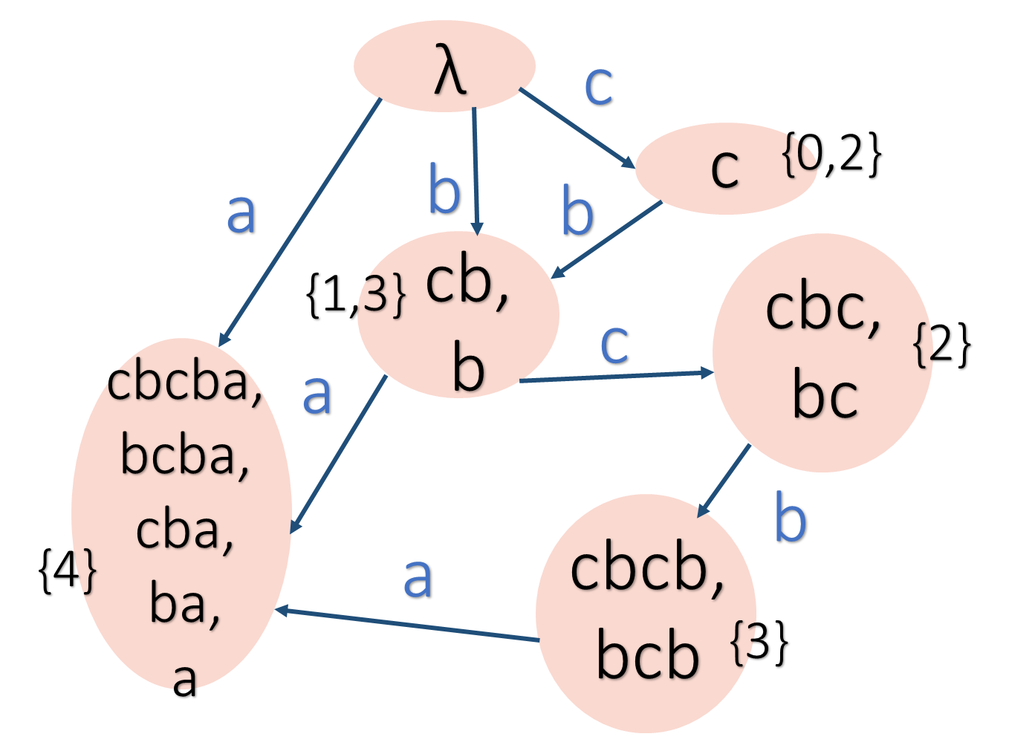
acbabcc
0
x
2
cbcba
abcbc

Slide 14
acbabcc
0
x
2
0
abcbc

Slide 15
acbabcc
0
x
2
0
3
abcbc

Slide 16
acbabcc
0
x
2
0
3
abcbc

Slide 18
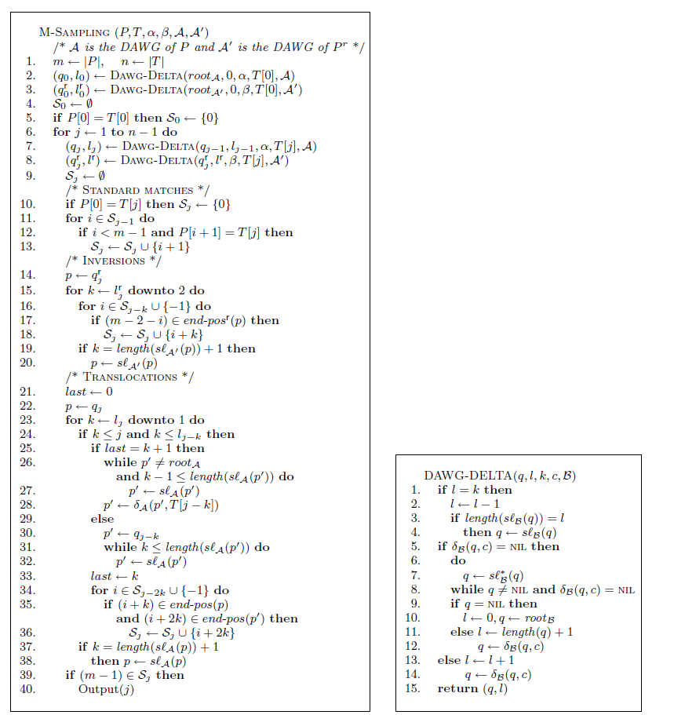
O(mn max(α, β))

Slide 20
λ
c
c
{0,2}
b
a
b
cb,
b
{1,3}
cbc,
bc
c
{2}
cbcba,
bcba,
cba,
ba,
a
a
b
{4}
a
cbcb,
bcb
{3}

