Slide 1
A New Algorithm for the Longest Common Subsequence Problem
Vahagn Minasyan
International Journal “Information Theories and Applications”, Vol. 17, Number 3, pp. 226-234 2010
Presenter: Siang-Huai Hung
Date:2015/11/03

Slide 2
Abstract
This paper discusses the problem of determining the longest common subsequence (LCS) of two sequences. Here we view this problem in the background of the well known algorithm for the longest increasing subsequence (LIS). This new approach leads us to a new online algorithm which runs in O(d log n) time and in O(n) space where n is the length of the input sequences and d is the number of minimal matches between them. Using an advanced technique of van Emde Boas trees the time complexity bound can be reduced to O(d log log n) preserving the space bound of O(n)

Slide 3
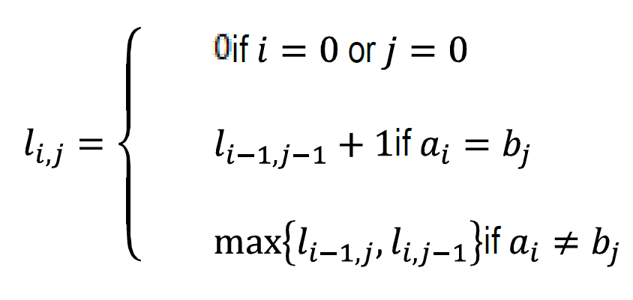
Minimal(or Dominant) Matching
( i’,j’) such that $li$_{,j} = $li$’, _{j’} i’ > i and j’ ≤ j or i’≤ i and j’ > j

Slide 4
Minimal(or Dominant) Matching
Sequence A: ACBA
Sequence B: CBAAC
( i,j) such that $li$_{,j} = $li$’, _{j’} i’ > i and j’ ≤ j or i’ ≤ i and j’ > j
 | ʘ | C | B | A | A | C
ʘ | 0 | 0 | 0 | 0 | 0 | 0
A | 0 | 0 | 0 | 1 | 1 | 1
C | 0 | 1 | 1 | 1 | 1 | 2
B | 0 | 1 | 2 | 2 | 2 | 2
A | 0 | 1 | 2 | 3 | 3 | 3

Slide 5
Van Emde Boas tree
置放大量正整數（與零）的資料結構，並且可以作為 Double Ended Priority Queue 。
Supported operations:
Insert: insert a key/value pair with an m-bit key
Delete: remove the key/value pair with a given key
Lookup: find the value associated with a given key
FindNext: find the key/value pair with the smallest key at least a given k
FindPrevious: find the key/value pair with the largest key at most a given k

Slide 6

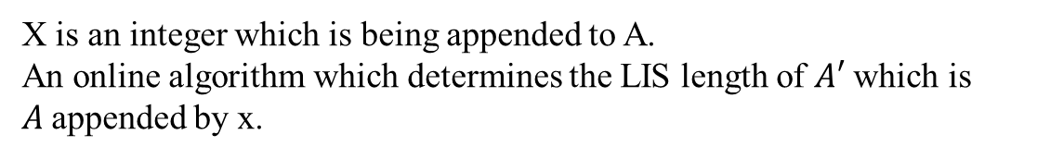
LIS(Longest Increasing Subsequence)
Sequence A: 1 2 4 3 5 3 7
X is an integer which is being appended to A.
An online algorithm which determines the LIS length of $A′$ which is $A$appended by x.
in A.

Slide 7
LIS(Longest Increasing Subsequence)
Sequence A: 1 2 4 3 5 3 7
input: 1
endpoints: 1
size: 1
input: 1 2
endpoints: 1 2
size: 2
input: 1 2 4
endpoints: 1 2 4
size: 3

Slide 8
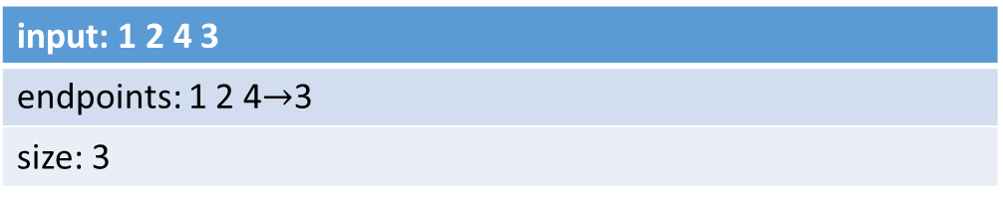
Sequence A: 1 2 4 3 5 3 7
input: 1 2 4 3
endpoints: 1 2 4$→$3
size: 3
input: 1 2 4 3 5
endpoints: 1 2 3 5
size: 4
input: 1 2 4 3 5 3
endpoints: 1 2 3 3
size: 4
input: 1 2 4 3 5 3 7
endpoints: 1 2 3 3 7
size: 5

Slide 9
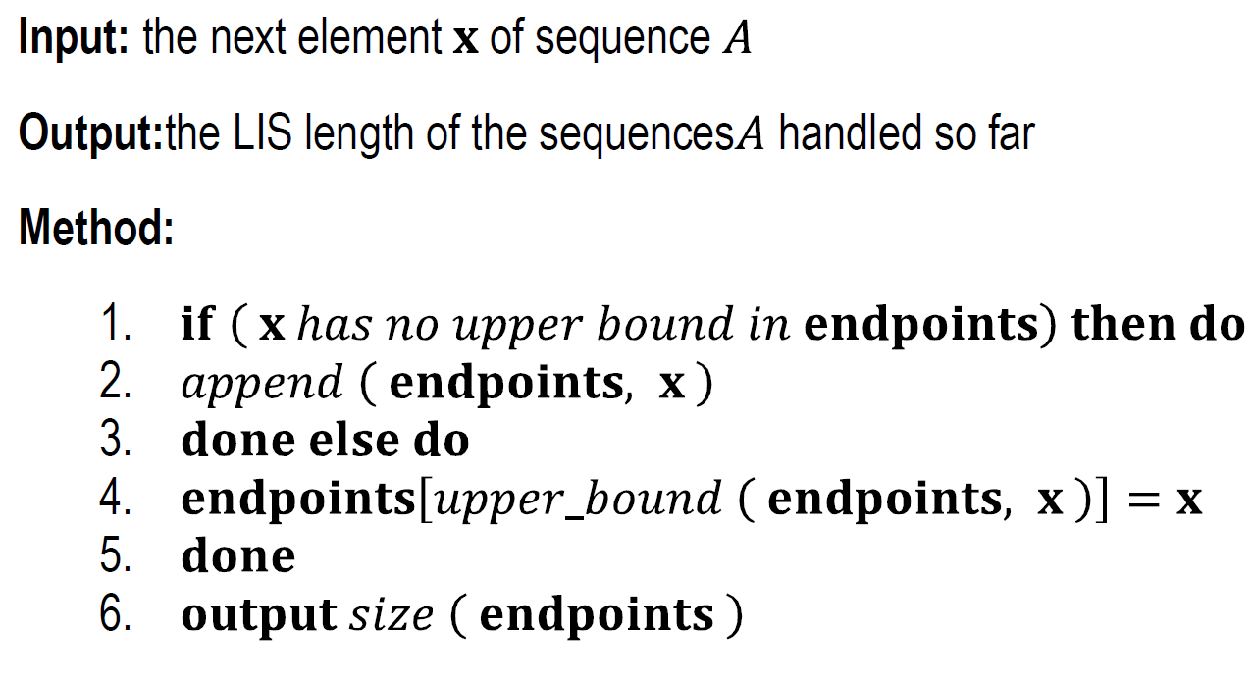

Slide 10
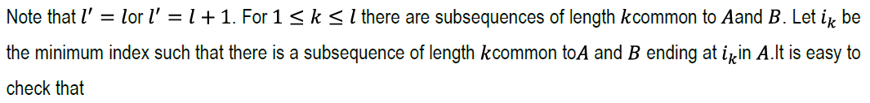


The new algorithm

Slide 11


The new algorithm
Index: 1 2 3 4 5 6 7
A: 1 2 3 5 4 3 7
B: 2 3 4 1 6 7
i₁ = 2, i₂ = 3, i₃ = 5, i₄ = 7
j₁ = 1, j₂ = 2, j₃ = 3, j₄ = 6
be the thresh values of sequence A with respect to $B′$ and
be the thresh values of $B′$ with respect to A.

Slide 12

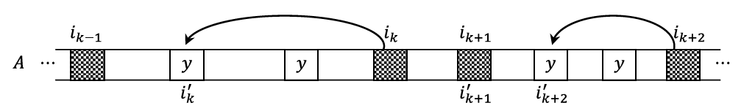

Slide 13

The algorithm maintains the sequences and in arrays sequence A and sequence B
respectively and for each symbol of alphabet, it maintains the set of occurrences of
z in A and B in binary search trees layersA[z] and layersB[z] respectively.
The algorithm also maintains the thresh indices in binary search trees
threshA and threshB respectively. The procedure uses two temporary variables and
which correspondto the next and previous values of updating thresh indices.

Slide 14
length | 1 | 2 | 3 | 4 | 5 | 6 | 7 | 8 | 9
Index | 0 | 1 | 2 | 3 | 4 | 5 | 6 | 7 | 8
stringA | A | B | C | A | B | D | B | C
stringB | B | C | A | C | D | D | A | B
threshA | 0 | 1 | 3 | 4 | 6
threshB | 0 | 1 | 2 | 3 | 7
k | 1 | 2 | 3 | 4 | 5
Layers A
A | 0 | 3
B | 1 | 4 | 6
C | 2 | 7
D | 5

Slide 15
length | 1 | 2 | 3 | 4 | 5 | 6 | 7 | 8 | 9
Index | 0 | 1 | 2 | 3 | 4 | 5 | 6 | 7 | 8
stringA | A | B | C | A | B | D | B | C
stringB | B | C | A | C | D | D | A | B | C
threshA | 0 | 1 | 3 | 4 | 6
threshB | 0 | 1 | 2 | 3 | 7
k | 1 | 2 | 3 | 4 | 5
Layers A
A | 0 | 3
B | 1 | 4 | 6
C | 2 | 7
D | 5

Slide 16
length | 1 | 2 | 3 | 4 | 5 | 6 | 7 | 8 | 9
Index | 0 | 1 | 2 | 3 | 4 | 5 | 6 | 7 | 8
stringA | A | B | C | A | B | D | B | C
stringB | B | C | A | C | D | D | A | B | C
threshA | 0 | 1 | 3 | 4 | 6
threshB | 0 | 1 | 2 | 3 | 7
k | 1 | 2 | 3 | 4 | 5
Layers A
A | 0 | 3
B | 1 | 4 | 6
C | 2 | 7
D | 5

Slide 17
length | 1 | 2 | 3 | 4 | 5 | 6 | 7 | 8 | 9
Index | 0 | 1 | 2 | 3 | 4 | 5 | 6 | 7 | 8
stringA | A | B | C | A | B | D | B | C
stringB | B | C | A | C | D | D | A | B | C
threshA | 0 | 1 | 2 | 4 | 6
threshB | 0 | 1 | 2 | 3 | 7
k | 1 | 2 | 3 | 4 | 5
Layers A
A | 0 | 3
B | 1 | 4 | 6
C | 2 | 7
D | 5

Slide 18
length | 1 | 2 | 3 | 4 | 5 | 6 | 7 | 8 | 9
Index | 0 | 1 | 2 | 3 | 4 | 5 | 6 | 7 | 8
stringA | A | B | C | A | B | D | B | C
stringB | B | C | A | C | D | D | A | B | C
threshA | 0 | 1 | 2 | 4 | 6 | 7
threshB | 0 | 1 | 2 | 3 | 7 | 8
k | 1 | 2 | 3 | 4 | 5
Layers A
A | 0 | 3
B | 1 | 4 | 6
C | 2 | 7
D | 5

Slide 19
