Slide 1
Sorting Strings by Reversals and by Transpositions
David A. Christie and Robert W. Irving
SIAM Journal on Discrete Mathematics, Vol. 14, No. 2, pp.193~206( 2001)
Presenter: Shian-Liang Lin
Notes:
http://www.combinatorialmath.ca/jcmcc/jcmcc71.html

Slide 2
Abstract
The problems of sorting by reversals and sorting by transpositions have been studied because of their applications to genome comparison.
Prior studies of both problems have assumed that the sequences to be compared (or sorted) contain no duplicates, but there is a natural generalization in which the sequences are allowed to contain repeated characters.
In this paper we study primarily the versions of these problems in which the strings to be compared are drawn from a binary
alphabet.
We obtain upper and lower bounds for reversal and transposition distance and show that the problem of finding reversal distance between binary strings, and therefore between strings over an arbitrary fixed-size alphabet, is NP-hard.

Slide 3
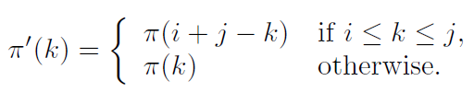
Reversals over permutations
Reversal distance =2
Input: | 4 | 2 | 1 | 3
Reverse [1,3] | 1 | 2 | 4 | 3
Reverse [3,4] | 1 | 2 | 3 | 4
The reversal ρ(i, j) (1 ≤ i < j ≤ n) transforms the permutation π of {1, 2, . . . , n } into π, where:

Slide 4
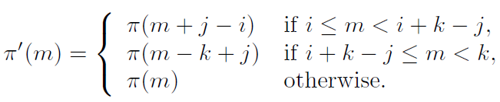
Transpositions over permutations
Transposition distance =2
Input: | 4 | 2 | 1 | 3
Transpose[1,3,5] | 1 | 3 | 4 | 2
Transpose[2,3,5] | 1 | 2 | 3 | 4
The transposition τ (i, j, k) (1 ≤ i < j < k ≤ n + 1) transforms the permutation
π of {1, 2, . . . , n} into π, where:

Slide 5
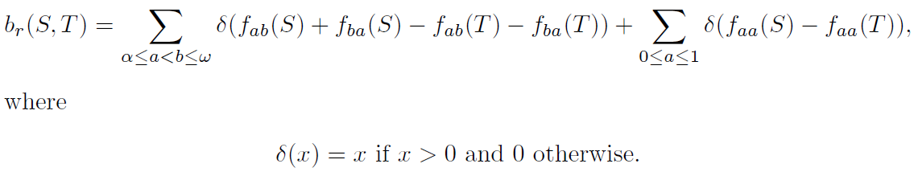
A lower bound of reversal distance (binary strings)
 | S | T
f_{α0} | 0 | 0
f_{α1} | 1 | 1
f₀₀ | 1 | 1
f₀₁ | 2 | 2
f₁₀ | 2 | 2
f₁₁ | 0 | 0
f_{1ω} | 1 | 1
f_{0ω} | 0 | 0
S: | α | 1 | 0 | 0 | 1 | 0 | 1 | ω
T: | α | 1 | 0 | 1 | 0 | 0 | 1 | ω

Slide 6
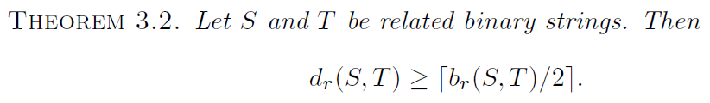
A lower bound of reversal distance (binary strings)

Slide 7
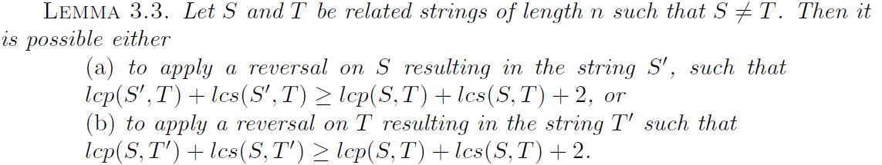
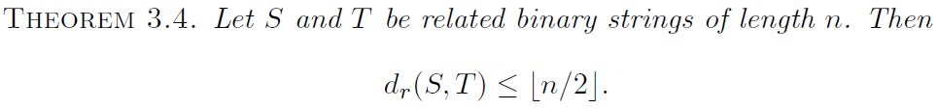
A upper bound of reversal distance (binary strings)
Define lcp(S, T) and lcs(S, T) to be the lengths of the longest common prefix and the longest common suffix, respectively, of S and T.

Slide 8

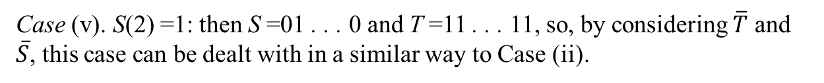

A upper bound of reversal distance (binary strings)
S: | 0 | 1 | 0 | 1 | 0 | 1 | 0 | 1 | 0
T: | 1 | 1 | 0 | 0 | 0 | 0 | 0 | 1 | 1
Case (v). S(2) =1: then S =01 . . . 0 and T =11 . . . 11, so, by considering $\overline{T}$ and
$\overline{S}$, this case can be dealt with in a similar way to Case (ii).
$\overline{T}$: | [0 | 0 | 1] | 1 | 1 | 1 | 1 | 0 | 0
$\overline{S}$: | 1 | 0 | 1 | 0 | 1 | 0 | 1 | 0 | 1
Case (ii). T(2) =0: then S = 0. . . 0 and T =10 . . . 1, so take S =[0 +1] . . . 0.
S: | 0 | 1 | 0 | 1 | 0 | 1 | 0 | 1 | 0
T: | 0 | 1 | 1 | 0 | 0 | 0 | 0 | 1 | 1

Slide 9




A upper bound of reversal distance (binary strings)
S: | 0 | 1 | [0 | 1] | 0 | 1 | 0 | 1 | 0
T: | 0 | 1 | 1 | 0 | 0 | 0 | 0 | 1 | 1
Case (ii). T(2) =0: then S = 0. . . 0 and T =10 . . . 1, so take S =[0 +1] . . . 0.
S: | 0 | 1 | 1 | 0 | 0 | 1 | 0 | 1 | 0
T: | 0 | 1 | 1 | 0 | 0 | 0 | 0 | 1 | 1
$\overline{S}$: | 1 | 0 | 0 | 1 | 1 | [0 | 1 | 0 | 1]
$\overline{T}$: | 1 | 0 | 0 | 1 | 1 | 1 | 1 | 0 | 0
Case (i). S(n) =1: then S = 0. . . 1 and T = 1. . . 0, so take S =[0 . . . 1].
$\overline{S}$: | 1 | 0 | 0 | 1 | 1 | 1 | [0 | 1] | 0
$\overline{T}$: | 1 | 0 | 0 | 1 | 1 | 1 | 1 | 0 | 0
Case (i). S(n) =1: then S = 0. . . 1 and T = 1. . . 0, so take S =[0 . . . 1].

Slide 10
A upper bound of reversal distance (binary strings)
S: | 0 | 1 | [0 | 1] | 0 | 1 | 0 | 1 | 0
S: | 0 | 1 | 1 | 0 | 0 | [1 | 0 | 1 | 0]
S: | 0 | 1 | 1 | 0 | 0 | 0 | [1 | 0] | 1
S: | [0 | 1 | 1] | 0 | 0 | 0 | 0 | 1 | 1
T: | 1 | 1 | 0 | 0 | 0 | 0 | 0 | 1 | 1

Slide 11
A upper bound of reversal distance (binary strings)
S: | 0 | 1 | [0 | 1] | 0 | 1 | 0 | 1 | 0
S: | 0 | 1 | 1 | 0 | 0 | [1 | 0 | 1 | 0]
S: | 0 | 1 | 1 | 0 | 0 | 0 | [1 | 0] | 1
S: | [0 | 1 | 1] | 0 | 0 | 0 | 0 | 1 | 1
T: | 1 | 1 | 0 | 0 | 0 | 0 | 0 | 1 | 1

Slide 12
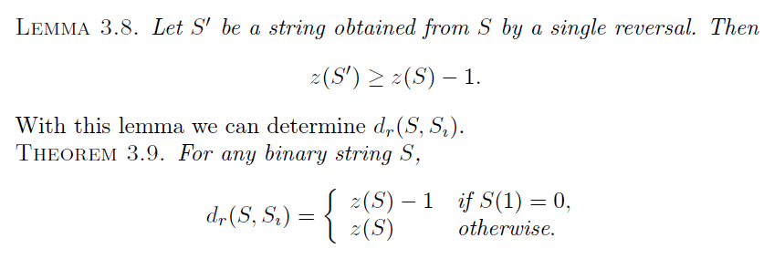
Sorting by reversals (binary strings)
S: | [1 | 0] | 1 | 0
z(S) =2
S’: | 0 | [1 | 1 | 0]
z(S’) =2
T: | 0 | 0 | 1 | 1
z(T) =1
z(S) denotes the number of blocks of zeros contained in S.

Slide 13
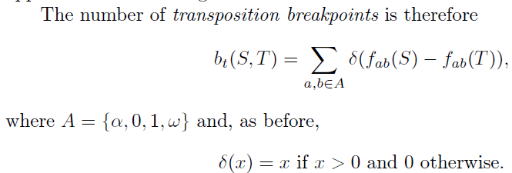
A lower bound of transposition distance (binary strings)
 | S | T
f_{α0} | 0 | 0
f_{α1} | 1 | 1
f₀₀ | 0 | 1
f₀₁ | 2 | 1
f₁₀ | 2 | 1
f₁₁ | 1 | 2
f_{1ω} | 1 | 1
f_{0ω} | 0 | 0
S: | α | 1 | 1 | 0 | 1 | 0 | 1 | ω
T: | α | 1 | 0 | 0 | 1 | 1 | 1 | ω
bt(S, T) =2

Slide 14

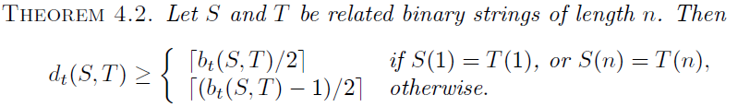
A lower bound of transposition distance (binary strings)
 | S | S’ | T
f_{α0} | 0 |  | 0
f_{α1} | 1 |  | 1
f₀₀ | 0 |  | 0
f₀₁ | 2 |  | 1
f₁₀ | 2 |  | 1
f₁₁ | 1 |  | 2
f_{1ω} | 1 |  | 1
f_{0ω} | 0 |  | 0
S: | α | 1 | [0 | 1] | [1 | 0] | 1 | ω
S’: | α | A | B | C | D | E | F | ω
T: | α | 1 | 0 | 0 | 1 | 1 | 1 | ω

Slide 15
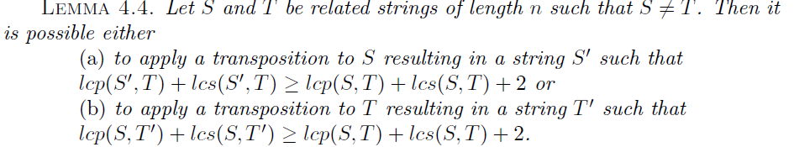

A upper bound of transposition distance (binary strings)
Define lcp(S, T) and lcs(S, T) to be the lengths of the longest common prefix and the longest common suffix, respectively, of S and T.

Slide 16
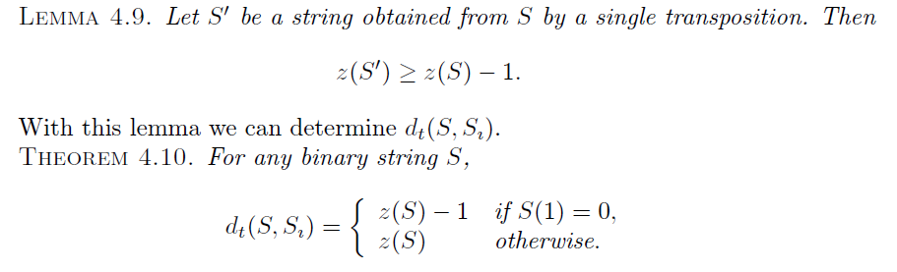
Sorting by transposition (binary strings)
S: | 1 | [0] | [1] | 0
z(S) =2
S’: | [1 | 1] | [0 | 0]
z(S’) =1
T: | 0 | 0 | 1 | 1
z(T) =1
z(S) denotes the number of blocks of zeros contained in S.

Slide 17
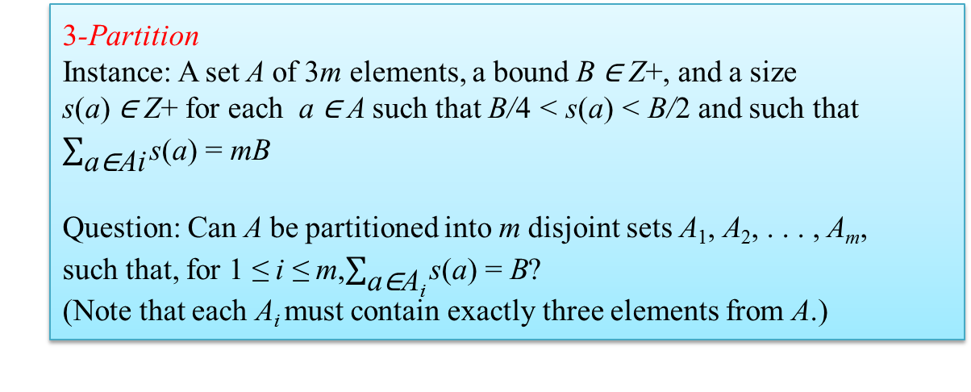
NP-completeness of reversal distance
We begin with a definition of the reversal distance problem as a decision problem (RD):
The proof consists of a pseudopolynomial transformation from 3-Partition to RD.
3-Partition
Instance: A set A of 3m elements, a bound B ∈ Z+, and a size
s(a) ∈ Z+ for each a ∈ A such that B/4 < s(a) < B/2 and such that $\sum_{\text{a}\text{∈}\text{Ai}}{\text{s}\text{(}\text{a}\text{) = }\text{m}\text{B}}$
Question: Can A be partitioned into m disjoint sets A₁, A₂, . . . , A_{m},
such that, for 1 ≤ i ≤ m,$\sum_{\text{a}\text{∈}\text{Ai}}{\text{s}\text{(}\text{a}\text{) = }\text{B}}$?
(Note that each A_{i} must contain exactly three elements from A.)
reversal distance problem (RD):
Instance: Related strings S and T of length n, over an alphabet of
size t ≥ 2, and a bound d ∈ Z+.
Question: Is dr(S, T) ≤ d?

