Slide 1
Application of the A* Algorithm to Solve the Longest Common Subsequence from Fragments Problem
Yu-Mei Pan and Chia-Tung Lee
The 23rd Workshop on Combinatorial Mathematics and Computation Theory pp.240-245
Presenter: Bi-Shiang Lin
Date:2015/11/11

Slide 2
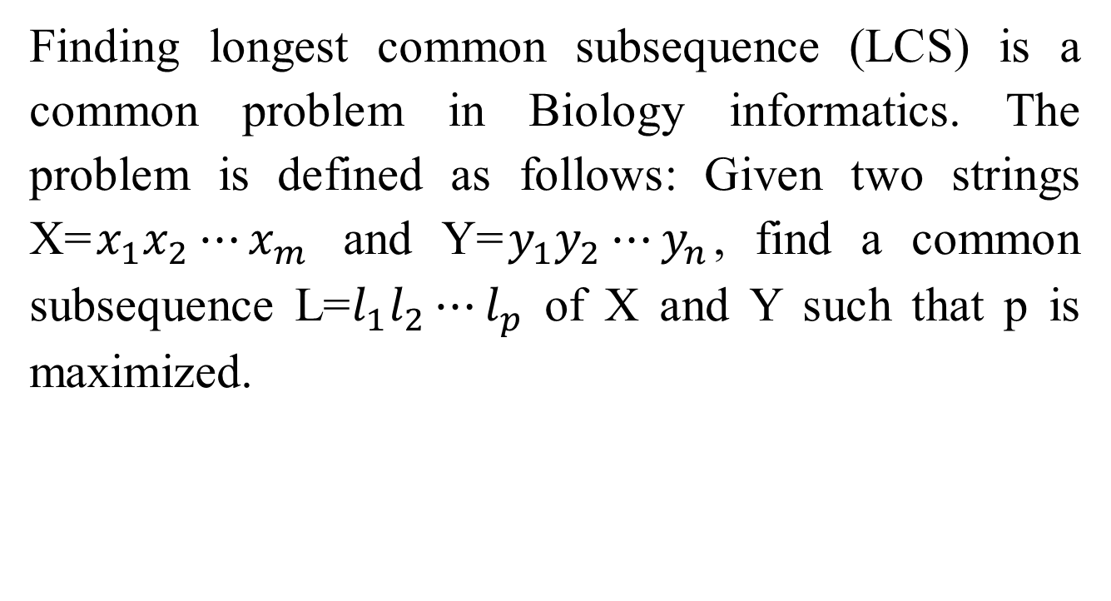
Abstract(1/3)
Finding longest common subsequence (LCS) is a common problem in Biology informatics. The problem is defined as follows: Given two strings X=$x_{1}x_{2}⋯x_{m}$ and Y=$y_{1}y_{2}⋯y_{n}$, find a common subsequence L=$l_{1}l_{2}⋯l_{p}$ of X and Y such that p is maximized.

Slide 3
Abstract(2/3)
In this paper, we discuss a variation of the LCS problem－LCS from fragments problem defined as follows: Given two strings X and Y and a set M of fragments which are matching substrings of X and Y, find a LCS from M. A new method using a tree searching strategy, A* algorithm, is proposed in this study for the LCS from fragments problem.

Slide 4
Abstract(3/3)
The method can help us to filter out some fragments which wouldn’t appear in solutions, and efficiently find a solution. However, in worst cases, all fragments are needed to be computed in the solving process.

Slide 5

The LCS Problem
Sequence $X$: actat
Sequence $Y$: tacat
Common Subsequence : at、cat…
Longest Common Subsequence : acat

Slide 6

The LCS from fragments problem
Sequence $X$: gactac
Sequence $Y$: ctatac
Set of fragments: { cta、tac、ac }
 | c | t | a | t | a | c
g
a
c
t
a
c

Slide 7

The LCS from fragments problem
Sequence $X$: gactac
Sequence $Y$: ctatac
Set of fragments: { cta、tac、ac }
 | c | t | a | t | a | c
g
a
c
t
a
c

Slide 8
Shortest path problem
Find the shortest path from (0,0) to (m,n)
Horizontal and vertical edge cost 1
Diagonal edge cost 0
 | c | t | a | t | a | c
g
a
c
t
a
c

Slide 9
The A* Algorithm
(0,0)
2 5 6 12
m1 m2 m3 (6,6)
(0,0)
4 8 6 12
 | c | t | a | t | a | c
g
a |  |  |  |  |  | m2
c |  | m1
t |  |  |  |  | m3
a
c
X 2 4
m2
m3
(6,6)
4 6
0
(6,6) 4
(6,6)

Slide 10
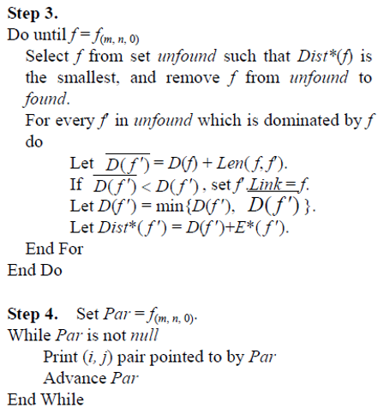
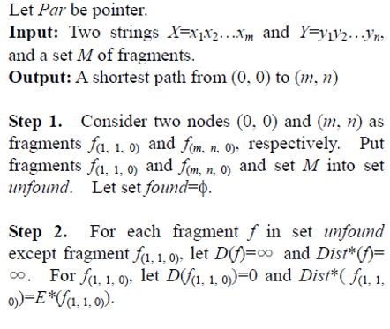
Algorithm

Slide 11
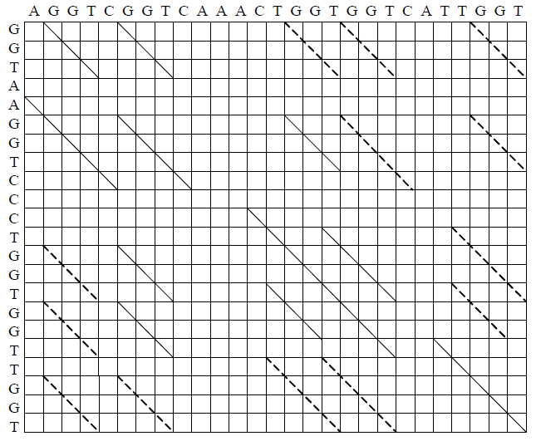
Example

Slide 12
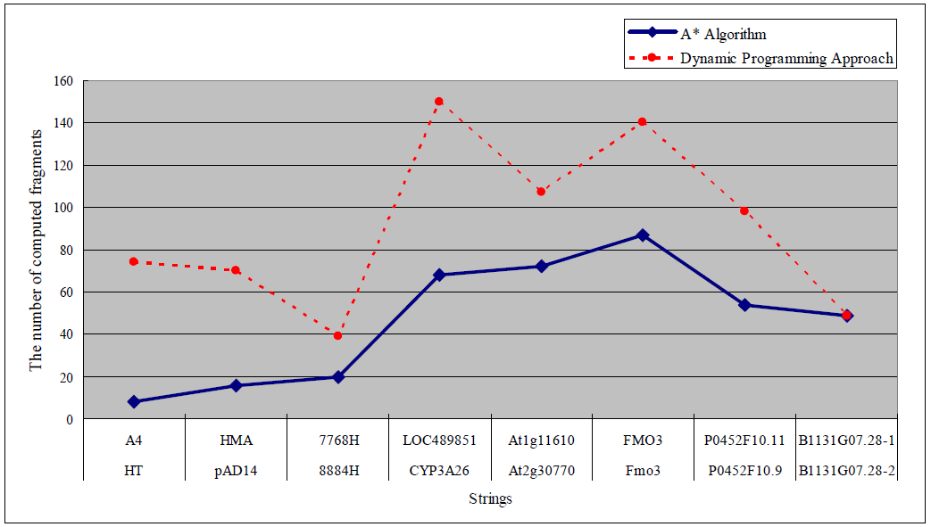
Experiment result

