Slide 1
Tree edit distance with gaps
Hélène Touzet
Information Processing Letters
Volume 85, Issue 3, 14 February 2003, Pages 123–129
Presenter: Syuan-Zong Ciou
Date:2015/12/1

Slide 2
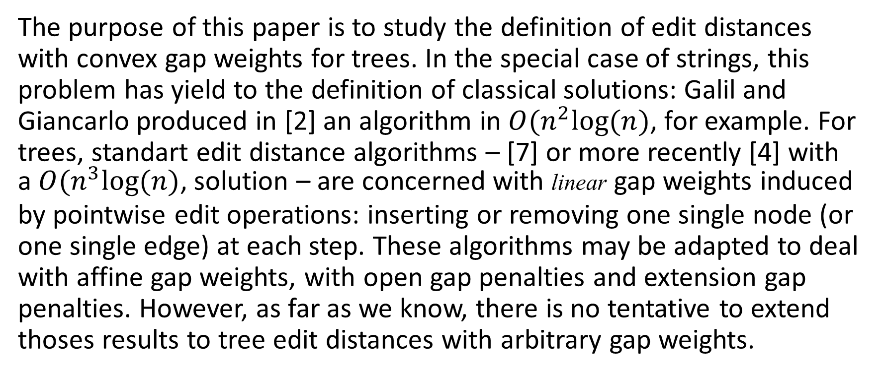
Abstract
The purpose of this paper is to study the definition of edit distances with convex gap weights for trees. In the special case of strings, this problem has yield to the definition of classical solutions: Galil and Giancarlo produced in [2] an algorithm in $O(n^{2}log⁡(n)$, for example. For trees, standart edit distance algorithms – [7] or more recently [4] with a $O(n^{3}log⁡(n)\text{,}$ solution – are concerned with linear gap weights induced by pointwise edit operations: inserting or removing one single node (or one single edge) at each step. These algorithms may be adapted to deal with affine gap weights, with open gap penalties and extension gap penalties. However, as far as we know, there is no tentative to extend thoses results to tree edit distances with arbitrary gap weights.
[2] Z. Galil, R. Giancarlo, Speeding up dynamic programming with applications to molecular biology, Theoret. Comput. Sci. 64 (1989) 107–118.
[4] P. Klein, Computing the edit-distance between unrooted ordered trees, in: Proceedings of 6th European Symposium on Algorithms, 1998, pp. 91–102.
[7] K. Zhang, D. Shasha, Simple fast algorithms for the editing distance between trees and related problems, SIAM J. Comput. 18 (6) (1989) 1245–1262.

Slide 3
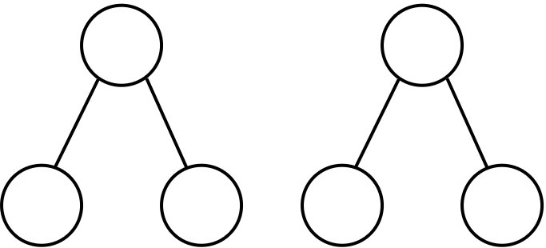




Trees,Forests
We work with ordered trees of arbitrary arity. Give a set of labels $ℒ$, we write $l(T_{1},…,T_{n})$ for the tree composed by a root labelled by $l$ and $n$ subtrees $T_{1},…,T_{n}$. A forest is a finite sequence of trees.
$$l l$$
$$T_{1} T_{2} T_{2} T_{1}$$
$$l\left(T_{1},T_{2}\right) l(T_{2},T_{1})$$

Slide 4
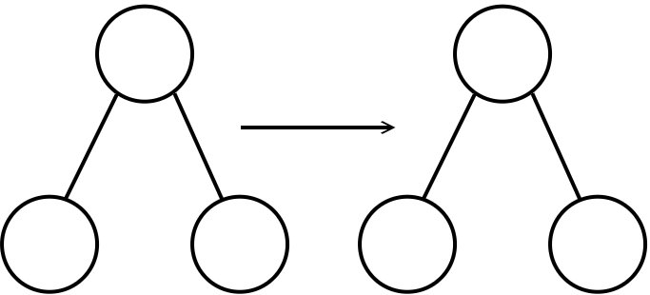
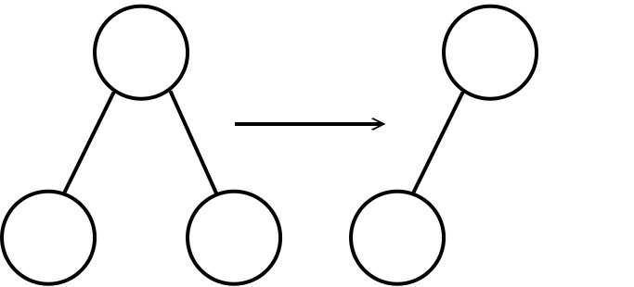
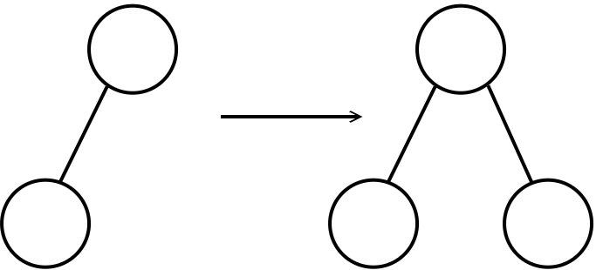






Gapped edit distance
$$l l′$$
Substitution
Deletion
Insertion
$$t_{1} { t}_{2} t_{1} t_{2}$$
$$T T$$
$$t_{1} t_{2} t_{1}$$
$$T T$$
$$t_{1} t_{1} { t}_{2}$$

Slide 5
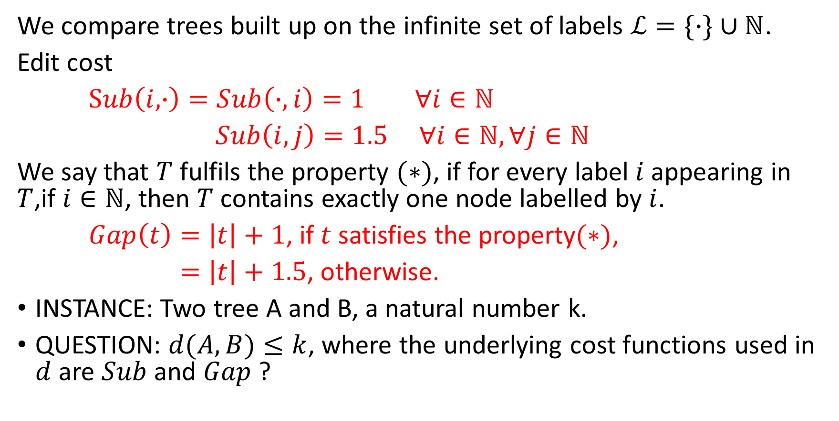
The DIST problem
We compare trees built up on the infinite set of labels $ℒ=\{∙\}∪ℕ$.
Edit cost
$Sub\left(i,∙\right)=Sub\left(∙,i\right)=1 ∀i∈ℕ$
$Sub\left(i,j\right)=1.5 ∀i∈ℕ,∀j∈ℕ$
We say that $T$ fulfils the property $(∗)$, if for every label $i$ appearing in $T$,if $i∈ℕ$, then $T$ contains exactly one node labelled by $i$.
$Gap\left(t\right)=\left|t\right|+1$, if $t$ satisfies the property$(∗)$,
$=\left|t\right|+1.5$, otherwise.
INSTANCE: Two tree A and B, a natural number k.
QUESTION: $d(A,B)≤k$, where the underlying cost functions used in $d$ are $Sub$ and $Gap$ ?

Slide 6
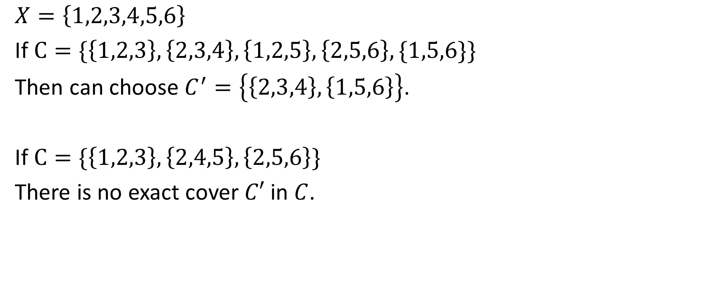
Exact cover by 3-sets problem
$$X=\left\{1,2,3,4,5,6\right\}$$
If $C=\{\left\{1,2,3\right\},\left\{2,3,4\right\},\left\{1,2,5\right\},\left\{2,5,6\right\},\{1,5,6\}\}$
Then can choose $C^{′}=\left\{\left\{2,3,4\right\},\left\{1,5,6\right\}\right\}$.
If $C=\{\left\{1,2,3\right\},\left\{2,4,5\right\}, \left\{2,5,6\right\}\}$
There is no exact cover $C′$ in $C$.

Slide 7
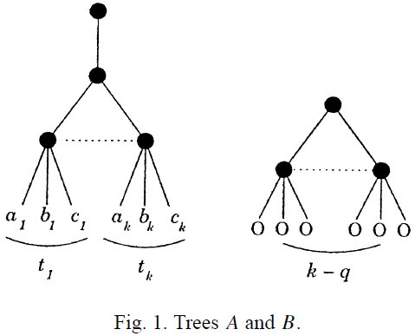

DIST is NP-hard
Tree A is $∙(∙(t_{1},…,t_{k}))$. Size is $4k+2$.
Tree B is defined as $∙(∙{(0,0,0)}^{(k−q)})$. Size is $4\left(k−q\right)+1$

Slide 8

Distance for complete subtrees
Let $l,l^{′}∈ℒ$, and let$f,f′$ be two forests.
$d\left(l\left(f\right),ℰ\right)=Gap\left(l\left(f\right)\right)$
$d\left(l\left(f\right),l^{′}\left(f^{′}\right)\right)=min\left\{\begin{matrix}d\left(l,l^{′}\right)+Distance(f,f′) \\ Gap\left(l\left(f\right)\right)+Gap(l′(f′))\end{matrix}\right.$

Slide 9
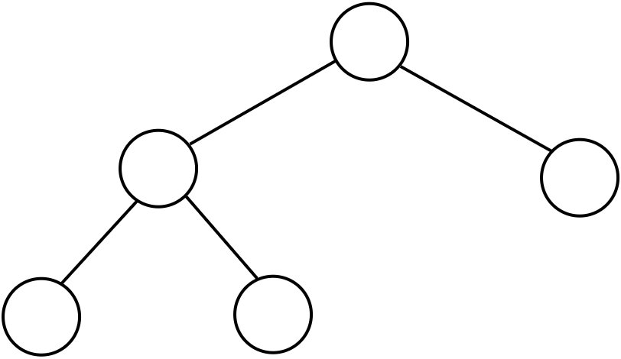
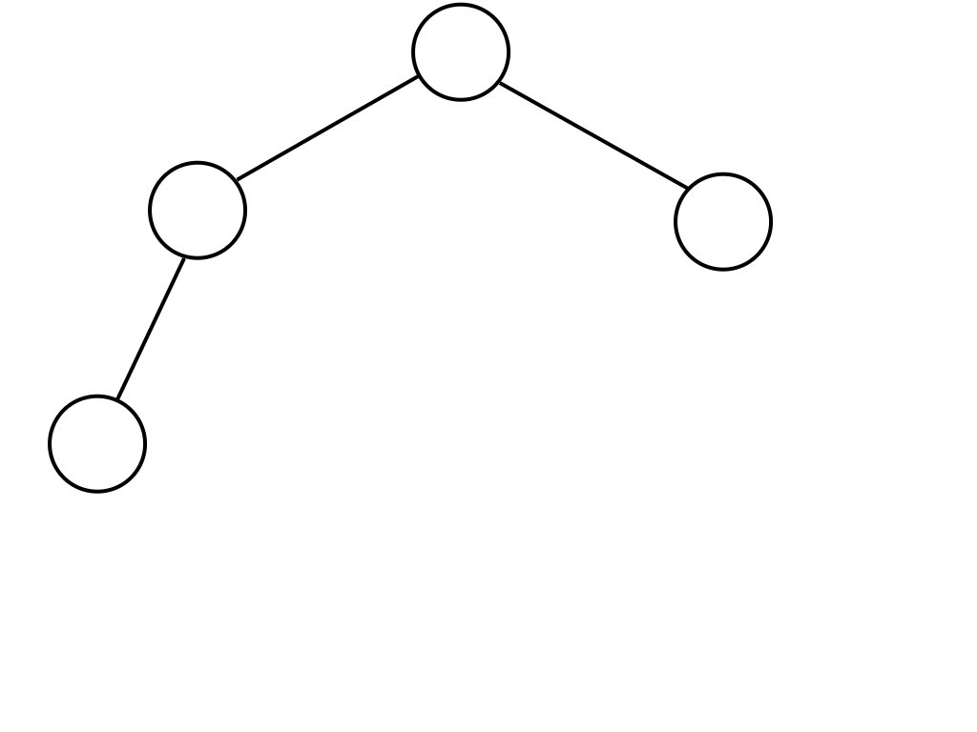







Product tree
$$a_{5} b_{4}$$
$$a_{3}$$
$$a_{4}$$
$$b_{2}$$
$$b_{3}$$
$$a_{1}$$
$$a_{2}$$
$$b_{1}$$

Slide 10
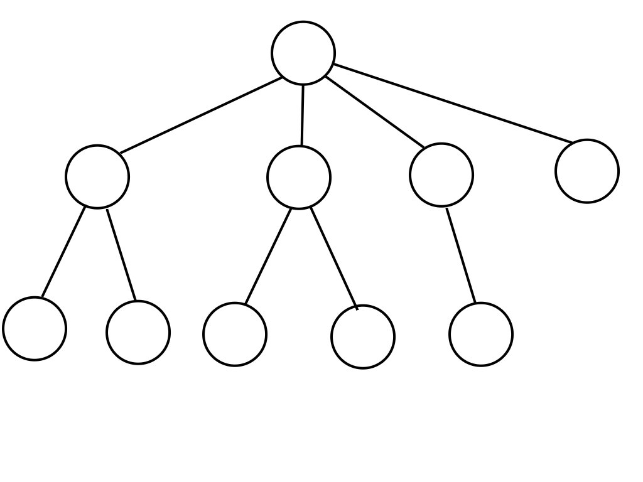







Product tree
$${d(T}_{a_{5}},T_{b_{4}})$$
$${d(T}_{a_{3}},T_{b_{2}})$$
$${d(T}_{a_{1}},T_{b_{1}})$$
$${d(T}_{a_{2}},T_{b_{1}})$$
$${d(T}_{a_{1}},ℰ)$$
$${d(T}_{a_{2}},ℰ)$$
$$d(ℰ,T_{b_{1}})$$

Slide 11
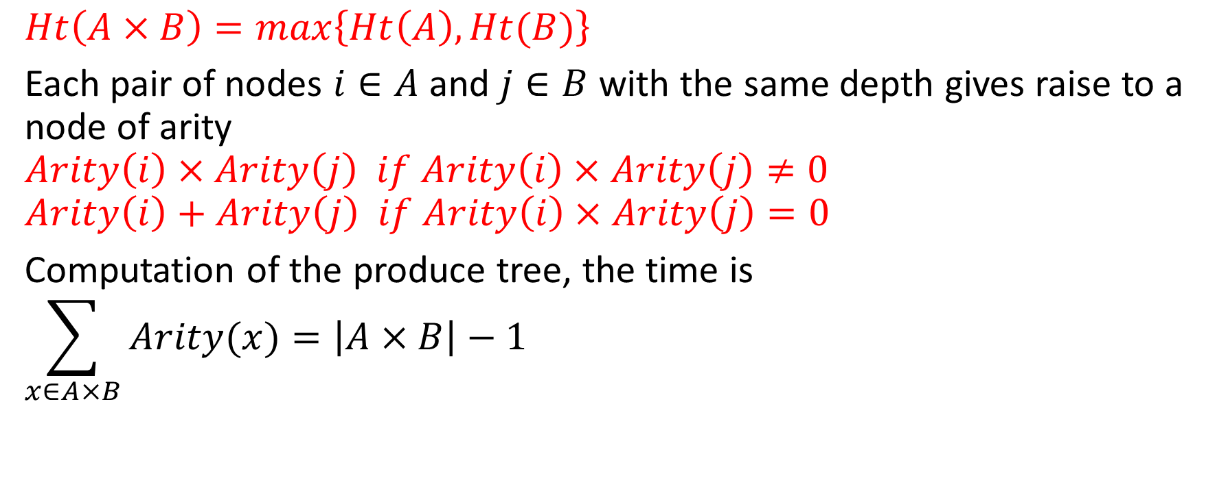
Product tree
$$Ht\left(A×B\right)=max\left\{Ht\left(A\right),Ht(B)\right\}$$
Each pair of nodes $i∈A$ and $j∈B$ with the same depth gives raise to a node of arity
$$Arity\left(i\right)×Arity\left(j\right) if Arity\left(i\right)×Arity\left(j\right)≠0$$
$$Arity\left(i\right)+Arity\left(j\right) if Arity\left(i\right)×Arity\left(j\right)=0$$
Computation of the produce tree, the time is
$$\sum_{x∈A×B}{Arity(x)}=\left|A×B\right|−1$$

Slide 12
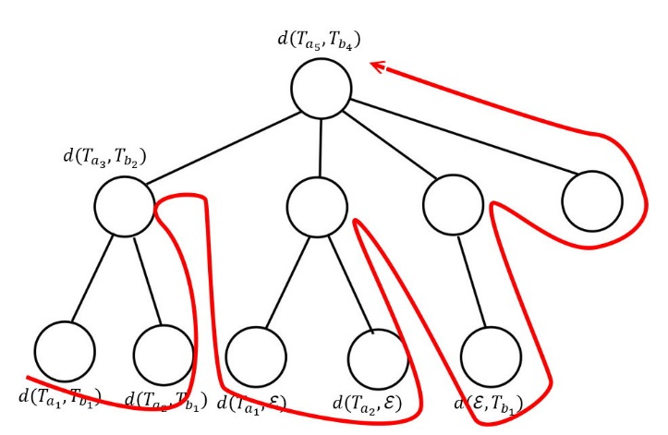
Product tree

Slide 13
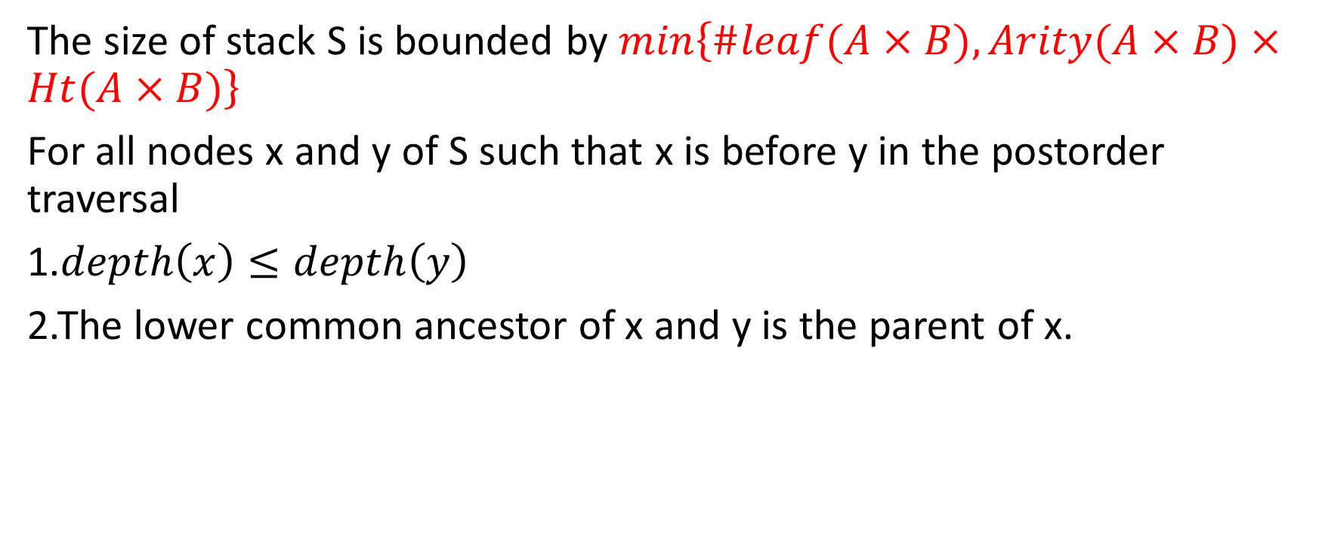
Product tree
The size of stack S is bounded by $min\left\{\#leaf(A×B),Arity(A×B)×Ht(A×B)\right\}$
For all nodes x and y of S such that x is before y in the postorder traversal
1.$depth\left(x\right)≤depth\left(y\right)$
2.The lower common ancestor of x and y is the parent of x.

Slide 14

Product tree
Let T be a tree that is not reduced to a leaf, and let $k=max\left\{2,Arity(T)\right\}$. The size of the stack S for the weighted postorder is bounded by $k×\log_{k}(|T|)$.

