Slide 1
A New Algorithm for the Longest Common Subsequence Problem
2007 International Conference on Computational Intelligence and Security Workshops
pp.350-353 May 1977
Xuyu Xiang^{a,b}
Dafang Zhangª
Jiaohua Qin^{a,b}
ªSchool of Computer & Communication, Hunan University, Changsha, Hunan China
^{b}Department of Computer, Hunan City University, Changsha, Hunan China
Presentor:Shih-Jhan Huang
Date:2015/12/1

Slide 2
Abstract
In order to find the longest common subsequence(LCS) as soon as possible, we, with the method of match pairs, propose the new algorithm of the sequence of DNA, which is efficient both in time and in space on the basis of the improved dynamic programming theorem.

Slide 3
The LCS Problem
Sequence X: TAGTCACG
Sequence Y: AGACTGTC
Common subsequences:GG, AGC, AGACG
Longest Common Subsequences: AGACG

Slide 4
Definition 1
Given two DNA sequences
I={i₁, i₂, ..., i_{m}} and J={j₁, j₂, ..., j_{n}}, when i_{i},j_{j}ϵ{A,C,G,T}.
the LCS problem is to find a largest subsequence
Z={z₁, z₂, ..., z_{L}}, when z_{i} ϵ{A,C,G,T},
satisfies 1 ≤ k ≤ L , z_{k}=i_{ik} =j_{jk}
and i₁ < i₂ < ... < i_{L} , j₁ < j₂ < … < j_{L}

Slide 5
Theorem1
(optimal-substructure property)
Sequences : I={i₁, i₂, ..., i_{m}} and J={j₁, j₂, ..., j_{n}}
LCS : Z={z₁, z₂, ..., z_{L}}
Define the i_{th} prefix of I, for i= 0, 1, ..., m, as I_{i}={i₁, i₂, ..., i_{i}} and I₀ is the empty sequence.
(1)If i_{m} = j_{n}, then z_{L} = i_{m} = j_{n} and Z_{L-1} is an LCS of I_{m-1} and J_{n-1}.
(2)If i_{m} ≠ j_{n}, then z_{L} ≠ i_{m} implies that Z is an LCS of I_{m-1} and J.
(3)If i_{m} ≠ j_{n}, then z_{L} ≠ j_{n} implies that Z is an LCS of I and J_{n-1}.
5

Slide 6
Theorem2
(The improved dynamic programming algorithm)
Sequences : I={i₁, i₂, ..., i_{m}} and J={j₁, j₂, ..., j_{n}}
LCS : Z={z₁, z₂, ..., z_{L}}
Define the i_{th} Suffixe of I, for i = 0, 1, ..., m, as I_{i}={i_{i}, i_{i+1}, ..., i_{m}} and I₀ is the empty sequence.
(1) If i₁= j₁ then z₁=i₁ and Z₂ is an LCS of I₂ and J₂,
(2) If i₁≠ j₁ then z₁≠i₁ and Z is an LCS of I₂ and J,
(3) If i₁≠ j₁ then z₁≠j₁ and Z is an LCS of I and J₂.
6

Slide 7
The approach to find the LCS of I and J is as following :
(1) if i1= j1 find LCS of I2 and J2,
(2) if i1≠ j1
a) find LCS of I2 and J
b) find LCS of I and J2
and take the larger one of 'a)' or 'b)'.
6

Slide 8
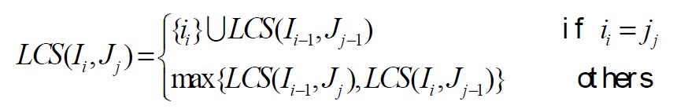
Thus we start with small problem, find LCS :
Let LCS(I_{i}, J_{j}) be LCS of I_{i} and J_{j}. Let
I₁={i₁,i₂,…,i_{m}}, I₂={i₂,i₃,…,i_{m}}, …, I_{m}={i_{m}};
J₁={j₁,j₂,…,j_{n}}, J₂={j₂,j₃,…,j_{n}}, …, J_{n}={j_{n}}.
then
6

Slide 9
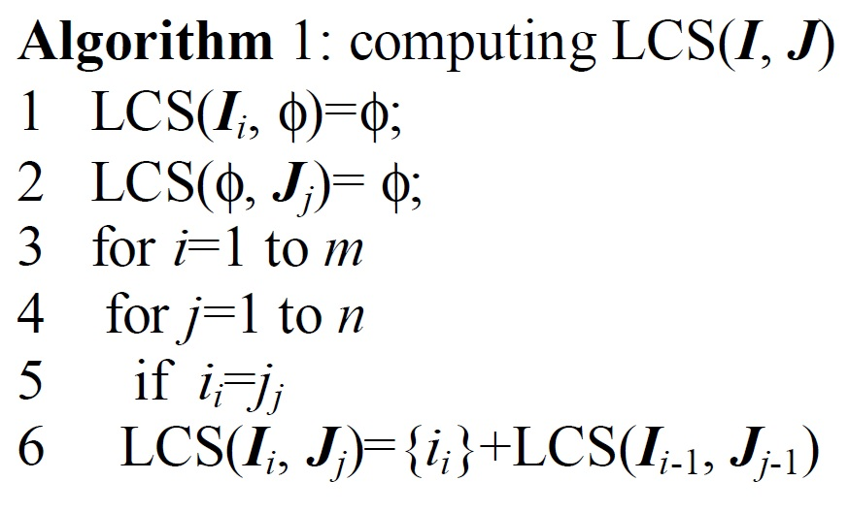
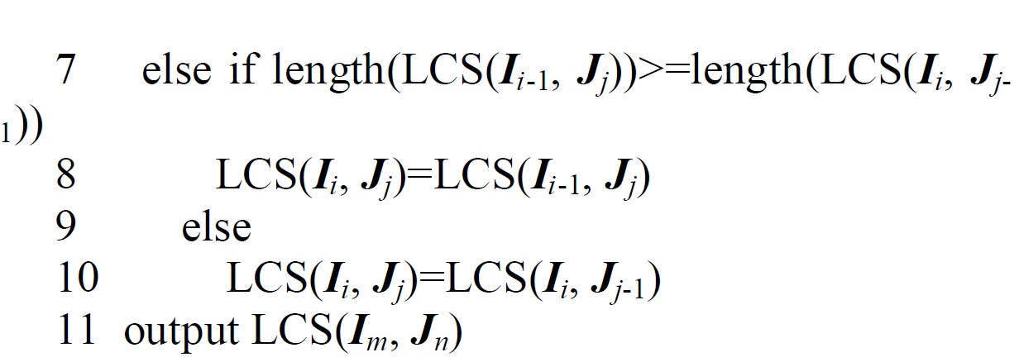
Time complexity : O(mn)

Slide 10
illustration of the improved dynamic programming algorithm
Input sequences: S_{i}=ATCTGAT and S_{j}=TGTATA
Pairs of matching:
 | J | T | G | C | A | T | A
I | ᶲ | ᶲ | ᶲ | ᶲ | ᶲ | ᶲ | ᶲ
A | ᶲ | ᶲ | ᶲ | ᶲ | A | ←A | A
T | ᶲ | T | ←T | ←T | ↑A | ↖AT | ←AT
C | ᶲ | ↑T | ↑T | ↖TC | ←TC | ↑AT | ↑AT
T | ᶲ | T | ↑T | ↑TC | ↑TC | ↖TCT | ←TCT
G | ᶲ | ↑T | ↖TG | ↑TC | ↑TC | ↑TCT | ↑TCT
A | ᶲ | ↑T | ↑TG | ↑TC | ↖TCA | ↑TCT | ↖TCTA
T | ᶲ | T | ↑TG | ↑TC | ↑TCA | ↖TCAT | ↑TCTA

Slide 11
illustration of the improved dynamic programming algorithm
Input sequences: S_{i}=ATCTGAT and S_{j}=TGTATA
Pairs of matching:
 | J | T | G | C | A | T | A
I | ᶲ | ᶲ | ᶲ | ᶲ | ᶲ | ᶲ | ᶲ
A | ᶲ | ᶲ | ᶲ | ᶲ | A | ←A | A
T | ᶲ | T | ←T | ←T | ↑A | ↖AT | ←AT
C | ᶲ | ↑T | ↑T | ↖TC | ←TC | ↑AT | ↑AT
T | ᶲ | T | ↑T | ↑TC | ↑TC | ↖TCT | ←TCT
G | ᶲ | ↑T | ↖TG | ↑TC | ↑TC | ↑TCT | ↑TCT
A | ᶲ | ↑T | ↑TG | ↑TC | ↖TCA | ↑TCT | ↖TCTA
T | ᶲ | T | ↑TG | ↑TC | ↑TCA | ↖TCAT | ↑TCTA

Slide 12
The New Algorithm
Definition 2 :
Given two DNA sequences I={i₁, i₂, ..., i_{m}} and J={j₁, j₂, ..., j_{n}}, when i_{i},j_{j}ϵ{A,C,G,T}.
Let i_{i}=j_{j} , i=1,2,…,m ; j=1,2,…,n. Define Ρ={(i, j): i_{i} =j_{j} }. then (i, j) is the match pair.
Each nucleotide independently has probability pA, pC, pG, pT of being A, C, G, T,respectively. We will also denote P = {p₁, p₂, … , p_{l}} where each p_{k} is a pair (i_{k}, j_{k}).
Definition 3 :
Given two match pairs p_{x}, p_{y}, if i_{x}<i_{y}, j_{x}<j_{y}, define p_{x} < p_{y}. p_{y} is the subsequence of the p_{x}, or p_{x} is the pre-sequence of the p_{y}.
Definition 4 :
If p_{x} < p_{y}, p_{x} < p_{z}, p_{y}, p_{z} ϵ P , and p_{z}< p_{y} doesn’t exist, define the specific order <* to be p_{x}<*p_{y}, p_{y} is the direct subsequence of the p_{x}, or p_{x} is the direct pre-sequence of the p_{y}.

Slide 13
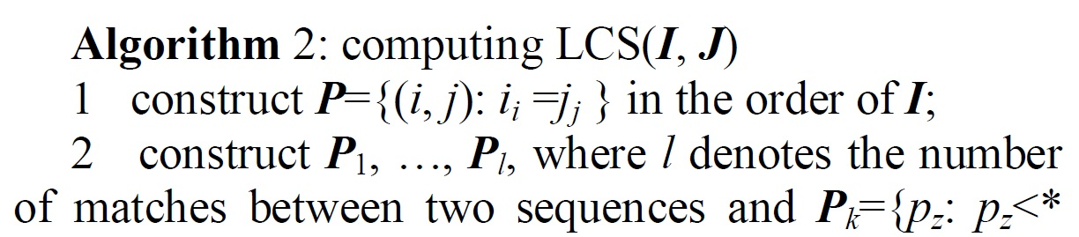
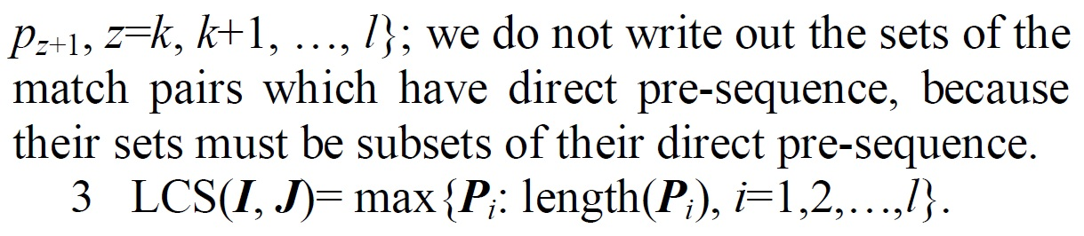
constructe Ρ : O(n+l)
construct P₁, …, P_{l} : O(lL)
Time complexity : O(n+l)

Slide 14
Example
I = ATCTGAT J = TGCATA
Ρ={(1,4), (1,6), (2,1), (2,5), (3,3), (4,1), (4,5), (5,2),(6,4), (6,6), (7,1), (7,5)}.
P₁={(1,4), (2,5), (6,6)};
P₂={ (1,6)};
P₃={ (2,1),(3,3), (4,5), (6,6)};
P₄={ (2,1), (3,3), (6,4), (7,5)}; →LCS : TCTA
P₅={ (4,1), (5,2), (6,4), (7,5)};
P₆={ (4,1), (5,2),(6,6)};
P₇={ (7,1)}.

Slide 15
Theorem3
(Induce the following theorem from the definitions and the algorithm)
Sequences : I={i₁, i₂, ..., i_{m}} and J={j₁, j₂, ..., j_{n}}
LCS(I, J) = max{Pi:length(Pi), i=1,2,…,l}.
6

Slide 16
I=abcbdda
 | 1 | 2 | 3
A | 1 | 6
G | 3
C | 5
T | 2 | 4 | 7
In order to constructe Ρ, we need to go through the O(m) elements of I.
Assume m=O(n). It takes O(n+l) time and space to construct Ρ. It takes O(lL) time and O(l+L) space to construct P1, …, Pl.

Slide 17
Conclusion
LCS problem:
Dynamic programming approach :
quadratic time but linear space
Nondynamic-programming approach :
O(nlogn) time or O(Ln) time, which is almost linear when the length of an LCS is small compared to n, but more than linear space.
This paper :(Nondynamic programming)
O(n+l) time and space

Slide 18
The End
Thanks for listening!

