Slide 1
Trading System based on the use of technical analysis: A computational experiment
Thiago Raymon Cruz Cacique da Costa , Rodolfo Toríbio Nazário , Gabriel Soares Zica Bergo , Vinicius Amorim Sobreiro, Herbert Kimura
University of Brasília
Journal of Behavioral and Experimental Finance, 2015
pp. 42 - 55
Presenter : Tsai Yao-Chou

Slide 2
Abstract
Previous studies highlight the influence of methods of technical analysis in the search for exceptional gains in the context of the financial market. Based on this scenario, the main objective of this paper is to analyze the performance of the Simple Moving Average, Exponential Moving Average, MACD and Triple Screen techniques in an actual trading system that included 198 stocks traded in the Brazilian. This paper studies the power of predictability of such methods using various combinations of periods, brokerage fees and a policy of Stop-Loss and compares these with the buy-and-hold strategy. The results indicate that while the studied techniques lead to a high probability of obtaining a return that exceeds the investment value, they have little power of predictability in the Brazilian market. In relation to the passive buy strategy, only the smallest part of the obtained returns outweighs the results of the buy-and-hold strategy.

Slide 3

Moving average (MA)
Description: 股價的趨勢(Trend)
Formula: $SMA=(\frac{P_{1}+P_{2}+…+P_{N}}{N})$
Example:
Date | 5/1 | 5/2 | 5/3 | 5/4 | 5/5 | 5/6 | 5/7 | 5/8
Close price | 46.25 | 45.6 | 44.55 | 51.55 | 41 | 41 | 41.65 | 43.8

Slide 4

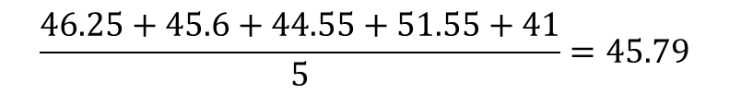
Moving average (MA)
Description: 股價的趨勢(Trend)
Formula: $SMA=(\frac{P_{1}+P_{2}+…+P_{N}}{N})$
Example:
Period 1
Date | 5/1 | 5/2 | 5/3 | 5/4 | 5/5 | 5/6 | 5/7 | 5/8
Close price | 46.25 | 45.6 | 44.55 | 51.55 | 41 | 41 | 41.65 | 43.8
$$\frac{46.25+45.6+44.55+51.55+41}{5}=45.79$$
45.79

Slide 5
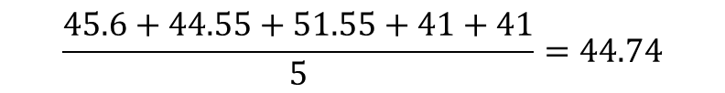
Moving average (MA)
Description: 股價的趨勢(Trend)
Formula: $SMA=(\frac{P_{1}+P_{2}+…+P_{N}}{N})$
Example:
Period 2
Date | 5/1 | 5/2 | 5/3 | 5/4 | 5/5 | 5/6 | 5/7 | 5/8
Close price | 46.25 | 45.6 | 44.55 | 51.55 | 41 | 41 | 41.65 | 43.8
$$\frac{45.6+44.55+51.55+41+41}{5}=44.74$$
45.79 | 44.74

Slide 6
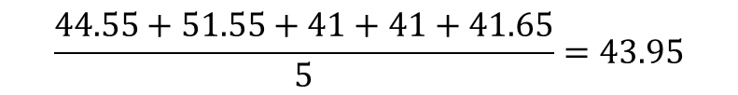
Moving average (MA)
Description: 股價的趨勢(Trend)
Formula: $SMA=(\frac{P_{1}+P_{2}+…+P_{N}}{N})$
Example:
Period 3
Date | 5/1 | 5/2 | 5/3 | 5/4 | 5/5 | 5/6 | 5/7 | 5/8
Close price | 46.25 | 45.6 | 44.55 | 51.55 | 41 | 41 | 41.65 | 43.8
$$\frac{44.55+51.55+41+41+41.65}{5}=43.95$$
45.79 | 44.74 | 43.95

Slide 7
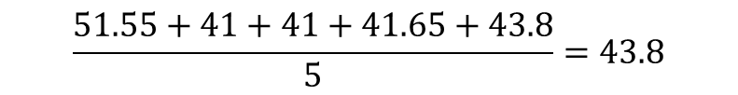
Moving average (MA)
Description: 股價的趨勢(Trend)
Formula: $SMA=(\frac{P_{1}+P_{2}+…+P_{N}}{N})$
Example:
Period 4
Date | 5/1 | 5/2 | 5/3 | 5/4 | 5/5 | 5/6 | 5/7 | 5/8
Close price | 46.25 | 45.6 | 44.55 | 51.55 | 41 | 41 | 41.65 | 43.8
$$\frac{51.55+41+41+41.65+43.8}{5}=43.8$$
45.79 | 44.74 | 43.95 | 43.8

Slide 8
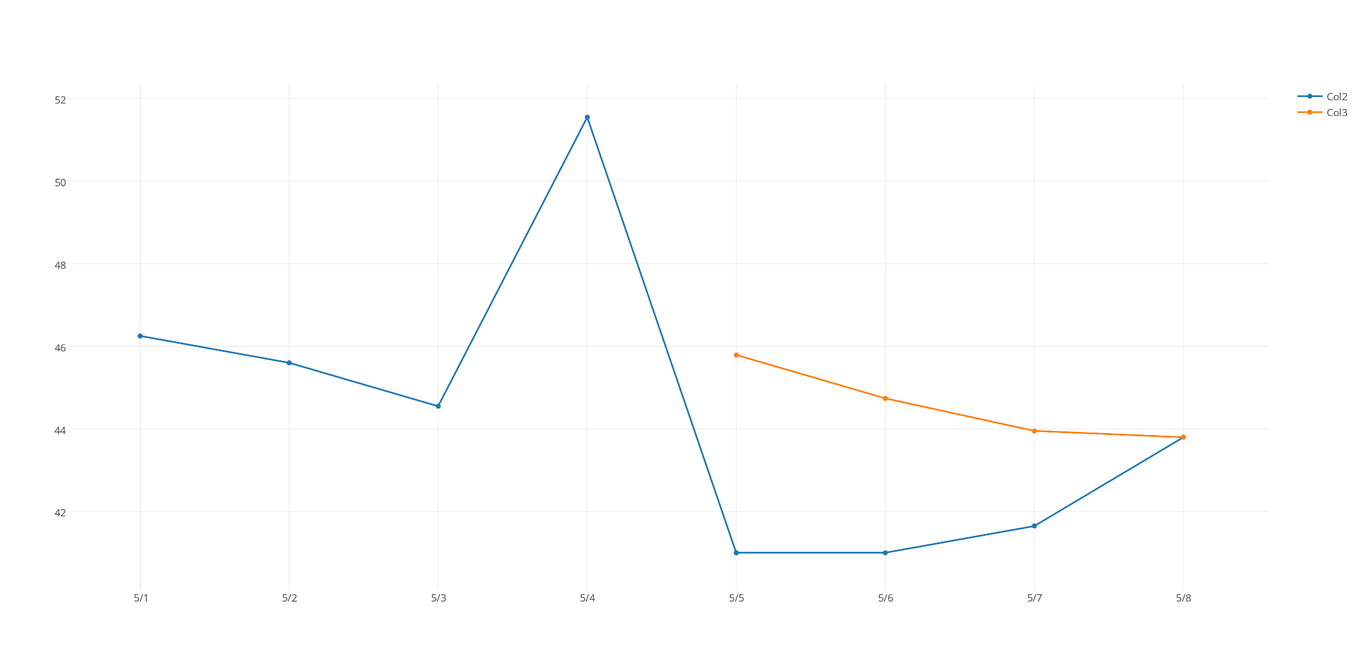
Moving average (MA)

Slide 9

Exponential Moving average (EMA)
Description: 股價的趨勢(Trend)
Formula: ${EMA}_{today}={EMA}_{yesterday}+α×({price}_{today}−{EMA}_{yesterday})$
$$α=\frac{2}{N+1}$$
Example:
Period 1
Date | 5/1 | 5/2 | 5/3 | 5/4 | 5/5 | 5/6 | 5/7 | 5/8
Close price | 46.25 | 45.6 | 44.55 | 51.55 | 41 | 41 | 41.65 | 43.8
41

Slide 10

Exponential Moving average (EMA)
Description: 股價的趨勢(Trend)
Formula: ${EMA}_{today}={EMA}_{yesterday}+α×({price}_{today}−{EMA}_{yesterday})$
$$α=\frac{2}{N+1}$$
Example:
Period 2
Date | 5/1 | 5/2 | 5/3 | 5/4 | 5/5 | 5/6 | 5/7 | 5/8
Close price | 46.25 | 45.6 | 44.55 | 51.55 | 41 | 41 | 41.65 | 43.8
$$41+0.33∗\left(41−41\right)=41$$
41 | 41

Slide 11

Exponential Moving average (EMA)
Description: 股價的趨勢(Trend)
Formula: ${EMA}_{today}={EMA}_{yesterday}+α×({price}_{today}−{EMA}_{yesterday})$
$$α=\frac{2}{N+1}$$
Example:
Period 3
Date | 5/1 | 5/2 | 5/3 | 5/4 | 5/5 | 5/6 | 5/7 | 5/8
Close price | 46.25 | 45.6 | 44.55 | 51.55 | 41 | 41 | 41.65 | 43.8
$41+0.33∗\left(41.65−41\right)=41$.21
41 | 41 | 41.21

Slide 12

Exponential Moving average (EMA)
Description: 股價的趨勢(Trend)，但越靠近今天的權重越高
Formula: ${EMA}_{today}={EMA}_{yesterday}+α×({price}_{today}−{EMA}_{yesterday})$
$$α=\frac{2}{N+1}$$
Example:
Period 4
Date | 5/1 | 5/2 | 5/3 | 5/4 | 5/5 | 5/6 | 5/7 | 5/8
Close price | 46.25 | 45.6 | 44.55 | 51.55 | 41 | 41 | 41.65 | 43.8
$$41.21+0.33∗\left(43.8−41.21\right)=42.06$$
41 | 41 | 41.21 | 42.06

Slide 13
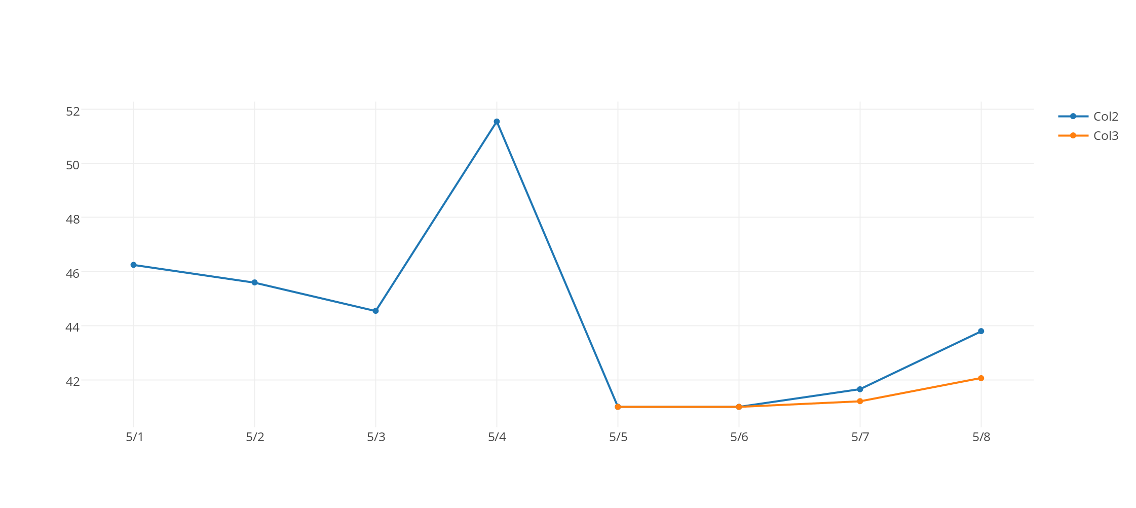
Exponential Moving average (EMA)

Slide 14

Moving Average Convergence Divergence
Description: 用long-term和short-term兩條EMA線來觀察股價趨勢
Formula:
$MACD=EMA\left(12\right)−EMA\left(26\right)$
$Signal=EMA\left(9, MACD\right)$
$Histogram=MACD−Signal$

Slide 15
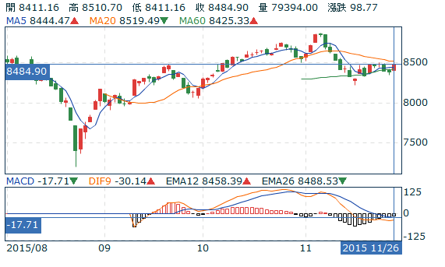
Moving Average Convergence Divergence

Slide 16
Triple Screen
中文名稱: 三層濾網
Author: Alexander Elder (投資專家、作者)
Time: 1985
Features:
Three Layers
Tracking trends
Avoiding false signals

Slide 17
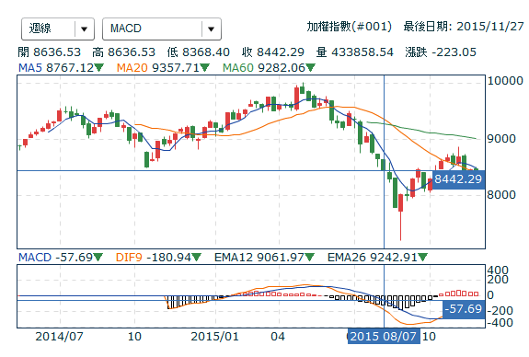
First Screen (第一層)
觀察目標: MACD histogram(柱狀圖)
重點:
趨勢上升，可能上漲
趨勢下降，可能下跌

Slide 18
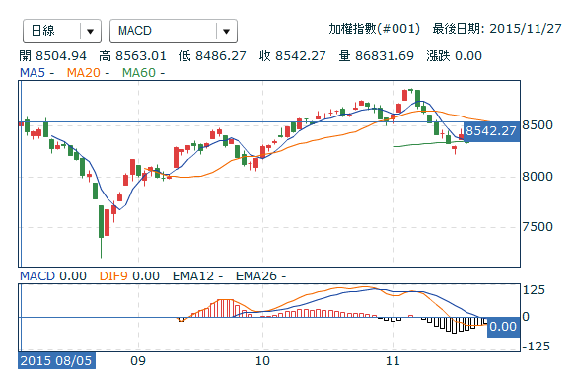
Second Screen (第二層)
觀察目標: MACD histogram(柱狀圖)
重點:
周線上升，日線下跌 ➔ Buy
周線下跌，日線上升 ➔ Sell

Slide 19
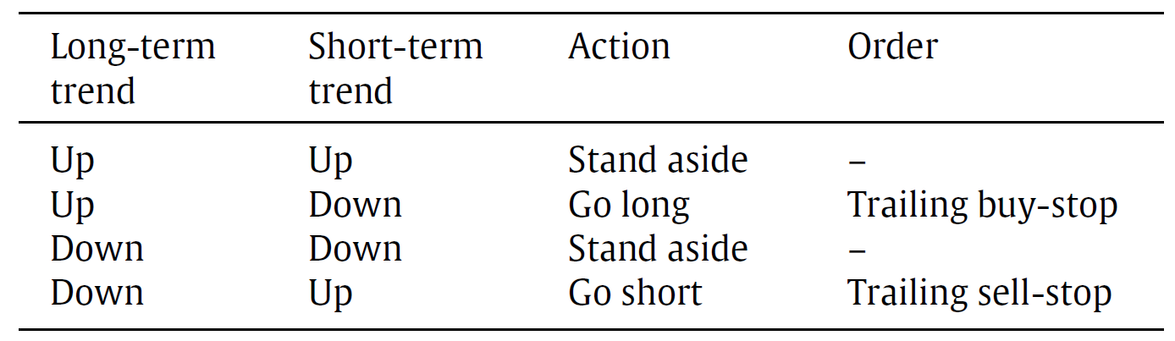
Third Screen (第三層)
Use Trailing buy-stop and Trailing sell-stop
Method:
Buy signal:
如果今天使用了第一層和第二層結果顯示出buy signal，那就把觸發價位設定為前一天最高價再往上一點，如果在盤中價格突破至設定的價位時，就進行買進動作。
Sell Signal:
如果今天使用了第一層和第二層結果顯示出sell signal，那就把觸發價位設定為前一天最低價再往下一點，如果在盤中價格跌出至設定的價位時，就進行賣出動作。

Slide 20

Strength Index (SI)
Formula:
$$SI=V_{k}×\left(P_{k}−P_{k−1}\right), where$$
$$V_{k} volume at time k.$$
$P_{k} closing price at time k.$
Explain:
Use in short run.
Buy signal in uptrends.
Sell signal in downtrends.

Slide 21
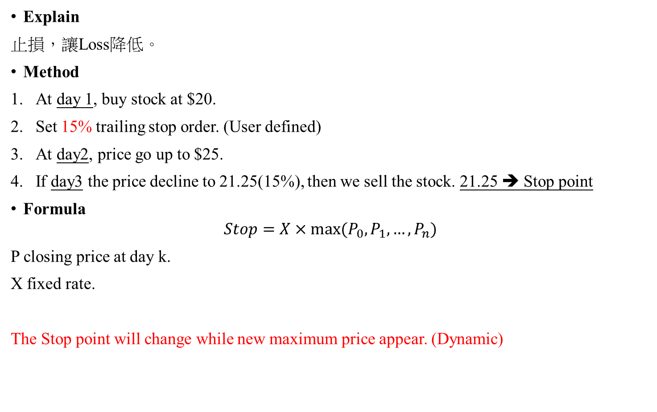
Trailing Stop (移動止損)
Explain
止損，讓Loss降低。
Method
At day 1, buy stock at $20.
Set 15% trailing stop order. (User defined)
At day2, price go up to $25.
If day3 the price decline to 21.25(15%), then we sell the stock. 21.25 ➔ Stop point
Formula
$$Stop=X×max⁡(P_{0},P_{1}, …,P_{n})$$
P closing price at day k.
X fixed rate.
The Stop point will change while new maximum price appear. (Dynamic)

Slide 22
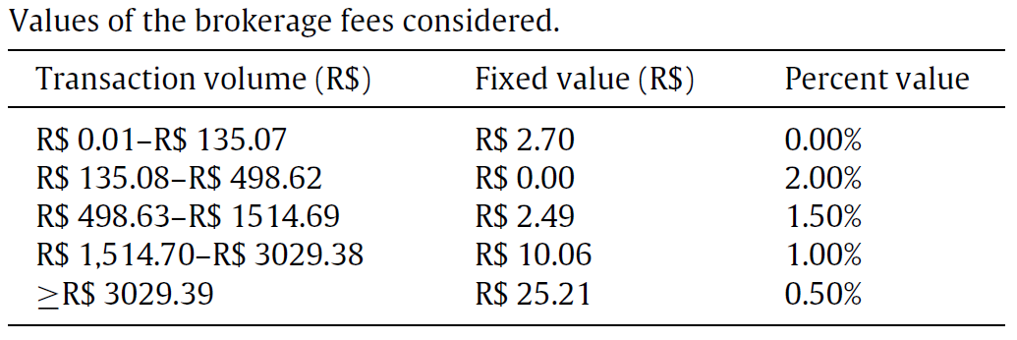
Environment & Sample
VB with Microsoft Office Excel.
Initial capital = R$10,000.00
R$是巴西貨幣巴西雷亞爾(Brazilian real, real), 1R$約等於8.45TWD
198 stocks from Brazilian stock
Period: 2000/1/3 – 2014/2/25
Brokerage fee

Slide 23

Signals Creation
Moving Average(MA)
Setting:
Short: $5≤k_{short}≤55$
Long: $60≤k_{long}≤220$
k = 9
Rules:
黃金交叉
Triple Screen
EMA: 65
Strength Index: 2
EMA Strength Index: 2 (What?)

Slide 24
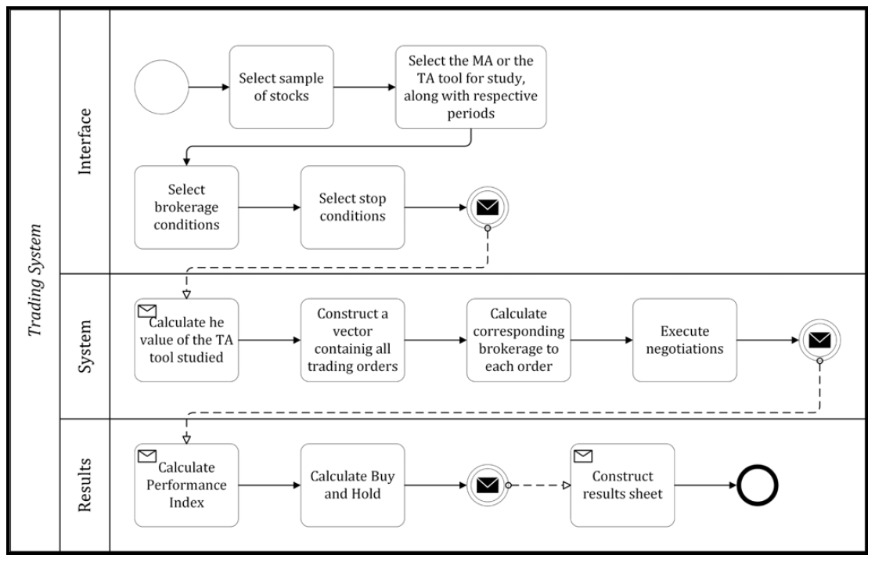
System flow

Slide 25

Relative Average Deviation (RAD)
Definition:
$$RAD=\frac{(f\left(h\right)−f^{∗})}{f^{∗}}, where$$
$f\left(h\right)$ standard deviation
$f^{∗}$ best value
Standard deviation definition: $\sqrt{\left(\sum{P\left(R\right)×R^{2}}\right)−{(\overline{R})}^{2}}$
Explain:
The lowest is the most profitable.

Slide 26

POCID
Name: Percentage of correct prediction directional
Definition:
$$POCID=\frac{\sum_{μ=1}^{N}{D_{μ}}}{N}×100, where$$
$$D_{μ}=\left\{\begin{aligned}1, if(P_{\left(k+1\right)}−P_{k})×(O_{\left(k+1\right)}−O_{k})>0 \\ 0, otherwise\end{aligned}\right.$$
$$P_{k} closing price in the period k.$$
$$O_{k} value found by the method.$$
$$N total trading orders$$
Notes:
用中文解釋公式即可

Slide 27
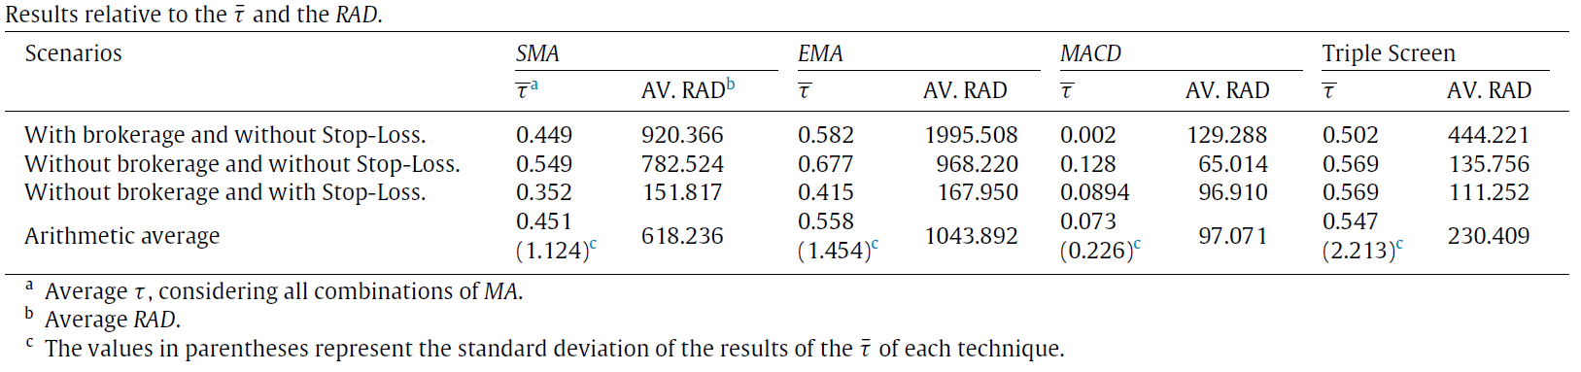
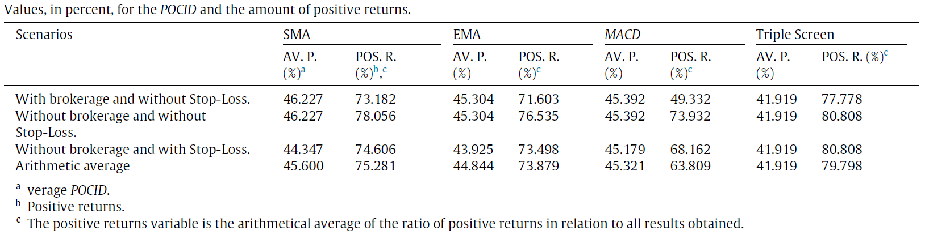
Result(1/3)
Notes:
用中文解釋公式即可

Slide 28
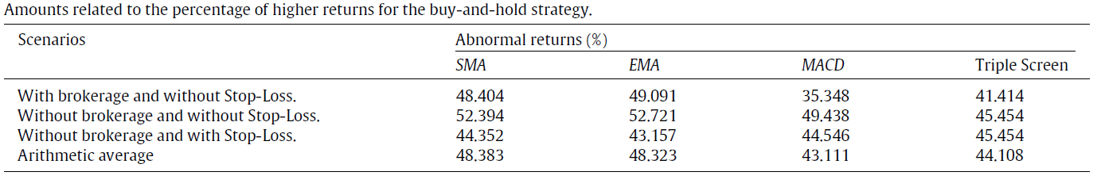
Result(2/3)
Notes:
用中文解釋公式即可

Slide 29
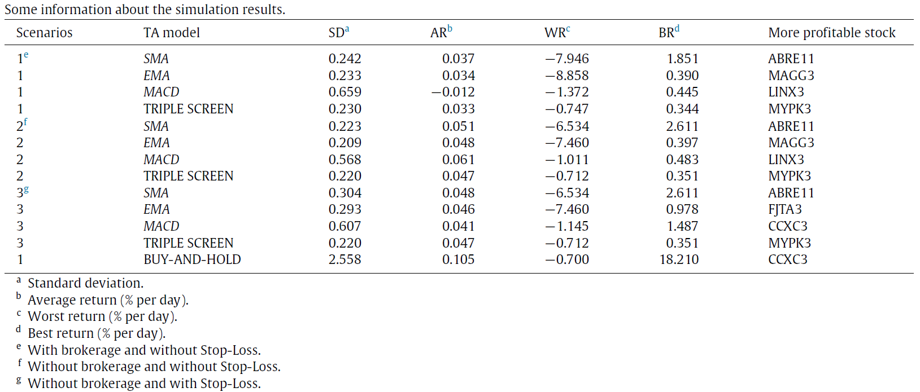
Result(2/3)
Notes:
用中文解釋公式即可

