Slide 1
Non-isometric Transforms in Time Series Classification using DTW
Tomasz Górecki and Maciej Łuczak
Knowledge-Based Systems
Vol. 61 (2014) pp 98–108
Presenter: Siang-Huai Hung
Date:2015/12/16

Slide 2
Abstract (1/2)
Over recent years the popularity of time series has soared. As a consequence there has been a dramatic increase in the amount of interest in querying and mining such data. In particular, many new distance measures between time series have been introduced. In this paper we propose a new distance function based on derivatives and transforms of time series. In contrast to well-known measures from the literature, our approach combines three distances: DTW distance between time series, DTW distance between derivatives of time series, and DTW distance between transforms of time series

Slide 3
Abstract (2/2)
The new distance is used in classification with the nearest neighbor rule. In order to provide a comprehensive comparison, we conducted a set of experiments, testing effectiveness on 47 time series data sets from a wide variety of application domains. Our experiments show that this new method provides a significantly more accurate classification on the examined data sets.

Slide 4
Time series
時間序列（time series）是依時間順序型態出現的一連串連續某變數（variable）的觀察值（observation）之集合。
Example:
Hugo 今天有5塊錢，明天有11塊錢，後天有17塊錢……
這樣每天記錄有多少錢的序列就是時間序列。

Slide 5
Dynamic time warping(DTW)
DTW was used to compare different speech patterns in automatic speech recognition. It is an algorithm for measuring similarity between two sequences which may vary in time or speed.

Slide 6
Dynamic time warping(DTW)
路人A說:
今天天氣真好阿
路人B說:
爽啦今今今今天天氣氣氣氣氣真真好好阿阿阿
DTW:
今天天氣真好阿
爽啦今今今今天天氣氣氣氣氣真真好好阿阿阿

Slide 7
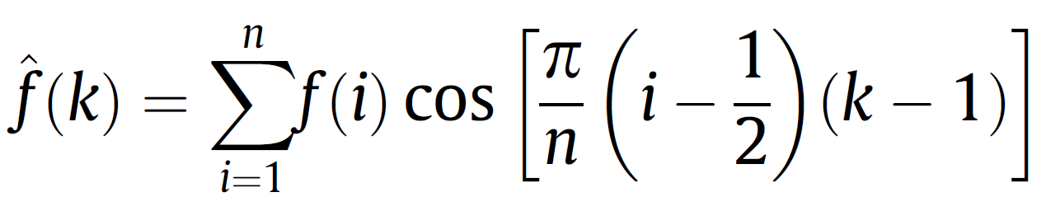
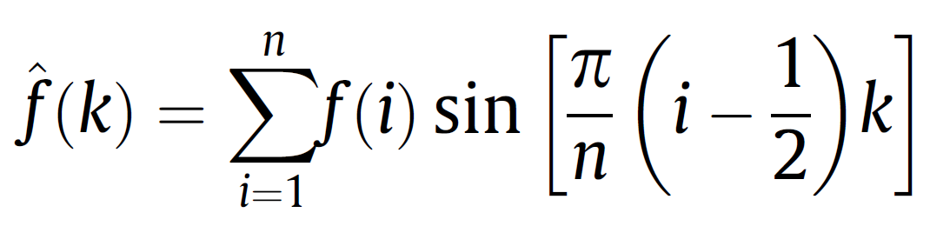
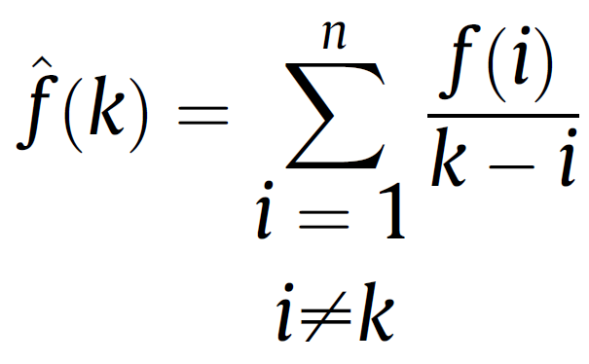
Transforms
Cosine transform:
Sine transform:
Hilbert transform:

Slide 8

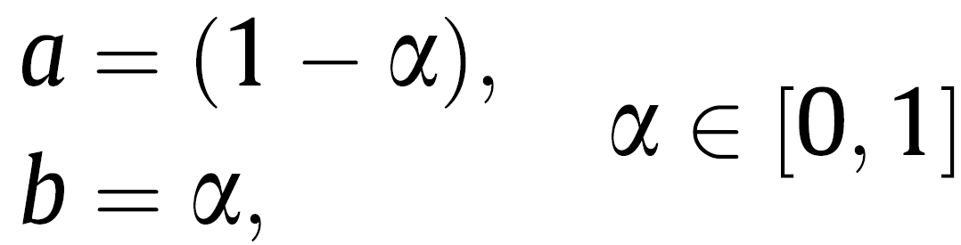
2D methods

Slide 9
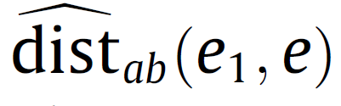
2D methods
1.Fix one element e of the training data set
2.Take an element e₁ ≠ e , for every parameter α,
compute the distance function d =
3.Put its value in a vector D(with k elements)
4.Repeat the procedure and obtain a new distance
vector d₂
5.Compare D and d₂ , insert smaller one in vector D

Slide 10
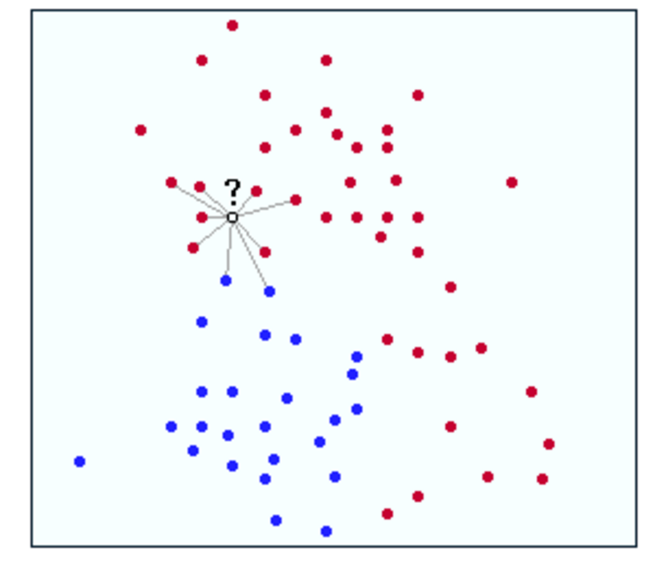
KNN(k nearest neighbors)

Slide 11
Cross-validation (leave-one-out)
交叉驗證，有時亦稱循環估計，是一種統計學上將數據樣本切割成較小子集的實用方法。先在一個子集上做分析， 而其它子集則用來做後續對此分析的確認及驗證。一開始的子集被稱為訓練集(training set)。而其它的子集則被稱為驗證集(validation set)或測試集(testing set)。

Slide 12
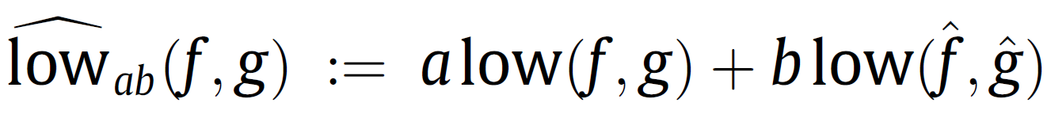
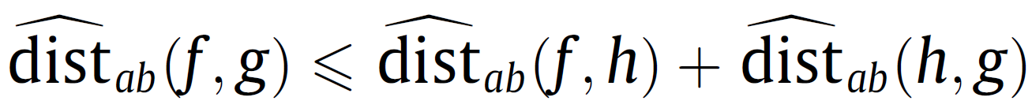
Lower bound and triangle inequality
為了節省時間，用approximation function: lower bound進行dist的運算
但若dist不為metric卻符合triangle inequality

Slide 13
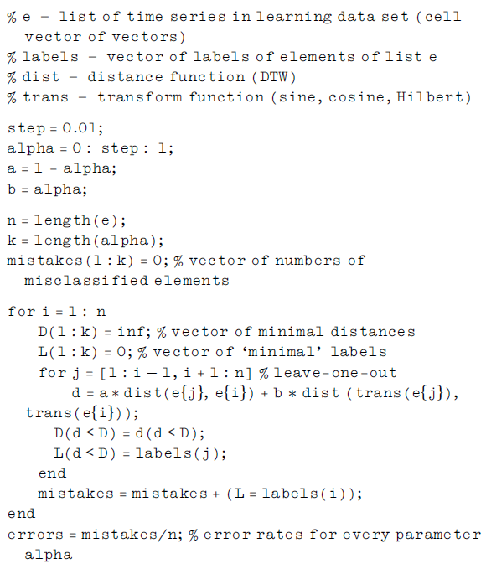

Slide 14
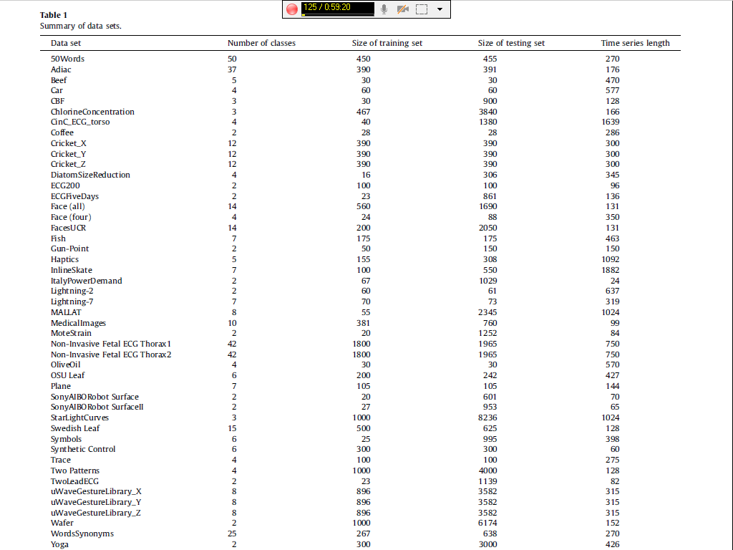
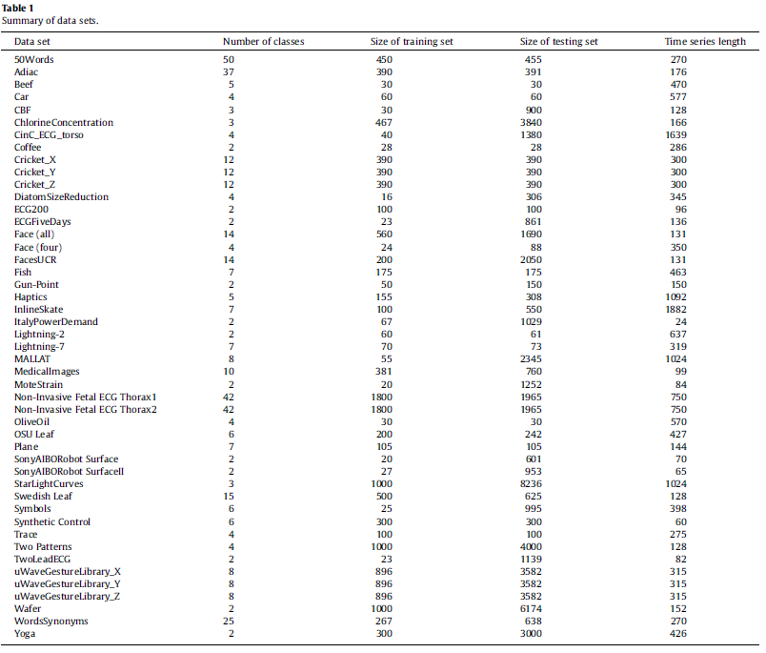

Slide 15
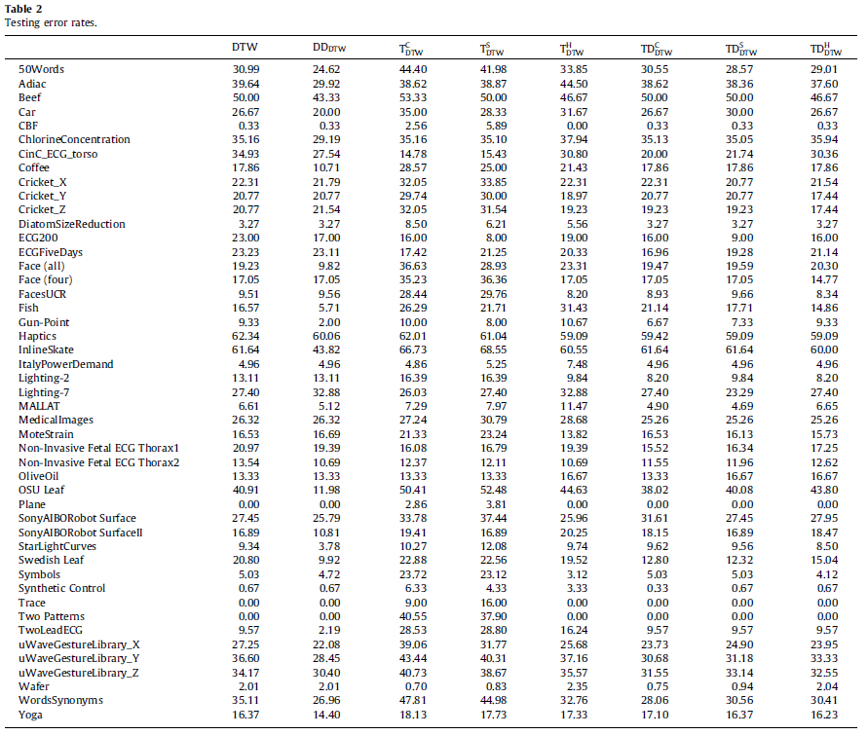

Slide 16
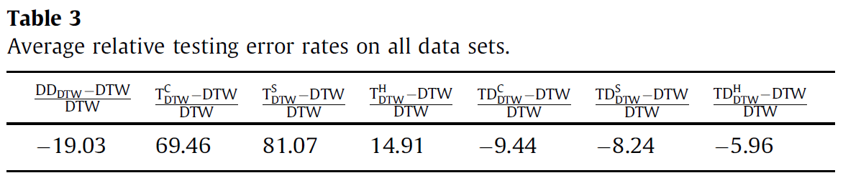

Slide 17
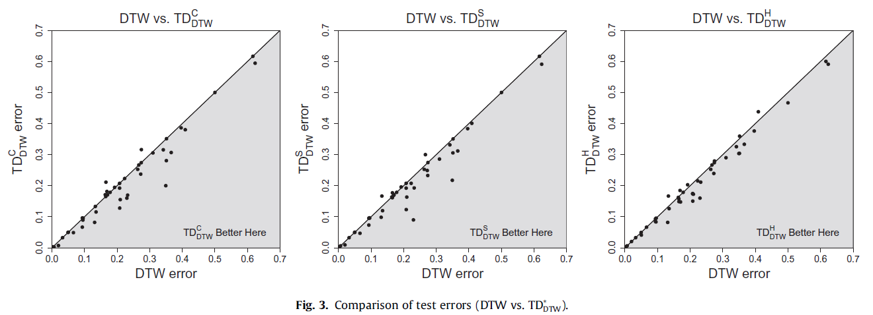

Slide 18
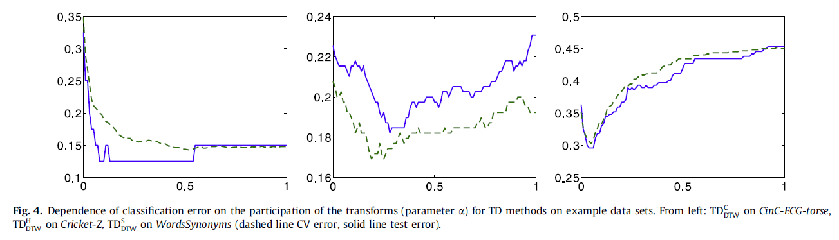
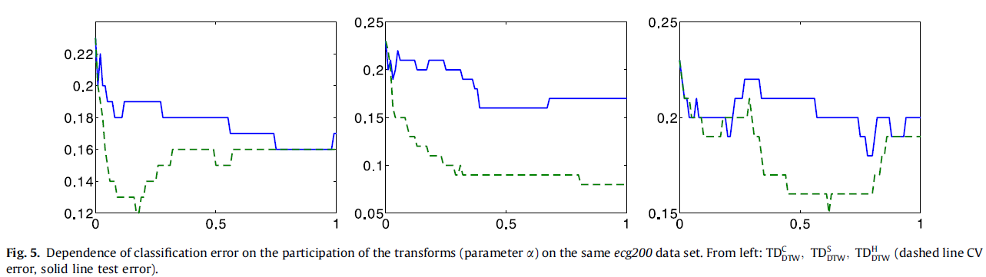

Slide 19
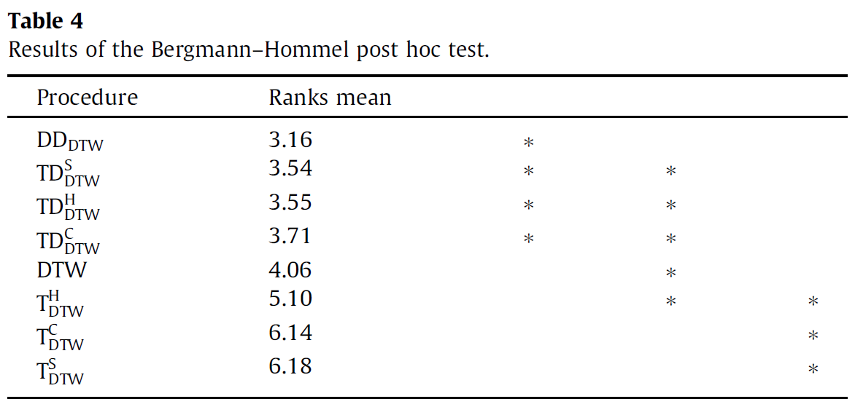

Slide 20
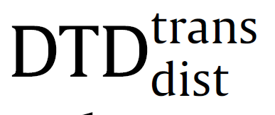
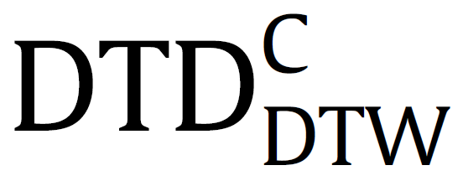
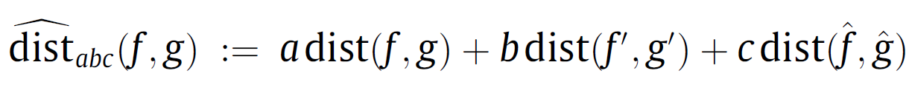
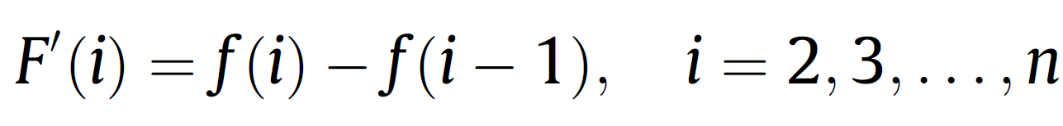
3D methods
We will combine information about a function (time series),
its derivative and its transform in one distance measure.
new distance measure by (derivative-transform
distance), for example
The discrete derivative of a time series f with length n is defined by

Slide 21
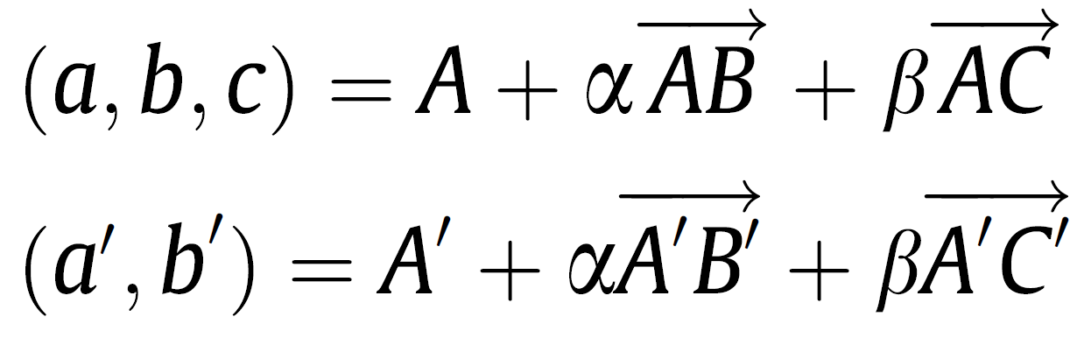
Parameter dimension

Slide 22
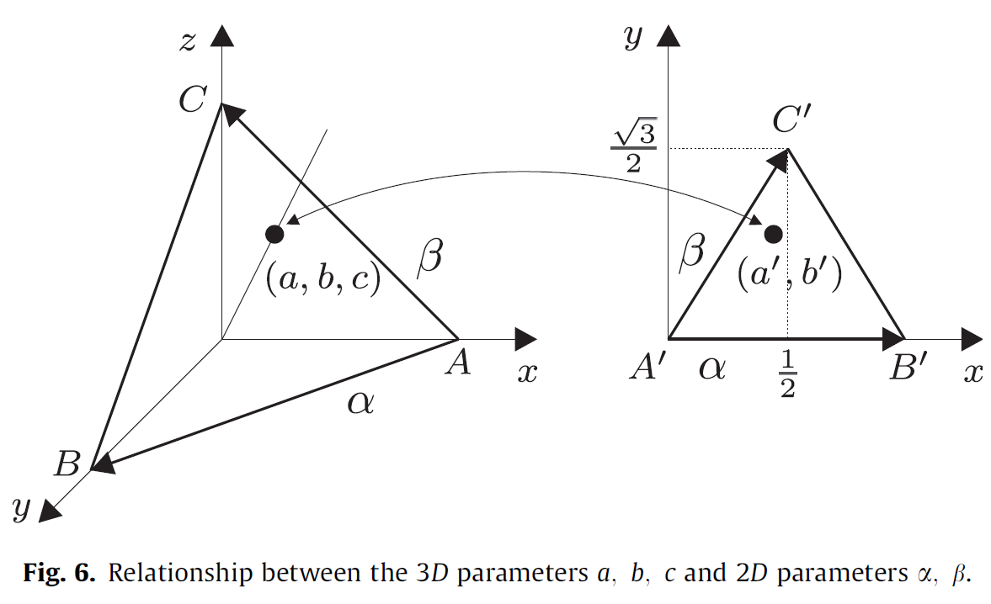

Slide 23
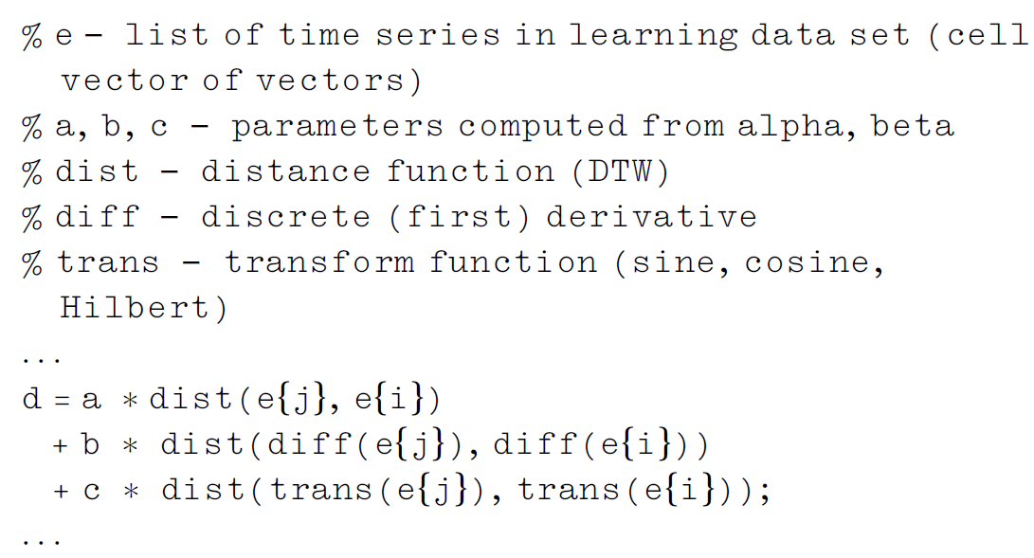

Slide 24
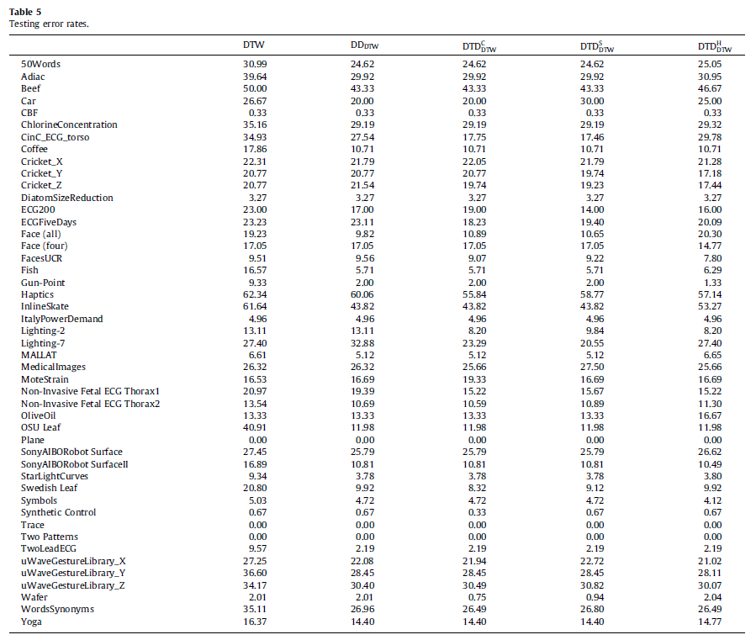

Slide 25
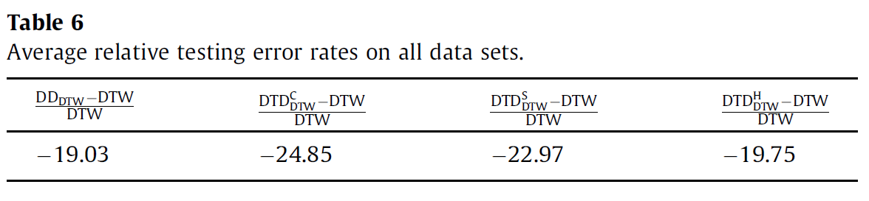

Slide 26
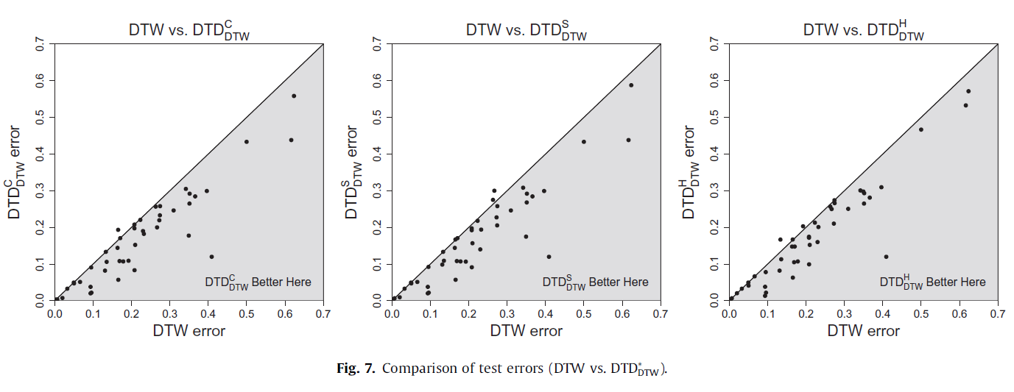
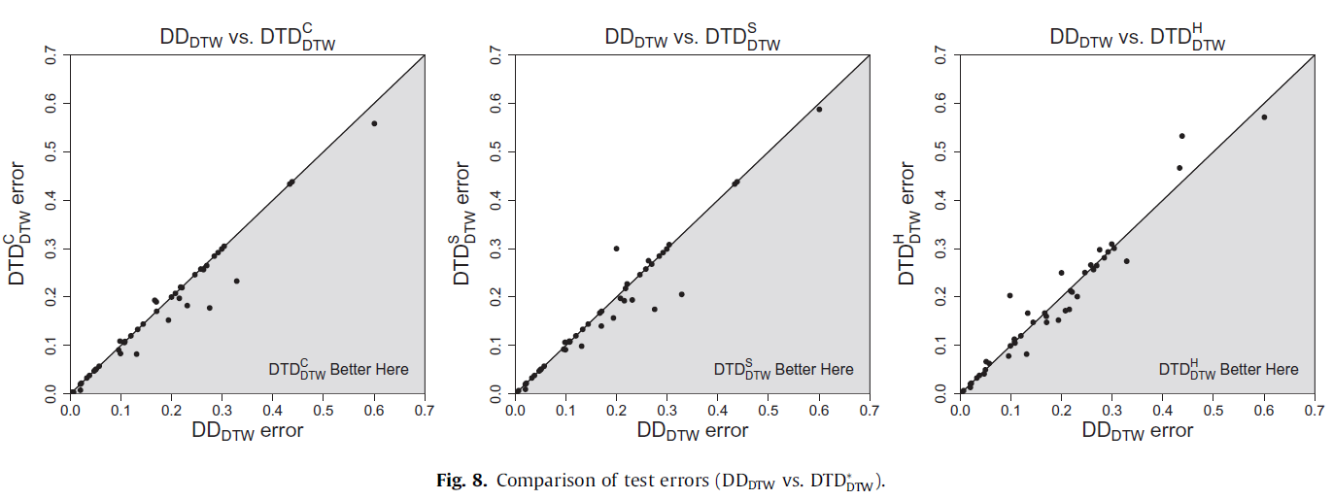

Slide 27
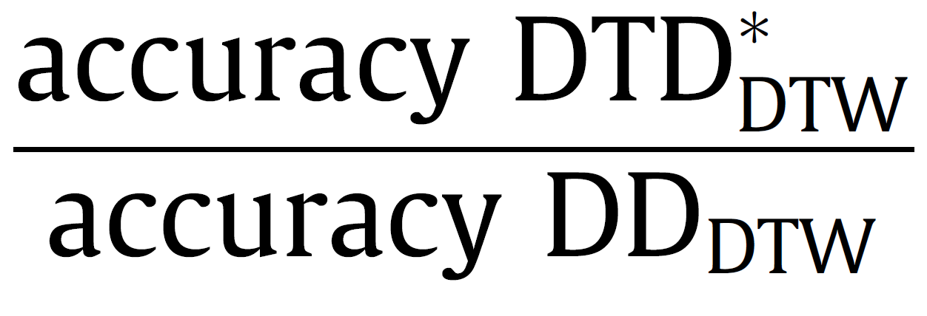
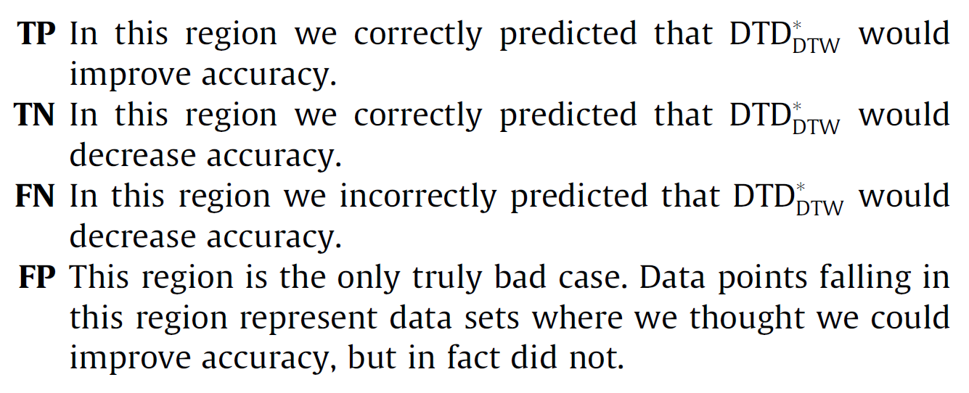

Slide 28
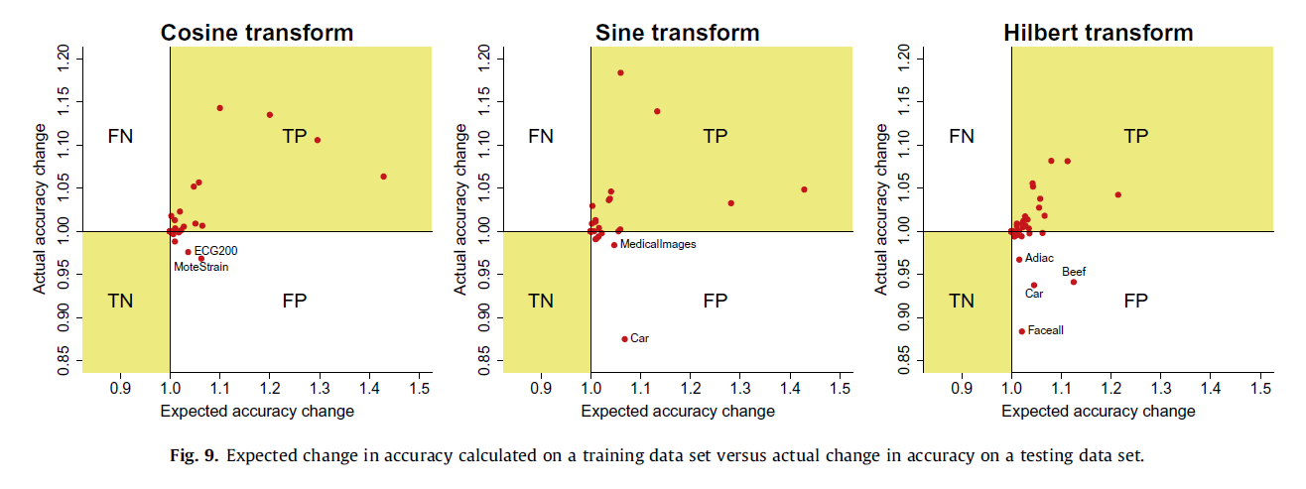

Slide 29
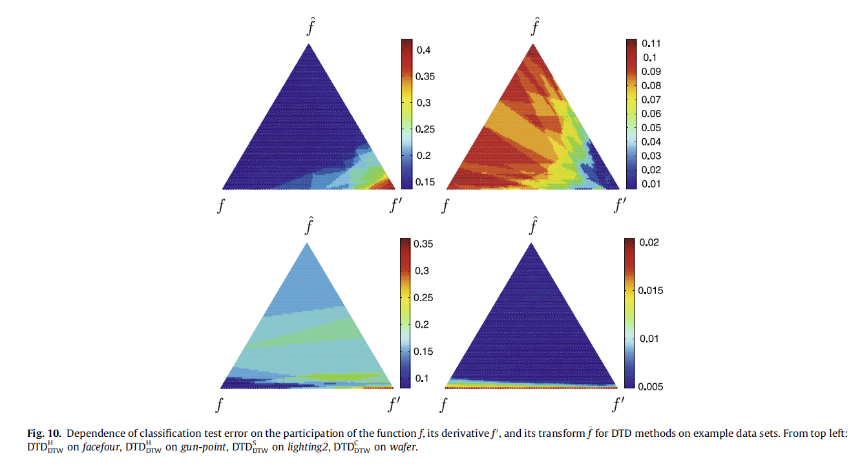

Slide 30
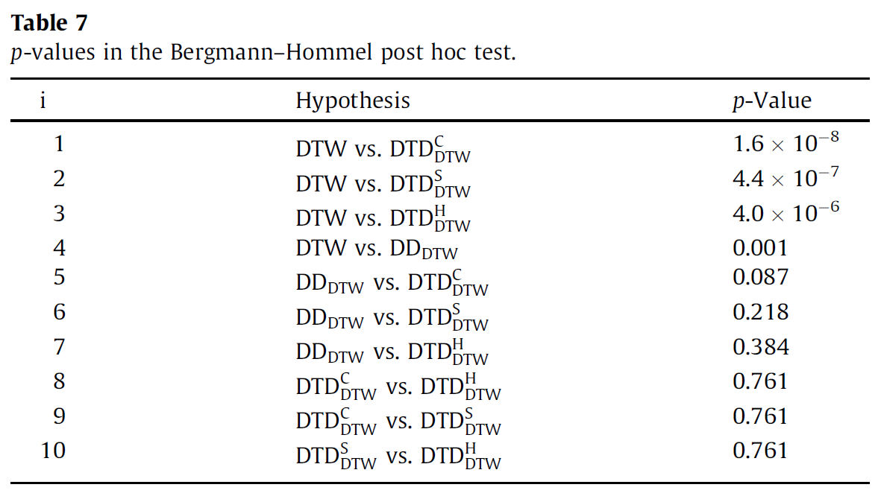
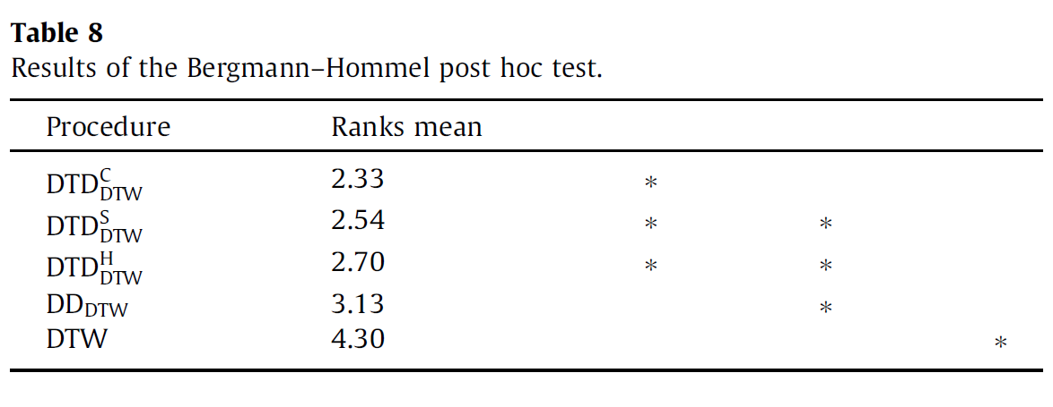

Slide 31
Conclusions and future work
In this paper we have introduced and studied an improvement
on our previous time series distance based on derivatives. As it
turns out, the addition of the transform gives very good results.
The new classification method, which combines three distances:
DTW distance between time series, DTW distance between derivatives
of time series and DTW distance between transforms of time
series, is superior to DD_{DTW}, which uses only the first two distances.
The method with cosine transform can be especially recommended,
as it is significantly better than DD_{DTW}. The proposed
method, thanks to its parametrical approach, makes it possible to
choose an appropriate model for any data set. Due to the high degree
of nonlinearity, the method does not easily admit a rigorous
theoretical analysis. However, the experiments that we have conducted
provide evidence of the power and usefulness of the
method.

