Slide 1
Presenter: Shu-Kai Hung Date:2015/12/16
Using derivatives in a longest common subsequence dissimilarity measure for time series classification
Pattern Recognition Letters
Received 12 November 2013
Available online 27 March 2014
Tomasz Gorecki
Adam Mickiewicz University, Umultowska 87, 61-614 Poznan’, Poland

Slide 2
Abstract(1/2)
Over recent years the popularity of time series has soared. Given the widespread use of modern information technology, a large number of time series may be collected. As a consequence there has been a dramatic increase in the amount of interest in querying and mining such data. A vital component in many types of time series analysis is the choice of an appropriate dissimilarity measure. Numerous measures have been proposed to date, with the most successful ones based on dynamic programming. One of such measures is longest common subsequence (LCSS).

Slide 3
Abstract(1/2)
In this paper, we propose a parametrical extension of
LCSS based on derivatives. In contrast to well-known measures from the literature, our approach considers
the general shape of a time series rather than point-to-point function comparison. The new dissimilarity
measure is used in classification with the nearest neighbor rule. In order to provide a comprehensive comparison, we conducted a set of experiments, testing effectiveness on 47 real time series. Experiments show that our method provides a higher quality of classification compared with LCSS on examined data sets.

Slide 4
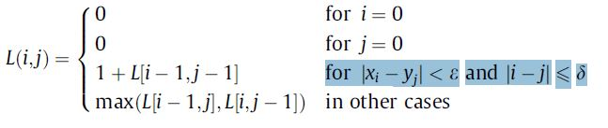
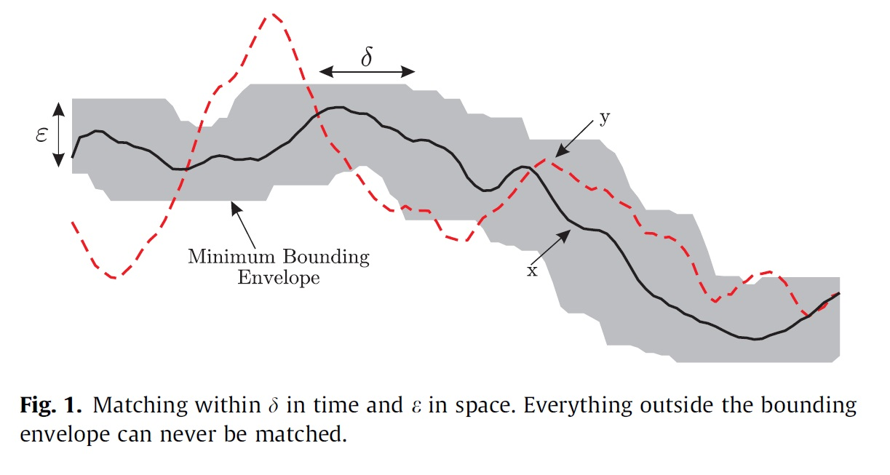
Longest common subsequences of the time series(LCSS)
value
i
j
δ : percentage of the sequence length(window size)
ε : The constant 0 < ε < 1 is the matching threshold

Slide 5

To define the dissimilarity between x and y, we can compute:

Slide 6

Longest common subsequence based on derivatives-2D/3D method
A dissimilarity measure which considers both the function values
of time series and values of the first derivative:
where ▽ x and ▽ y are the first discrete derivatives of x, y and
a ,b ∈ [0,1] are parameters.
The discrete derivative of a time series x with length n is defined by
▽ y同理
3D method:

Slide 7

Parameter dimension-2D
We do not have to check all values of a , b ∈ [0,1]
If a1 =ka2 and b1 =kb2, where k > 0 is a constant
(linearly dependent)
simplest case :
a=1-α ,b=α , α ∈ [0,1] (the straight line)

Slide 8

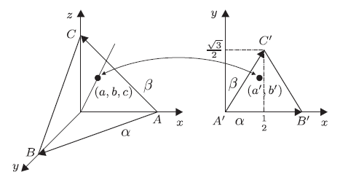
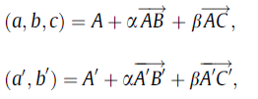

Parameter dimension-3D
We do not have to check all values of a,b, c ∈ [0,1] If a1 =ka2,b1 =kb2, c1 =kc2 where k > 0 is a constant(linearly dependent)
For simplicity: 3D->2D
(0,0,1)
(1/2,$\sqrt{3}/2$)
(1,0,0)
(0,0)
(1,0)
(0,1,0)
其中: α ∈ [0,1] β ∈[0,1- α]

Slide 9
Experimental setup
experiments on 47 data sets(include many field)
The proposed dissimilarity measures are used with the 1NN(最近鄰居分類法)method in the classification process.
leave-one-out cross-validation (CV) method to find the best parameter α, β
δ to 100%. (LCSS is very resistant to changes it)
Notes:
http://blog.xuite.net/x5super/studyroom/61471385-%E4%B8%80%E7%AF%87%E5%BE%88%E6%A3%92%E7%9A%84%E6%B8%AC%E8%A9%A6(%E5%9B%9E%E6%B8%AC)%E6%8A%80%E8%A1%93%E6%96%87%E7%AB%A0(1NN)

Slide 10
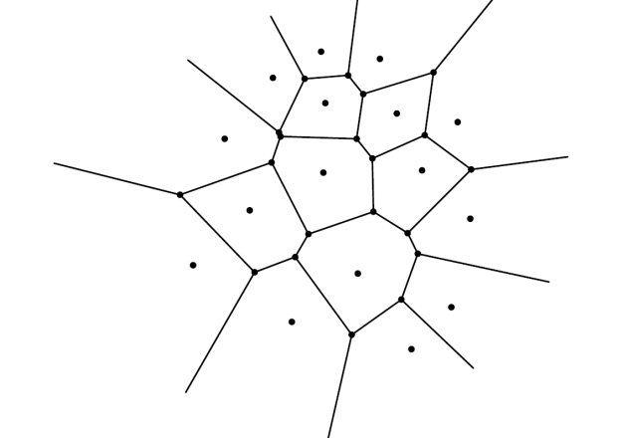
最近鄰居分類法
Training set
Test set
1D:
2D:利用voronoi diagram降低複雜度(黑點為training data 紅點為 test data)
Training data
Test data
Training data
y
x

Slide 11
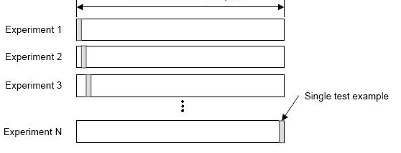
leave-one-out cross-validation
樣本數(data set : N) 就採取 N次experiments
第 i 次experiment 則 採用前 i-1次的data 來當training data 第 i 次當 testing data
Example:
testing data
data set : N
Training data

Slide 12
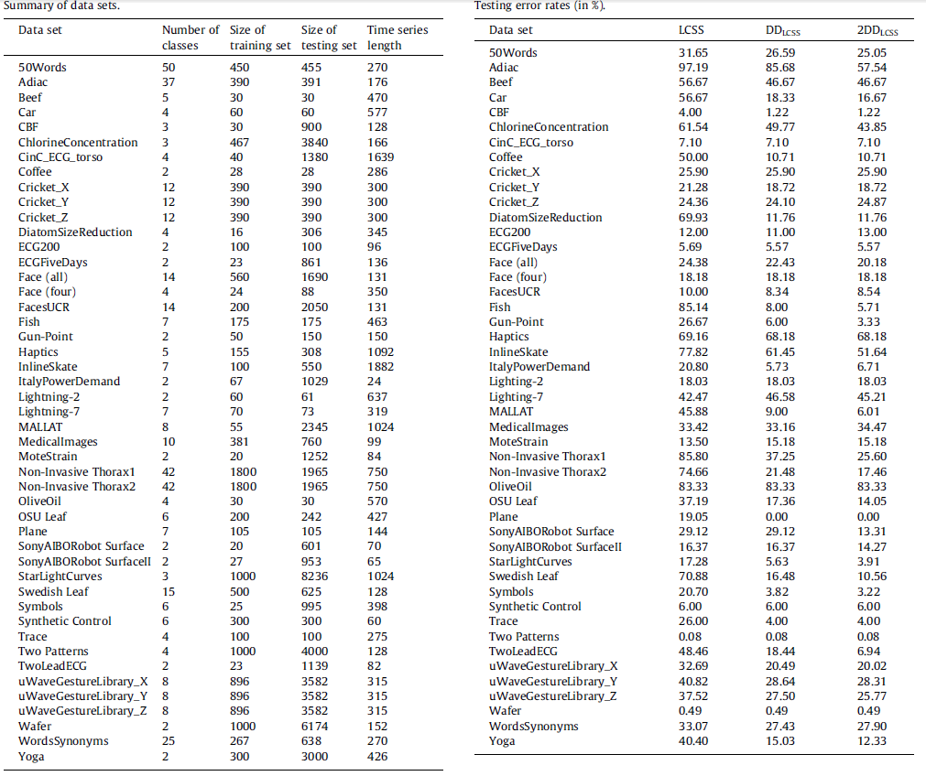
Results

Slide 13
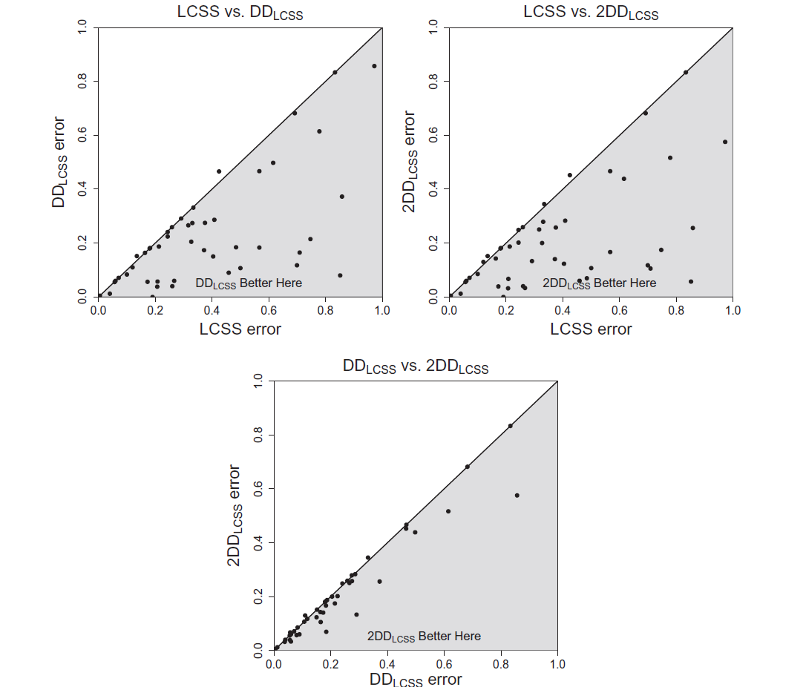
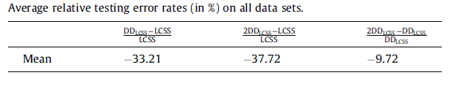

Slide 14
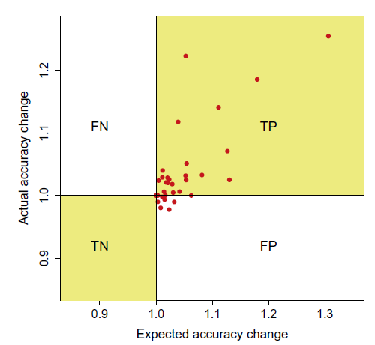
TP : In this region we correctly predicted that 2DDLCSS would improve accuracy.
TN : In this region we correctly predicted that 2DDLCSS would decrease accuracy.
FN : In this region we incorrectly predicted that 2DDLCSS would decrease accuracy.
FP : This region is the only truly bad case. Data points falling in this region represent data sets where we thought we could improve accuracy, but in fact did not.

Slide 15
Statistical comparison of methods
To identify differences between the methods, we present a detailed statistical comparison(ANOVA).
ANOVA(變異數分析):
用來算出平均值，與組間的差距(每個classifier)比較的仍然是組與組之間 對於某一個依變數的「平均數」是否有顯著的差異
找出F值(組間均方和/組內均方和)
Post hoc test: 因ANOVA無法知道組與組之間的比較，而post hoc 可倆倆互相比對，去知道組與組之間的差異，事後檢驗創建更好地了解誰能夠制定更好的。
p-value: 一種“無單位”的“通用”指標，只跟1. null hypothesis 2. test statistics(測試統計量)這兩個量有關係 ，而我們的決策是：拒絕null hypothesis 當p值比給定的顯著水準還要小
Notes:
p.s. p值不僅跟null hypothesis有關 也跟test statistics有關 同樣的null hypothesis 給定同樣的資料 我們可以用不同的test statistics去處理 在這種情況 不同的test statistics會有不同的p值
p.s.2. 因為p值的比較對象是顯著水準 因此嚴格的p值定義裡會看到顯著水準的影子:

Slide 16
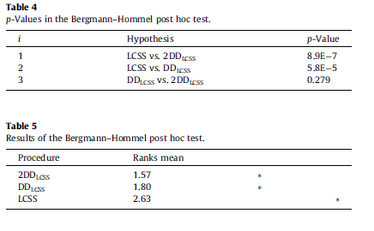
The results of multiple comparisons

Slide 17
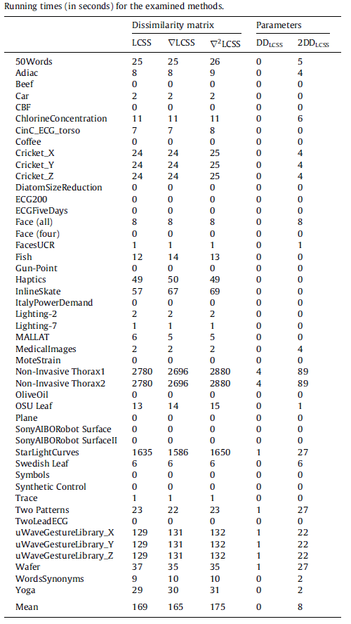
Result in time/speed

Slide 18
Conclusion
we have introduced and studied new time series
dissimilarity measures based on derivatives. We used these measures to classify time series in conjunction with the 1NN method. Our measures are superior to the LCSS. In a situation where computation time is significant it is also possible to use the DDLCSS method, which is only slightly less efficient than 2DDLCSS (giving larger classification error) but is less computationally complex (by about one-third). We do not recommend using the pure LCSS method.

