Slide 1
Genome Rearrangements and Sorting by Reversals
VINEET BAFNA AND PAVEL A. PEVZNER
SIAM J. COMPUT, Vol. 25, No. 2, pp. 272-289(1996)
Presenter: Shian-Liang Lin
Notes:
聖地牙哥加利福尼亞大學，是美國一所著名公立學府，為美國全國性第一級 的大學

Slide 2
Abstract
Sequence comparison in molecular biology is in the beginning of a major paradigm shift--a shift from gene comparison based on local mutations to chromosome comparison based on global rearrangements.
The classical methods of sequence comparison do not work for global rearrangements, and little is known in computer science about the edit distance between sequences if global rearrangements are allowed.
In the simplest form, the problem of gene rearrangements
corresponds to sorting by reversals, i.e., sorting of an array using reversals of arbitrary fragments.
The gene rearrangement problem forces us to consider reversals of signed permutations, as the genes in DNA could be positively or negatively oriented. An approximation algorithm for signed permutation is presented, which provides a performance guarantee of 3/2.
Finally, using the signed permutations approach, an approximation algorithm for sorting by reversals is described which achieves a performance guarantee of 7/4.
Notes:
i,e –in other words

Slide 3
Reversals over permutations
Reversal distance =2
Input: | 4 | 2 | 1 | 3
Reverse [1,3] | 1 | 2 | 4 | 3
Reverse [3,4] | 1 | 2 | 3 | 4

Slide 4
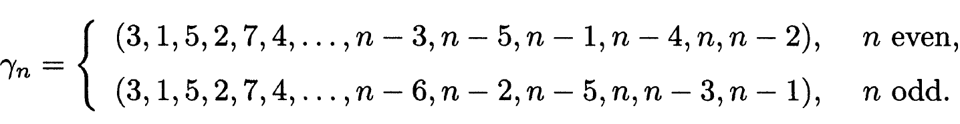
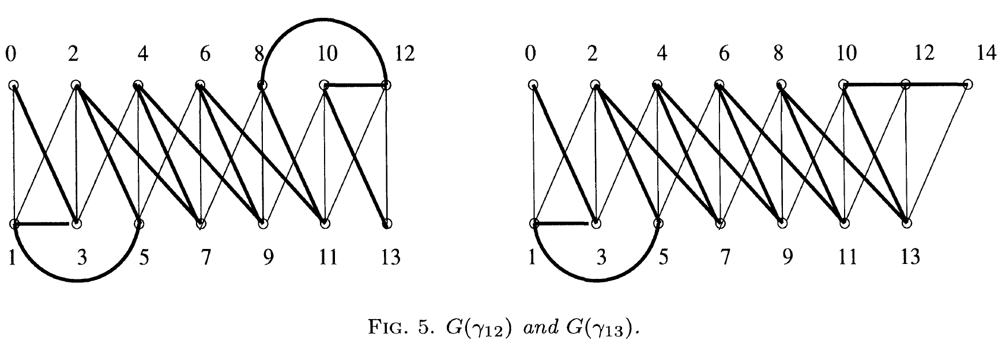
The Gollan permutation
G(r₁₂): | 0 | 3 | 1 | 5 | 2 | 7 | 4 | 9 | 6 | 11 | 8 | 12 | 10 | 13
G(r₁₃): | 0 | 3 | 1 | 5 | 2 | 7 | 4 | 9 | 6 | 11 | 8 | 13 | 10 | 12 | 14
Black edge( ) : if (i, j) is a breakpoint of π.
Gray edge ( ) : if j and j are not consecutive in π

Slide 5
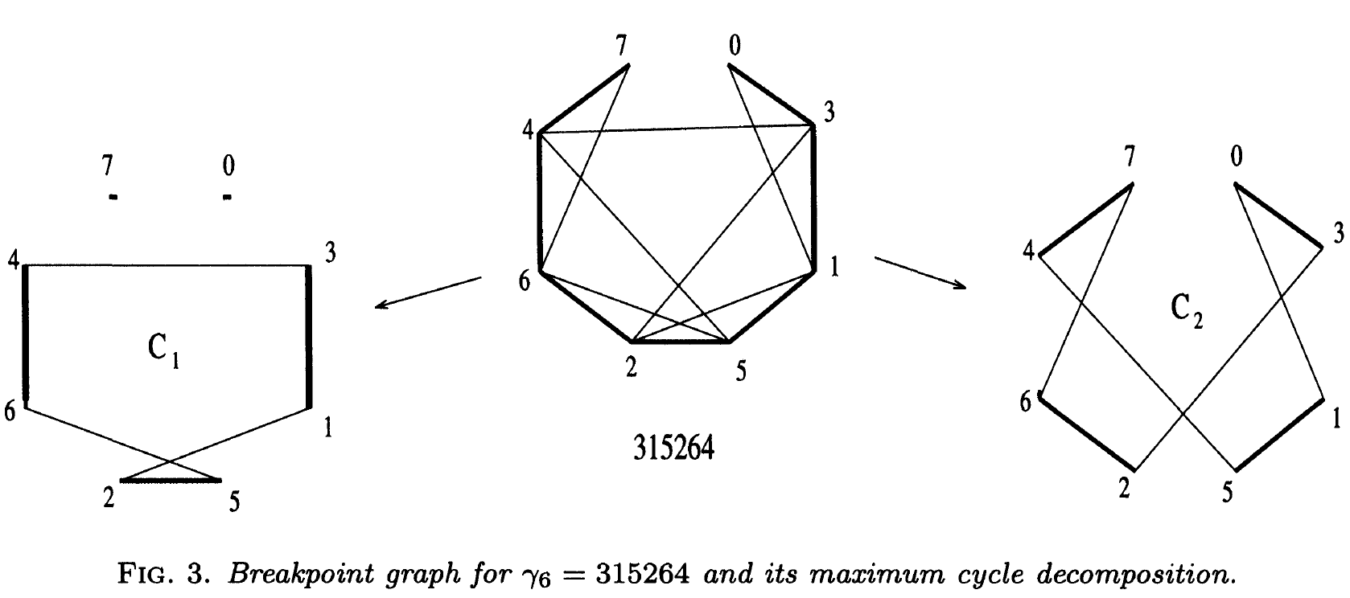
Maximum cycle decomposition
Black edge( ) : if (i, j) is a breakpoint of π.
Gray edge ( ) : if j and j are not consecutive in π

Slide 6
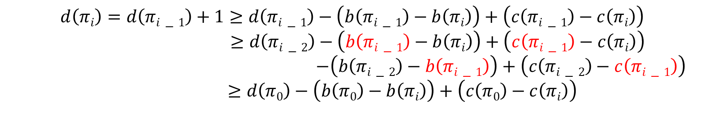
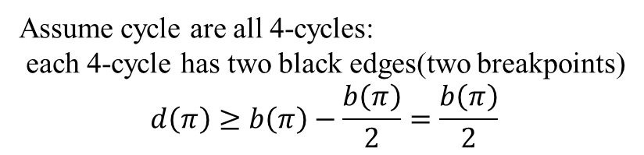
A new lower bound
$$d\left(πi\right)=d\left(πi−1\right)+1≥d\left(πi−1\right)−\left(b\left(πi−1\right)−b\left(πi\right)\right)+\left(c\left(πi−1\right)−c\left(πi\right)\right)$$
$≥d\left(πi−2\right)−\left(b\left(πi−1\right)−b\left(πi\right)\right)+\left(c\left(πi−1\right)−c\left(πi\right)\right)$
$$−\left(b\left(πi−2\right)−b\left(πi−1\right)\right)+\left(c\left(πi−2\right)−c\left(πi−1\right)\right)$$
$≥d\left(π0\right)−\left(b\left(π0\right)−b\left(πi\right)\right)+\left(c\left(π0\right)−c\left(πi\right)\right)$
Assume cycle are all 4-cycles:
each 4-cycle has two black edges(two breakpoints)
$$d\left(π\right)≥b\left(π\right)−\frac{b\left(π\right)}{2}=\frac{b\left(π\right)}{2}$$

Slide 7
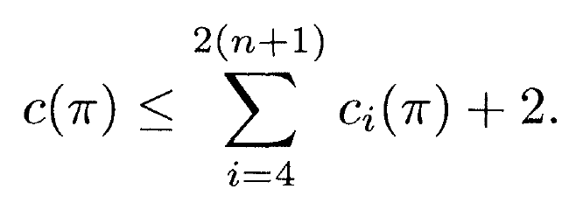
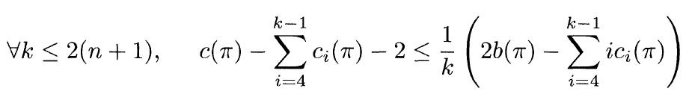
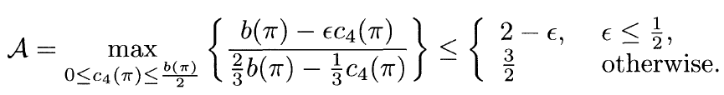
A new lower bound
(1)
(2)
包含0跟n+1的cycle最多2個
假設cycle的size最小值為k:
(3)
所有edge數量 – 所有小於k的cycle的edge數量
k=6(因為cycle的size必為偶數):
the performance ratio of our algorithms is

Slide 8
Approximation algorithm for signed permutations
Define a transformation from a signed permutation π of order n to an unsigned permutation π’ as follows:
replace +i by 2i- 1,2i and
-i by 2i, 2i- 1.
π: | 0 | -7 | +1 | +2 | +4 | +5 | +3 | -6 | +8 | 9
π’: | 0 | 14 | 13 | 1 | 2 | 3 | 4 | 7 | 8 | 9 | 10 | 5 | 6 | 12 | 11 | 15 | 16 | 17

Slide 9


Approximation algorithm for signed permutations
π: | 0 | -7 | +1 | +2 | +4 | +5 | +3 | -6 | +8 | 9
+2
15
11
10
5
+4
+3
17
+5
14
4
9
16
8
+8
-6
0
9
7
2
+1
3
1
13
12
6
0
-7
$$⇒d\left(π\right)≥6−0=7$$
$⇒d\left(π^{′}\right)≥6−1$=5
π’: | 0 | 14 | 13 | 1 | 2 | 3 | 4 | 7 | 8 | 9 | 10 | 5 | 6 | 12 | 11 | 15 | 16 | 17

Slide 10
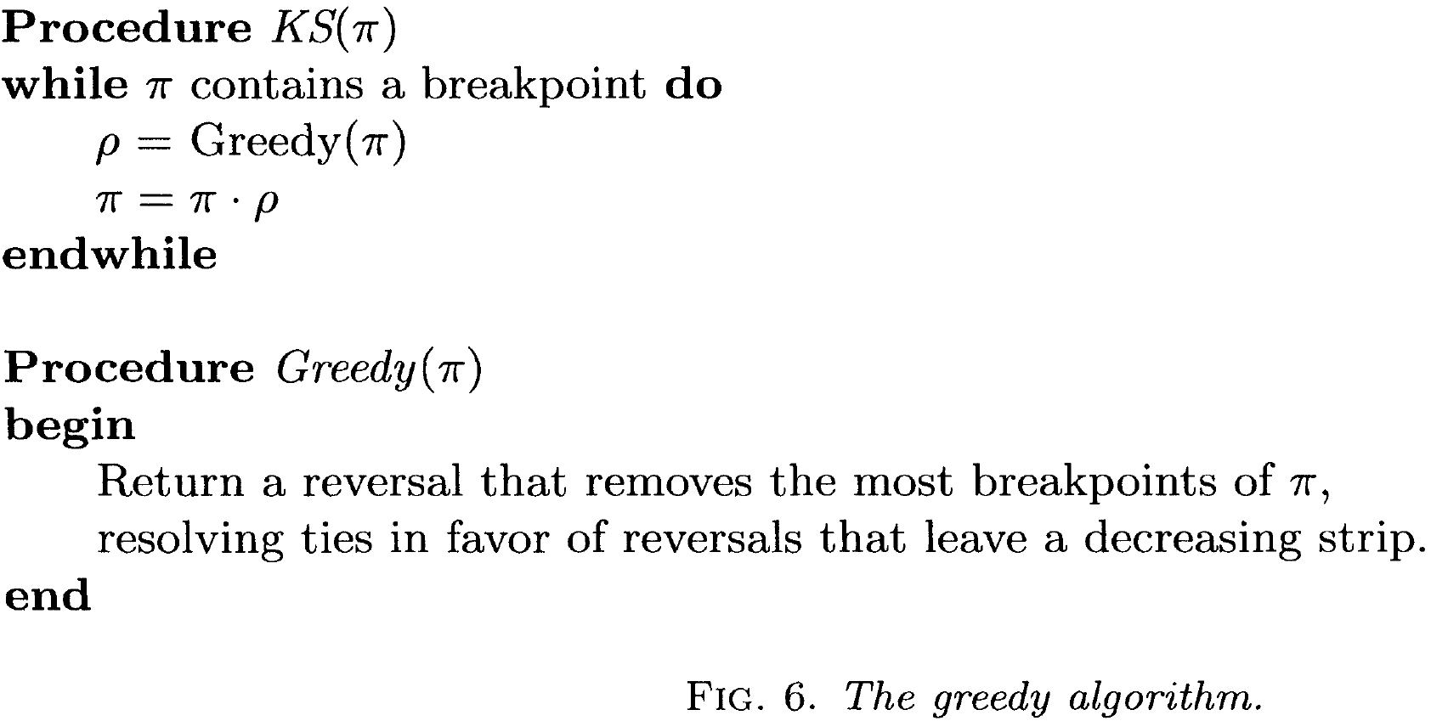
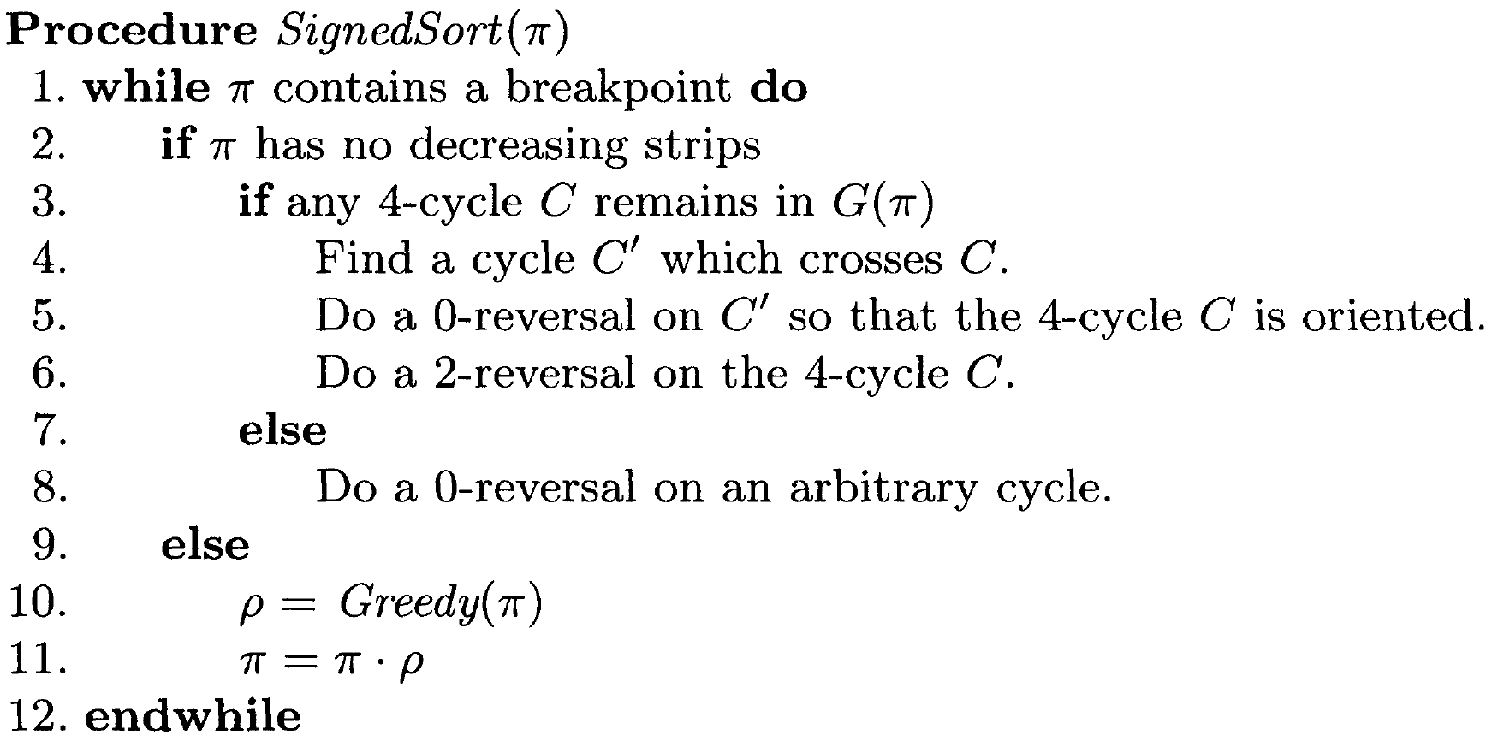
SignedSort(π)
At most n-1 breakpoints
O(n) time
Steps in sorting: b(π)- 1/2c₄(π) steps
Time complexity : O(n²)
Performance ratio : 3/2

Slide 11
$π$: | 0 | 3 | 1 | 5 | 2 | 6 | 4 | 7

Slide 12
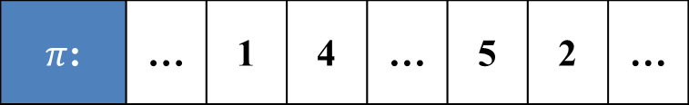
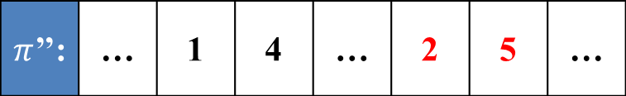
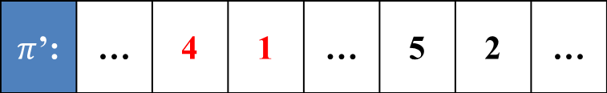
$π$: | … | 1 | 4 | … | 5 | 2 | …
$π$’: | … | 4 | 1 | … | 5 | 2 | …
$π$’’: | … | 1 | 4 | … | 2 | 5 | …

Slide 13
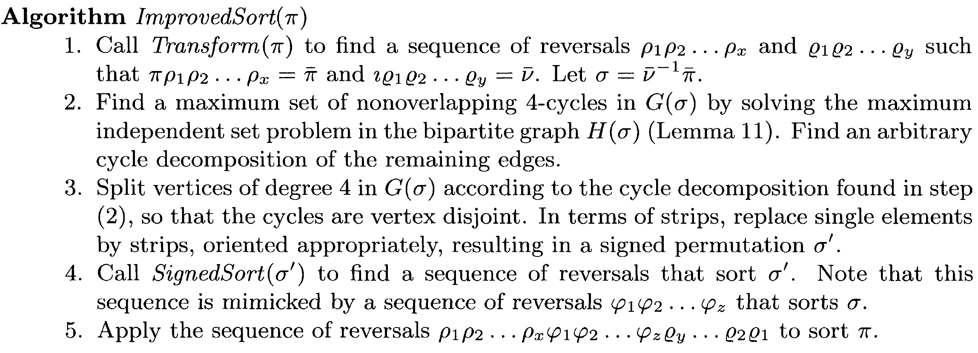

ImprovedSort($π$)
O(n^{3/2}) time
O(n²) time
Steps in sorting: b(π)- 1/4c₄(π) steps
Time complexity: O(n²)
Performance ratio : 7/4

Slide 14





ImprovedSort($π$)
G(r₆)
$π$: | 0 | 3 | 1 | 5 | 2 | 6 | 4 | 7
$i$: | 0 | 1 | 2 | 3 | 4 | 5 | 6 | 7
$iδ1$: | 0 | 1 | 5 | 4 | 3 | 2 | 6 | 7
$σ$: | 0 | 4 | 1 | 2 | 5 | 6 | 3 | 7
$i$: | 0 | 1 | 2 | 3 | 4 | 5 | 6 | 7

Slide 15
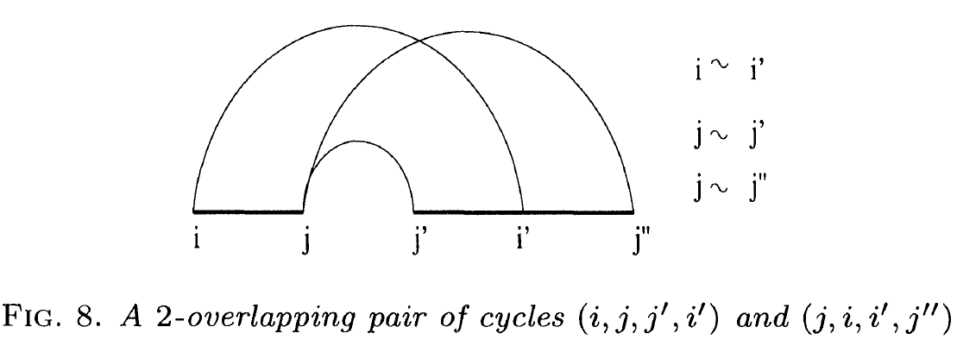
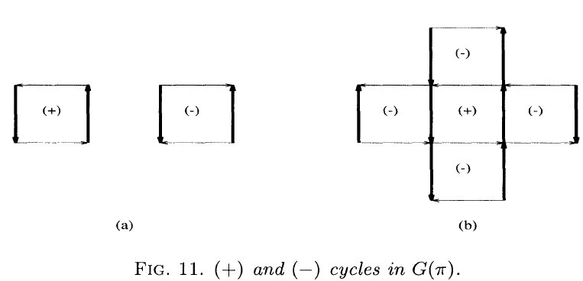
ImprovedSort($π$)

Slide 16
ImprovedSort($π$)
π: | 0 | 5 | 10 | 6 | 2 | 7 | 3 | 1 | 8 | 9 | 4 | 11
1
2
4
5
0
3
6
8
7
9
10
11

Slide 17

ImprovedSort($π$)
A₁
A
A₂
B₁
B
B₂

Slide 18
ImprovedSort($π$)
Steps in sorting: b(π)- 1/2c₄(π) steps
Time complexity : O(n²)
Performance ratio : 3/2

Slide 19
ImprovedSort($π$)
O(n^{3/2}) time
O(n²) time
Steps in sorting: b(π)- 1/4c₄(π) steps
Time complexity: O(n²)
Performance ratio : 7/4

Slide 20
π’: | 0 | 14 | 13 | 1 | 2 | 3 | 4 | 7 | 8 | 9 | 10 | 5 | 6 | 12 | 11 | 15 | 16 | 17
15
11
10
5
11
10
5
4
4
14
7
0
7
0
1
13
12
6
1
13
12
6
π’: | 0 | 11 | 12 | 6 | 5 | 10 | 9 | 8 | 7 | 4 | 3 | 2 | 1 | 13 | 14 | 15 | 16 | 17

Slide 21
π’: | 0 | 11 | 12 | 6 | 5 | 10 | 9 | 8 | 7 | 4 | 3 | 2 | 1 | 13 | 14 | 15 | 16 | 17
11
10
5
11
10
5
4
4
0
7
7
1
13
12
6
13
12
6
π’: | 0 | 1 | 2 | 3 | 4 | 7 | 8 | 9 | 10 | 5 | 6 | 12 | 11 | 13 | 14 | 15 | 16 | 17

Slide 22
π’: | 0 | 1 | 2 | 3 | 4 | 7 | 8 | 9 | 10 | 5 | 6 | 12 | 11 | 13 | 14 | 15 | 16 | 17
11
10
5
11
10
5
4
4
7
7
13
12
6
6
π’: | 0 | 1 | 2 | 3 | 4 | 7 | 8 | 9 | 10 | 5 | 6 | 11 | 12 | 13 | 14 | 15 | 16 | 17

Slide 23
π’: | 0 | 1 | 2 | 3 | 4 | 7 | 8 | 9 | 10 | 5 | 6 | 11 | 12 | 13 | 14 | 15 | 16 | 17
11
10
5
11
10
5
4
4
7
7
6
6
π’: | 0 | 1 | 2 | 3 | 4 | 10 | 9 | 8 | 7 | 5 | 6 | 11 | 12 | 13 | 14 | 15 | 16 | 17

Slide 24
π’: | 0 | 1 | 2 | 3 | 4 | 10 | 9 | 8 | 7 | 5 | 6 | 11 | 12 | 13 | 14 | 15 | 16 | 17
11
10
5
5
4
4
7
7
6
6
π’: | 0 | 1 | 2 | 3 | 4 | 6 | 5 | 7 | 8 | 9 | 10 | 11 | 12 | 13 | 14 | 15 | 16 | 17

