Slide 1
Regular expression constrained sequence alignment
Abdullah N. Arslan, Journal of Discrete Algorithms, Volume 5, Issue 4, 2007, Pages 647–661.
Presenter: Wen-Chuan Ho
Date: 2015/12/29

Slide 2
Abstract(1/5)
We introduce regular expression constrained sequence alignment as the problem of finding the maximum alignment score between given strings S₁ and S₂ over all alignments such that in these alignments there exists a segment where some substring s₁ of S₁ is aligned to some substring s₂ of S₂, and both s₁ and s₂ match a given regular expression R, i.e. s₁, s₂ ∈ L(R) where L(R) is the regular language described by R.

Slide 3
Abstract(2/5)
For complexity results we assume, without loss of generality, that n = |S₁|≥ m = |S₂|.A motivation for the problem is that protein sequences can be aligned in a way that known motifs guide the alignments. We present an O(nmr) time algorithm for the regular expression constrained sequence alignment problem where r = O(t⁴), and t is the number of states of a nondeterministic finite automaton N that accepts L(R).

Slide 4
Abstract(3/5)
We use in our algorithm a nondeterministic weighted finite automaton M that we construct from N. M has O(t²) states where the transition-weights are obtained from the given costs of edit operations, and state-weights correspond to optimum alignment scores we compute using the underlying dynamic programming solution for sequence alignment. If we are given a deterministic finite automaton D accepting L(R) with t_{d} states then our construction creates a deterministic finite automaton M_{d} with t²_{d} states.

Slide 5
Abstract(4/5)
In this case, our algorithm takes O(t²_{d} nm) time. Using M_{d} results in faster computation than using M when t_{d} < t². If we only want to compute the optimum score, the space required by our algorithm is O(t²m). If we also want to compute an optimal alignment then our algorithm uses O(t²m + t²|s₁||s₂|) space where s₁ and s₂ are substrings of S₁ and S₂, respectively, s₁, s₂ ∈ L(R), and s₁ and s₂ are aligned together in the optimal alignment that we construct.

Slide 6
Abstract(5/5)
We also show that our method generalizes for the case of the problem with affine gap penalties, and for finding optimal regular expression constrained local sequence alignments.

Slide 7
Longest Common Subsequence
S₁ = babbccdcca
S₂ = badeaccbcea
LCS = 6
b | a | - | b | b | - | c | - | c | c | d | - | c | c | - | a
| | | |  |  |  |  |  |  | | | | |  |  | | |  |  | |
b | a | d | - | - | e | - | a | c | c | - | b | c | - | e | a

Slide 8
Regular Expression Constrained Sequence Alignment
S₁ = babbccdcca
S₂ = badeaccbcea
R = a(b+c)*(d+e)
Ans = 4
b | - | - | - | a | b | b | c | c | d | c | c | a
| |  |  |  | | |  |  |  | | |  |  |  | |
b | a | d | e | a | c | c | b | c | e | - | - | a

Slide 9
Nondeterministic Finite Automaton N
R = a(b+c)*(d+e)
N = (Q, Σ, δ, q₀,F)
q₀
a
q₁
d,e
q₂
b,c

Slide 10
Finite Automaton M
for all x → y in Σ^{M}
c→ε, b→ε
M = (Q^{M}, W^{M}, Σ^{M}, q₀^{M},F^{M})
0
-∞
p₀, q₀
a→ε
p₁, q₀
d→a, e→a
a→a
ε→b
ε→c
ε→a
ε→a
-∞
-∞
p₀, q₁
a→ε
p₁, q₁
d→ε, d→b, d→c
e→ε, e→b, e→c
p₂, q₁
b→b, b→c
c→c, c→b
-∞
ε→b
ε→c
ε→d, ε→e
b→d, b→e
c→d, c→e
d→d, d→e
e→d, e→e
ε→d
ε→e
-∞
a→d, a→e
p₁, q₂
p₂, q₂
-∞
d→ε, e→ε
b→ε, c→ε
for all x → y in Σ^{M}

Slide 11
Updated Weights of states
Step 1: there exist (p’,q’) such that (p,q)∈δ^{M}((p’,q’),x→y) and W^{M}(p’,q’) ≠ -∞
Step 2: there does not exist (p’,q’) such that (p,q)∈δ^{M}((p’,q’),x→y) and W^{M}(p’,q’) ≠ -∞
p’, q’
x → y
p, q
W_{p’,q’}
W_{p’,q’}+ γ(x→y)
p’, q’
p, q
W_{p’,q’}
-∞

Slide 12
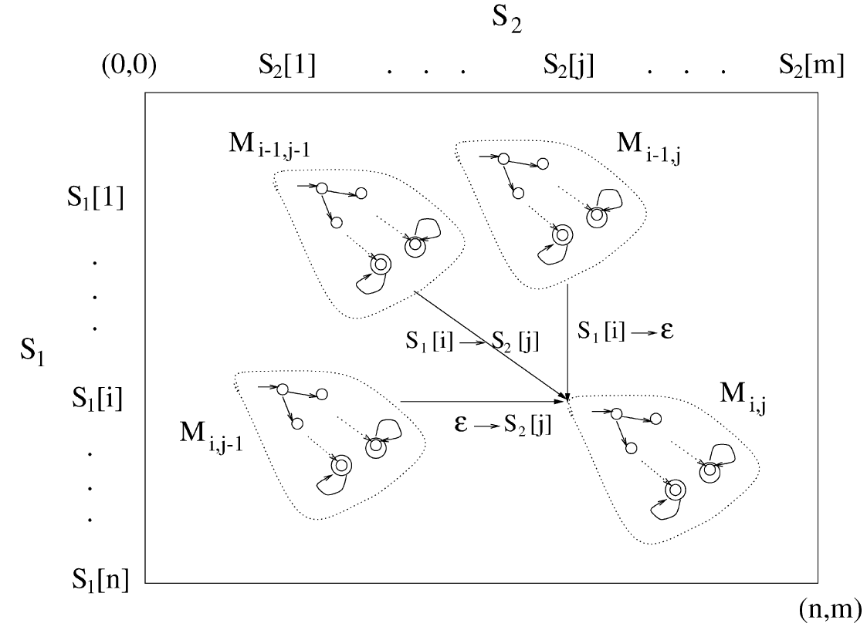
The Algorithm
Boundary: M_{i,0} = −∞, 0 ≤ i ≤ n , M_{0,j} = −∞, 0 ≤ j ≤ m

Slide 13
Example(1/12)
A_{0,11}
S₁ = babbccdcca
S₂ = badeaccbcea
R = a(b+c)*(d+e)
A_{0,0}
A_{0,1}
p | 0
w | 0
p | 0
w | 0
⋅⋅⋅⋅⋅⋅
p | 0
w | 0
A_{1,0}
0
p | 0
w | 0
⋅⋅⋅⋅⋅⋅
0
1
-∞
-∞
-∞
-∞
⋅⋅⋅⋅⋅⋅
⋅⋅⋅⋅⋅⋅
2
3
4
A_{10,0}
A_{10,11}
5
6
-∞
p | 0
w | 0
-∞
⋅⋅⋅⋅⋅⋅
p
w

Slide 14
Example(2/12)
A_{0,0}
A_{0,1}
for all x → y in Σ^{M}
p | 0
w | 0
p | 0
w | 0
S₁[1] = b
S₂[1] = b
0
b→ b
b→ ε
A_{1,0}
A_{1,1}
0
1
p | 0
w | 0
p | 0
w | 1
ε→ b
2
3
4
5
6

Slide 15
Example(3/12)
A_{0,1}
A_{0,2}
S₁[1] = b
S₂[2] = a
0
p | 0
w | 0
p | 0
w | 0
ε→a
b→ a
b→ ε
2
A_{1,1}
A_{1,2}
0
1
p | 0
w | 1
p | 0 | 2
w | 1 | 1
ε→ a
2
3
4
5
6

Slide 16
Example(4/12)
A_{0,2}
A_{0,3}
S₁[1] = b
S₂[3] = d
0
p | 0
w | 0
p | 0
w | 0
b→ d
b→ ε
A_{1,2}
A_{1,3}
2
p | 0 | 2
w | 1 | 1
p | 0
w | 1
0
1
ε→ d
2
3
4
5
6

Slide 17
Example(5/12)
A_{0,3}
A_{0,4}
S₁[1] = b
S₂[4] = e
0
p | 0
w | 0
p | 0
w | 0
b→ e
b→ ε
A_{1,3}
A_{1,4}
0
1
p | 0
w | 1
p | 0
w | 1
ε→ e
2
3
4
5
6

Slide 18
Example(6/12)
A_{0,4}
A_{0,5}
S₁[1] = b
S₂[5] = a
0
p | 0
w | 0
p | 0
w | 0
ε→a
b→ a
b→ ε
A_{1,4}
A_{1,5}
1
p | 0
w | 1
p | 0 | 2
w | 1 | 1
0
1
ε→ a
2
3
4
5
6

Slide 19
Example(7/12)
A_{0,5}
A_{0,6}
S₁[1] = b
S₂[6] = c
0
p | 0
w | 0
p | 0
w | 0
b→ c
c→ ε
A_{1,5}
A_{1,6}
0
1
p | 0 | 2
w | 1 | 1
p | 0 | 2
w | 1 | 1
ε→ c
2
3
4
5
6

Slide 20
Example(8/12)
A_{0,6}
A_{0,7}
S₁[1] = b
S₂[6] = c
0
p | 0
w | 0
p | 0
w | 0
b→ c
c→ ε
A_{1,6}
A_{1,7}
p | 0 | 2
w | 1 | 1
p | 0 | 2
w | 1 | 1
0
1
ε→ c
2
3
4
5
6

Slide 21
Example(9/12)
A_{1,0}
A_{1,1}
S₁[2] = a
S₂[1] = b
0
p | 0
w | 0
p | 0
w | 1
a→ b
a→ ε
A_{2,0}
A_{2,1}
0
1
p | 0
w | 0
p | 0 | 1
w | 1 | 1
ε→ b
2
3
4
5
6

Slide 22
Example(10/12)
S₁[2] = a
S₂[2] = a
0
A_{1,1}
A_{1,2}
p | 0
w | 1
p | 0 | 2
w | 1 | 1
a→a
3
a→ a
a→ ε
A_{2,1}
A_{2,2}
0
1
p | 0 | 1
w | 1 | 1
p | 0 | 3
w | 2 | 2
ε→ a
2
3
4
5
6

Slide 23
Example(11/12)
S₁[2] = a
S₂[3] = d
0
A_{1,2}
A_{1,3}
p | 0 | 2
w | 1 | 1
p | 0
w | 1
a→a
3
a→ d
a→ ε
A_{2,2}
A_{2,3}
0
1
p | 0 | 3
w | 2 | 2
p | 0 | 5
w | 2 | 2
2
3
4
ε→ d
5
6

Slide 24
Example(12/12)
S₁[2] = a
S₂[4] = e
0
A_{1,3}
A_{1,4}
p | 0
w | 1
p | 0
w | 1
a→ e
a→ ε
A_{2,3}
A_{2,4}
0
1
p | 0 | 5
w | 2 | 2
p | 0
w | 2
2
3
4
ε→ e
5
6

Slide 25
Complexity
Time Complexity : O(mnr) where r = t⁴.
t is the number of states N.
Space Complexity : O(t²m)

