Slide 1
Constrained Longest Common Subsequences with Run-Length-Encoded Strings
Jia-Jie Liu, Yue-Li Wang and Yu-Shan Chiu
The Computer Journal Advance Access published March 5, 2014
Presenter: EN-AN SONG
Date: July 28, 2020

Slide 2
Abstract
Given two strings X and Y and a constraining string P, a string Z is called a constrained longest common subsequence of X and Y with respect to P if Z is the longest common subsequence of X and Y such that P is a subsequence of Z. In this paper, we propose an O(r×min{mN,nM})-time algorithm for solving this problem, where m,n and r are the lengths of X,Y and P, respectively, and M and N are the number of runs of the run-length-encoded strings of X and Y, respectively.

Slide 3
Run-Length Encoded
X =
X can be encoded as a⁴b⁴c³a¹b⁴c²
RX₁= a , RX₂= b , RX₃= c , RX₄= a , RX₅= b , RX₆= c
a | a | a | a | b | b | b | b | c | c | c | a | b | b | b | b | c | c

Slide 4
Example
X = ddaaadddd
RLE(X) = d²a³d⁴
Y = adaaddd
P = ddd
CLCS(X,Y,P) : daaddd、aaaddd

Slide 5
Example
p₀ | a | d | a | a | d | d | d
d
d
a
a
a
d
d
d
d
p₁ | a | d | a | a | d | d | d
d
d
a
a
a
d
d
d
d
p₂ | a | d | a | a | d | d | d
d
d
a
a
a
d
d
d
d
p₃ | a | d | a | a | d | d | d
d
d
a
a
a
d
d
d
d
p₀ : LCS(X_{i},Y_{j})
p₁: CLCS(X_{i},Y_{j}) consists ‘d’
p₂: CLCS(X_{i},Y_{j}) consists ‘dd’
p₃ : CLCS(X_{i},Y_{j}) consists ‘ddd’

Slide 6
RX_{i} ≠ Y_{j}
p₀ | a | d | a | a | d | d | d
d
d | 0 | 1 | 1 | 1 | 2 | 2 | 2
a
a
a | 1 | 1 | 2 | 3
d
d
d
d

Slide 7
RX_{i} = Y_{j} ≠ P_{k}
p₁ | a | d | a | a | d | d | d
d
d | - | 1 | 1 | 1 | 2 | 2 | 2
a
a
a | - | 1 | 2
d
d
d
d
p₁ | a | d | a | a | d | d | d
d
d | - | 1 | 1 | 1 | 2 | 2 | 2
a
a
a | - | 1 | 2
d
d
d
d
p₁ | a | d | a | a | d | d | d
d
d | - | 1 | 1 | 1 | 2 | 2 | 2
a
a
a | - | 1 | 2
d
d
d
d
+3
+2
+1
LCS(‘’,dd) + LCS(adaa,aaa)
= -∞+3 = -∞
LCS(ad,dd) + LCS(aa,aaa)
= 1+2 = 3
LCS(ada,dd) + LCS(a,aaa)
= 1+1 = 2

Slide 8
RX_{i} = Y_{j} = P_{k}
p₀ | a | d | a | a | d | d | d
d
d
a
a
a | 1 |  |  | 3
d
d
d
d
p₁ | a | d | a | a | d | d | d
d
d
a
a
a |  |  |  |  | 3
d
d
d
d
LCS(adaadd,ddaaa) + LCS(d,dddd)
= 2+1 = 3
+2
+4
+3
LCS(adaad,ddaaa) + LCS(dd,dddd)
= 3+2 = 5
LCS(adaa,ddaaa) + LCS(ddd,dddd)
= 3+3 = 6
p₂ | a | d | a | a | d | d | d
d
d
a
a
a |  |  |  |  |  | 2
d
d
d
d
p₃ | a | d | a | a | d | d | d
d
d
a
a
a
d
d
d
d
LCS(adaadd,ddaaa) + LCS(dddd,dddd)
= 1+4 = 5
+1

Slide 9
Now Time complexity
RX_{i} ≠ Y_{j} : O(1)
RX_{i} = Y_{j} ≠ P_{k} : O(l_{i})
RX_{i} = Y_{j} = P_{k} : O(l_{i})
Totally time complexity :
O(nr(l₁+l₂+…l_{M}) - ξ)
= O(nrm-ξ)
 | a | d | a | a | d | d | d
d
d
a
a
a
d
d
d
d
l₁ = 2
l₂ = 3
l₃ = 4

Slide 10
Improve method
Assume that a₁,a₂,...,a_{n} are a list of numbers
ω_{i} = max{j | a_{j} = max{a_{i},a_{i+1},...,a_{n}}
Example : list (3,7,4,6,2,1,6,4)
ω₁ = 2 (3,7,4,6,2,1,6,4) , ω₂ = 2 (3,7,4,6,2,1,6,4) , ω₃ = 7 (3,7,4,6,2,1,6,4)
ω₄ = 7 (3,7,4,6,2,1,6,4) … ω₈ = 8 (3,7,4,6,2,1,6,4)
ω-indices = 2,2,7,7,7,7,7,8
ω-intervals = {[1,2],[3,7],[8,8]}

Slide 11
Improve method
ω-intervals = {[1,2],[3,7],[8,8]}
a₂ = max{a₁,a₂,...,a₈}
a₇ = max{a₃,a₄...,a₈}
a₈ = max{a₈,...,a₈}
a₂ > a₇ > a₈

Slide 12
RX_{i} = Y_{j} ≠ P_{k}
 | … |  | d | d |  |  | d | d
…
…
… |  | 3 | 3 |  |  | 4 | 4
d
d
d
 | … |  | d | d |  |  | d | d
…
…
… |  | 3 | 3 |  |  | 4 | 4
d
d
d
list={4}
ω-indices = 1
ω-intervals = [1,1]
list={5,4}
ω-indices = 1,2
ω-intervals = [1,1]
[2,2]
+1
+2
+1
 | … |  | d | d |  |  | d | d
…
…
… |  | 3 | 3 |  |  | 4 | 4
d
d
d
 | … |  | d | d |  |  | d | d
…
…
… |  | 3 | 3 |  |  | 4 | 4
d
d
d
list={6,5,5}
ω-indices = 1,3,3
ω-intervals = [1,1]
[2,3]
list={6,6,6,5}
ω-indices = 3,3,3,4
ω-intervals = [1,3]
[4,4]
+3
+2
+1
+3
+3
+2
+1

Slide 13
RX_{i} = Y_{j} ≠ P_{k}
 | … |  | d | d |  |  | d | d
…
…
… |  | 3 | 3 |  |  | 4 | 4
d
d
d
R₁
R₂
R₃
list={6,5,5}
{6(3+3) , 5(3+2) , 5(4+1)}
+3
+2
R₁
R₂
+1
R₃
new R₂ = origin R₂ +1
new R₃ = origin R₃ +1
new R₁ = origin R₁
 | … |  | d | d |  |  | d | d
…
…
… |  | 3 | 3 |  |  | 4 | 4
d
d
d
list={6,6,6,5}
{6, 5+1, 5+1 , R₄(4+1)}
+3
+3
+2
+1
R₄
Notes:
那麼因為我在上一輪R1已經加到最大值3了，那麼在這一輪我就知道R1不能再加上去了，所以可以從這邊知道，只有在R1之後的才需要把值再+1
所以就是原先的R2 R3 再+1 ，再新增R4。

Slide 14
RX_{i} = Y_{j} ≠ P_{k}
origin ω-intervals = {[1,1],[2,3]}
R₃+1 ≥ R₁
R₁ = max{R₁,R₂,R₃}
R₃ = max{R₂,R₃}
new R₃ = max{new R₁, new R₂ , new R₃}
{[1,1],[2,3]} merge = [1,3]
R_{i} = R_{i} +1 , if i >1
R₄ 是否大於new R₃?
Yes
No
R₃ 加1之後可能大於R₁?
[1,3][4,4] merge = [1,4]
[1,3][4,4]
R₃+1 ≥ R₁
R₃+1 < R₁
new R₃ is maximum

Slide 15
RX_{i} = Y_{j} ≠ P_{k}
 | … |  | d | d |  |  | d | d
…
…
… |  | 3 | 3 |  |  | 4 | 4
d
d
d |  |  |  |  |  |  |  | 6
ω-intervals = [1,3][4,4]
+3
+3
+2
+1

Slide 16
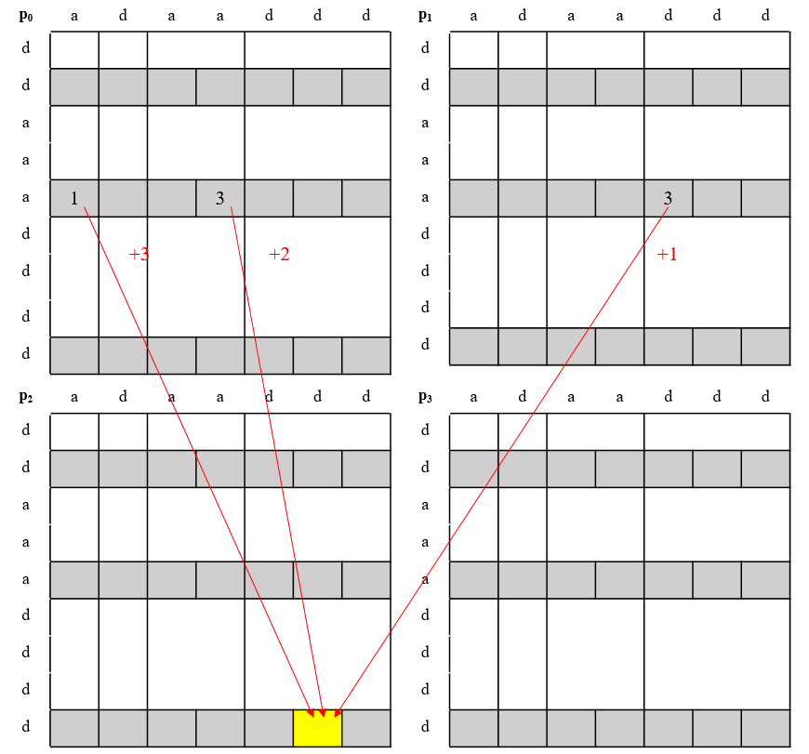
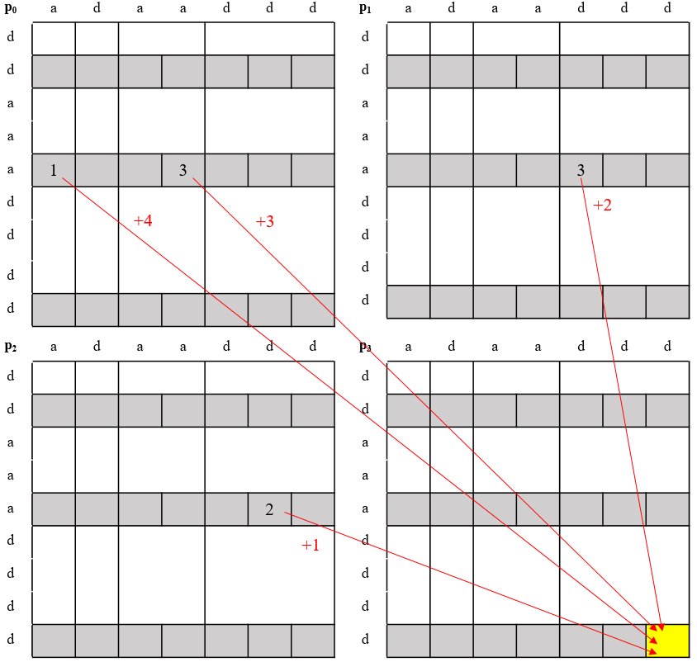
RX_{i} = Y_{j} = P_{k}

Slide 17
Amortized time
{[1,1][2,2]…[λ, λ]} : O(λ)/ λ = O(1)
{[1,1][2,2]…[λ, λ]} → [λ-1 ,λ-1][λ, λ] merge = {[1,1][2,2]…[λ-1, λ]} →
[λ-2 ,λ-2][λ-,1 λ] merge … → {[1, λ]}
At most merging λ-1 time , (O(λ)+O(λ)) / λ = O(1)

Slide 18
Time complexity
RX_{i} ≠ Y_{j} : O(1)
RX_{i} = Y_{j} ≠ P_{k} : amortized O(1)
RX_{i} = Y_{j} = P_{k} : amortized O(1)
Totally time complexity : O(nrM)

