Slide 1
A Review of Population-based Meta-heuristic Algorithms
Beheshti, Zahra and Shamsuddin, Siti Mariyam Hj
International Journal of Advances in Soft Computing and its Applications, 2013, Vol. 5, No. 1, pp.1-35.
Presenter : Tz-Hsu Lee
Date : Aug. 04, 2020.

Slide 2
Metaheuristic Algorithms: A Comprehensive Review
Abdel-Basset, Mohamed and Abdel-Fatah, Laila and Sangaiah, Arun Kumar
Computational intelligence for multimedia big data on the cloud with engineering applications, 2018, pp.185-231.
Presenter : Tz-Hsu Lee
Date : Aug. 04, 2020.

Slide 3
Abstract(1/2)
Exact optimization algorithms are not able to provide an appropriate solution in solving optimization problems with a high-dimensional search space. In these problems, the search space grows exponentially with the problem size therefore; exhaustive search is not practical. Also, classical approximate optimization methods like greedy-based algorithms make several assumptions to solve the problems. Sometimes, the validation of these assumptions is difficult in each problem. Hence, meta-heuristic algorithms which make few or no assumptions about a problem and can search very large spaces of candidate solutions have been extensively developed to solve optimization problems these days.

Slide 4
Abstract(2/2)
Among these algorithms, population-based meta-heuristic algorithms are proper for global searches due to global exploration and local exploitation ability. In this paper, a survey on meta-heuristic algorithms is performed and several population-based meta-heuristics in continuous (real) and discrete (binary) search spaces are explained in details. This covers design, main algorithm, advantages and disadvantages of the algorithms.

Slide 5

Imperialist Competitive Algorithm (ICA)
Notes:
同化 革命 最弱的給最強的

Slide 6
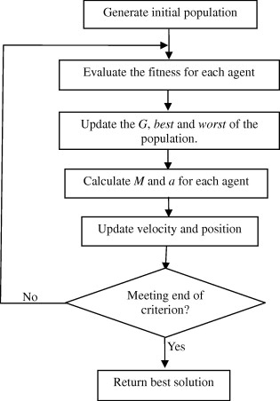
Gravitational Search Algorithm(GSA)

Slide 7
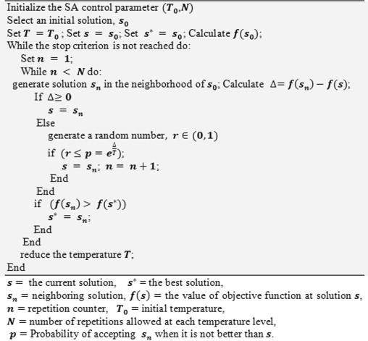
Simulated annealing(SA)

Slide 8
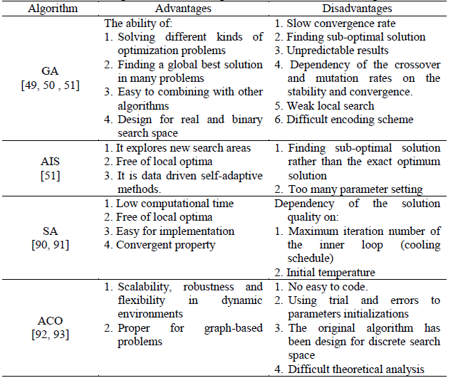
Conclusion(1/2)

Slide 9
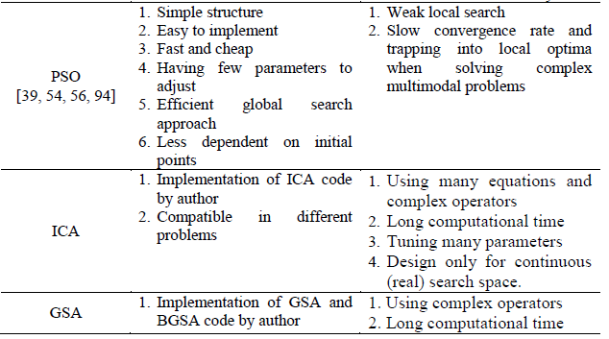

Conclusion(2/2)

Slide 10
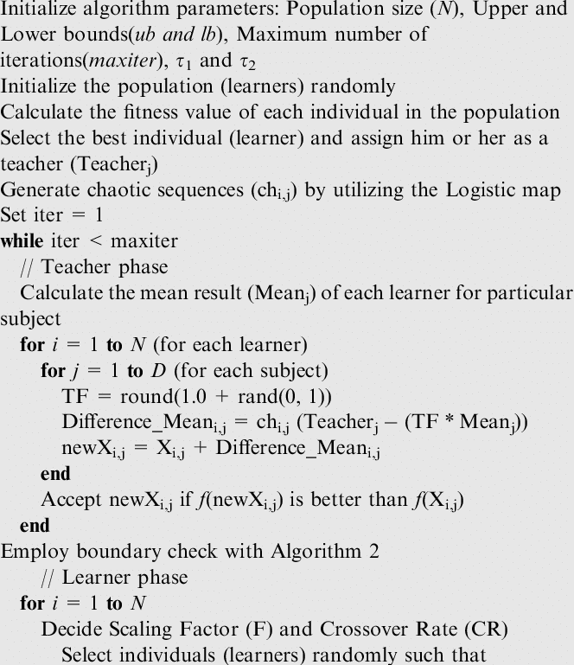
Teaching–Learning-Based Optimization(TLBO)
Notes:
教學階段 學習階段

Slide 11
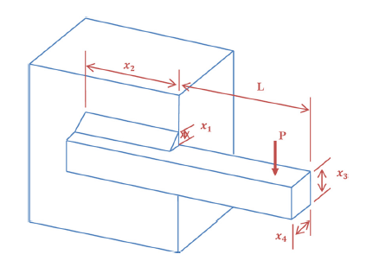

Weld Beam Design Problem
Objective function :

Slide 12
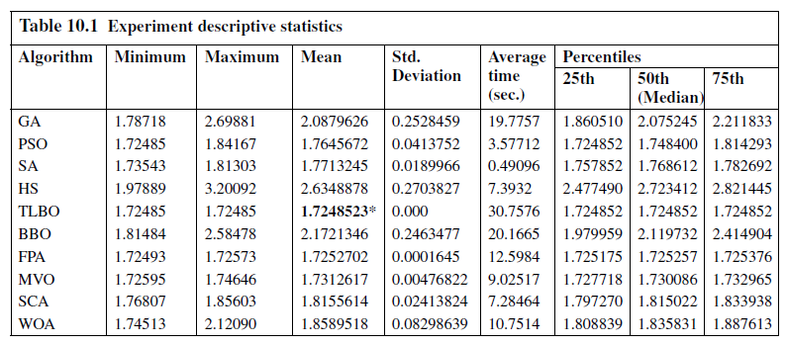
Experimental Results(1/2)

Slide 13
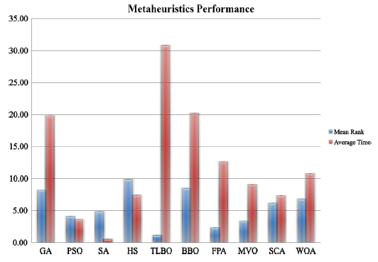
Experimental Results(2/2)

Slide 14
結論
將蛋白質問題encoding成其他問題，再用適合的啟發式演算法來解決。

