Slide 1
A Genetic Algorithm for Multiprocessor Task Scheduling
Tashniba Kaiser, Olawale Jegede, Ken Ferens, Douglas Buchanan
IEEE Transactions on Parallel and Distributed Systems, Feb. 1994, 113-120
Presenter : Chih-Kai Wu
Date: Aug. 4, 2020.
Notes:
聖胡安是美國自治領地波多黎各的首府和最大城市

Slide 2
Abstract (1/2)
The goal of task scheduling in a multiprocessor system is to schedule dependent tasks on processors such that the processing time is minimized. This ensures optimal usage of the processing systems. However this problem is NP-hard in nature and heuristic based techniques are used to obtain a good schedule in polynomial time. Genetic Algorithms (GA) have been proposed over other heuristics
because it can use its genetic processes to find multiple solutions faster. The GA proposed is based on a non-preemptive precedence relation between tasks in the task graph.

Slide 3
Abstract (2/2)
Tasks assignment is prioritized based on the number of tasks dependencies (NTD) and the earliest start time (EST) of each task. For tasks with multiple possible earliest start times, the minimum earliest start time is chosen for such tasks. Java simulations compared the results obtained using the minimum EST and the maximum EST. Our simulation shows that the proposed algorithm with minimum EST
achieves faster processing periods compared with the maximum EST.

Slide 4
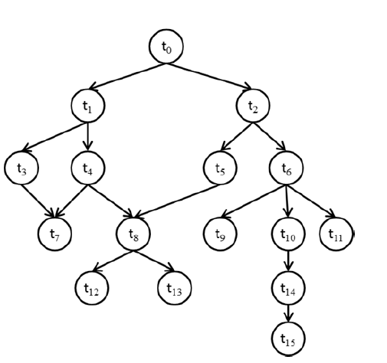
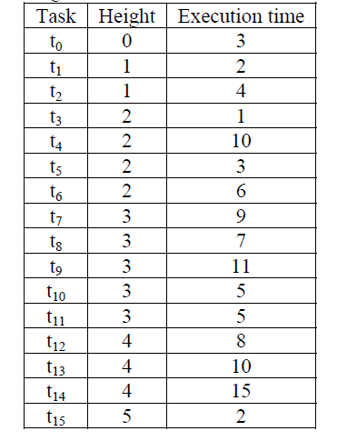
Problem with Height-Based Scheduling

Slide 5
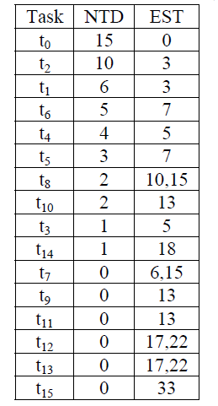
Problem with Height-Based Scheduling

Slide 6
Experiment
0 | 2 | 1 | 6 | 4 | 5 | 8 | 10 | 3 | 14 | 7 | 9 | 11 | 12 | 13 | 15
A
0 | 2 | 1 | 6 | 4 | 5 | 10 | 8 | 3 | 14 | 9 | 12 | 7 | 11 | 15 | 13
B
Crossover
0 | 2 | 1 | 6 | 4 | 5 | 10 | 8 | 3 | 14 | 9 | 12 | 7 | 11 | 13 | 15
A’
0 | 2 | 1 | 6 | 4 | 5 | 8 | 10 | 3 | 14 | 7 | 9 | 11 | 12 | 15 | 13
B’

Slide 7
Experiment
Mutation
0 | 2 | 1 | 6 | 4 | 5 | 10 | 8 | 3 | 14 | 9 | 12 | 7 | 11 | 13 | 15
A
0 | 2 | 1 | 6 | 4 | 5 | 8 | 10 | 3 | 14 | 11 | 12 | 7 | 9 | 13 | 15
A’

Slide 8
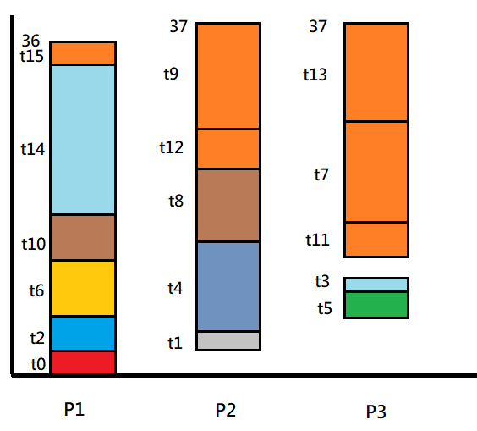
Experiment
0 | 2 | 1 | 6 | 4 | 5 | 8 | 10 | 3 | 14 | 11 | 12 | 7 | 9 | 13 | 15

Slide 9
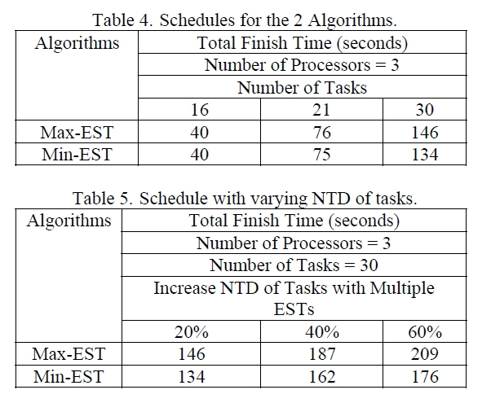
Experiment

