Slide 1
Fast Computation of a Longest Increasing Subsequence and Application
Maxime Crochemore, Ely Porat
Information and Computation
Volume 208, Issue 9, September 2010, Pages 1054-1059
Presenter：Yu-Cheng Chang
Date：Sept. 1, 2020
Notes:
Maxime Crochemore : (法國人)
King’s College London, Strand, London WC2R 2LS, UK (倫敦國王大學)
Université Paris-Est, France (法國東巴黎大學)
Ely Porat:
巴伊蘭大學 (Bar-Ilan University) 以色列

Slide 2
Abstract
We consider the complexity of computing a longest increasing subsequence (LIS) parameterized by the length of the output. Namely, we show that the maximal length k of an increasing subsequence of a permutation of the set of integers {1, 2, . . . , n} can be computed in time O(nloglogk) in the RAM model, improving the previous 30-year bound of O(nlogk). The algorithm also improves on the previous O(nloglogn) bound. The optimality of the new bound is an open question. Reducing the computation of a longest common subsequence (LCS) between two strings to an LIS computation leads to a simple O(rloglogk)-time algorithm for two sequences having r pairs of matching symbols and an LCS of length k.

Slide 3
LIS
12
8
8 | 9
1 | 9
1 | 9 | 11
1 | 6 | 11
1 | 6 | 7
1 | 2 | 7
1 | 2 | 7 | 10
1 | 2 | 4 | 10
1 | 2 | 4 | 5
1 | 2 | 3 | 5
S₀ = { 12 , 8 , 9 , 1 , 11 , 6 , 7 , 2 , 10 , 4 , 5 , 3 }
LIS(S₀) = { {1 , 2 , 4 , 5} , {1 , 6 , 7 , 10} }
Time Complxity：
O(nlogn) → O(nlogk), k is the length of LIS
O(nloglogn) with van Emde Boas Tree

Slide 4
Time complexity of LIS
k is the length of LIS
O(nlogn)
↓
O(nlogk)
↓
O(nloglogn)
↓
O(nloglogk)

Slide 5
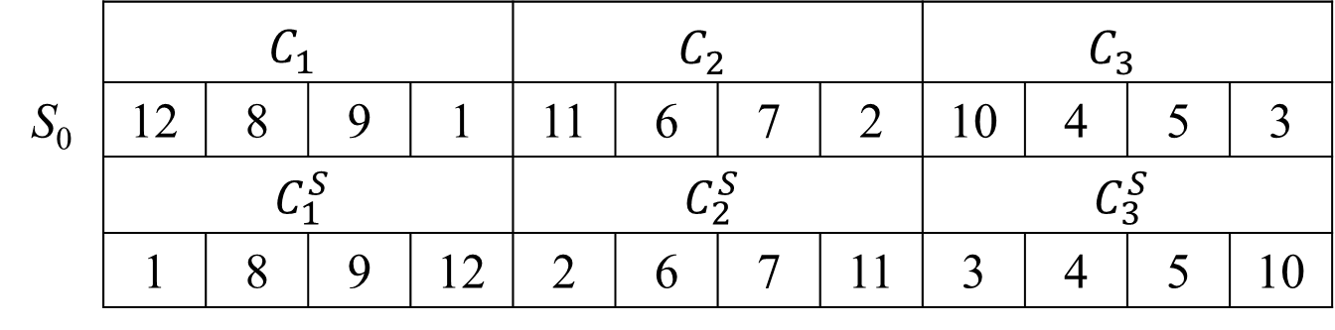
Renaming
將 S₀ 分成 n / m 堆，其中 m ≥ k，k 為 LIS 的長度
設 m = 4 (後面再講找m)
 | $$C_{1}^{}$$ |  |  |  | $$C_{2}^{}$$ |  |  |  | $$C_{3}^{}$$
S₀ | 12 | 8 | 9 | 1 | 11 | 6 | 7 | 2 | 10 | 4 | 5 | 3
 | $$C_{1}^{S}$$ |  |  |  | $$C_{2}^{S}$$ |  |  |  | $$C_{3}^{S}$$
 | 1 | 8 | 9 | 12 | 2 | 6 | 7 | 11 | 3 | 4 | 5 | 10

Slide 6
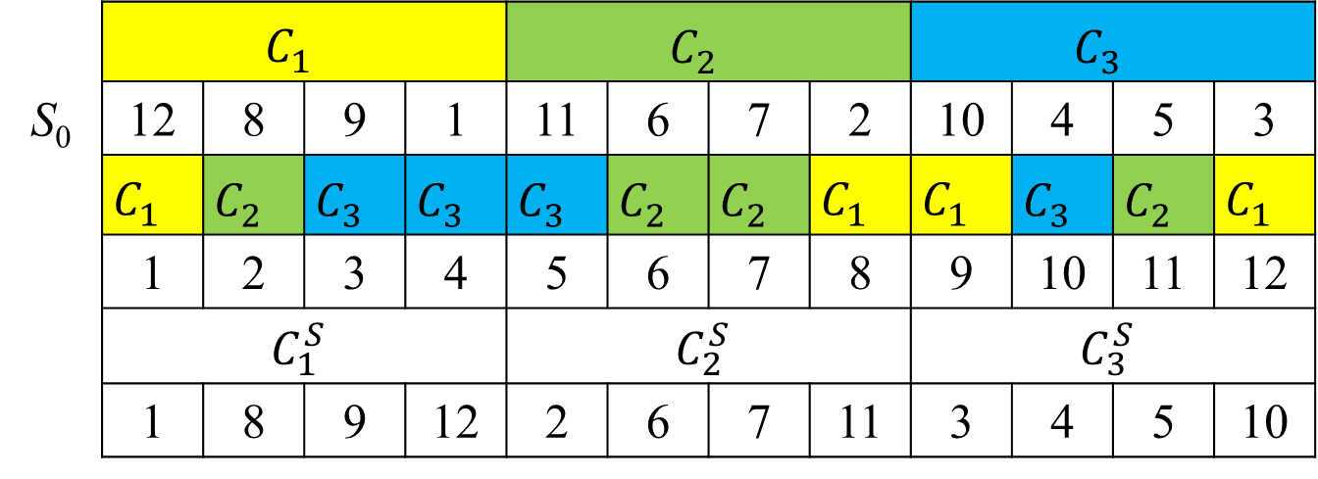
Sort
將 S₀[i] 與 ⎡i / m⎤ 綁成 pair ： (⎡i / m⎤ ,S₀[i])
使用 radix sort ：O(d * (n + r)) → O(n)
 | $$C_{1}^{}$$ |  |  |  | $$C_{2}^{}$$ |  |  |  | $$C_{3}^{}$$
S₀ | 12 | 8 | 9 | 1 | 11 | 6 | 7 | 2 | 10 | 4 | 5 | 3
 | $$C_{1}^{}$$ | $$C_{2}^{}$$ | $$C_{3}^{}$$ | $$C_{3}^{}$$ | $$C_{3}^{}$$ | $$C_{2}^{}$$ | $$C_{2}^{}$$ | $$C_{1}^{}$$ | $$C_{1}^{}$$ | $$C_{3}^{}$$ | $$C_{2}^{}$$ | $$C_{1}^{}$$
 | 1 | 2 | 3 | 4 | 5 | 6 | 7 | 8 | 9 | 10 | 11 | 12
 | $$C_{1}^{S}$$ |  |  |  | $$C_{2}^{S}$$ |  |  |  | $$C_{3}^{S}$$
 | 1 | 8 | 9 | 12 | 2 | 6 | 7 | 11 | 3 | 4 | 5 | 10

Slide 7
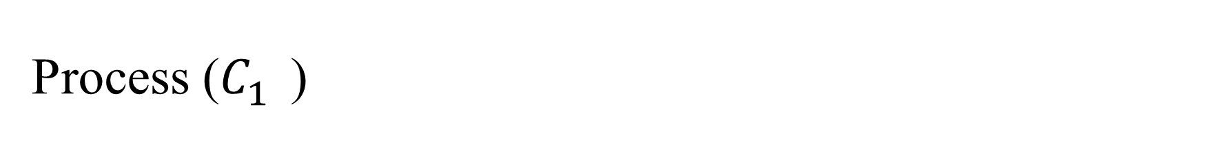
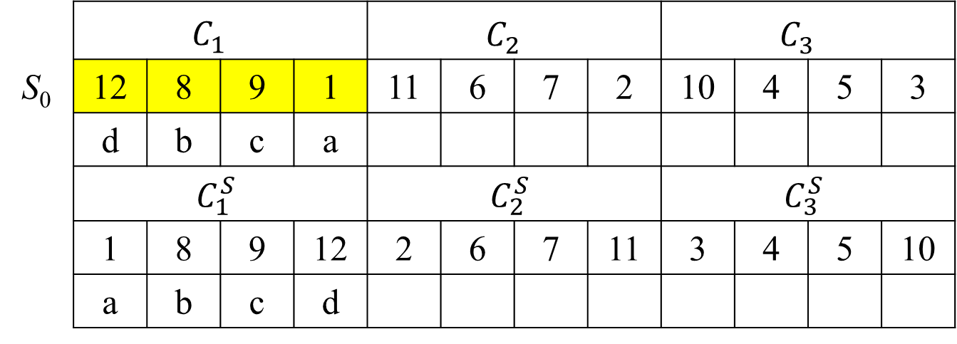
Process ($C_{1}^{}$)
d
b
b | c
a | c
 | $$C_{1}^{}$$ |  |  |  | $$C_{2}^{}$$ |  |  |  | $$C_{3}^{}$$
S₀ | 12 | 8 | 9 | 1 | 11 | 6 | 7 | 2 | 10 | 4 | 5 | 3
 | d | b | c | a
 | $$C_{1}^{S}$$ |  |  |  | $$C_{2}^{S}$$ |  |  |  | $$C_{3}^{S}$$
 | 1 | 8 | 9 | 12 | 2 | 6 | 7 | 11 | 3 | 4 | 5 | 10
 | a | b | c | d

Slide 8
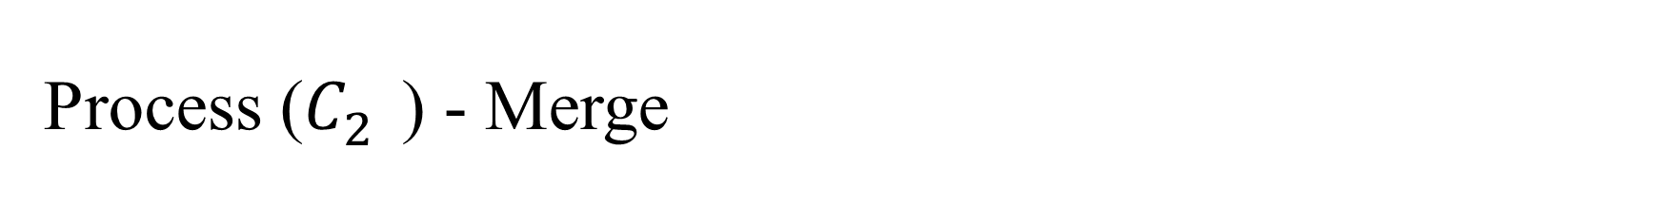
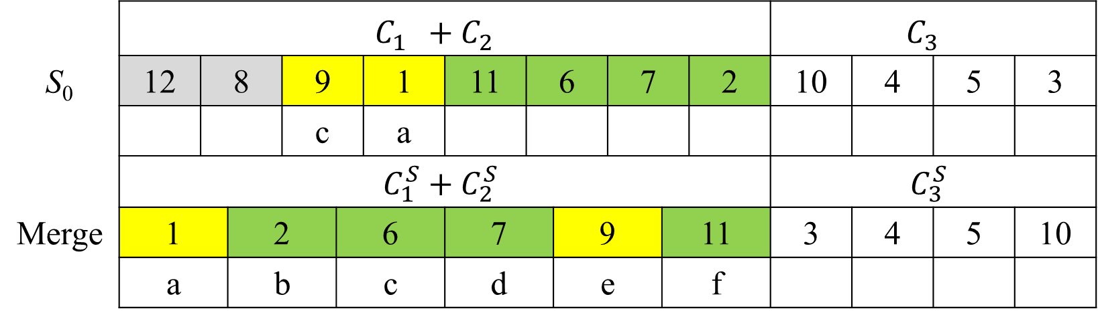
Process ($C_{2}^{}$) - Merge
 | $$C_{1}^{}+C_{2}^{}$$ |  |  |  |  |  |  |  |  |  |  |  | $$C_{3}^{}$$
S₀ | 12 | 8 |  | 9 |  | 1 | 11 | 6 |  | 7 |  | 2 | 10 | 4 | 5 | 3
 |  |  |  | c |  | a
 | $$C_{1}^{S}+C_{2}^{S}$$ |  |  |  |  |  |  |  |  |  |  |  | $$C_{3}^{S}$$
Merge | 1 |  | 2 |  | 6 |  | 7 |  | 9 |  | 11 |  | 3 | 4 | 5 | 10
 | a |  | b |  | c |  | d |  | e |  | f

Slide 9
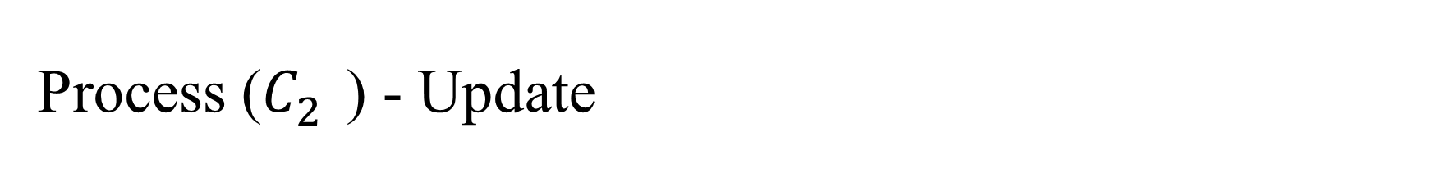

Process ($C_{2}^{}$) - Update
 | $$C_{1}^{}+C_{2}^{}$$ |  |  |  |  |  |  |  |  |  |  |  | $$C_{3}^{}$$
S₀ | 12 | 8 |  | 9 |  | 1 | 11 | 6 |  | 7 |  | 2 | 10 | 4 | 5 | 3
 |  |  |  | e |  | a | f | c |  | d |  | b
 | $$C_{1}^{S}+C_{2}^{S}$$ |  |  |  |  |  |  |  |  |  |  |  | $$C_{3}^{S}$$
Merge | 1 |  | 2 |  | 6 |  | 7 |  | 9 |  | 11 |  | 3 | 4 | 5 | 10
 | a |  | b |  | c |  | d |  | e |  | f

Slide 10
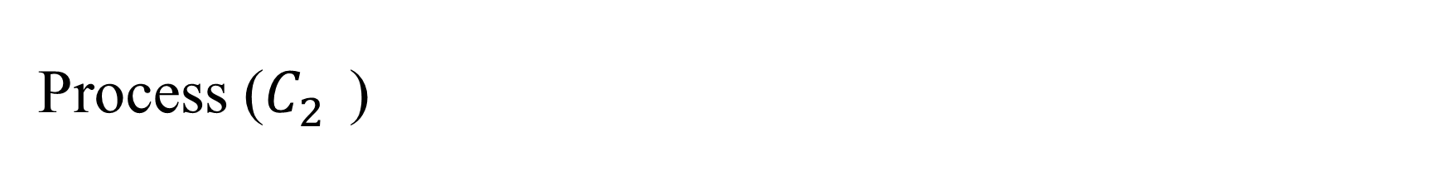
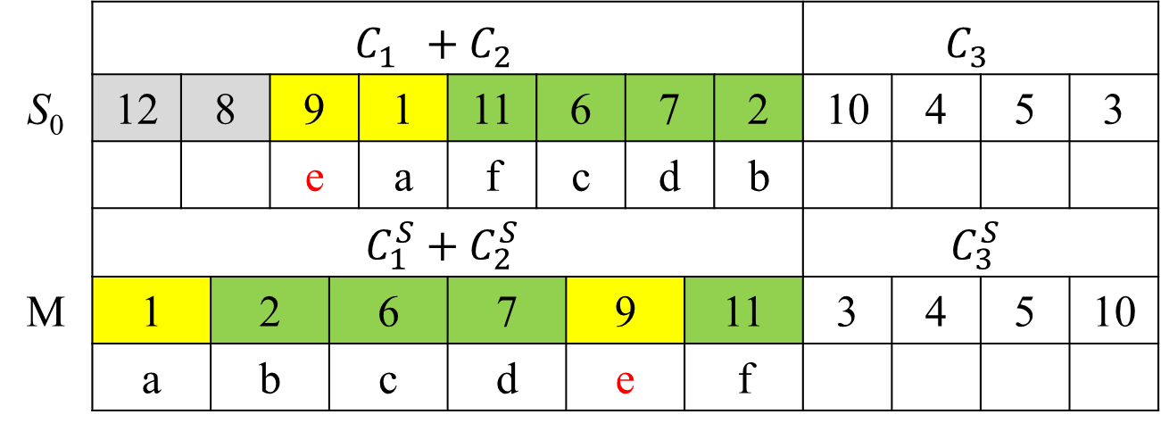
Process ($C_{2}^{}$)
d
b
b | c
a | c
a | e | f
a | c | f
a | c | d
a | b | d
update 改變了c 的編號
 | $$C_{1}^{}+C_{2}^{}$$ |  |  |  |  |  |  |  |  |  |  |  | $$C_{3}^{}$$
S₀ | 12 | 8 |  | 9 |  | 1 | 11 | 6 |  | 7 |  | 2 | 10 | 4 | 5 | 3
 |  |  |  | e |  | a | f | c |  | d |  | b
 | $$C_{1}^{S}+C_{2}^{S}$$ |  |  |  |  |  |  |  |  |  |  |  | $$C_{3}^{S}$$
M | 1 |  | 2 |  | 6 |  | 7 |  | 9 |  | 11 |  | 3 | 4 | 5 | 10
 | a |  | b |  | c |  | d |  | e |  | f

Slide 11
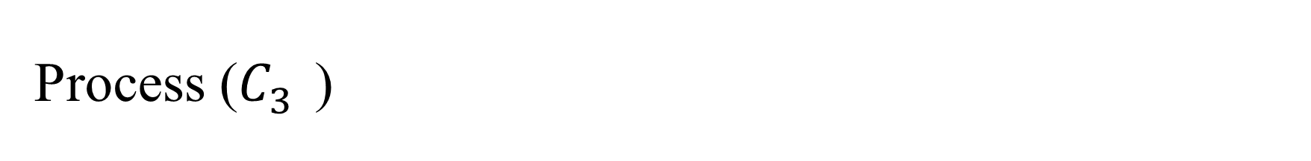
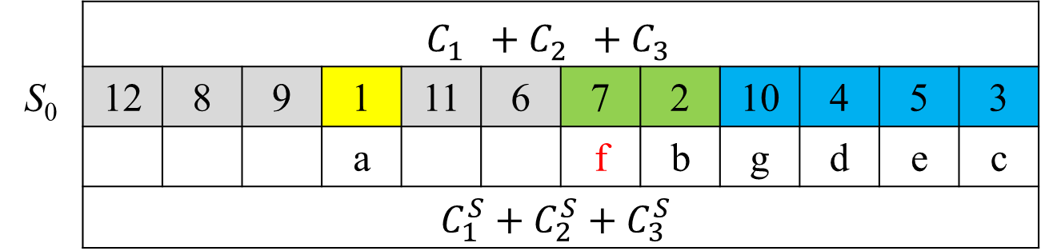
Process ($C_{3}^{}$)
d
b
b | c
a | e
a | e | f
a | c | f
a | c | d
a | b | d
a | b | f | g
a | b | d | g
a | b | d | e
a | b | c | e
update 改變了d 的編號
 | $$C_{1}^{}+C_{2}^{}+C_{3}^{}$$
S₀ | 12 | 8 | 9 | 1 | 11 | 6 | 7 | 2 | 10 | 4 | 5 | 3
 |  |  |  | a |  |  | f | b | g | d | e | c
 | $$C_{1}^{S}+C_{2}^{S}+C_{3}^{S}$$
M | 1 | 2 | 3 | 4 | 5 | 7 | 10
 | a | b | c | d | e | f | g
{a , b , c , e} => {1 , 2 , 3 , 5}
LIS of length 4 ending with 5

Slide 12
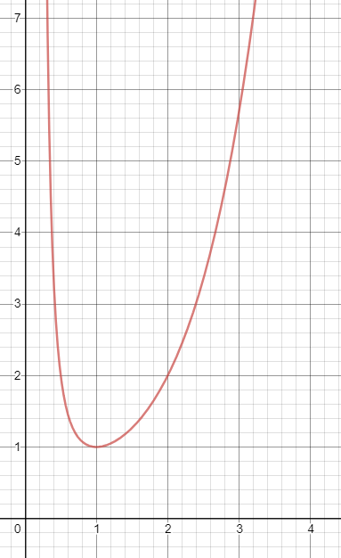
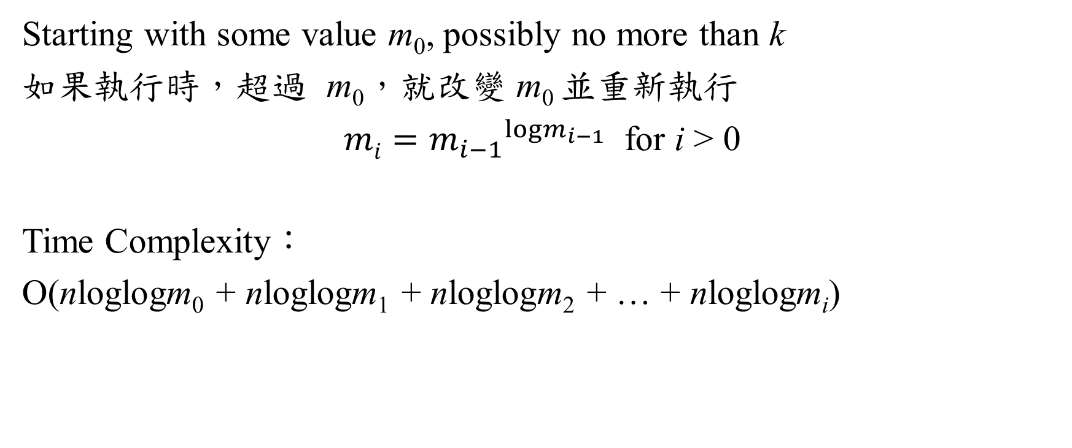
Find m
Starting with some value m₀, possibly no more than k
如果執行時，超過 m₀，就改變 m₀ 並重新執行
${{mi=m}_{i−1}}^{{logm}_{i−1}}$ for i > 0
Time Complexity：
O(nloglogm₀ + nloglogm₁ + nloglogm₂ + … + nloglogm_{i})

Slide 13

Time Complexity
${{mi=m}_{i−1}}^{{logm}_{i−1}}$ for i > 0
loglog(m^{logm}) = 2loglogm
$$loglog{{mi=loglogm}_{i−1}}^{{logm}_{i−1}}=2loglogm_{i−1}$$
$$\frac{1}{2}loglogmi=loglogm_{i−1}$$

Slide 14
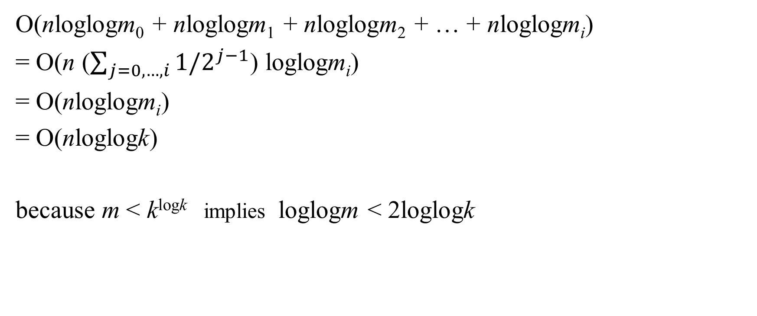
Time Complexity
O(nloglogm₀ + nloglogm₁ + nloglogm₂ + … + nloglogm_{i})
= O(n ($\sum_{j=0,…,i}{1/2^{j−1}}$) loglogm_{i})
= O(nloglogm_{i})
= O(nloglogk)
because m < k^{logk} implies loglogm < 2loglogk

Slide 15
Reduces LCS to LIS
A = ababa 、 B = aabba
p(a) = { 5 , 2 , 1}
p(b) = { 4 , 3 }
Index | 1 |  |  | 2 |  | 3 |  |  | 4 |  | 5
 | a |  |  | b |  | a |  |  | b |  | a
S(A,B) | 5 | 2 | 1 | 4 | 3 | 5 | 2 | 1 | 4 | 3 | 5 | 2 | 1
 | (5,3) | (2,3) | (1,3) | (4,2) | (3,2) | (5,2) | (2,2) | (1,2) | (4,1) | (3,1) | (5,1) | (2,1) | (1,1)
 | 13 | 6 | 3 | 10 | 8 | 12 | 5 | 2 | 9 | 7 | 11 | 4 | 1

Slide 16
Reduces LCS to LIS
Index | 1 |  |  | 2 |  | 3 |  |  | 4 |  | 5
 | a |  |  | b |  | a |  |  | b |  | a
S(A,B) | 5 | 2 | 1 | 4 | 3 | 5 | 2 | 1 | 4 | 3 | 5 | 2 | 1
 | (5,3) | (2,3) | (1,3) | (4,2) | (3,2) | (5,2) | (2,2) | (1,2) | (4,1) | (3,1) | (5,1) | (2,1) | (1,1)
 | 13 | 6 | 3 | 10 | 8 | 12 | 5 | 2 | 9 | 7 | 11 | 4 | 1
LIS = { 3 , 5 , 7 , 11 }
可以得到 (1,1), (3,2), (4,3), (5,5)
LCS = aaba
Time Complexity ： O(rloglogk), r is number of matches, k is length of LCS
Worst ： O(n²loglogk)

Slide 17
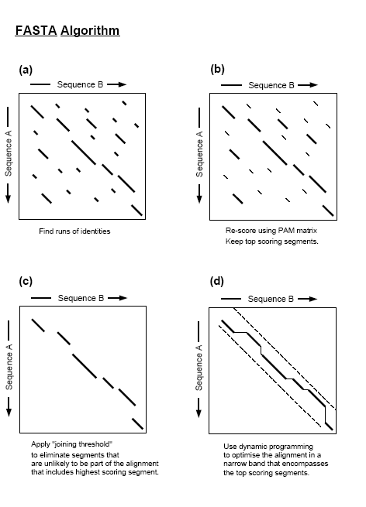
FASTA
A = ababa 、 B = aabba
限制 w = 1
A = ababa 、 B’ = abb
⸪ |S(A,B’)| < wn
⸫ O(rloglogk) → O(nloglogn)

