Slide 1
Ions Motion Algorithm for Solving Optimization Problems
Behzad Javidy, Abdolreza Hatamlou, and Seyedali Mirjalili
Applied Soft Computing, 2015, Vol. 32, pp.72-79.
Presenter : Tz-Hsu Lee
Date : Oct. 06, 2020.
Notes:
journal

Slide 2
Abstract
This paper proposes a novel optimization algorithm inspired by the ions motion in nature. In fact, the proposed algorithm mimics the attraction and repulsion of anions and cations to perform optimization. The proposed algorithm is designed in such a way to have the least tuning parameters, low computational complexity, fast convergence, and high local optima avoidance. The performance of this algorithm is benchmarked on 10 standard test functions and compared to four well-known algorithms in the literature. The results demonstrate that the proposed algorithm is able to show very competitive results and has merits in solving challenging optimization problems.
Notes:
the least number of tuning parameters, low computational complexity, fast convergence, and high local optima avoidance

Slide 3
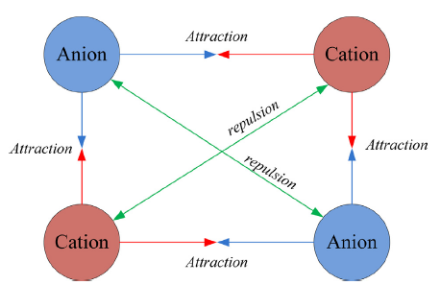

Inspirations
Anion: ions with negative (−) charge.
Cation: ions with positive (+) charge.

Slide 4
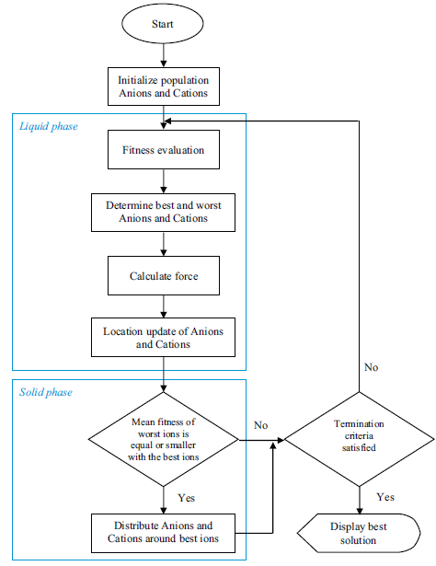
General Steps of the IMO Algorithm

Slide 5
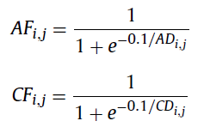

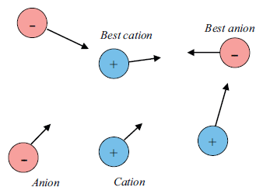
Liquid phase
Calculate the force :
, , where
Update position :
Notes:
ignore repulsion forces in this phase in order to explore the search space.

Slide 6
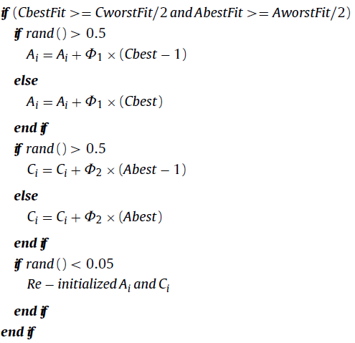
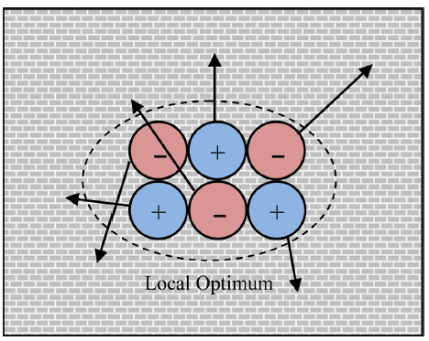
Crystal phase
resolve local optima entrapment :
Notes:
˚1and ˚2are random numbers in [−1, 1] and rand() is a function that returns a random number in [0, 1].

Slide 7
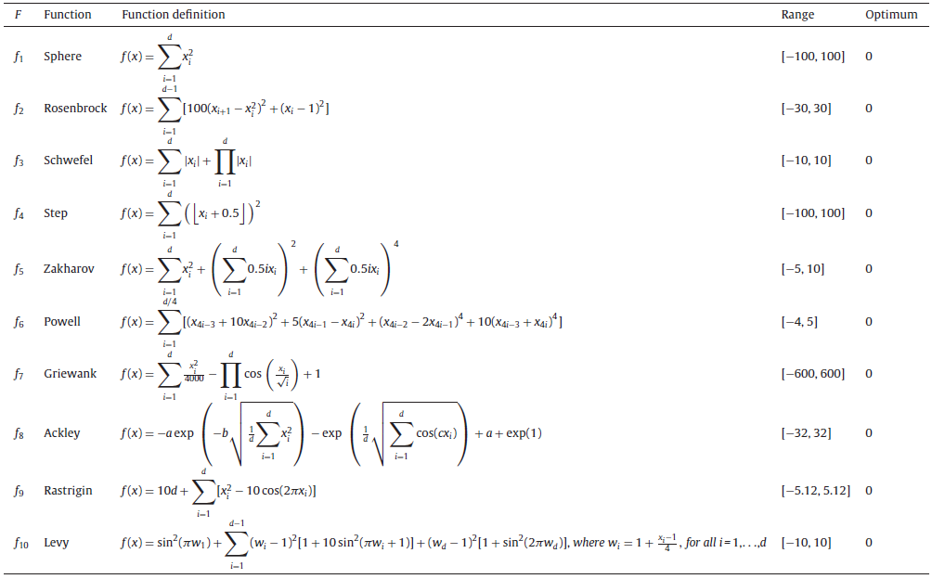
Results(1/3)
Notes:
population to 50 The maximumnumbers of iterations are also e1000 for IMO.qual to 10,000 1000 for IMO.

Slide 8
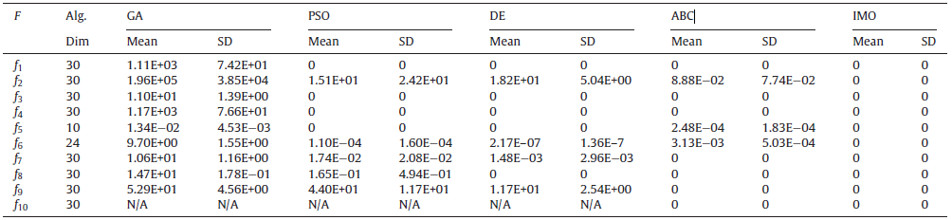
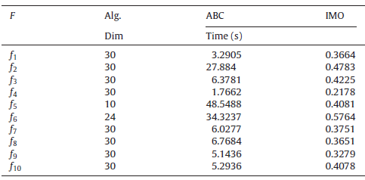
Results(2/3)
Notes:
population to 50 The maximum numbers of iterations are also equal to 10,000 1000 for IMO.

Slide 9
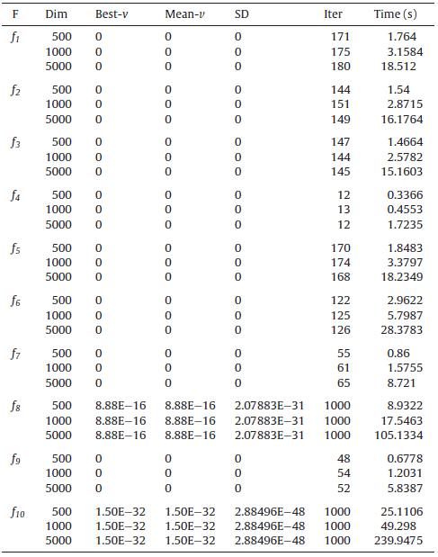
Results(3/3)

