Slide 1
A Novel Efficient Graph Model for the Multiple Longest Common Subsequences (MLCS) Problem
Zhan Peng and Yuping Wang, Frontiers in Genetics, 8:104, 2017
Presenter: Shao-Xuan Lee
Date: Oct. 14, 2020

Slide 2
Abstract(1/2)
Searching for the Multiple Longest Common Subsequences (MLCS) of multiple sequences is a classical NP-hard problem, which has been used in many applications. One of the most effective exact approaches for the MLCS problem is based on dominant point graph, which is a kind of directed acyclic graph (DAG). However, the time and space efficiency of the leading dominant point graph based approaches is still unsatisfactory: constructing the dominated point graph used by these approaches requires a huge amount of time and space, which hinders the applications of these approaches to large-scale and long sequences. To address this issue, in this paper, we propose a new time and space efficient graph model called the Leveled-DAG for the MLCS problem.

Slide 3
Abstract(2/2)
The Leveled-DAG can timely eliminate all the nodes in the graph that cannot contribute to the construction of MLCS during constructing. At any moment, only the current level and some previously generated nodes in the graph need to be kept in memory, which can greatly reduce the memory consumption. Also, the final graph contains only one node in which all of the wanted MLCS are saved, thus, no additional operations for searching the MLCS are needed. The experiments are conducted on real biological sequences with different numbers and lengths respectively, and the proposed algorithm is compared with three state-of-the-art algorithms. The experimental results show that the time and space needed for the Leveled-DAG approach are smaller than those for the compared algorithms especially on large-scale and long sequences

Slide 4
Multiple Longest Common Subsequences (MLCS) problem
A = A C B A B
B = B A C C A
C = A C C B A
MLCS(A,B,C) = A C A

Slide 5
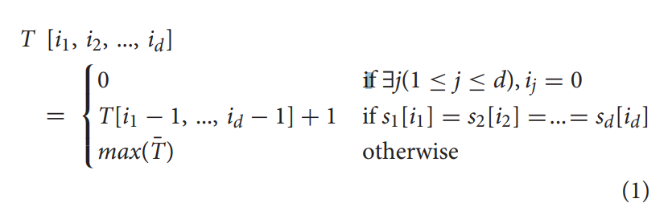
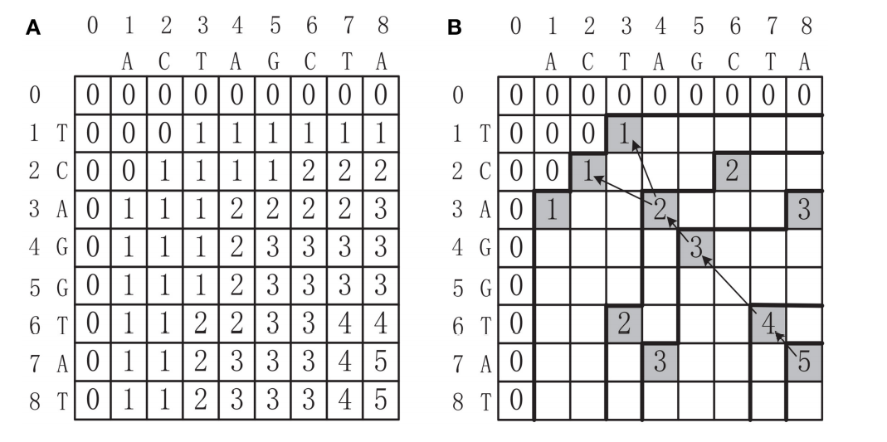
Dynamic Programming Based Approaches

Slide 6
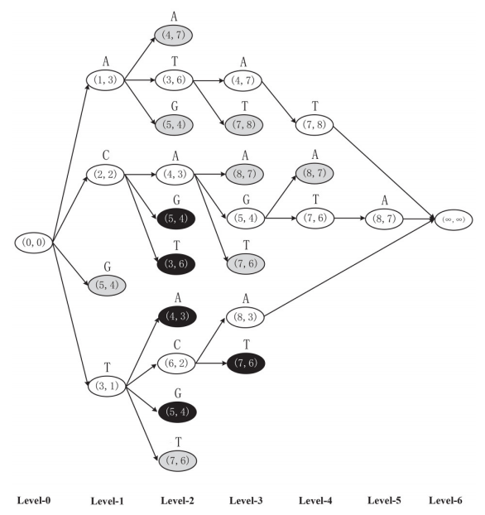
Dominant Point Based Approaches
A = A C T A G C T A
B = T C A G G T A T

Slide 7
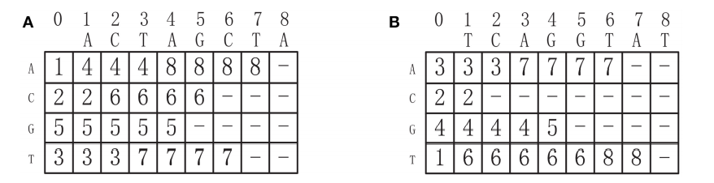
Leveled-DAG Algorithm
A = A C T A G C T A
B = T C A G G T A T

Slide 8
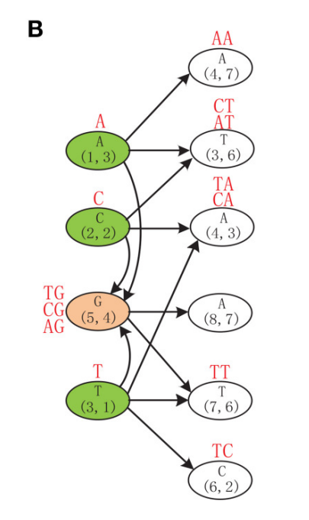
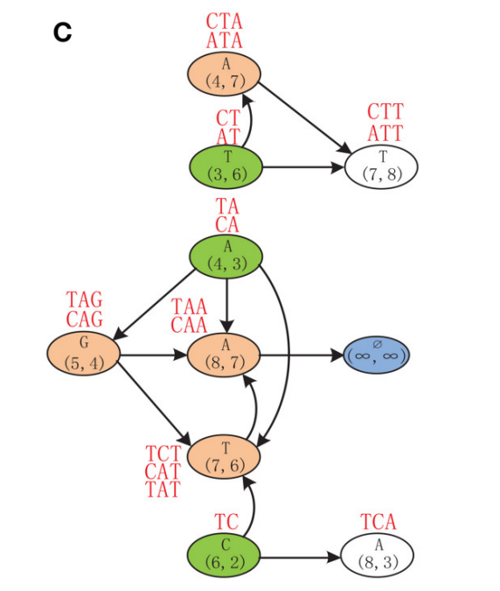
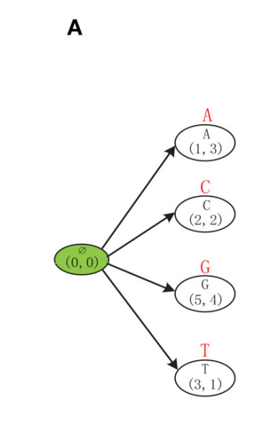

Slide 9
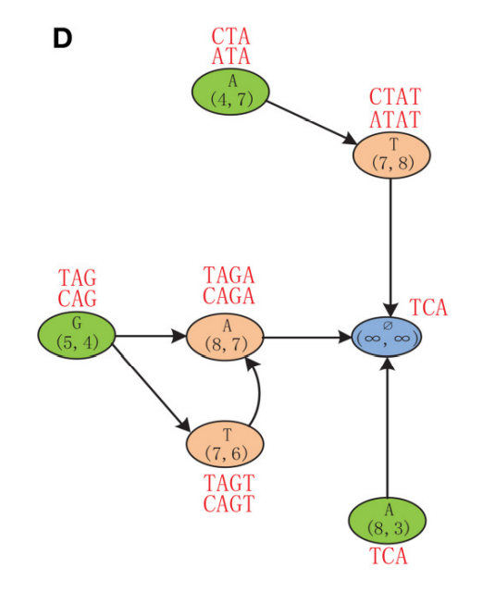

Slide 10
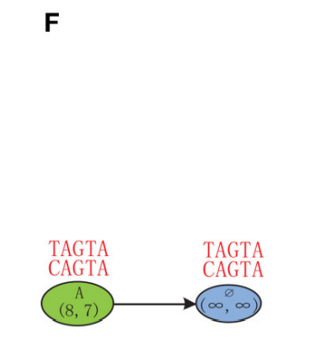
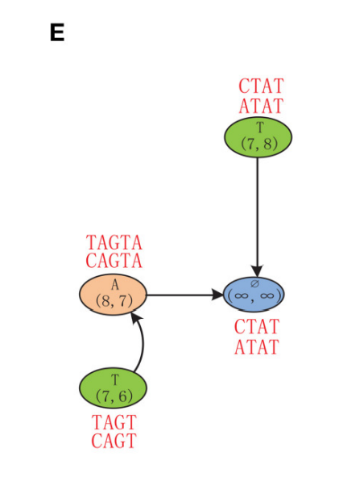

Slide 11
Conclusion
Time complexity
Build the successor table = O( d | Σ | n )
Construct the Leveled-DAG graph = O ( 2 | Nodes | )
Space complexity = O ( | Max_Level | )

