Slide 1
Enhanced Dynamic Algorithm of Genome Sequence Alignments
Arabi E. keshk
International Journal of Information Technology and Computer Science, 2014, vol.06,no.6, pp.40-46
Presenter: Jue-Jun Wu
Date: Oct. 14,2020
Notes:
計算機學院的教授梅努菲亞大學
在埃及Menoufia University · Department of Computer Science and Engineering

Slide 2
Abstract(1/2)
The merging of biology and computer science has created a new field called computational biology that explore the capacities of computers to gain knowledge from biological data, bioinformatics. Computational biology is rooted in life sciences as well as computers, information sciences, and technologies. The main problem in computational biology is sequence alignment that is a way of arranging the sequences of DNA, RNA or protein to identify the region of similarity and relationship between sequences. This paper introduces an enhancement of dynamic algorithm of genome sequence alignment, which called EDAGSA.

Slide 3
Abstract(2/2)
It is filling the three main diagonals without filling the entire matrix by the unused data. It gets the optimal solution with decreasing the execution time and therefore the performance is increased. To illustrate the effectiveness of optimizing the performance of the proposed algorithm, it is compared with the traditional methods such as Needleman-Wunsch, Smith-Waterman and longest common subsequence algorithms. Also, database is implemented for using the algorithm in multi-sequence alignments for searching the optimal sequence that matches the given sequence.

Slide 4
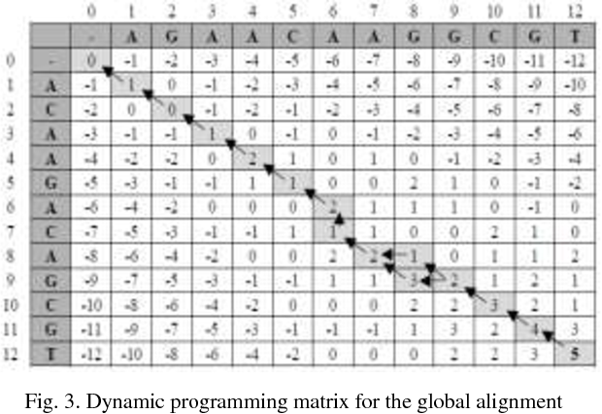


Needlman – Wunsch Algorithm
Scoring table :match:+1;mistach:-1;gap:-1
M [i, j] = max {M [i -1, j -1] + sub (A[i], B[j]);
M [i -1, j] + del (A[i] ); M [i, j -1] + ins ( B[j])}
O($n^{3}$)
Notes:
生物序列 dynamic 最早期的幾個實例之一。該算法是由 Saul B. Needlman和 Christian D. Wunsch 於1970年發明的。
找兩條序列最佳解 ，數學問題分解為一系列小問題，從小問題的解決方法重建大問題的解決方法。
箭頭代表在我們對準，插入，缺失。
在Needleman-Wunsch（全局性）算法中，分數跟蹤系統是基於得分矩陣的右下角開始的。
水平的箭頭表示會有一個縱(->)向序列的間隔gap(A)
O(n三次方)

Slide 5
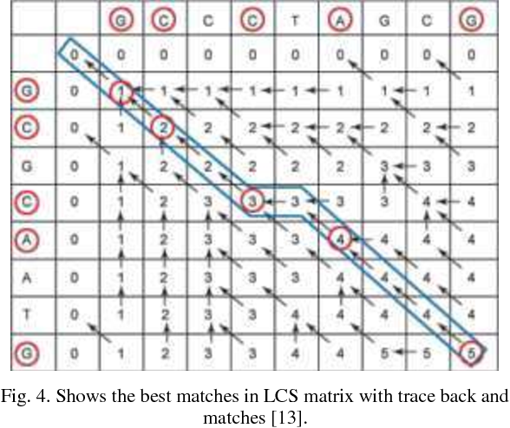

Smith Waterman Algorithm
M (i, j) = MAX{ 0;
M (i-1, j-1) + sub (A(i), B(j));
M(i-1,j) + del(A(i));
M(i,j-1) +ins (B(j))}
Scoring table :match:+1;mistach:-1;gap:0
O($m^{2}n)time$
Notes:
該演算法由 Temple F. Smith and Michael S. Waterman 於1981年提出。 DP一個變體
區別:不存在負分（負分被替換為零），回溯從分數最高的矩陣元素開始(不一定是從右下角開始)，局部是成立的。
通常無法實際應用於大規模問題，因此被替換為通用性較低但計算效率更高的替代方法
O(某個序列m,n 則時間來到n*m)

Slide 6
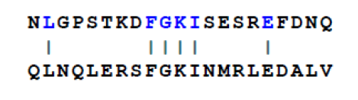
match:+5 mismatch:-1gap:-1
global : 6*5 + (-1)*15 = 15 local : 5*5 + (-1)*7 = 18
Notes:
蛋白質氨基酸序列的相似性
(全部的序列納入考慮範圍之內後進行的序列配對)整個序列（從起始端到結束端）來進行配對
局部性配對用於在非同源性的基因序列中尋找具有相似性的同源的基因域(序列的一小部分進行優先比對)
長度不一致
當兩序列長度相差很大時，造成配對含有很長的gap。儘管在某處配對序列和參考序列的匹配程度相當高，在全局性配對時，將不會把這兩個片段直接進行配對，而是儘量嘗試讓參考序列內的所有鹼基都參與匹配，造成結果與局部性配對方法有極大差別。

Slide 7
longest common subsequence problem
 |  | G | C | C | C | T | A | G | C | G
 | 0 | 0 | 0 | 0 | 0 | 0 | 0 | 0 | 0 | 0
G | 0 | 1 | 1 | 1 | 1 | 1 | 1 | 1 | 1 | 1
C | 0 | 1 | 2 | 2 | 2 | 2 | 2 | 2 | 2 | 2
G | 0
G | 0
A | 0
A | 0
T | 0
G | 0
M (i, j) = { 0;
M (i-1, j-1) + 1;
max{ M(i-1,j) , M(i,j-1) }
Notes:
不看先前的 就看有沒有match 或 mismatch
Match 就會試斜角線+1 ，mismatch 就會是看上面或左邊取max值，沒有gap
左邊一個 和右邊一個，兩個，三個…..
左邊兩個 和….
到左邊全部 和…..

Slide 8
longest common subsequence problem
M (i, j) = { 0;
M (i-1, j-1) + 1;
max{ M(i-1,j) , M(i,j-1) }
It is found the score of LCS alignment = 5.
Performance:
time Complexity is O (M*N) as it is
time of backing trace is (M+N).
Notes:
不連續
左邊一個 和右邊一個，兩個，三個…..
Match就是斜線加1，左邊大 或是上面大

Slide 9
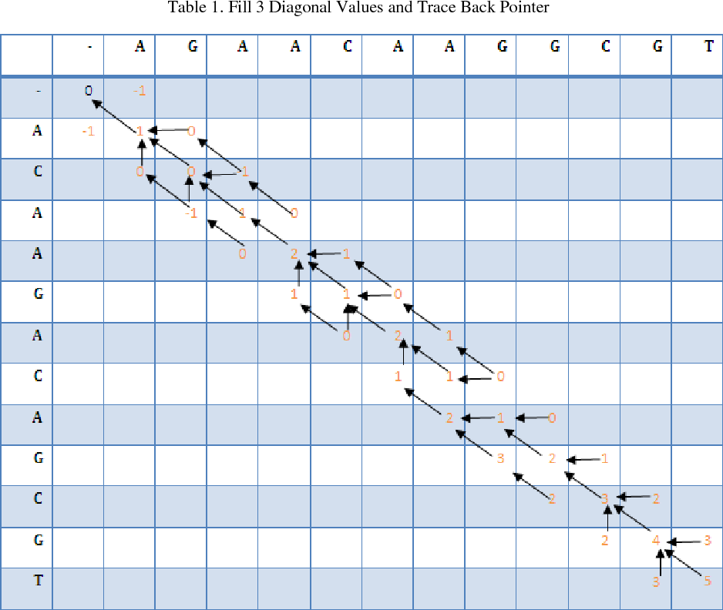
Enhanced Dynamic Algorithm of Genome Sequence Aligments(EDAGSA) algorithm
Notes:
EDAGSA algorithm 是找global apigment DP的最佳解
他也用來找lcs 他主要是忽略其他沒被使用到的data，他可以簡化執行時間和增加效率

Slide 10
Enhanced Dynamic Algorithm of Genome Sequence Aligments(EDAGSA) algorithm
以這個實例來說: 直的12個 橫的12個
Time = O(3*M+1) = O(37)
Space: O (3M + 1) space =O(3*12+1) = O(37)
Notes:
Needleman-Wunsch O($n^{3}$) 長度依樣 Smith-Waterman O(mn(m+n)) =O($m^{2}n)$
Lcs O(mn$)$
EDAGSA O(3*M+1)

Slide 11
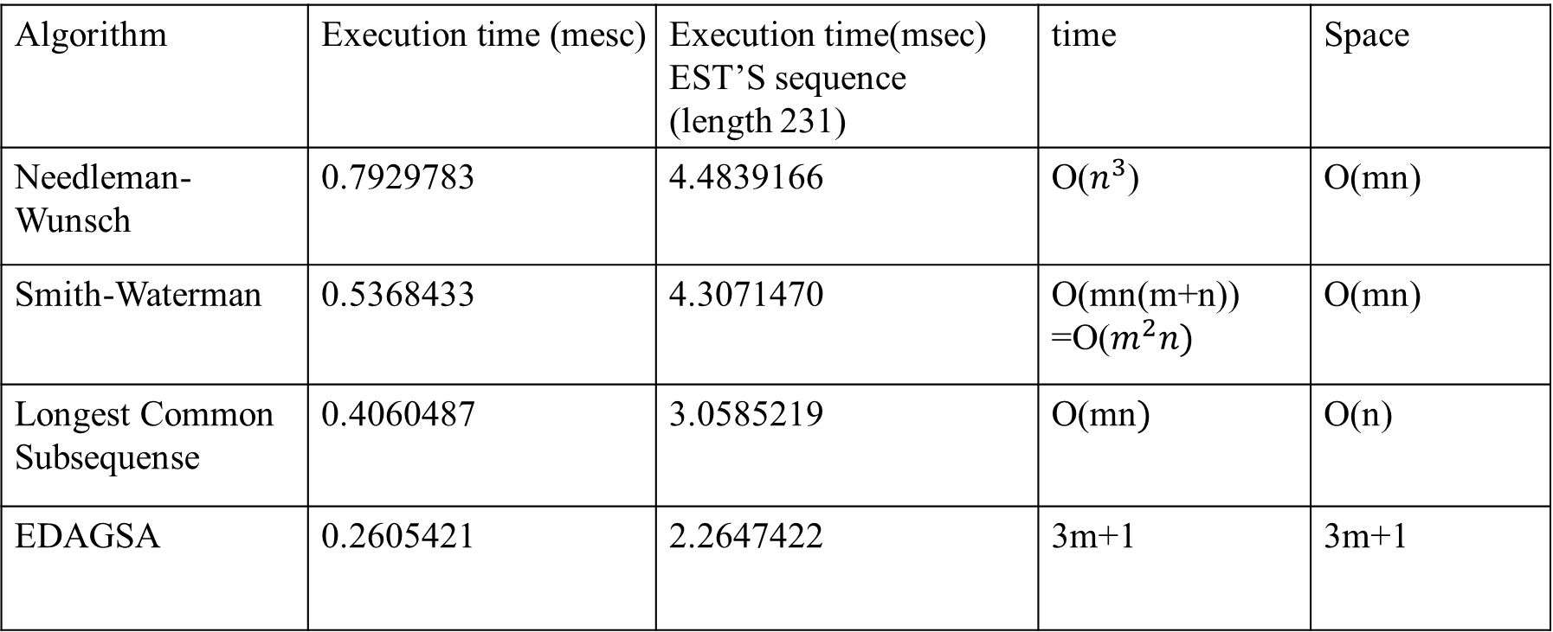
Experimental Result
Algorithm | Execution time (mesc) | Execution time(msec) EST’S sequence (length 231) | time | Space
Needleman-Wunsch | 0.7929783 | 4.4839166 | O($n^{3}$) | O(mn)
Smith-Waterman | 0.5368433 | 4.3071470 | O(mn(m+n)) =O($m^{2}n)$ | O(mn)
Longest Common Subsequense | 0.4060487 | 3.0585219 | O(mn$)$ | O(n)
EDAGSA | 0.2605421 | 2.2647422 | 3m+1 | 3m+1
Notes:
他發表了EDAGSＡ 忽略不使用的資料
只計算來自三個方向的數值 來減少執行時間 ，增加效率，減少記憶體配置

Slide 12
the end
thanks for listening

