Slide 1
Edit Distance of Run-Length Encoded Strings
Ora Arbell, Gad M. Landau and Joseph S. B. Mitchell
Information Processing Letters,
Vol. 83, pp. 307–314, 2002.
Date: Mar. 26, 2008
Introducer: Hsing-Yen Ann

Slide 2
Abstract
Let X and Y be two run-length encoded strings, of encoded lengths k and l, respectively. We present a simple O(|X|l +|Y|k) time algorithm that computes their edit distance.

Slide 3
Problem Definition
Run-length encoding (RLE) compression
aaaaabbbccccdd ➔ a⁵b³c⁴d²
Given two RLE strings X and Y, to find the edit distance (Levenshtein distance) without uncompressing X and Y.

Slide 4
Edit Distance & Levenshtein Distance
Costs in Edit distance (LCS)
  0: match
  1: insertion, deletion
  2: replacement (deletion + insertion)
Costs in Levenshtein distance
  0: match
  1: insertion, deletion, replacement

Slide 5
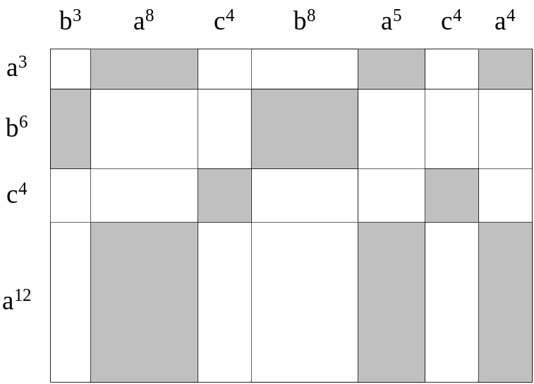
Dark Blocks & Light Blocks
Divide the DP lattice into k × l blocks.
Dark blocks: matched blocks
Light blocks: mismatched blocks

Slide 6
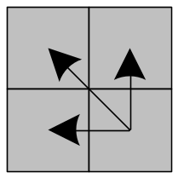
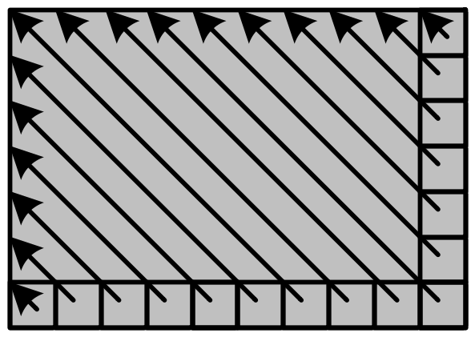
Computation in Dark Blocks
For every element A[i, j] of a dark block,
A[i, j] = A[i-1, j-1]
Therefore,

Slide 7
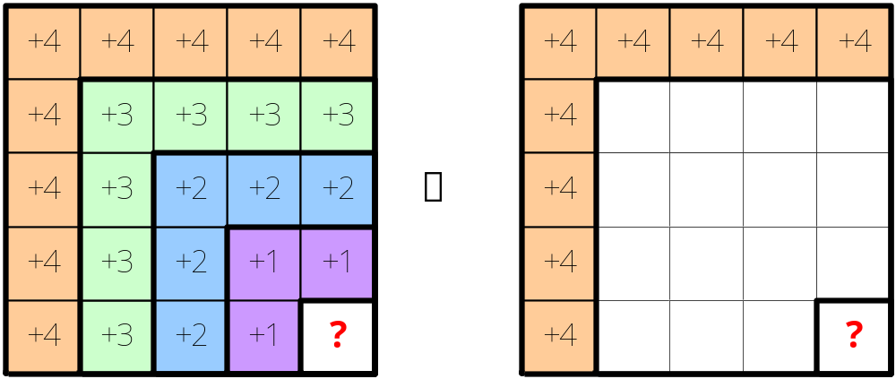
Computation in Light Blocks (1/3)
For every element A[i, j] of a light block,
A[i, j] = min(A[i-1, j-1], A[i-1, j], A[i, j-1])+1

Slide 8
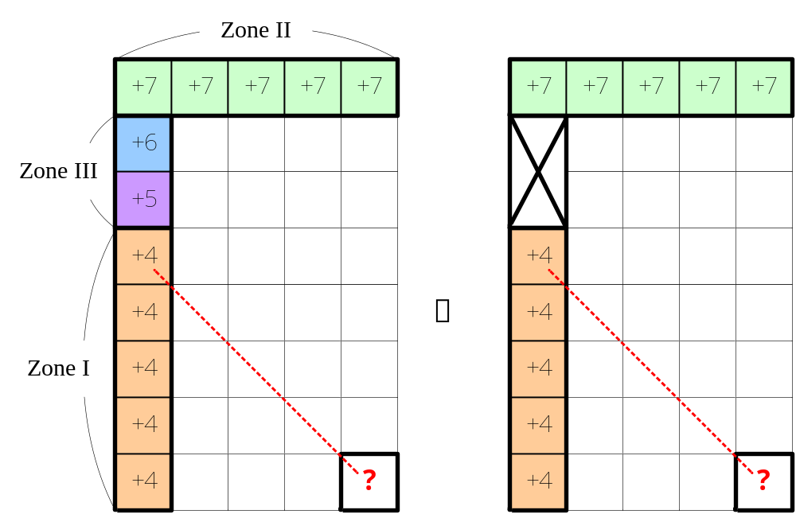
Computation in Light Blocks (2/3)
We do not need to consider Zone III, since

Slide 9
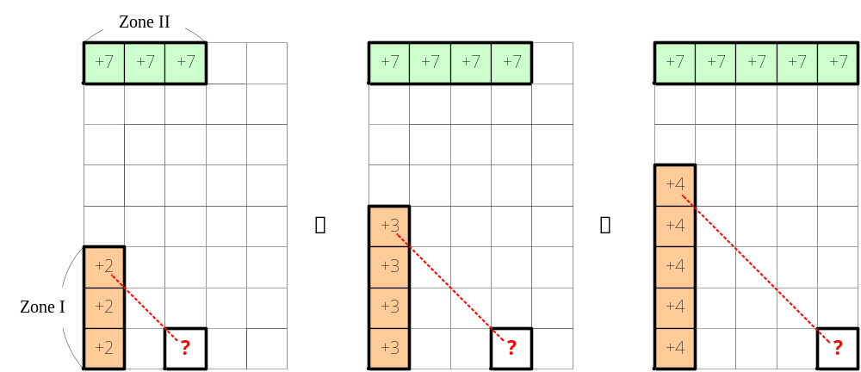
Computation in Light Blocks (3/3)
The minimum in Zone I and the minimum in Zone II can be determined in O(1) time.

Slide 10
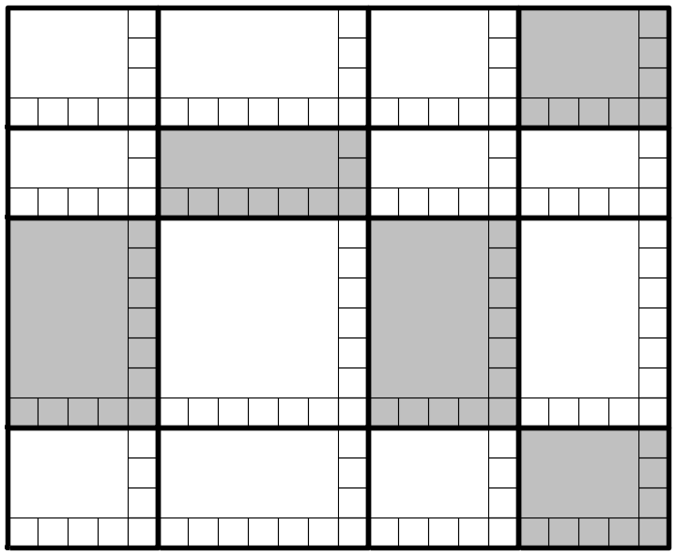
Conclusion
There is an O(|X|l +|Y|k) time algorithm that computes the Levenshtein distance.

