Slide 1
A Heuristic with Worst-case Analysis for Minimax Routing of Two Travelling Salesmen on a Tree
Igor Averbakh, Oded Berman
Discrete Applied Mathematics 68 (1996), pp. 17-32
Presenter : Hsiang-Yi Weng
Date : August 13, 2008

Slide 2
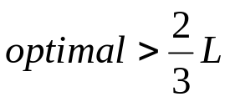
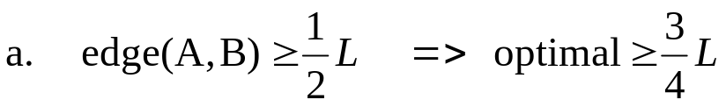
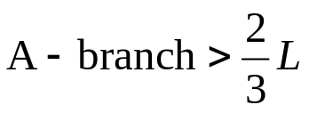
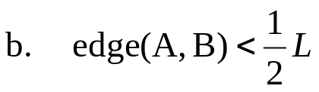
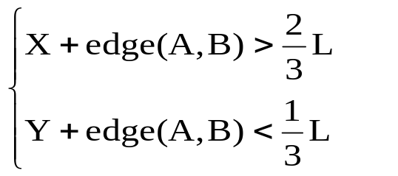
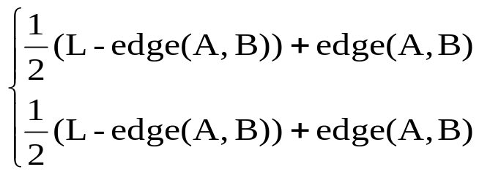
A為home
1. edge (A, B) is served by only one server.
A
Y
B
2. edge (A, B) is served by both servers.
X

Slide 3
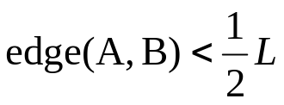
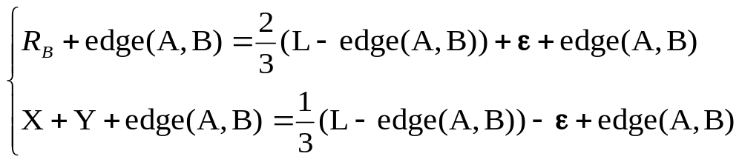
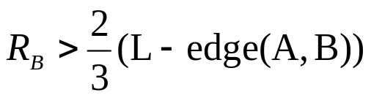
A為home
1. edge (B, C) is served by only one server.
Y
A
C
B
D
X

Slide 4
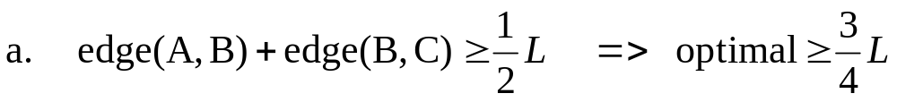
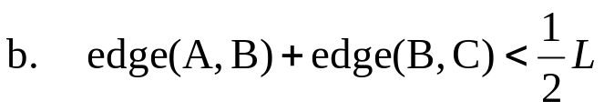
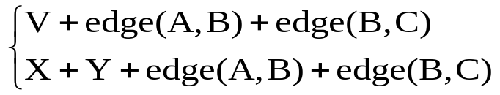
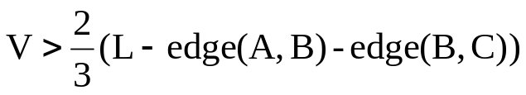
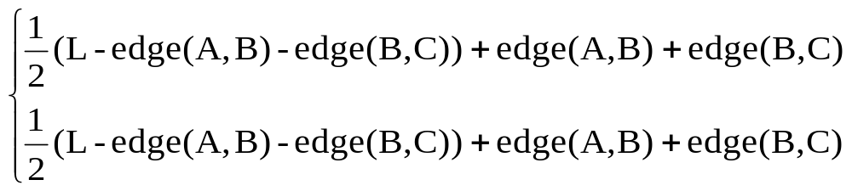
A為home
1. edge (B, C) is served by both servers.
Y
A
C
B
D
X

Slide 5
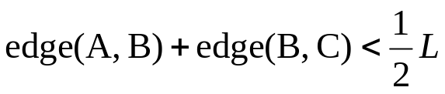
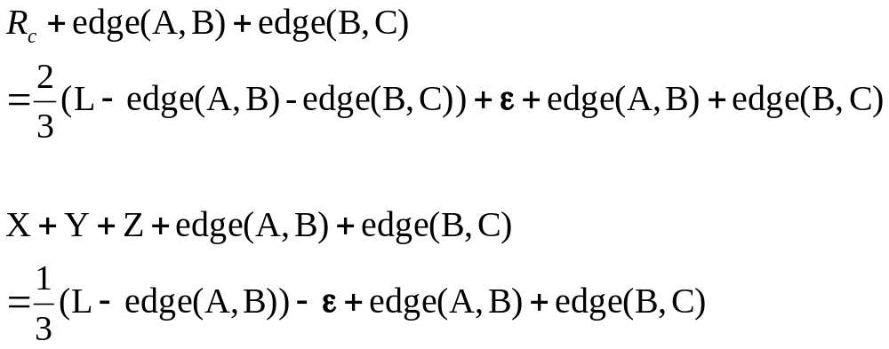
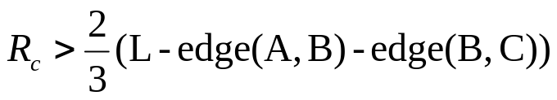
A為home
edge (C, D) is served by only one server.
Y
A
Z
C
B
D
X

Slide 6
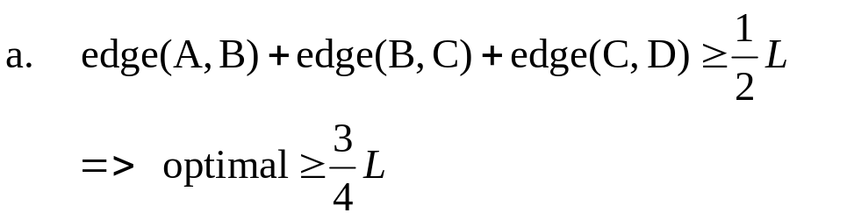
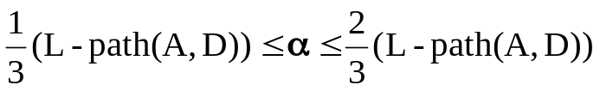
A為home
edge (C, D) is served by both servers.
Y
A
Z
C
B
D
X

Slide 7
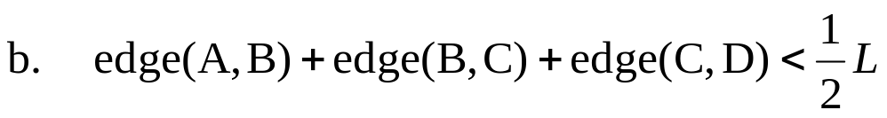
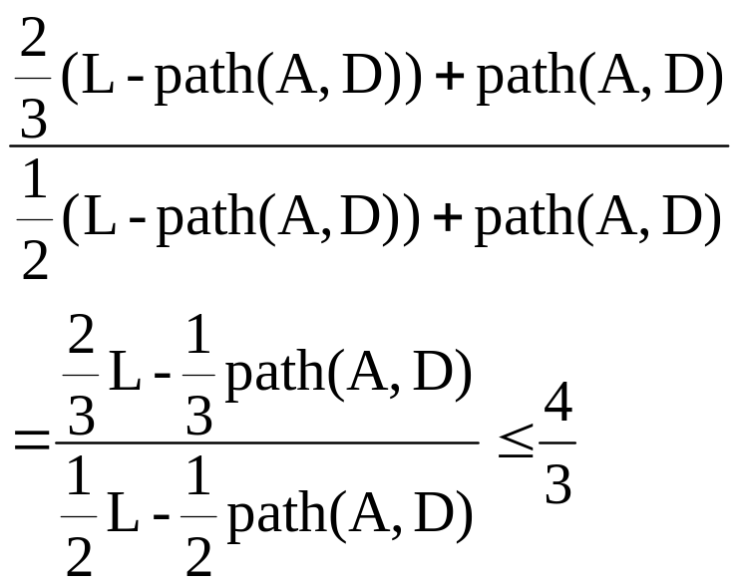
edge (C, D) is served by both servers.
A為home
Y
A
Z
C
B
D
X

